Slide 1
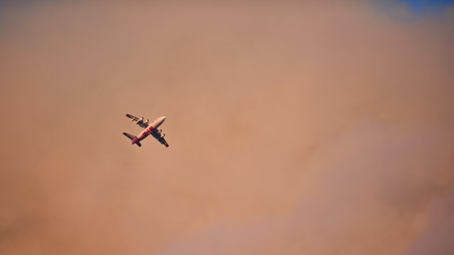
2019 TRB Transportation Planning Applications Conference June 5, 2019
Economic Impacts of Interstate 84 Closure Due to Wildfire
Becky Knudson
Oregon Department of Transportation

Slide 2
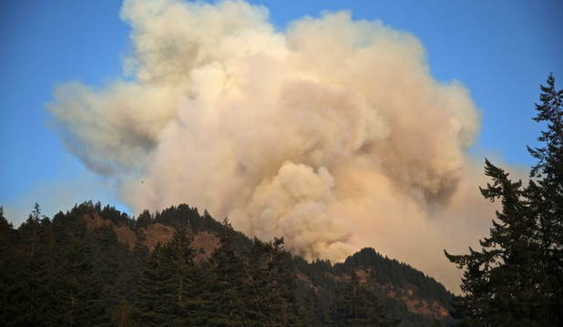
By the Numbers (OregonLive.com Dec 2017)
Started September 2, 2017
Began 2.5 miles west of Cascade Locks
48,831 acres burned
Notes:
http://www.oregonlive.com/wildfires/index.ssf/2017/12/by_the_numbers_a_look_back_at.html

Slide 3
176 hikers rescued, hundreds evacuated
30 miles dozer line, 5 miles of hand-line

Slide 4
1,060 personnel at peak effort
$20 M in Firefighting Cost by Nov 2017

Slide 5
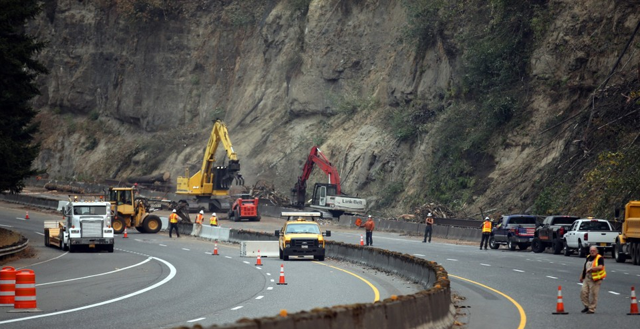
I-84 Westbound Closed for 10 Days
I-84 Eastbound Closed for 19 Days

Slide 6
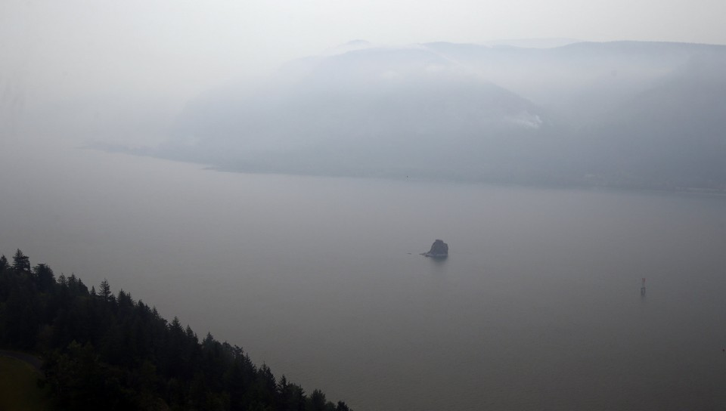
Union Pacific Railroad Stopped for 3 Days
Columbia River Closed for 2 Days

Slide 7
Truck Cost of Closures Multiple Analytical Options
Use official detour routes to estimate costs
Use Automatic Traffic Recorder data to infer detour patterns
Use travel model to identify detour routes

Slide 8
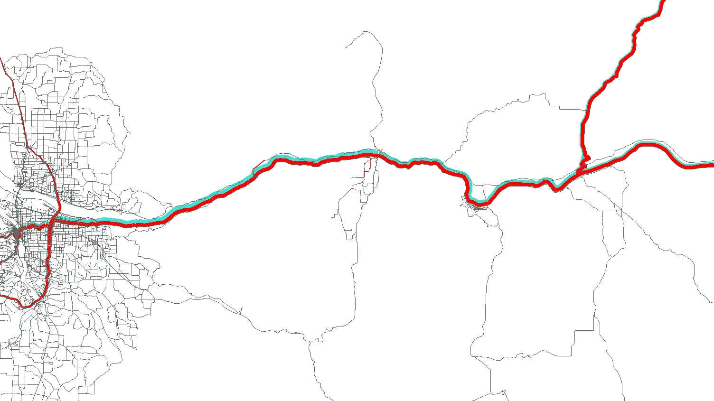
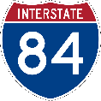
West Bound
Vancouver WA
Portland OR
Heavy Vehicles
Light Vehicles

Slide 9
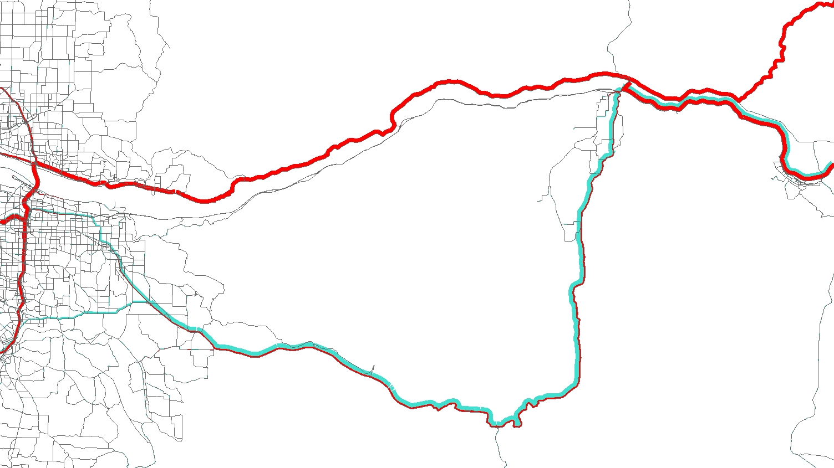
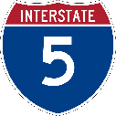
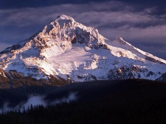
West Bound Patterns with Closure
Mt. Hood
Heavy Vehicles
Light Vehicles

Slide 10
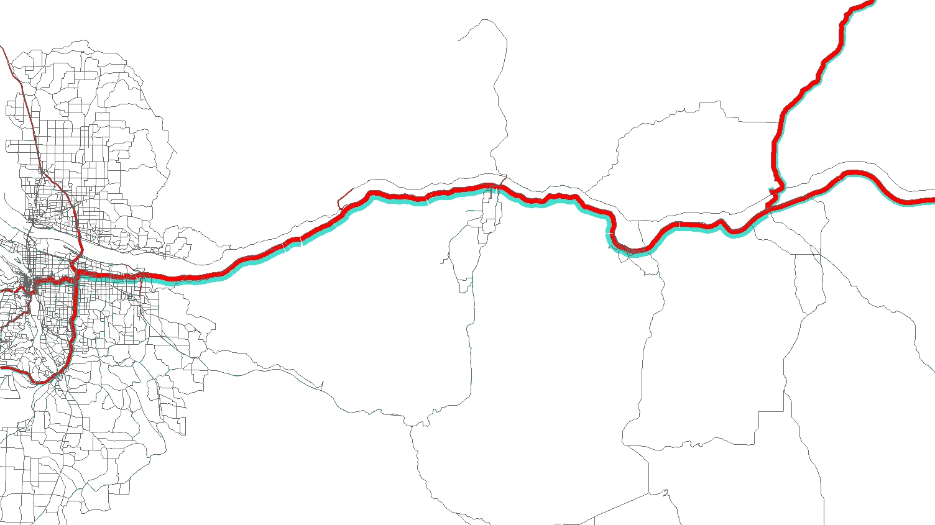
East Bound
Vancouver WA
Portland OR
Heavy Vehicles
Light Vehicles

Slide 11
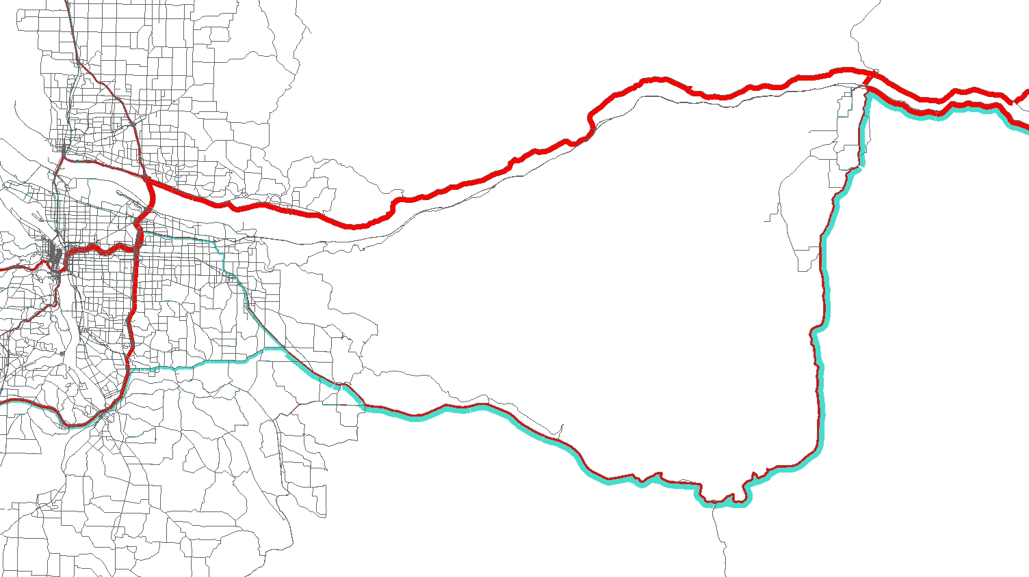
East Bound Patterns with Closure
Mt. Hood
Heavy Vehicles
Light Vehicles

Slide 12
Hybrid Approach to Estimate Cost
Model Select Link
Identify the routes used
ATR
Provide the range of truck volumes
Detour Costs
Extra distance and time due to detour

Slide 14
Estimated Cost of One Day Closure to Heavy Trucks
 | Range of Estimated Costs
Additional Time Costs | $160,000 | $180,000
Additional Operating Costs | $ 90,000 | $110,000
TOTAL COST | $250,000 | $290,000

Slide 15
Thank You! Becky Knudson Oregon DOT Transportation Planning Analysis Unit Rebecca.a.knudson@odot.state.or.us

