Slide 1

Quick Launch DTA
Portland Metro’s Attempt to Mainstream Mesoscopic Modeling
TRBAPPCON – June 2, 2019

Slide 2
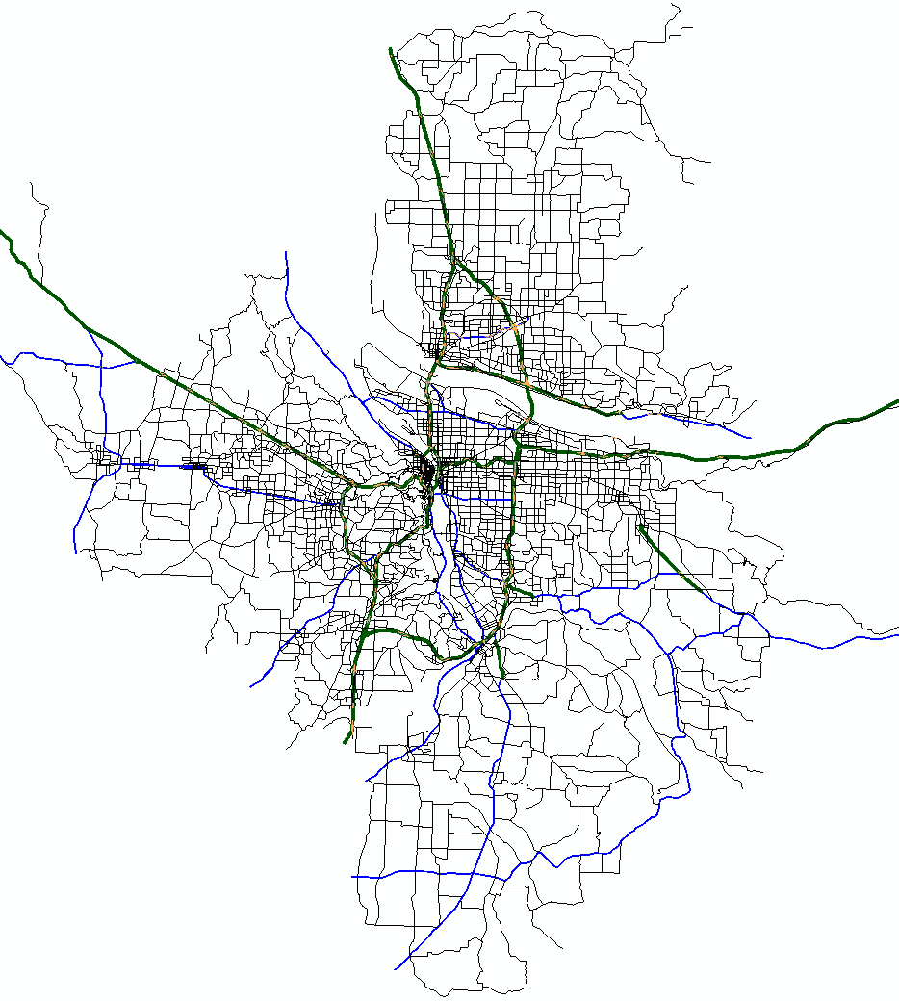
In the beginning…
Early adopter of Regional DTA
Significant investments in networks
Theory ahead of practical large-scale application
Notes:
Early adopters of Regional DTA
Spent significant time and money to develop very detailed networks
Including signal locations, phasing, turn bays, and lane-to-lane movements
Thought we were on the cusp of a DTA revolution, but we a bit early to the party!

Slide 3
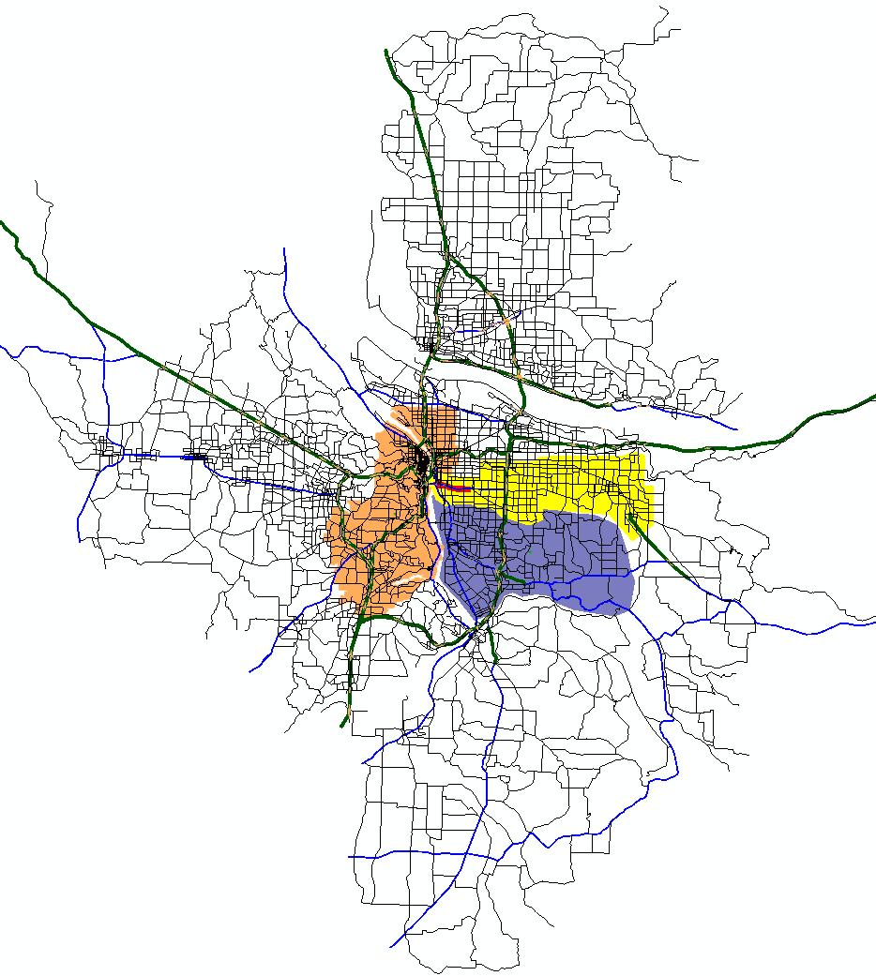
Early applications
Regional applications limited to research (e.g., SHRP2 L35)
Non-reusable subareas
Network and demand calibration cost- and time-prohibitive for most projects
Notes:
Most regional applications were limited to research, using link-based DTA software packages
Produced a handful of one-off subareas for use in traffic studies, or feeders into microsimulations
Though lots of interest in DTA by our clients, viewed as too expensive and limited in scale for use in most projects
Regional DTA was not practical given software requirements and limitations

Slide 4
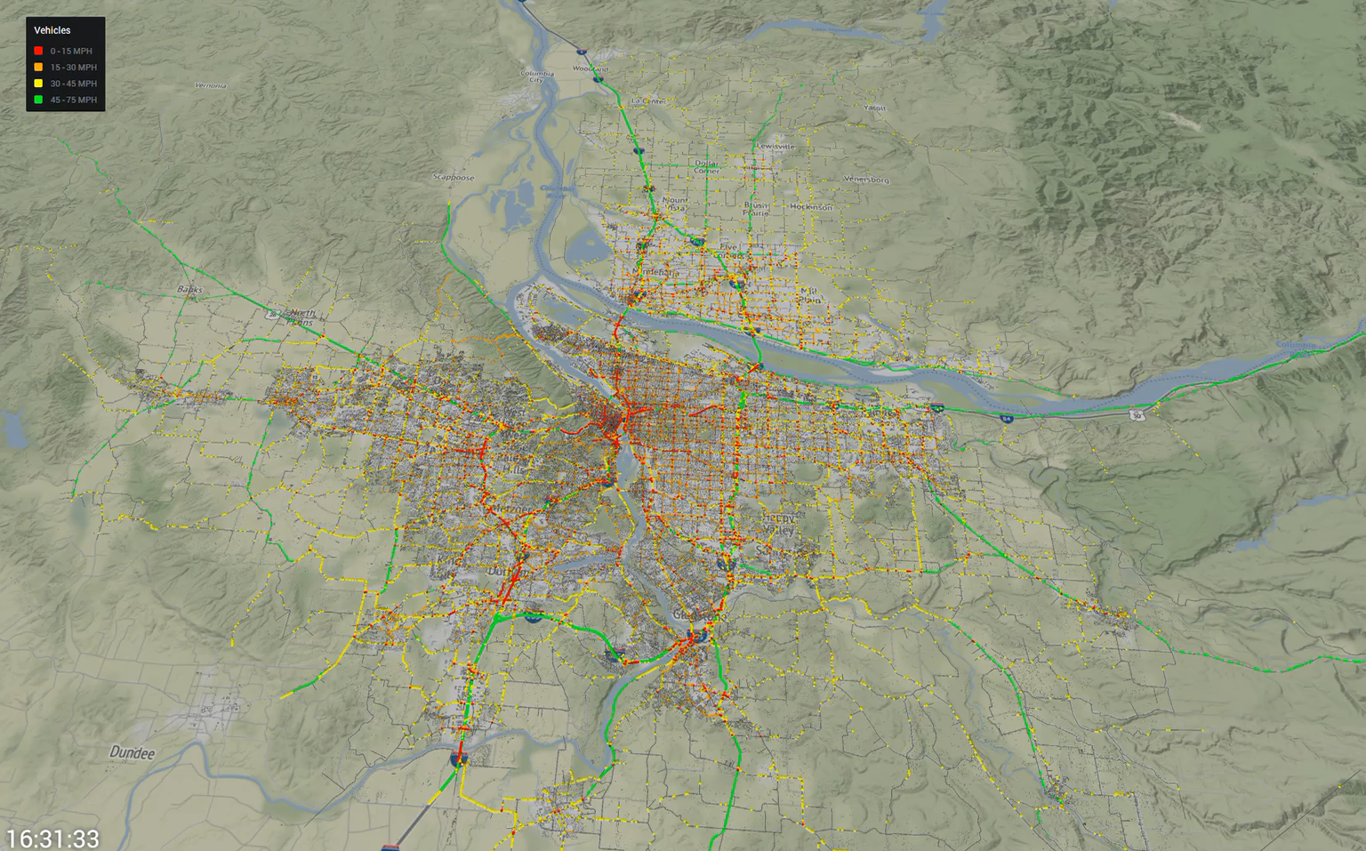
Tool evolution
Multi-threaded assignments
Automated signal optimization
Methods for dealing with super saturated conditions
Capability to efficiently scale to larger areas
animation
Notes:
Software and hardware have evolved substantially
Can now rely on software automation for much network development and brute computational strength for large area assignments
Result is that DTA for even lane-based platforms can scale up efficiently

Slide 5
QLDTA goal and objectives
Greater diversity and frequency of project applications – Mainstream Mesoscopic Models
Quick Launch DTA (QLDTA):
  Minimally viable networks and trip tables
  Simplify and Standardize through automation
  Economize by creating repurposable networks
Notes:
Develop a process and tools necessary to deploy DTA across a wider range of projects in our agency
Determine network attributes and demand characteristics for “minimally viable” assignments at Regional and Sub-regional levels
Accomplished through simplifying and standardizing DTA network attribute creation and calibration, and economizing by using Regional and Large sub-regional models that can be repurposed

Slide 6
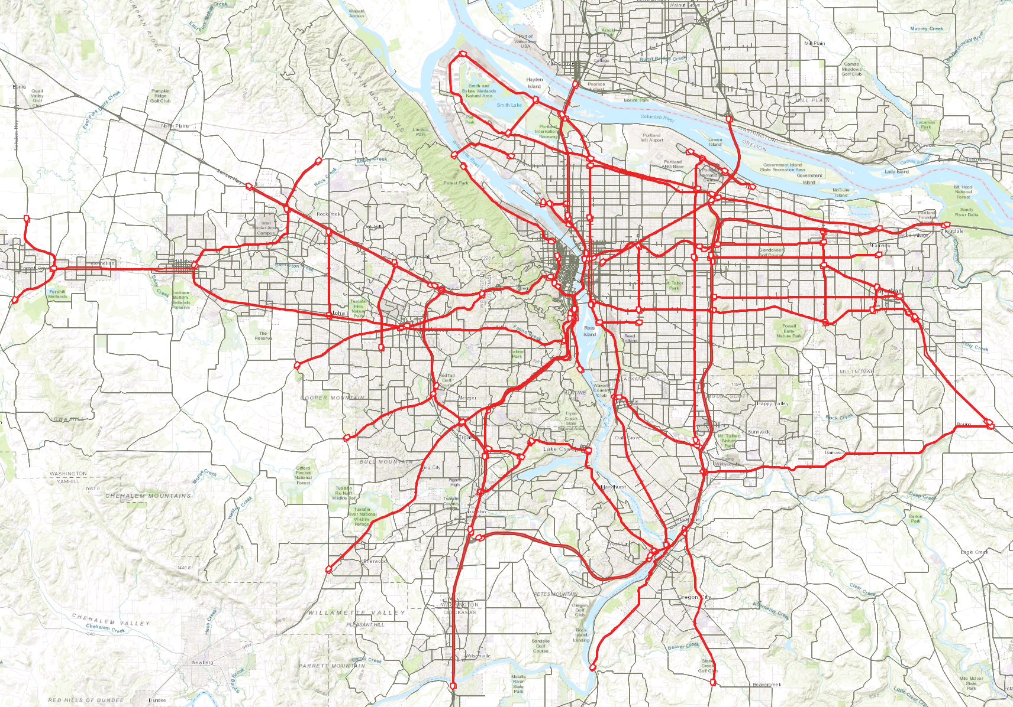
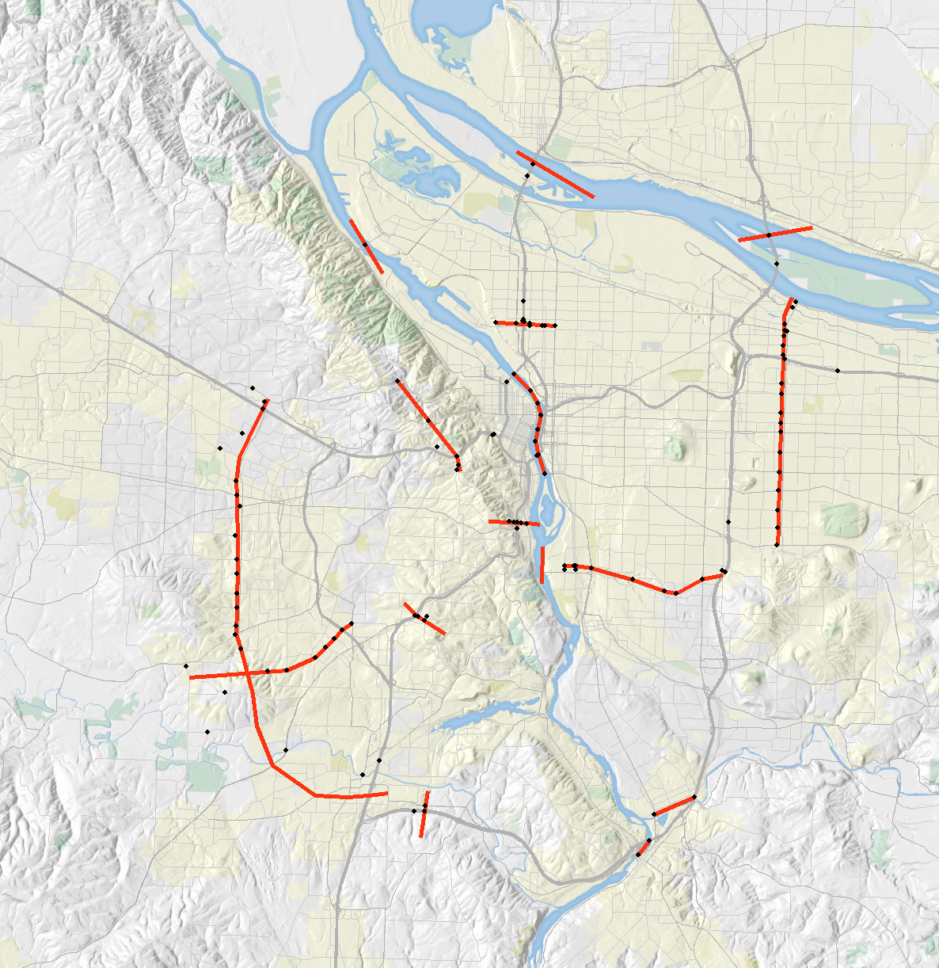
QLDTA process – metrics
NPMRDS-derived travel times
Screenline vehicle counts

Slide 7
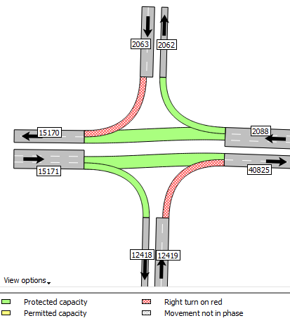

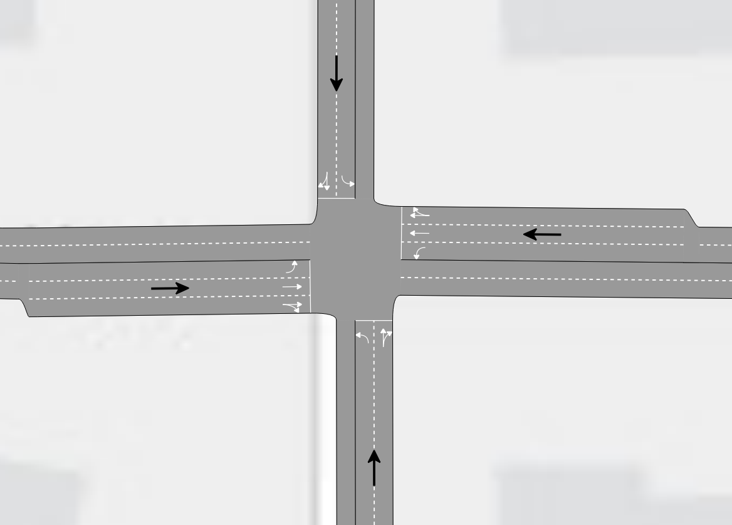
Low Resolution
(static assignment network)
Signals and Phasing
Turn Bays and Lane Storage
Freeway Management
High Resolution
(regional DTA network)
Notes:
Low resolution networks: Static assignment networks with basic link-level attributes: # lanes, speed, capacity
Systematically add attribute data to the networks via automated scripts and some manual coding to test impact of each network feature to gauge the cost/benefit of adding
In addition, tested high resolution networks that we originally developed to see impact of the ‘truest’ representation of what’s on the ground (e.g., signal location and phasing, turn bay locations and sizes, etc)

Slide 8
QLDTA results - networks
Presence of signals matter
  Computed locations more or less similar to imported locations
  Optimized signals better than imported phasing
Ramp meters matter
  Improved freeway validation (volumes and travel times)
Turn bays did not improve model validation
  Unexpected, function of congestion and phasing
Notes:
Signals matter (not a surprise)
Computed locations worked more or less the same as imported locations
Optimized signals (timing and phasing) work better than signals with correct phasing but generic timing
Ramp meters important for accurately managing freeway travel times and volumes
Surprisingly, turn bays did not improve model validation at the scale for which we were measuring (cutlines and corridor-length travel times). Likely, the optimized signals adjusted phasing to adequately compensate for lack of turn bay storage

Slide 9

QLDTA results – demand
Regional 2hr
Regional 3hr
Regional 4hr
converges
validates well
minimal gridlock
not sufficiently long warm up period
converges
validates well
some over-congestion during exit time
does not converge
network congestion too high: prolonged v/c > 1 overloaded key bottlenecks
too much demand from TBM
Notes:
Tested a range of PM peak period demand imported directly from trip based model
Various warm-up and cool-down bookending analysis period
At regional level, 2 and 3 hour demand both converged and validated well, though 3-hr demand started showing over congestion during exit time
4 hour demand could not converge, did not validate. Too much demand, which shows limits to using demand from a model calibrated using static assignments.

Slide 10
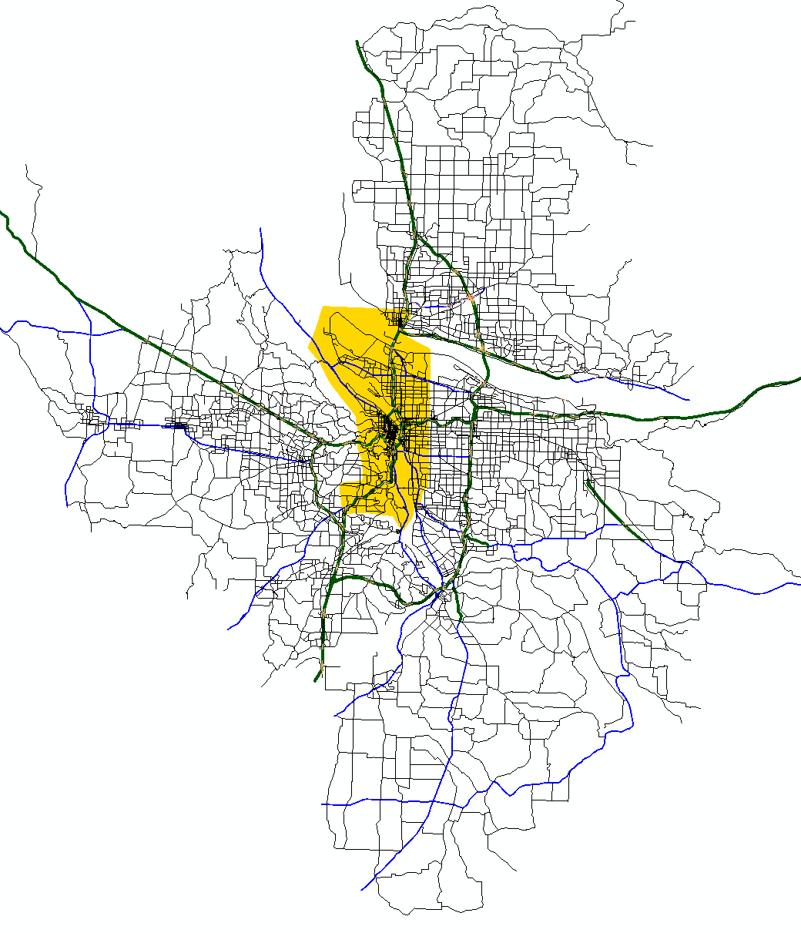
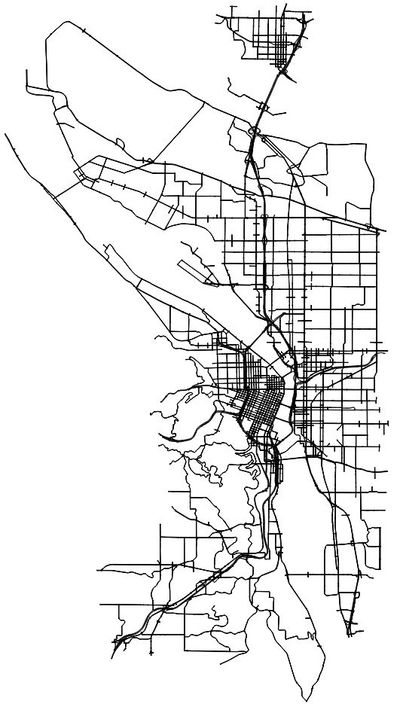
QLDTA process – subareas
Regional DTA to Subarea DTA
Regional STA to Subarea DTA
Notes:
Tested two subarea processes: Taking network attributes and demand directly from Regional DTA and taking Regional DTA network and Static Assignment subarea demand
Red line indicates corridor on display in next slide

Slide 11
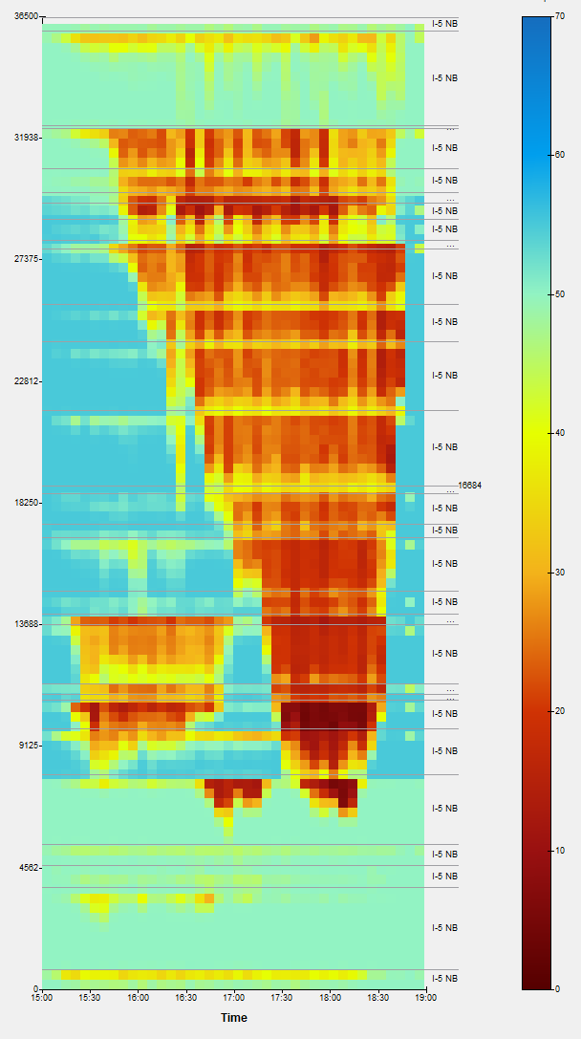
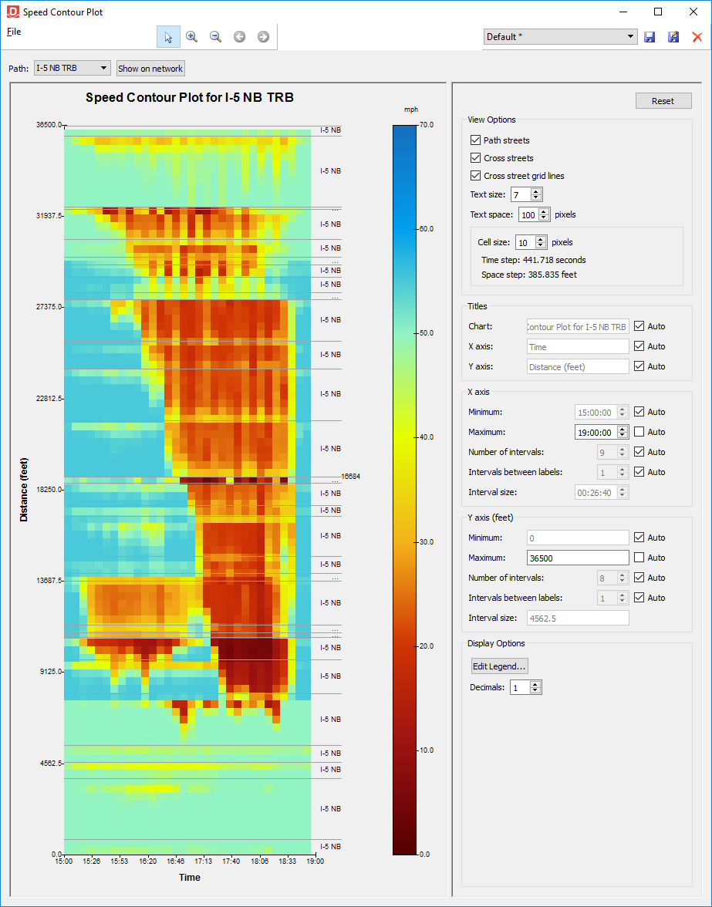
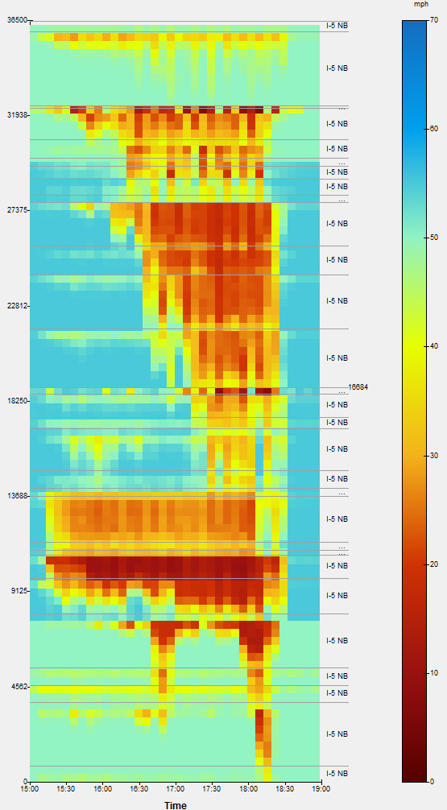
QLDTA results – subareas
Subarea DTA
Regional DTA Demand
INRIX
(observed)
Subarea DTA
STA Demand
Regional DTA
Notes:
Space-time diagrams
Most important thing is to match the left image in blue box (observed data) with graphs to the right. Regional DTA and subarea using regional DTA demand both validate relatively well with no adjustment (red boxes). Static demand subarea does not represent the bottlenecks and queuing quite as well.

Slide 12
Findings
QLDTA approach allows for cost-effective deployment of large DTA models
Network cleanup, signal optimization, turn bays can be automated
  Particularly beneficial for Future Year networks
Demand adjustment still necessary for longer analysis periods in heavily congested areas
  Harder to automate
  To use *out of the box* requires more robust demand models
    DTA feedback
Notes:
Deploy regional network in about 2 weeks that validates very well against travel times and regional count cutlines. This includes conversion, clean-up, and coding of network attributes
Subareas can be quickly generated, and we now have multiple methods for importing initial demand
Much of the time consuming network attribute details can be automated. Software optimized signals actually validate better.
However, there’s still a need for more manual demand adjustment. Demand calibration is much harder to automate due to temporal and spatial dimensions (upstream bottlenecks leading to low counts downstream). This requires more robust demand models with DTA feedback…advanced tbm or abm.

Slide 13
Peter Bosa peter.bosa@oregonmetro.gov
Michael Mahut michaelm@inrosoftware.com
Ido Juran ido@inrosoftware.com

Slide 14
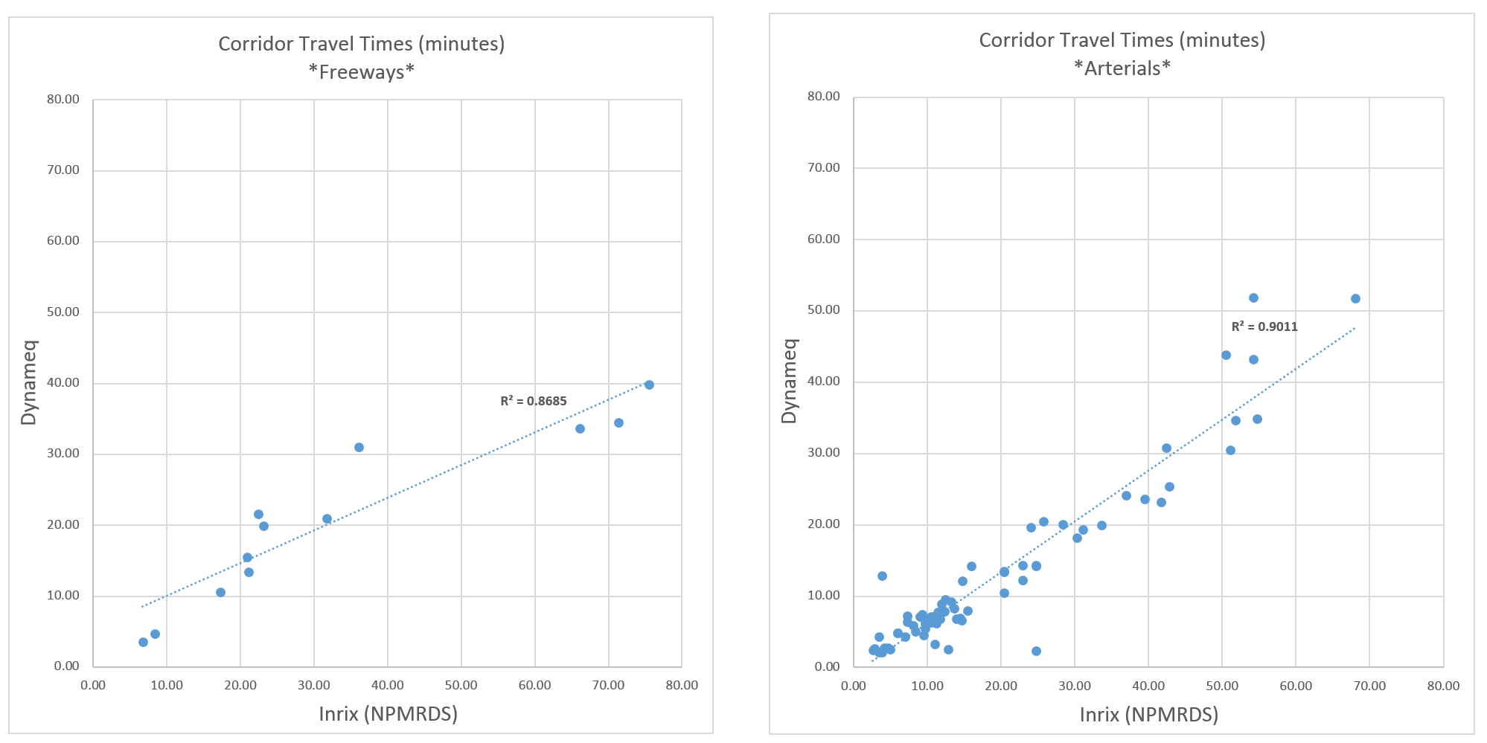
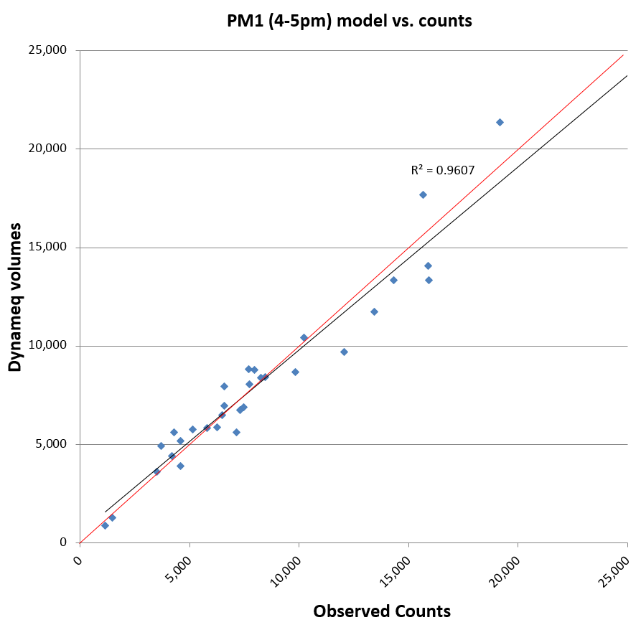
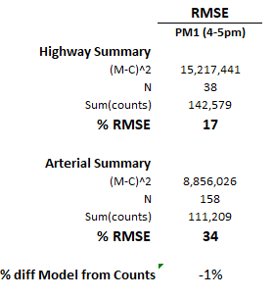
QLDTA process – metrics
NPMRDS-derived travel times
Screenline vehicle counts

Slide 15
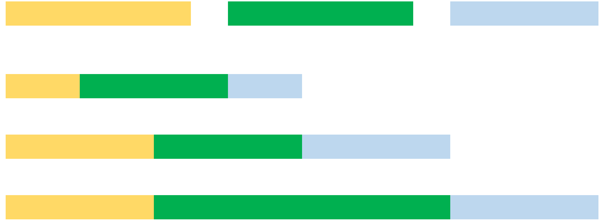
QLDTA process – demand
Warm Up Time
Analysis Period
Exit Time
Regional 2-hour PM peak demand
30 min
1 hour
30 min
15:30
16:00
17:00
17:30
Regional 3-hour PM peak demand
1 hour
1 hour
1 hour
15:00
16:00
17:00
18:00
Regional 4-hour PM peak demand
1 hour
2 hour
1 hour
15:00
16:00
17:00
18:00
19:00
Notes:
Tested multiple durations of peak period demand, including different warm up and exit times.

Slide 16
Implementation
Base Year regional network on the shelf
Produce 2027 and 2040 networks using automated tools
  Optimize for new / improved facilities
Freeway pricing study beginning Fall 2019
Transit enhancement studies (queue jumps, BAT lanes)
Demand enhancements -> integration with MTIP and RTP
Notes:
Base year network on shelf…plan on creating 2027 and 2040 networks next
Plans to use process in upcoming freeway pricing studies (large networks)
Have interest from clients in deploying to look at feasibility studies of transit enhancement projects
Once we can further improve demand, use DTA for regional transportation plans

Slide 17
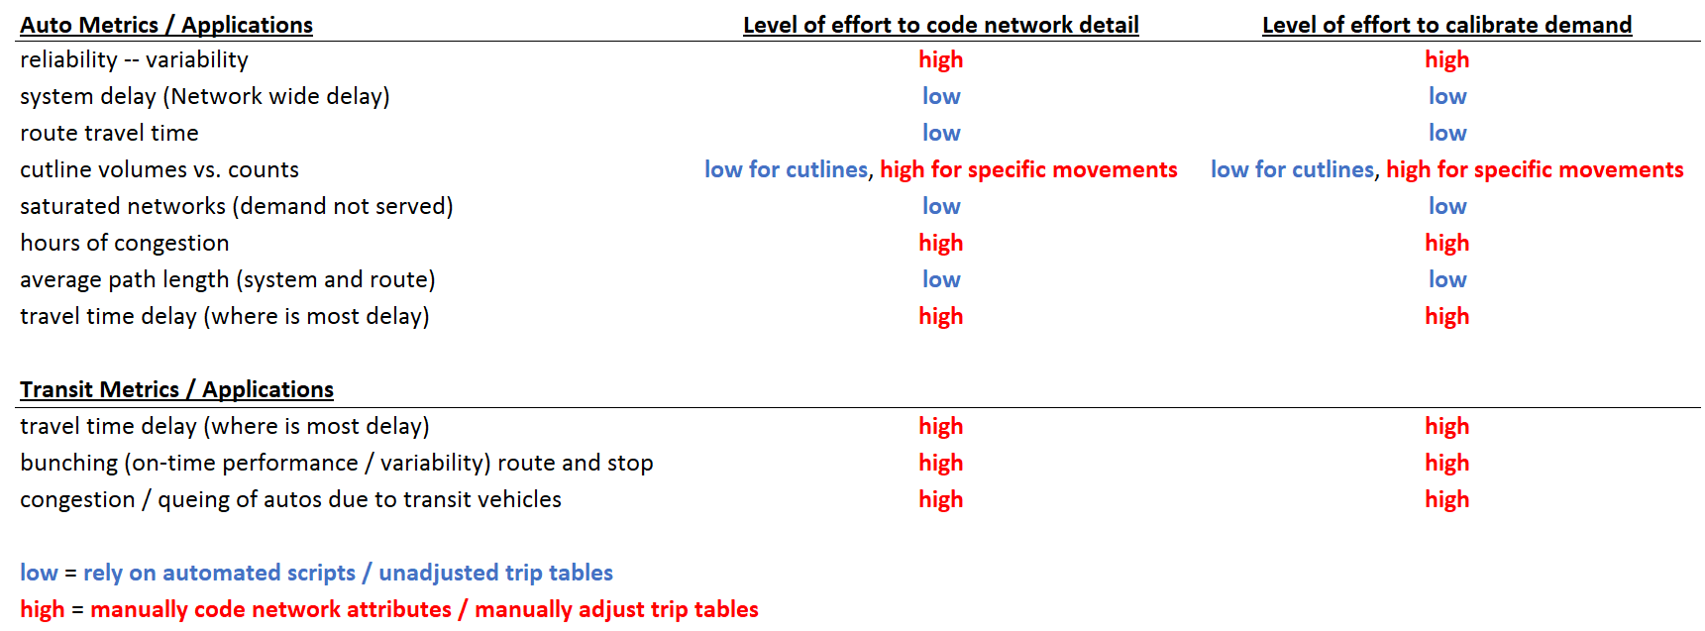
Implementation
Notes:
Develop a list of potential DTA applications with an indication of the amount of effort required to get a product up and running. Clients will then be able to select

