Slide 1

Impact of E-shopping on travel demand
Daniel Fay, WSP
Peter Vovsha, Gaurav Vyas, INRO

Slide 2
Background motivation & hypothesis

Slide 3
Background & motivation
Modelling shopping behavior is important since shopping represents a substantial component of regional travel demand (≈10% of all trips)
Over the past decade the adoption of E-shopping has significantly increased leading to considerable impacts on out-of-home shopping
Need for a reliable model which accurately captures this change in shopping behavior
This analysis presents findings on the adoption and intensity of E-shopping and its impact on traditional onsite shopping

Slide 4
Plausible hypotheses
E-shopping reduces conventional shopping trip rates?
E-shopping reduces out-of-home shopping duration?
E-shopping may generate more freight deliveries and person trips for returning purchases?
All above might be differential by shopping types:
  Major shopping (clothes, furniture)
  Routine grocery shopping

Slide 5
Modeling issues related to shopping trips
Common to an aggregate trip-based 4-step model or tour-based Activity-Based Model (ABM):
  Trip frequency (trip generation)
  Choice of shopping destination (trip length distribution),
  Choice of mode
  Choice of time-of-day period
Additional travel dimensions pertinent to ABM:
  Intra-household allocation of shopping tasks to persons
  Placement of shopping activity in the individual activity pattern
  Joint vs. individual implementation of shopping tasks

Slide 6
Principal question
Modeling issues of this type are resolved by using comprehensive Household Travel Surveys (HTS’s). The models are well calibrated to reproduce the observed patterns in HTS
Principal question is how stable these parameters are over time and to what extent the shopping travel habits observed today will be relevant 20-30 years from now
While this question is fundamental to all travel purposes, it is especially crucial for shopping as the significant impact of E-shopping is already being observed and the future impacts may be even greater due to the very dynamic changes in mobility

Slide 7
Results of statistical analysis

Slide 8
Data: 2 HTS’s for Columbus, OH
Characteristic | HTS 1999 | HTS 2017
Collected data & technology | All out-of-home activities and trips of all household members for one workday (24 hours) | iPhone app trace for 7 days of which one (primary) workday was chosen for a complete retrieval of all out-of-home activities and trips of all household members
E-shopping activity during the week | N/A | Yes | No
Number of HHs | 5,555 | 1,991 | 1,032
Pure effect of E-shopping
General time trend & survey technology impact

Slide 9
Focuses of analysis
The analysis focused on 4 dimensions:
Household-level frequency of shopping activities
Intra-household allocation of shopping tasks and person shopping activity levels
Shopping activity time allocation and epoch duration
Shopping activity placement in the individual daily activity-travel patterns

Slide 10
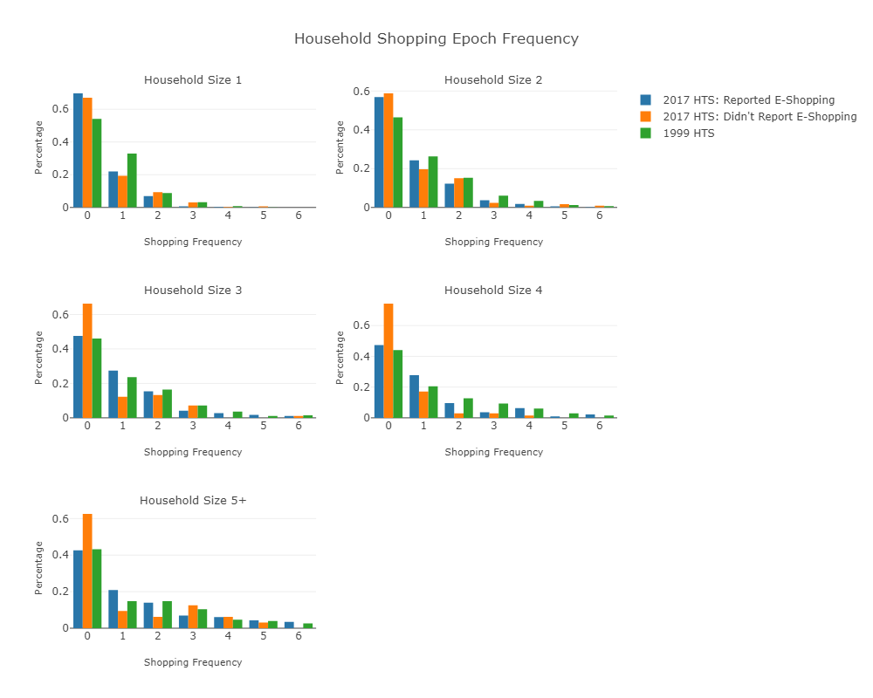
Daily frequency of shopping activity per HH

Slide 11
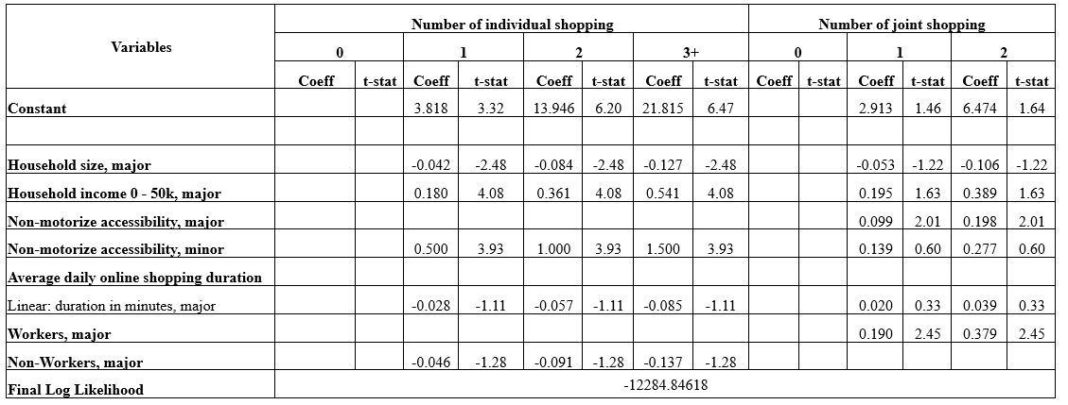
Model estimation results for HH daily shopping activity frequency
√

Slide 12
Conclusions on HH shopping activity rates
Pure effect of E-shopping:
  HH with 3 or more members who reported E-shopping exhibited a tendency for a higher frequency of shopping epochs
  E-shopping duration negatively affects frequency of individual major shopping
  E-shopping duration positively affects frequency of joint major shopping
Time trend:
  Observed HHs in 1999 performing more frequent shopping epochs than observed HHs in 2017
  This is evident from analyzing both the proportion of HH shopping epoch frequency by HHs size as well as the coefficients of the estimated choice models

Slide 13
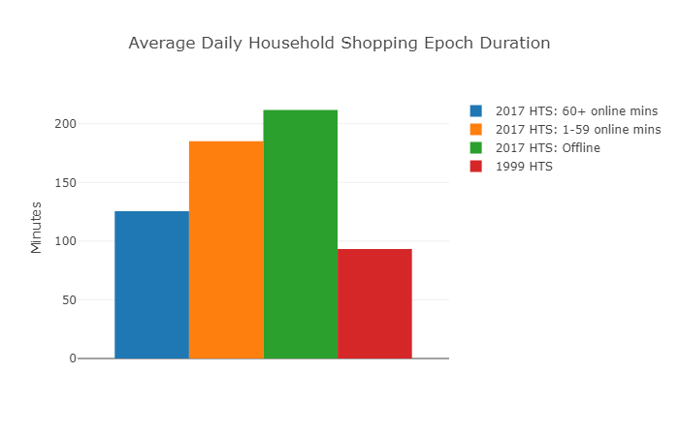
Average daily HH time for out-of-home shopping

Slide 14
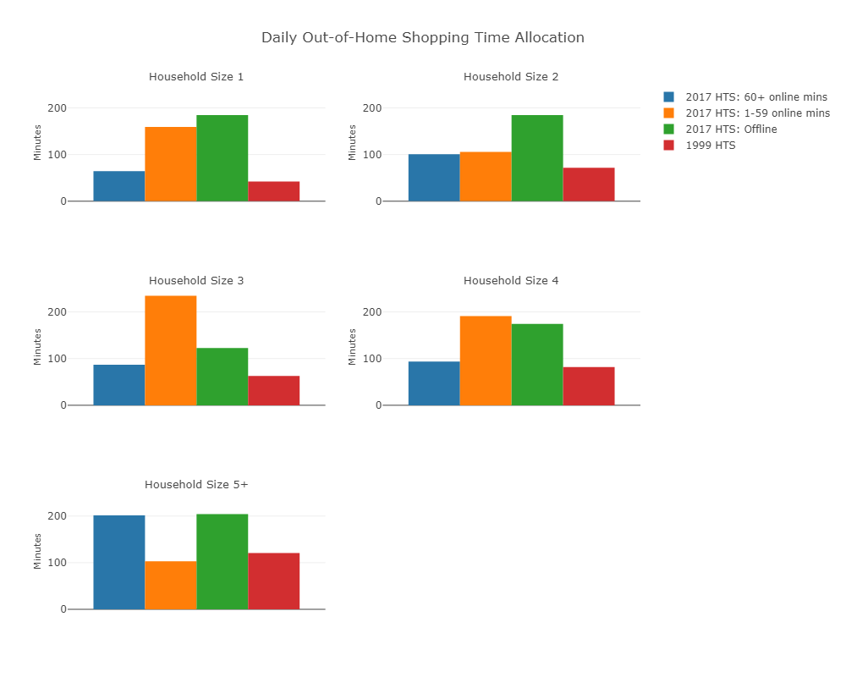
Daily HH time allocation to out-of-home shopping by HH size

Slide 15
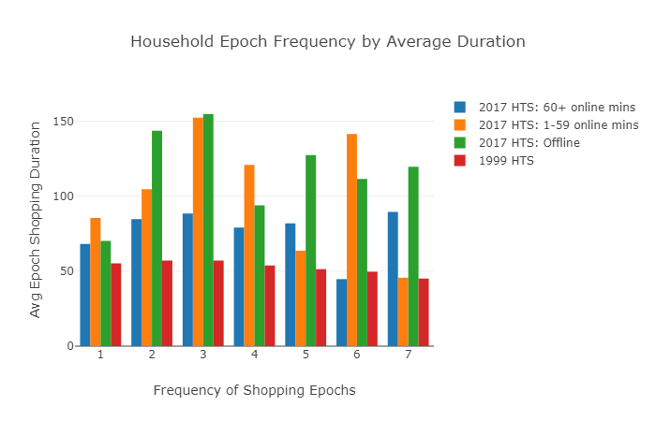
Average shopping epoch duration by HH shopping frequency

Slide 16
Conclusions on shopping time allocation and activity epoch duration
Daily time allocated to out-of-home shopping tasks:
  Online shopping for HH sizes ≤2 was found to have an inverse relationship, whereas HH that spend more time online shopping are more likely to allocate less time to out-of-home shopping
  However, HHs with size ≥3 did not illustrate any discernible pattern related to online shopping
Average epoch duration:
  Very clear negative correlation between average daily online shopping time and the average epoch duration (expected effect of online shopping)
Time trend:
  More time on shopping over years (can be a survey technology effect)

Slide 17
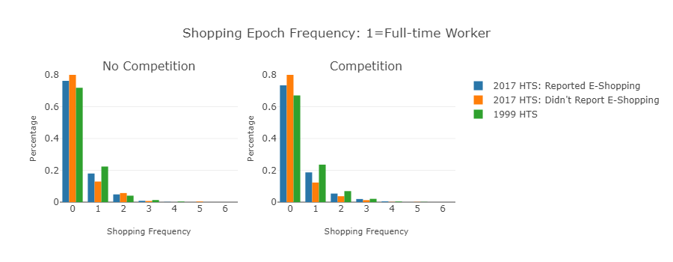
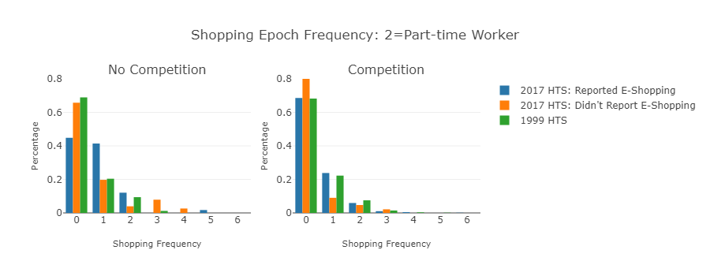
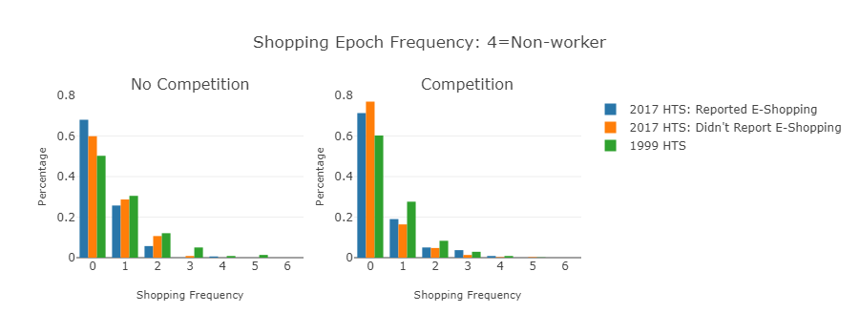
Daily frequency of shopping activity per person type

Slide 18
Conclusions on intra-household allocation of shopping tasks
Full-time workers and university students who tend to have relatively rigid schedules:
  No strong impact of competition and online versus offline
Part-time workers who have a much more flexible schedule:
  Highly impacted by both the presence of competition and online and offline HHs. Within HHs of only part time workers, ones who participate in online shopping make considerably more 1 and 2 daily shopping epochs as compared to the offline HHs
Competition in the HH results in a substantial decrease in the frequency of shopping epochs:
  Other person types will typically perform the shopping epoch rather than the part-time workers in the HH
  Contrary to the initial hypothesis, non-workers and retirees also see a reduction in the frequency of shopping epochs when there is competition presence

Slide 19
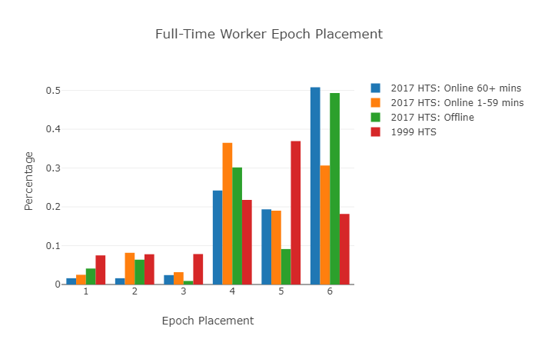
Shopping activity placement in individual daily pattern

Slide 20
Conclusions on shopping activity placement in the individual daily activity pattern
Workers:
  Most shopping epochs are performed on a tour within a non-mandatory pattern with the exception of full-time workers in 2017 who participate in 1 to 59 minutes of online shopping. Those perform the majority of their shopping epochs on the way home from a mandatory activity
  Full-time workers in 1999 HTS perform majority of their shopping epochs after a mandatory activity on a separate tour (stands out)
University students:
  Tend to perform shopping epochs during a non-mandatory daily activity pattern
Driving age and pre-driving age school children:
  Tend to perform shopping epochs on a separate tour after completing their mandatory activity
Pre-school children:
  Most likely to participate in shopping epoch during the time retirees and non-workers perform theirs and thus are most likely to perform a shopping epoch during a non-mandatory pattern.

Slide 21
Recommendations for travel modeling in practice
Pure effect of E-shopping:
  Overall, E-shopping does not affect household trip rates that much and trip generation rates applied in 4-step models observed in the recent surveys can be applied for future forecasts
  However, finer effects that are captured in more advanced ABMs such as shopping epoch duration and daily time allocation to shopping can be affected by E-shopping
  The best way to accommodate E-shopping in a future forecast is to include it as a variable in the corresponding sub-models and then apply them assuming 100% of E-shopping penetration
General trend after controlling for E-shopping:
  There can be a general time trend on a reduction of shopping frequency as was observed for Columbus, OH for the period from 1999 to 2017
  It is always better to have a “younger” HTS for a model estimation
  It is possible to extrapolate this tendency into the future assuming that people will shop in-store less
  Would be interesting to cross-compare different regions before making a generalization

Slide 22

Thank You!
Peter Vovsha
peter@inrosoftware.com

