Slide 1
Transportation Policy Analysis for a Carbon Free Boston
TRB AppCon 2019
Marty Milkovits, Chris Porter
June 3, 2019

Slide 2
Outline
Project background
Tools
  Sketch-planning spreadsheet tool
  Spatial model
Pathways to Carbon Free Boston

Slide 3
Project Background

Slide 4
Baseline Projection, Trip-end Auto & Truck GHG
30% below 2016
39% below 2016
Source: CS analysis of CTPS data

Slide 5
EV Projections
Notes:
EV projections are all over the map, with Annual Energy outlook (orange) the most conservative

Slide 6
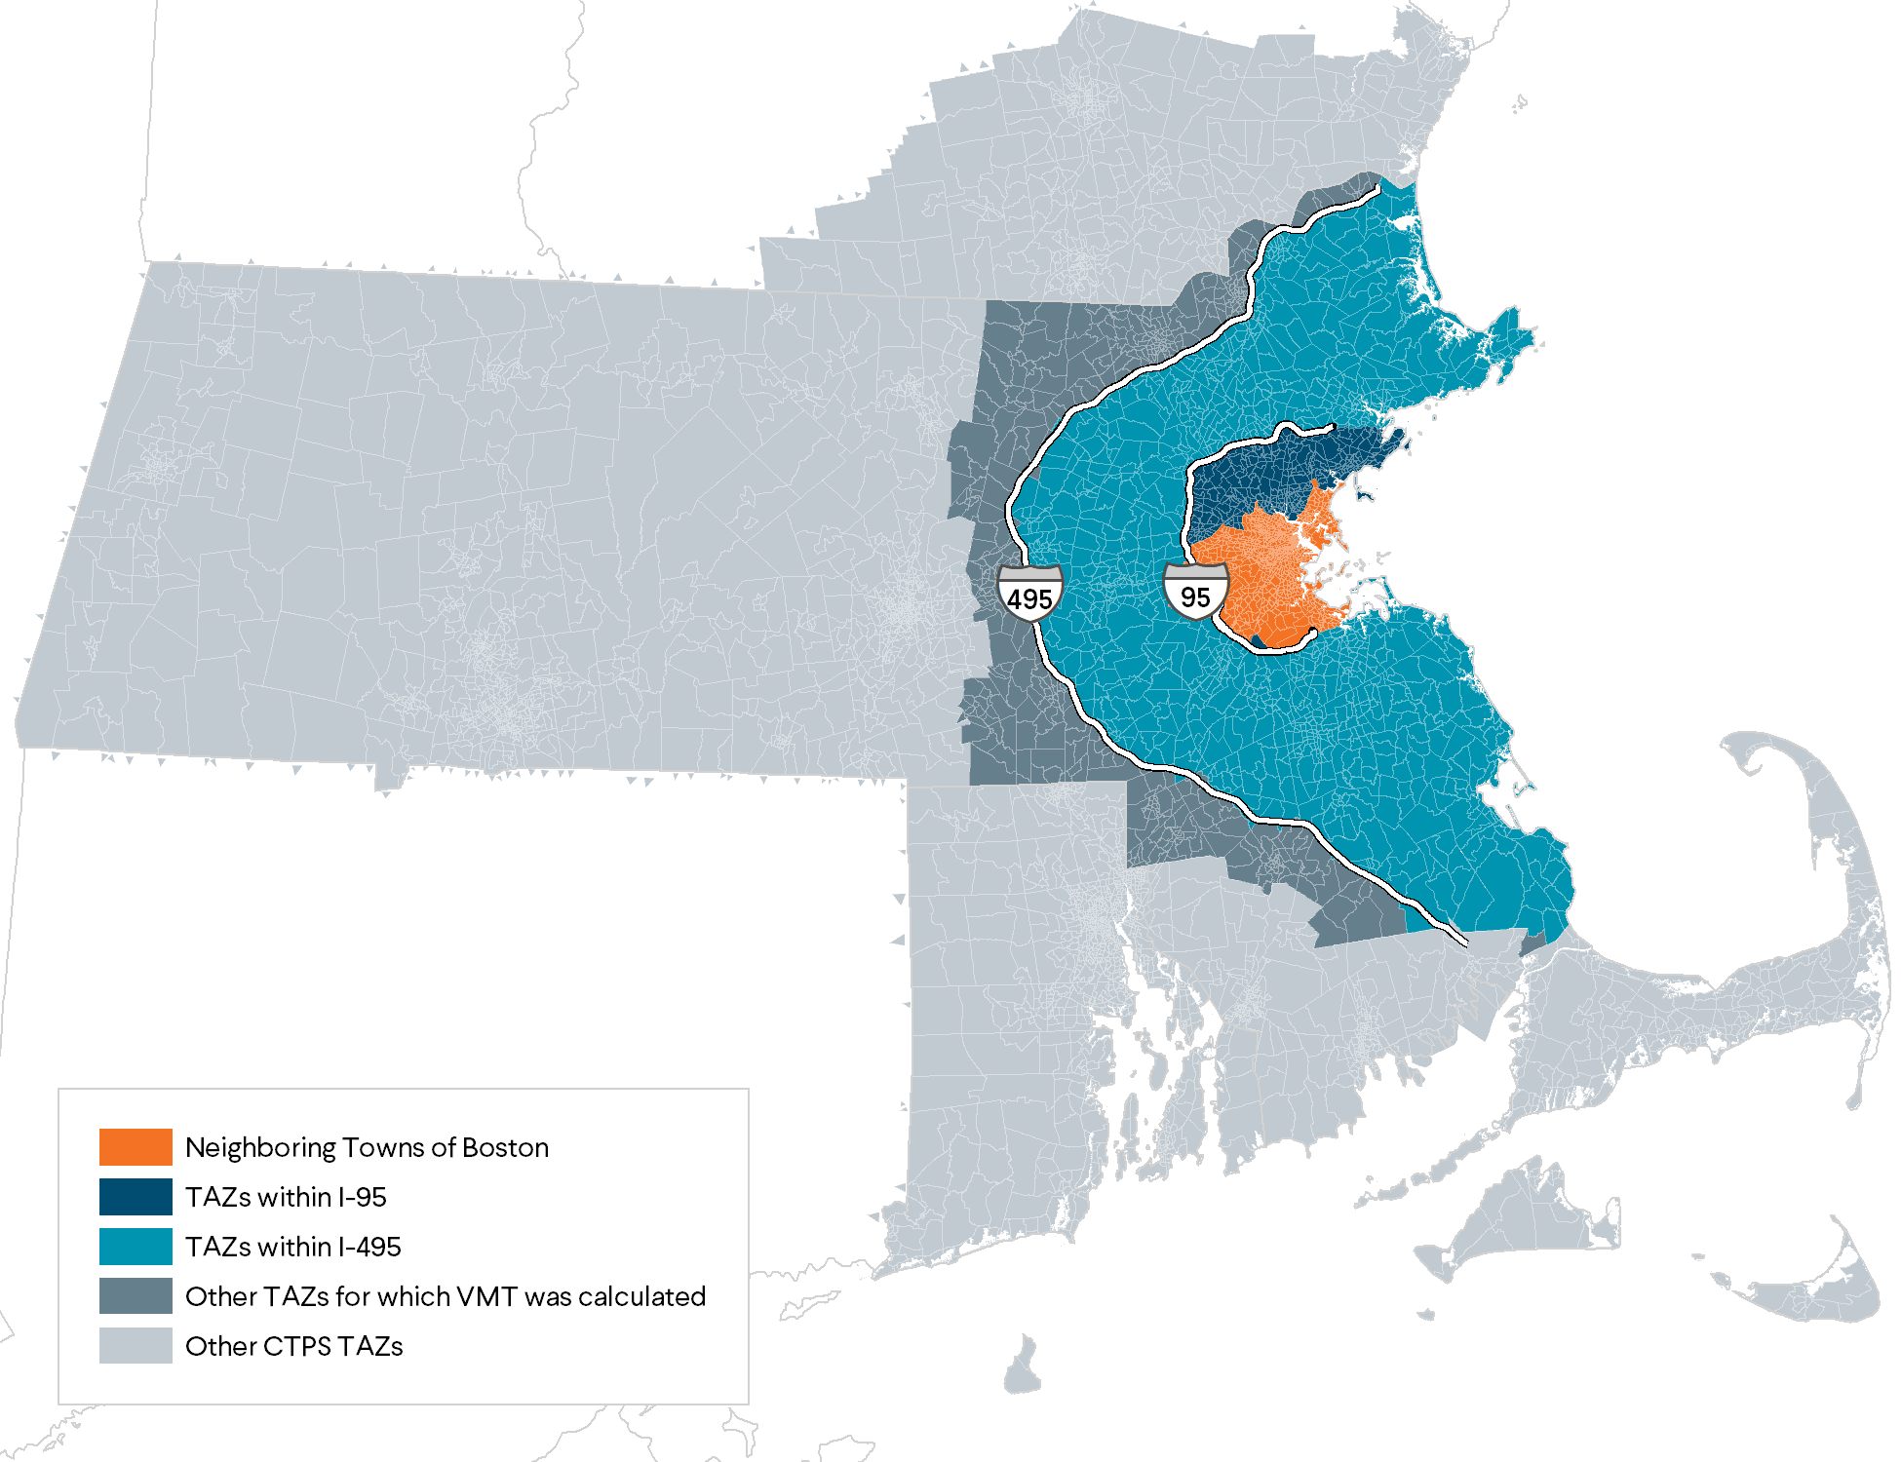
Trips and Vehicle Miles Traveled (VMT) To/From Boston

Slide 7
Overall Analysis Approach
Baseline
“Business as usual”
Sketch Assessment
Pricing/ incentives
Detailed Assessment
Land use
Transit & active trans. Infrastructure
Clean vehicles
Smart mobility
Spatial model
Demand management

Slide 8
Sketch Planning Tool

Slide 9
Sample Scenarios
Focus Area: | Low Impact | Medium Impact | High Impact
Clean Vehicles | AEO high oil price | Industry forecast mean + electric bus | Industry forecast high +all-electric transit
Transit | Operational improvements on key bus routes + BRT | Go Boston proposed projects (1/2 by 2030) | Go Boston + 25% increase in ridership elasticity & load factor
Active Transportation | 2-3x bike growth, 5-10% of short trips convert to walk | 3-5x bike growth, 10-20% of short trips convert to walk | 5-8x bike growth, 15-25% of short trips convert to walk

Slide 10
Sample Scenarios (continued)
Focus Area: | Low Impact | Medium Impact | High Impact
Connected – Autonomous Vehicles | Medium CAV market penetration, high VMT change | Medium CAV-EV market penetration, med VMT change | High CAV-EV market penetration, med VMT change
Smart Mobility | Medium market penetration, low occupancy | Medium market penetration, increase occupancy | High market penetration, increase occupancy, EV
Travel Pricing | $0.10/trip | $0.20/trip | $0.50/trip
TDM | +10% workers with worksite TDM | +15% workers with worksite TDM; residential TDM for new buildings | +25% workers with worksite TDM; residential TDM for new buildings

Slide 11
Sample Scenario #1: Low Impact
Notes:
2050: -4% vs baseline, -40% vs 2016

Slide 12
Sample Scenario #6: High EV + Demand Reduction
Notes:
2050: -81% vs baseline, -88% vs 2016

Slide 13
Spatial Model

Slide 14
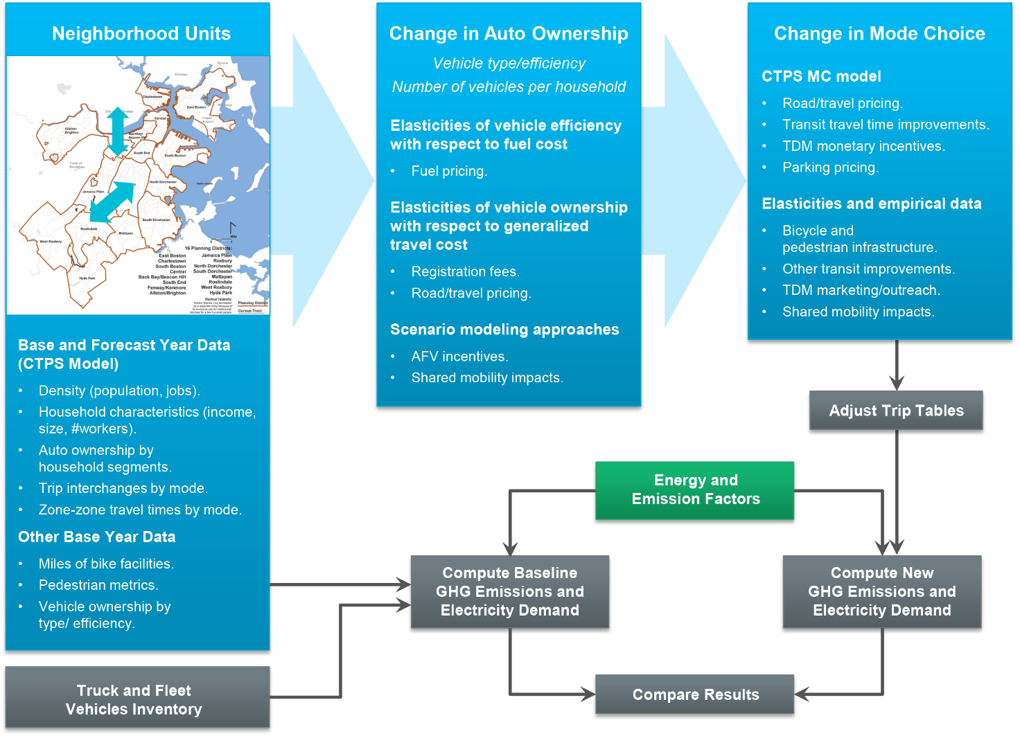
Model Logic
Notes:
A set of neighborhood units (NU) is defined, corresponding to the 15 City of Boston neighborhoods and possibly some subdivisions of these, as well as neighboring cities and towns to capture trips that start or end outside the City. The NUs are aggregations of regional travel model traffic analysis zones (TAZ).
Data on NU characteristics is obtained from the Census and the CTPS regional travel demand model, for the base year as well as forecast years (as available), including:
Population and job density;
Household characteristics (e.g., number of households by income category, auto ownership, size/number of workers);
Trip interchanges – number of trips between each NU pair by mode (drive-alone, high-occupancy vehicle, transit, bike, walk);
NU-to-NU travel times by mode (weighted average of TAZ-TAZ travel times by mode within each NU pair); and
Metrics of bicycle and pedestrian infrastructure.
The change in auto ownership as a result of various GHG strategies is predicted for households in each NU, based on available data (e.g., elasticities with respect to cost) and scenario approaches where data are not yet available (e.g., impact of C/AVs). The tool will allow the user to apply each strategy at the same level for the entire city, or at different levels in different neighborhoods (e.g., higher parking pricing in core neighborhoods).
Starting with the existing set of trip tables (baseline and forecast), the change in mode choice for each NU-NU trip interchange is predicted as a result of various GHG strategies. Strategies that can be defined in terms of travel time or cost changes are directly evaluated using the CTPS mode choice model. Auto ownership is included in this model and changes in auto ownership will be reflected in changes in mode choice. Again, some strategies may be citywide, while others are defined for specific neighborhood units or for specific NU-NU interchanges (network-based strategies such as transit enhancements).
Some strategies cannot be evaluated directly using the CTPS model. These may require the application of elasticities (e.g., change in bike travel with respect to miles of bike lanes); “skimming” of trips from based on empirical evidence from the literature (e.g., percent trip reduction observed from TDM marketing/‌outreach programs); or scenario analysis for strategies for which no good predictive data exists (e.g., shared mobility). CS has compiled an extensive literature of relevant elasticities and empiri­cal data from our GHG analysis work for Georgetown Climate Center, MassDOT, Maryland DOT, Oregon, and other states and metropolitan areas. To the extent that resources permit, we also may sup­plement literature information with select additional analysis of local data (e.g., to relate trends in bicycling in the Boston area to network development).
To the extent that data is available, the tool will reflect different strategy impacts on different population groups/market segments. For example, auto ownership models are typically segmented by household income, and the CTPS mode choice model considers household size. Population and job density also factor into these models, so that land use strategies can be evaluated.
Strategies that directly affect fleets and truck traffic (e.g., clean municipal fleet and transit vehicles, truck idle reduction) will be evaluated separately, based on information on miles driven per year and GHG emission rates from different technologies. From our previous work we have a substantial amount of data on emission rates associated with different vehicle technologies.

Slide 15
Trip Tables
(by market segment)
Scenario Specific Adjustments
Trip Tables
(by market segment)
Mode Choice
Network LOS
(skims)
Network LOS
(skims)
Discrete Choice
Trip Tables
(by mode)
Land Use
Land Use
Elasticities
Vehicle Characteristics
Vehicle Characteristics
Mode Choice Parameters
Mode Choice Parameters

Slide 16
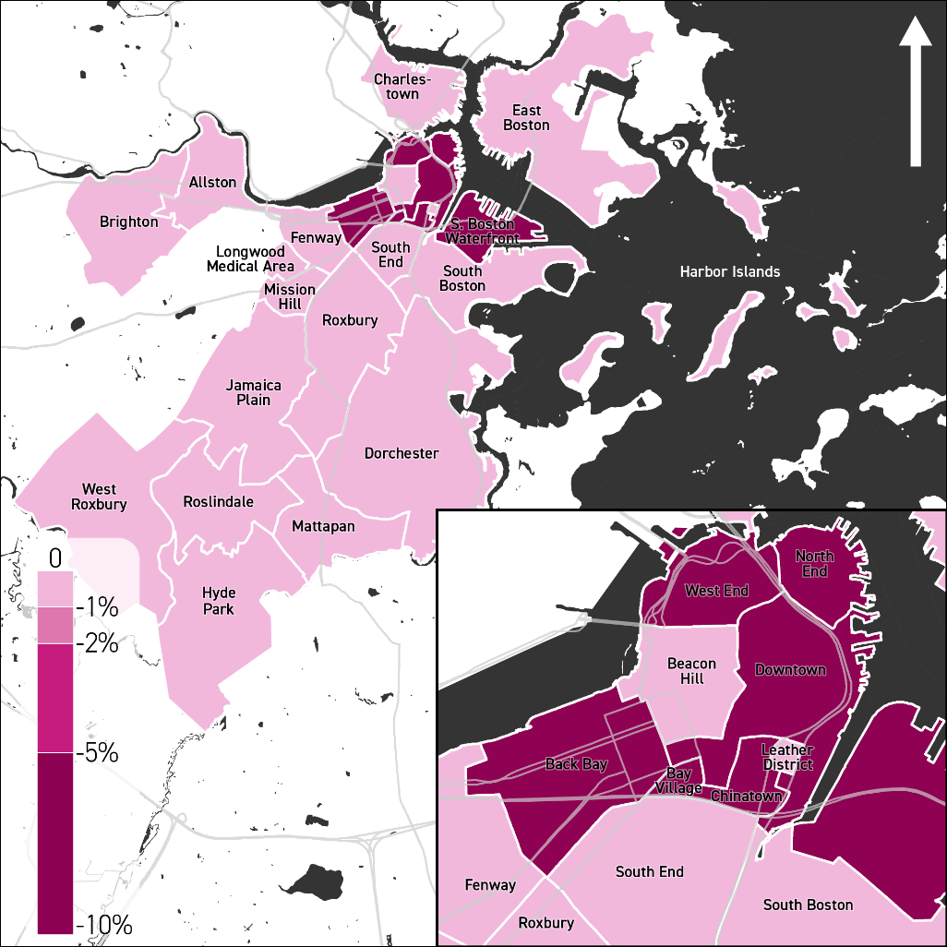
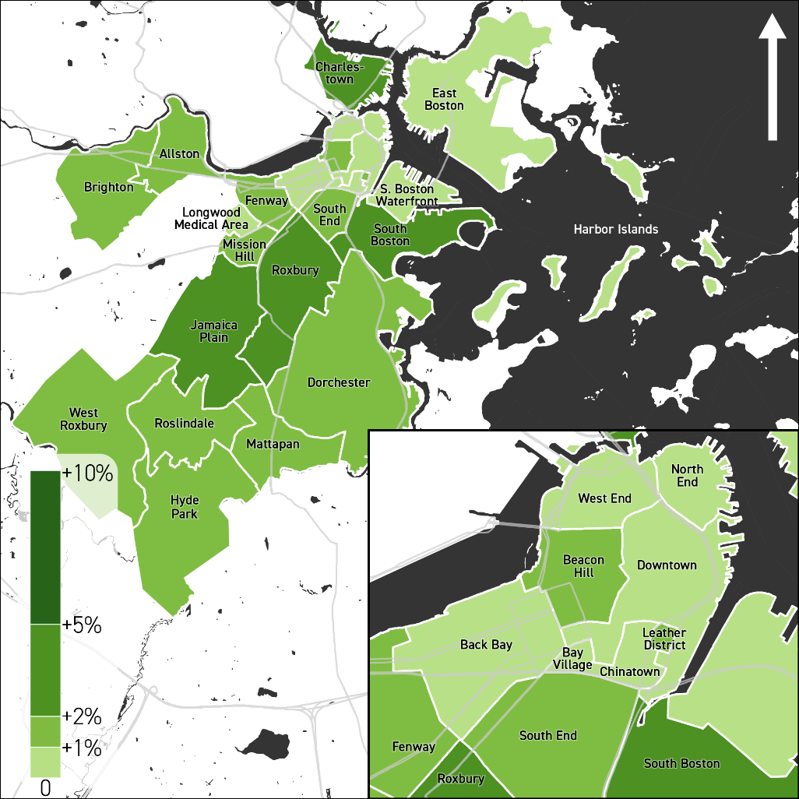
VMT & Active PMT Change by Neighborhood: Central Area Pricing
Notes:
With central area pricing ($5) VMT declines by 5-10% in core neighborhoods, <1% elsewhere
Increase in active PMT is somewhat spread in other neighborhoods

Slide 17
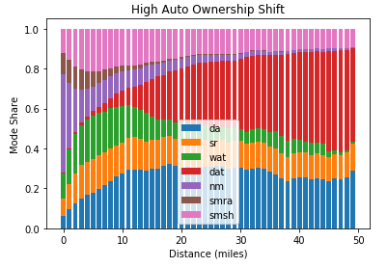
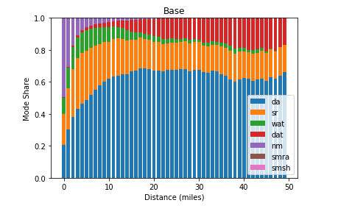
VMT Reduction through Mode Shift

Slide 18
EV Policy Scenarios
Source: CS analysis using ORNL MA3T model
Notes:
We used the Oak Ridge National Labs MA3T model to look at the impacts of EV policies such as vehicle and charging equipment cost incentives or subsidies, and increasing public and private charging availability

Slide 19
Pathways to Carbon-Free Boston

Slide 20
Pathway 5 – Maximum Policies
Trajectory Towards 2050 GHG Levels
Notes:
We looked at five illustrative pathways … of course we need to follow pathway 5, maximum policies, to get close to net zero by 2050
Figure 36 shows how GHG reduction will evolve over time to meet the 2050 levels. With no additional policy action, GHG emissions will decline from 1.99 Mt CO₂e in 2016 to 898,000 t CO₂e in 2050. However, unmanaged smart mobility could increase that by 51,000 t CO₂e. Combined transportation infrastructure investment strategies will reduce 54,000 t CO₂e, and pricing an additional 184,000 t CO₂e. The largest gain will be from electrification, with the efficiency benefits of EVs contributing 330,000 t CO₂e (assuming the 2016 electricity grid), an additional 334,000 t CO₂e with the MA Clean Energy Standard grid, and an additional 108,000 t CO₂e with a zero-carbon grid. The remaining 102,000 t CO₂e is due to heavy-duty vehicle emissions (largely outside the City’s control) that will need to be reduced by electrification or renewable fuels, or offset.

Slide 21
Co-Benefits
⬆ = positive (beneficial) impact
⬇ = negative (not beneficial) impact
⬆ ⬇ = could go either way
--- = neutral/little or no impact
Notes:
Summary of co-benefits. Green (up arrow) is good, red (down arrow) is bad

Slide 22
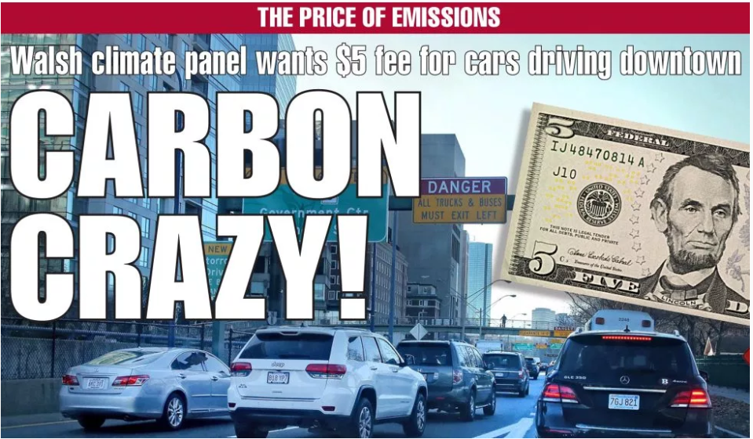
Public Reception
Boston Herald: 2019-01-30

Slide 23
Short-Term Policy Options
Requirements for clean transportation amenities in new development (EV charging, bike parking, TDM)
Strategically located public charging infrastructure for EVs
Zoning changes to increase population and jobs near transit and encourage reductions in vehicle use
Acceleration of policies and investments to implement Complete Streets, bike, pedestrian, and transit improvements in street work
Testing of policies to encourage multi-occupancy shared vehicle use
Curb space reprioritization to support active transportation and shared mobility
Low-cost transit speed and reliability improvements
Policies to support micro-mobility
EV purchases for public fleets

Slide 24
Long-Term Policy Options
Subsidies, incentives, or direct investment in EV charging serving existing multi-family and commercial buildings
  Implement as a clear market for EVs (beyond early adopters) is demonstrated
Exploration of travel pricing options (cordon/congestion pricing, parking fees, fees for high-emission vehicles)
  Need to develop political support and address equity
Larger scale transit investments
  Contingent upon increased revenue stream
Policies to regulate the technology and use of self-driving vehicles
  Prepare in advance, and implement as these vehicles come to market and use cases are observed

Slide 25
Thank You!

Slide 26
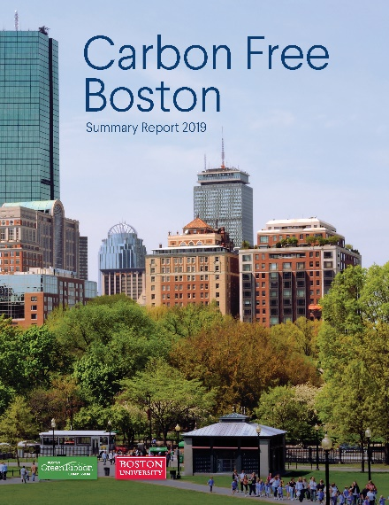

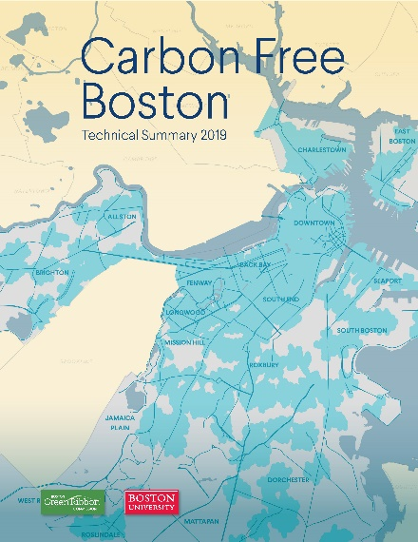
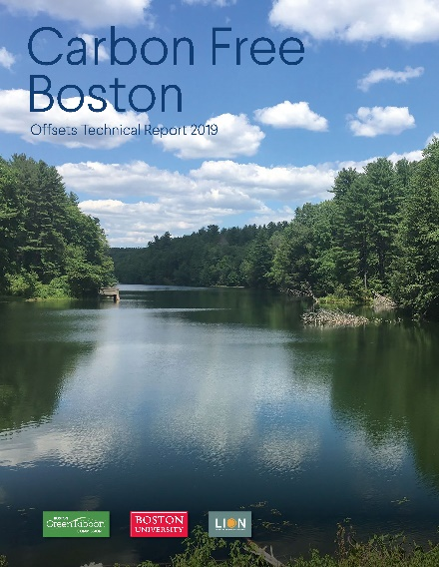
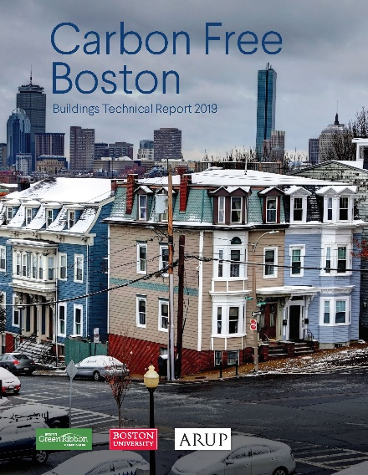
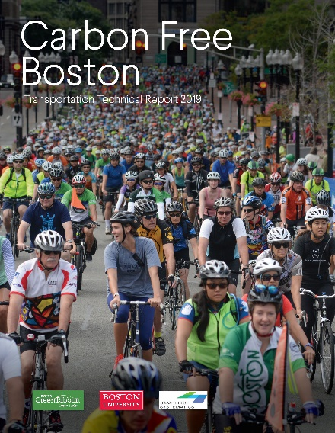

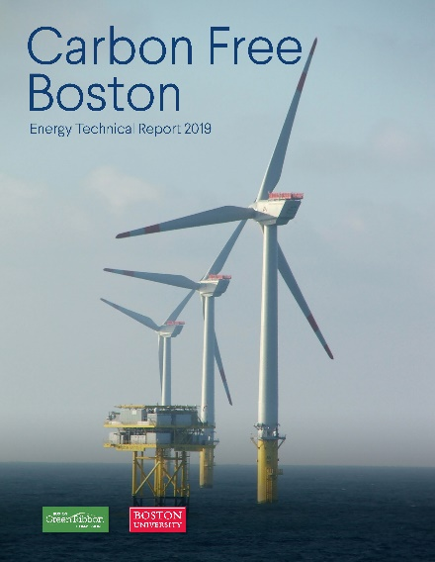
Available online: http://sites.bu.edu/cfb/carbon-free-boston-report-released

Slide 27
Questions?
Chris Porter cporter@camsys.com
Marty Milkovits mmilkovits@camsys.com

