Slide 1
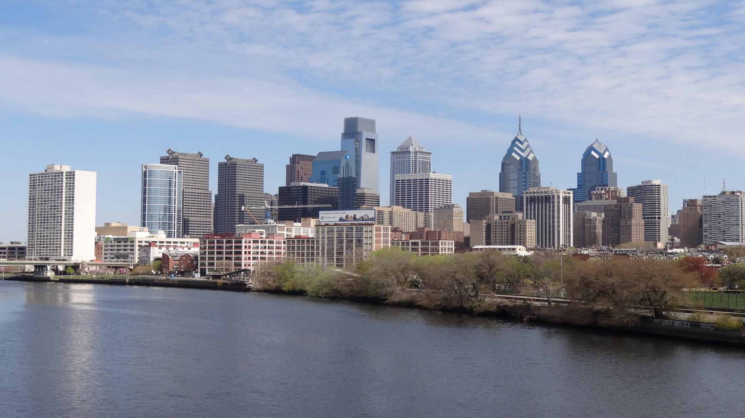
Vehicle Trip & Parking Reduction Benefits of TOD and Smart Growth Development: A Case Study in Philadelphia
Brad S. Lane & Lei Xu
Delaware Valley Regional Planning Commission
June 4, 2019

Slide 2
Outline
Purpose / Motivation
Methodology
3 examples of study sites
Results
Caveats & Conclusions

Slide 3
motivation
Like a lot of urban areas, Philadelphia is struggling with congestion
According to INRIX
#9 most congested urban area in U.S.
#6 most congested road (I-76)
According to recent GasBuddy study
#2 most aggressive drivers in the U.S.
Notes:
INRIX data
http://inrix.com/press-releases/scorecard-2018-us/
GasBuddy study
https://www.usatoday.com/story/money/cars/2019/03/12/most-aggressive-drivers-gasbuddy/3137818002/

Slide 4
motivation
One of our key strategies to address increasing congestion is:
- encouraging Smart Growth and TOD
- reducing parking requirements
There has been a lot of new TOD residential development in Philadelphia since 2010
Mainly mid-level apartments located close to rail stations
Notes:
Mid-Level = 3 – 10 floors
Cite the Long Range Plan
See page 46: Promote compact, Centers-based development through smart growth tools and techniques, such as transit-oriented development (TOD),
See page 114: promote TOD and mixed-use development
also, reduce parking minimums

Slide 6
Notes:
Trenton is in Mercer County
60% - 70% of new development in the urban part of the region is multi-family

Slide 7
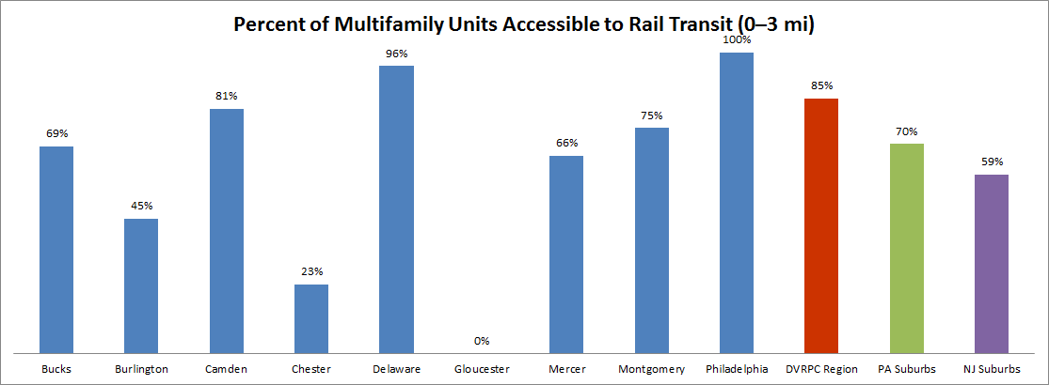

Slide 8
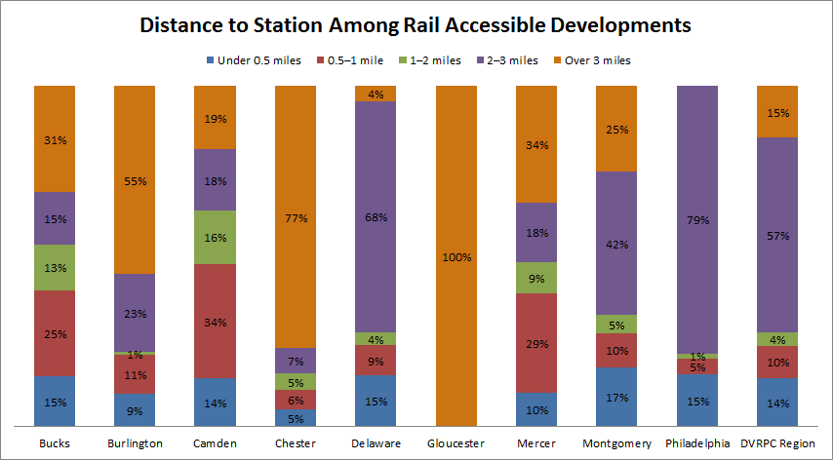
Notes:
It’s really the lower, blue colored band that counts
Sites within 0.5 miles of rail

Slide 9
motivation
But question is – what is the real vehicle trip reduction benefit of TOD?
There are only a few studies of vehicle trip generation and parking demand at multifamily developments near transit.
The question of how much vehicle trip and parking demand reduction occurs with TOD is largely unexplored in the literature.
Everyone agrees that there should be some reduction, but how much?
Notes:
What does this strategy really buy you?
In terms of reducing vehicle trips
There is very little data
Certainly not much in Philadelphia
We did a HH Survey in 2012 –
but did not collect data at any TOD or Smart Growth sites
For what it’s worth – HH survey showed a region-wide average of 6.71 vehicle trips per day per HH
Pages 15, and 94 of DVRPC Household Travel Survey
But to be fair, a lot of this new multifamily development has occurred after that 2012 HH survey was done
And that’s really focus of this study
Just trying to get a feel for what the trip generation rates are
And – for DVRPC, and others doing traffic analysis
We want to use our local rates,
Should be more accurate than ITE

Slide 10
methodology
We counted vehicle trips at 13 sites
Data collected in 2018
In most cases, both Daily and AM Peak Hour
Trip rates are per occupied unit
We also counted parking occupancy
Compared local data to ITE rates (10th edition Trip Gen, 4th edition Parking Gen)

Slide 11
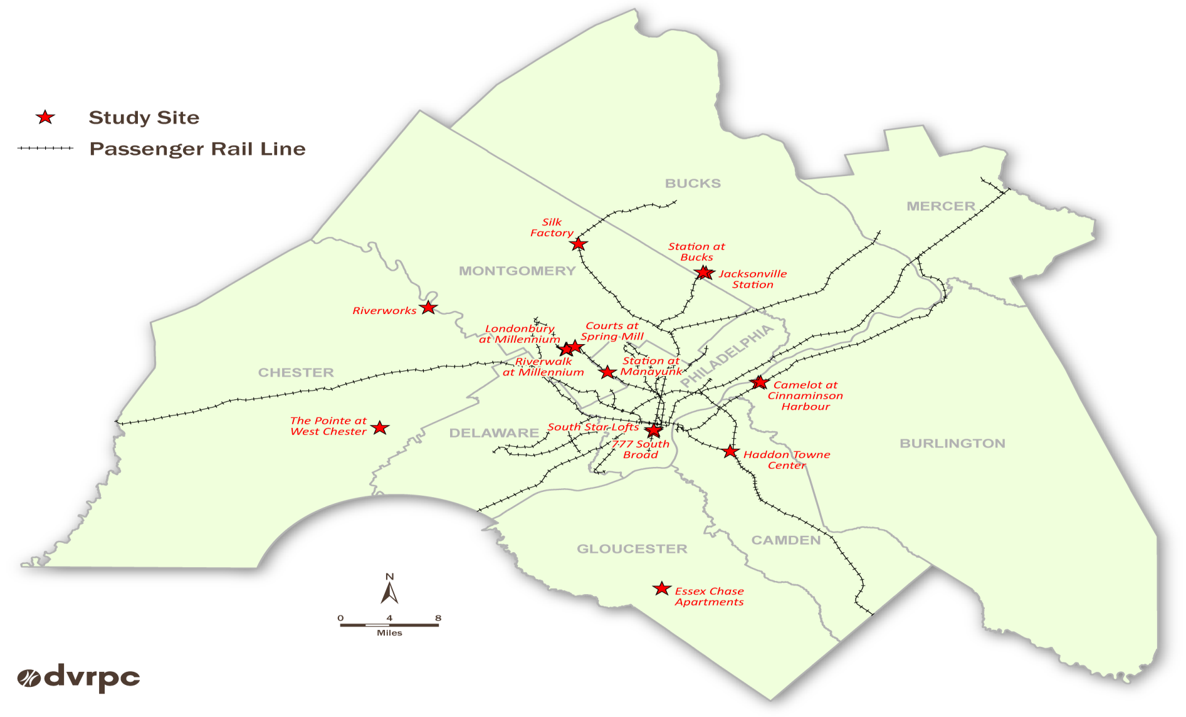
Location of Study sites
c
Notes:
Glenn will help revise this
Some are located right in downtown Philadelphia
Others are located further out – in the suburbs
Next several slides provide detailed info on the 3 highlighted in yellow

Slide 12
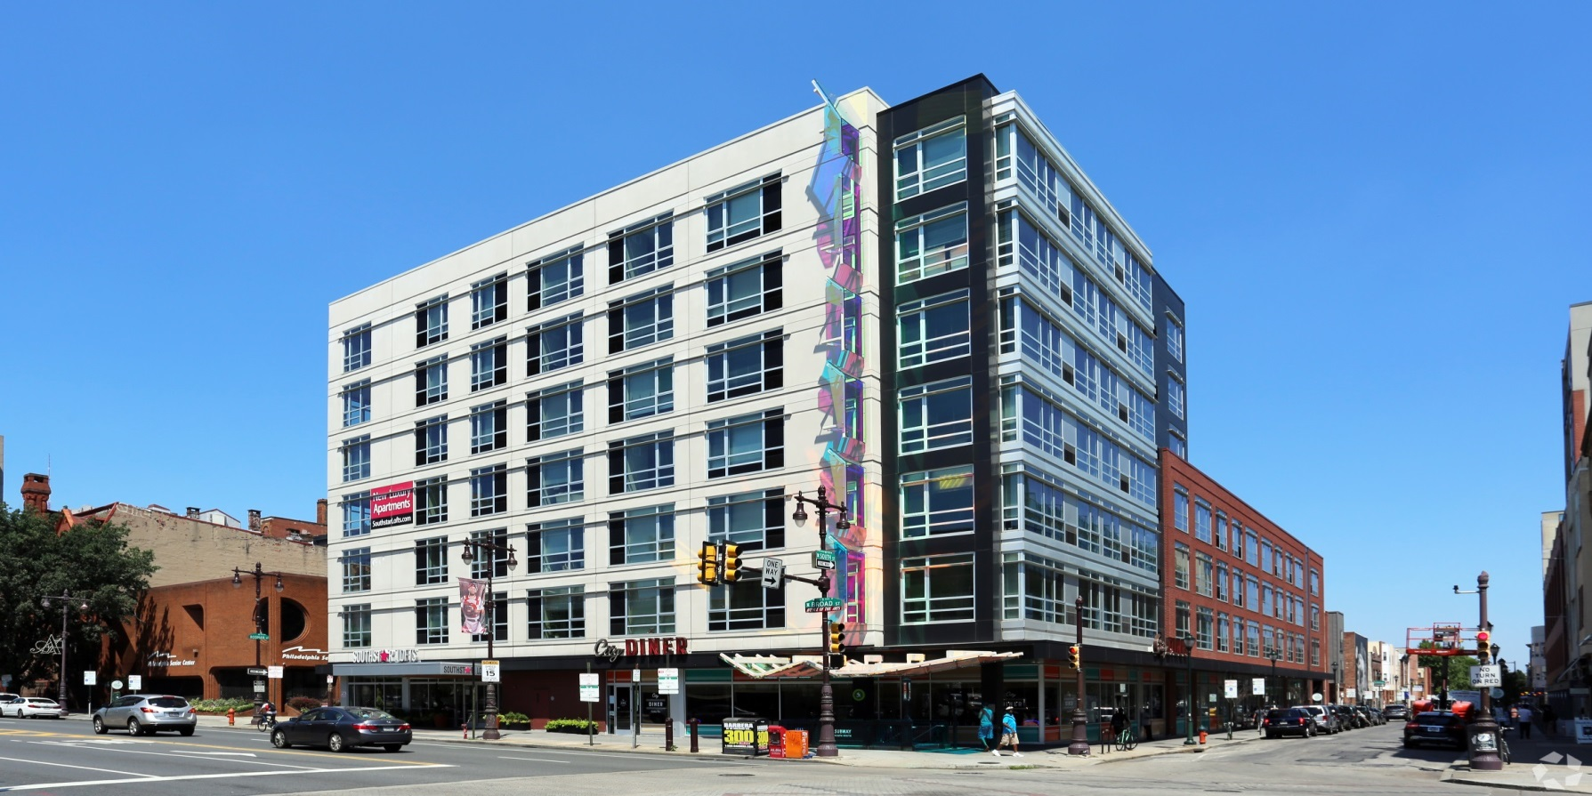
urban tod– southstar lofts
Notes:
This is a good example of one of the “urban” TOD sites
This one is located in downtown Philadelphia
Built in 2014
Point out the subway station, right in front of the building
Broad Street Subway – Lombard South Station
Ground floor retail / Diner

Slide 13
Data for the surrounding census Tract
Walk Share | Transit Share | Vehicles per HH | Median HH Income
37.2% | 24.7% | 0.58 | $72,869
Notes:
From American FactFinder
https://factfinder.census.gov/faces/nav/jsf/pages/community_facts.xhtml
Note the very high walk and transit shares for Journey to Work, for the surrounding area

Slide 14
Site data
Number of Units | Occupied | Floors | Distance to Rail Transit (miles)
85 | 78 | 7 | 0.0 – subway station right below building

Slide 15
Vehicle trips – ITE versus observed
ITE Category | Trips - AM Peak Hour | Trips -Daily | Trip Rate – AM Peak Hour | Trip Rate - Daily
Mid-rise apartment (221) | 28 | 424 | 0.36 | 5.44
Observed | Trips - AM Peak Hour | Trips -Daily | Trip Rate – AM Peak Hour | Trip Rate - Daily
 | 8 | 54 | 0.10 | 0.69
Notes:
Talk a little bit about why we compared to ITE
How ITE is a widely used “benchmark” - but typically represents “suburban” conditions

Slide 16
parking – ITE versus observed
ITE Category | Units | Spaces | Spaces per Unit
Mid-rise apartment (221) | 85 | 119 | 1.40
Observed (5:00 AM) | Spaces | Spaces per Unit | Occupied Spaces | Empty Spaces
 | 85 | 1.00 | 85 | 0

Slide 17
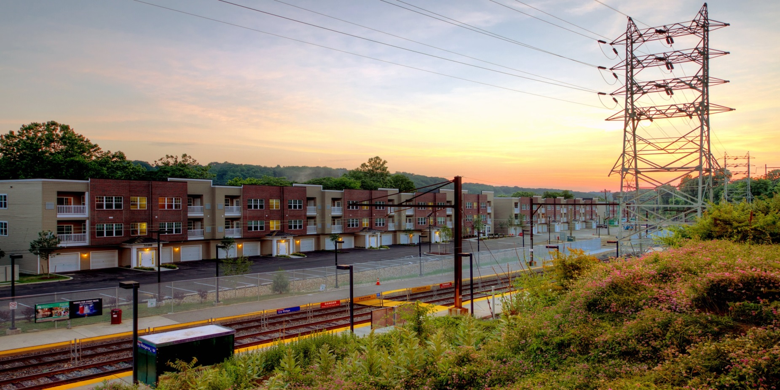
Suburban tod - Station at manayunk
Notes:
This one is a good example of a “suburban” TOD site
Also built in 2014
9 miles from downtown Philadelphia
Located on the Manayunk / Norristown Regional Rail line, at the Ivy Ridge Station

Slide 18
Data for the surrounding census tract
Walk Share | Transit Share | Vehicles per HH | Median HH Income
1.8% | 25.3% | 1.54 | $71,280
Notes:
Walk share is much lower than the Urban site

Slide 19
Site data
Number of Units | Occupied | Floors | Distance to Rail Transit (miles)
149 | 142 | 3 | 0.0 – rail station is right outside their front door

Slide 20
Vehicle trips – ite versus observed
ITE Category | Trips - AM Peak Hour | Trips -Daily | Trip Rate – AM Peak Hour | Trip Rate - Daily
Mid-rise apartment (221) | 51 | 772 | 0.36 | 5.44
Observed | Trips - AM Peak Hour | Trips -Daily | Trip Rate – AM Peak Hour | Trip Rate - Daily
 | 44 | 555 | 0.31 | 3.91
Notes:
A lot of people from surrounding neighborhoods using this site for “kiss-n-ride”
We subtracted those trips out
Trip rates are not as low as the Urban TOD site,
But still lower than ITE

Slide 21
Parking – ite versus observed
ITE Category | Units | Spaces | Spaces per Unit
Mid-rise apartment (221) | 149 | 209 | 1.40
Observed (5:00 AM) | Spaces | Spaces per Unit | Occupied Spaces | Empty Spaces
 | 241 | 1.62 | 195 | 46
Notes:
This site was a little complicated
Some of the units had their own garage
But they didn’t always use them to park vehicles - in some cases they were treated as “extra” room / space
And we could not gain access to these garages to figure out what the true vehicle occupancy was.
A little bit of a guess as to what is really going on

Slide 22
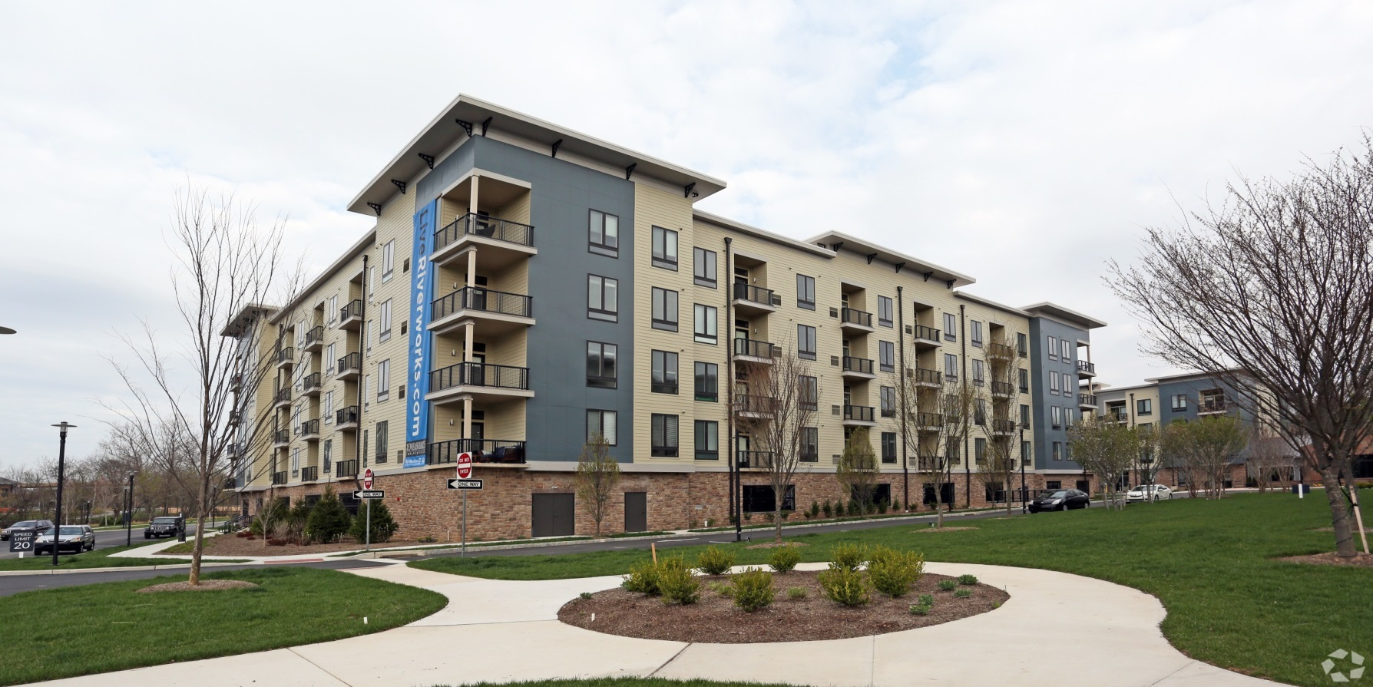
Smart growth – Riverworks
Notes:
Built in 2016
Not TOD - no rail near this site
Located 30 miles from downtown Philadelphia
But a short walk (0.2 miles) to downtown Phoenixville

Slide 23
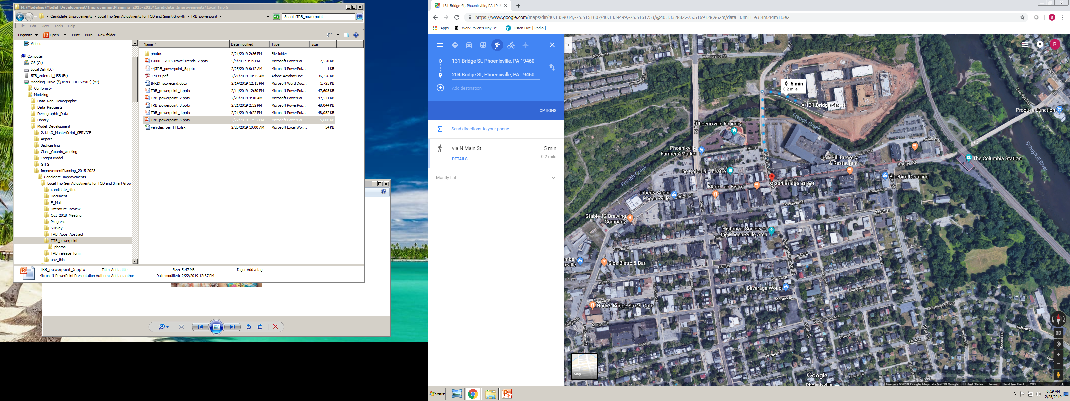
Proximity to downtown
Notes:
0.2 miles a 5 minute walk to downtown Phoenixville
Need a pointer / highlighter

Slide 24
Data for the surrounding census tract
Walk Share | Transit Share | Vehicles per HH | Median HH Income
2.0% | 2.8% | 1.71 | $89,360
Notes:
Both walk and transit shares are low

Slide 25
Site data
Number of Units | Occupied | Floors | Distance to Rail Transit (miles)
349 | 276 | 5 | Not located near rail – 12 miles to Norristown Transportation Center
Notes:
This is also a bigger site than the other two - about 350 units

Slide 26
Vehicle trips – ite versus observed
ITE Category | Trips - AM Peak Hour | Trips -Daily | Trip Rate – AM Peak Hour | Trip Rate - Daily
Mid-rise apartment (221) | 99 | 1,501 | 0.36 | 5.44
Observed | Trips - AM Peak Hour | Trips -Daily | Trip Rate – AM Peak Hour | Trip Rate - Daily
 | 112 | 1,010 | 0.41 | 3.66
Notes:
AM peak hour trip rate is higher than ITE

Slide 27
Parking – ite versus observed
ITE Category | Units | Spaces | Spaces per Unit
Mid-rise apartment (221) | 349 | 489 | 1.40
Observed (5:00 AM) | Spaces | Spaces per Unit | Occupied Spaces | Empty Spaces
 | 515 | 1.48 | 335 | 180
Notes:
Actual number of spaces is higher than what ITE recommends
Lots of empty parking spaces
Even out here - they could probably get away with far fewer

Slide 28
DATA FOR ALL STUDY SITES

Slide 29
Am Peak Hour
Urban TOD
Suburban TOD
Non Rail
Notes:
Some of the Suburban TOD sites have trip rates higher than ITE
Even though they are really close to rail station - doesn’t mean they are taking transit to work.
The Non-Rail sites - looks like they are driving to work

Slide 30
daily
Urban TOD
Suburban TOD
Non Rail
Notes:
Comparing the Urban TOD to Suburban TOD
The folks living in the City - they can probably do without a car
But in the suburbs, there’s probably a lot of trips where you still need a car.
You may be taking the train to work,
But if you’re chauffeuring your kids to soccer practice, or going to pick up groceries, then you’re probably driving

Slide 31
Summary – ranges for all sites
 |  | AM Peak Trip Rate |  | Daily Trip Rate
 | Number of sites | ITE | Observed | ITE | Observed
Urban TOD | 3 | 0.36 | 0.10 – 0.22 | 5.44 | 0.69 – 2.17
Suburban TOD | 7 | 0.36 | 0.26 – 0.39 | 5.44 | 3.49 – 4.35
Smart Growth | 3 | 0.36 | 0.36 – 0.47 | 5.44 | 3.66 – 5.18
Notes:
This is what we needed – ballpark trip gen rates
We would really overestimate daily trip generation using ITE’s rates
On the other hand, we would probably underestimate AM Peak trip generation at these non TOD sites
So, bottom line - we’re better off using local rates

Slide 32
caveats
This data reflects Philadelphia conditions / travel behavior
This was a pretty simple (but feasible and affordable) approach
Small sample size
Question as to how representative residents of these new multifamily projects are, in terms of race, age, income, ….
Notes:
Ideally - we would have been able to interview the people living at these sites
Find out a little bit more about them
But that was way beyond our scope, schedule, and budget

Slide 33
conclusions
The data shows real vehicle trip reduction benefits to TOD – especially at the “urban” sites
Proximity to transit is important, but it does not totally explain travel behavior. For example, comparing AM Peak trip generation at the suburban sites – in some cases, the sites that were closer to transit generated more vehicle trips
For parking, wondering whether we should recommend using ITE’s 1.40 spaces / unit as an upper threshold?

Slide 34
Questions?

