Slide 1
Deep Thoughts on NextGen NHTS
Becky Knudson
Senior Transportation Economist
Oregon Department of Transportation

Slide 2
feedthedatamonster.com

Slide 3
Tools Require Accurate Data
Recognize priority needs
Identify “nice to have”
Consider additional “desires”

Slide 4
Priorities
Data required to meet mandates
Sustainable and affordable data program
Validation data

Slide 5
Nice to Have
Continuous data collection
Agile sampling
Faster turnaround from collection to application

Slide 6
Luxuries
Entire state coverage
Extra questions – health, household location, personal modes
Passive GPS with demographics
Multiple days – seasonal patterns – long distance

Slide 7
Questions…
What is the minimum needed to meet mandates?
What tools require the data?
What questions can we answer with our tools?
What questions do we expect in the future?
What risks are there associated with little to no data collection?
SnorgTees.com

Slide 8
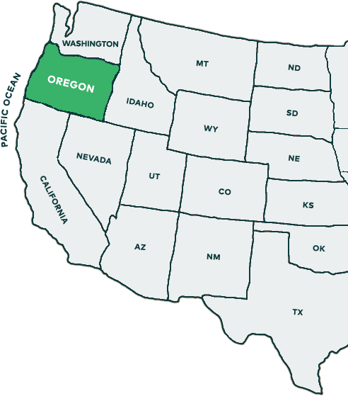
Oregon Approach
Oregon Household Survey
Oregon Modeling Steering Committee
MPO data collection 2020-2021
Validate purchased O/D data
FHWA NextGen project
Evaluate potential cost savings
Gain knowledge of survey design/collection methods – advances
Peer exchange

Slide 9
Expectations
Learn, so we make informed decisions

Slide 10
Becky Knudson
Oregon Department of Transportation
rebecca.a knudson@odot.state.or.us

