Slide 1
Open Source + Zephyr
Elizabeth Sall, UrbanLabs LLC
[ zephyr volunteer ]

Slide 2
?
Vision
The primary venue through which leading researchers and practitioners seek to develop and implement travel analysis methods and tools that are demonstrably more valuable, credible, transparent, tractable, reproducible, and usable in order to support decision-making that is inclusive and promotes equitable outcomes, shared prosperity, and sustainability.
http://zephyrtransport.org

Slide 3
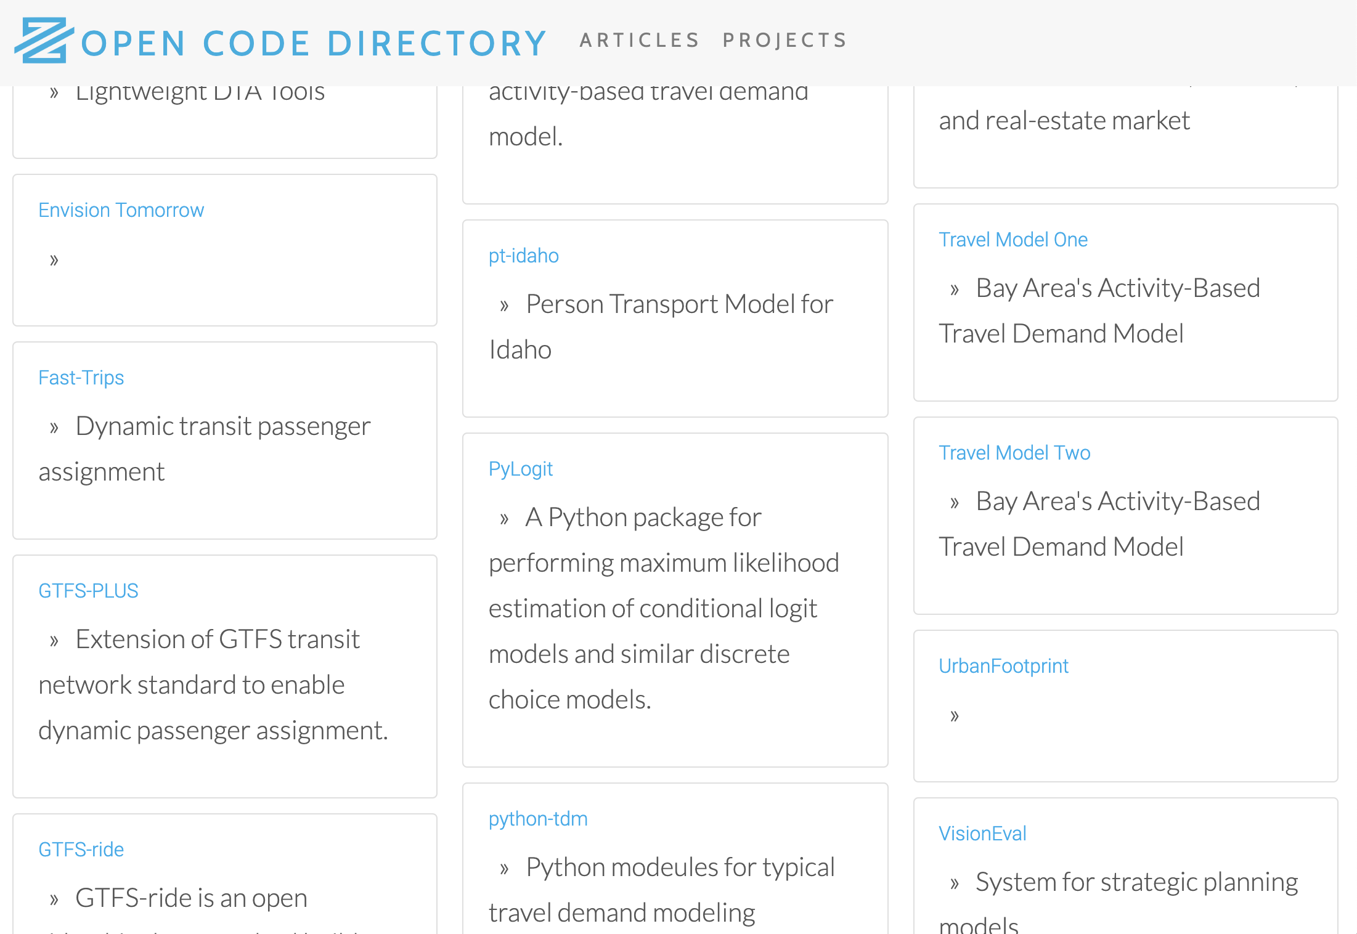
What is out there?
https://zephyrtransport.github.io/zephyr-directory

Slide 4
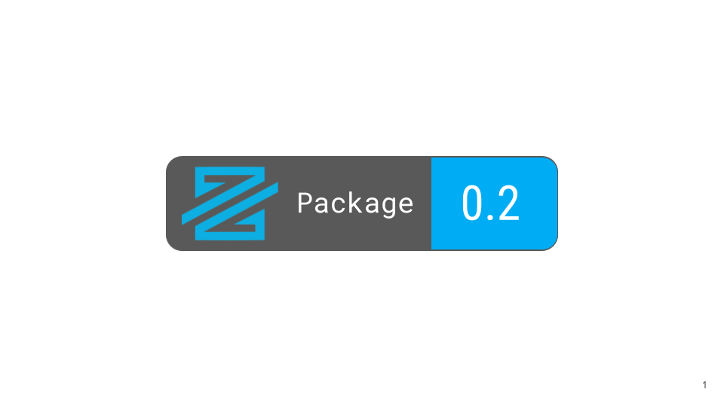
Is it any good?
Developing badge-worthy standards: https://medium.com/zephyrfoundation

Slide 5
Who is carrying the torch?

Slide 6
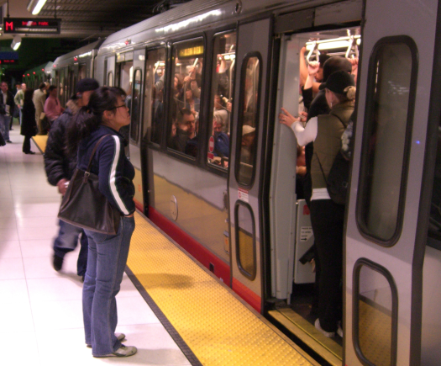
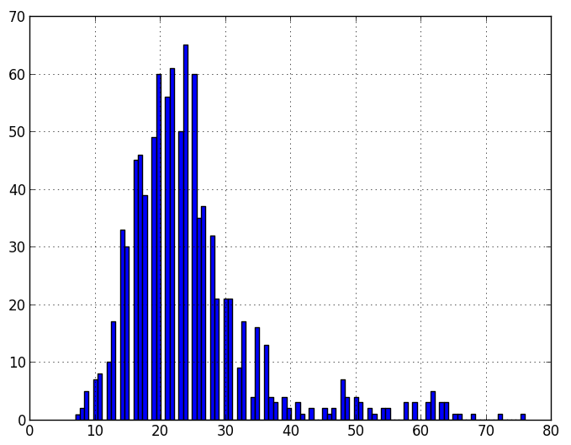
What is Fast-Trips?

Slide 7
Phases of Leadership
Academic Research Project
Agency Research Project

Slide 8
Who is on the board?
Members
What projects?
Who is on PMG?
Compliance
Board
Project Management Group
How do we achieve:
- Project objective?
Stakeholder involvement?
Necessary resources?

Slide 9
Membership-based resources
Board
Staff
PMG
Grant-assistance
Admin-support
Grant-writing
Stakeholder-based fundraising

Slide 10
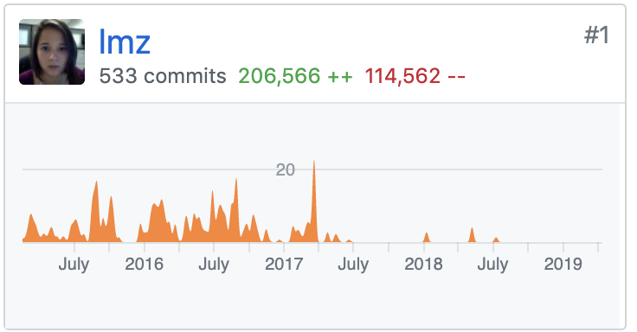
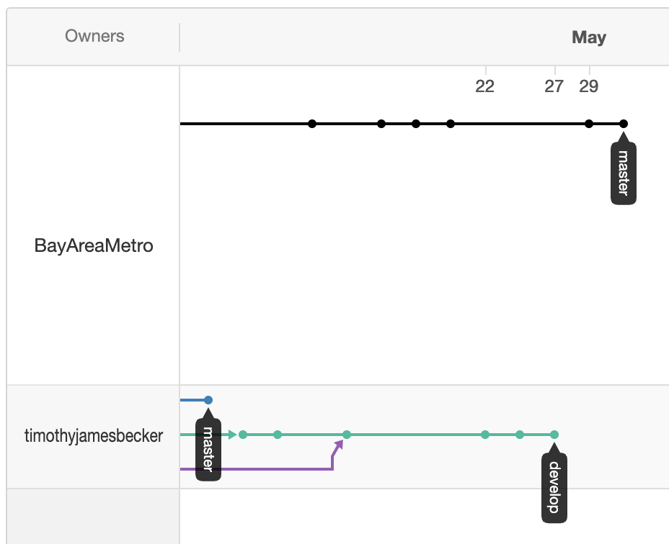
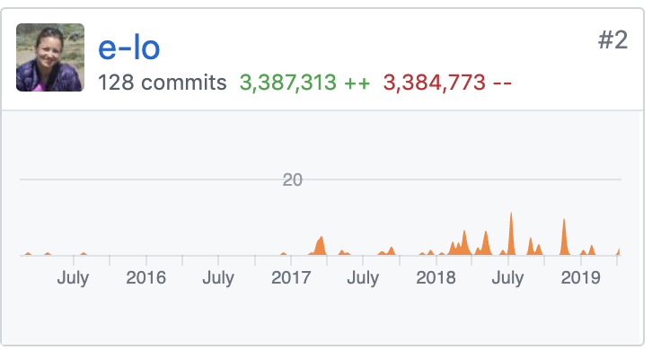
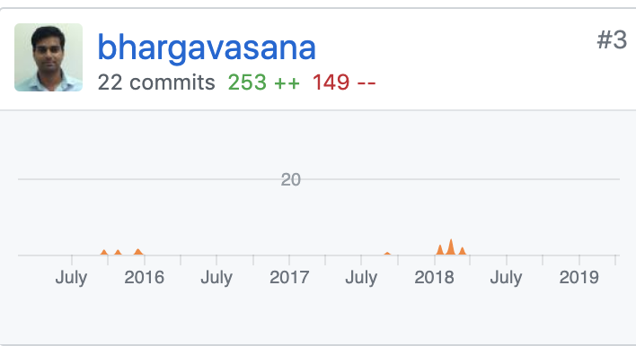

Slide 11
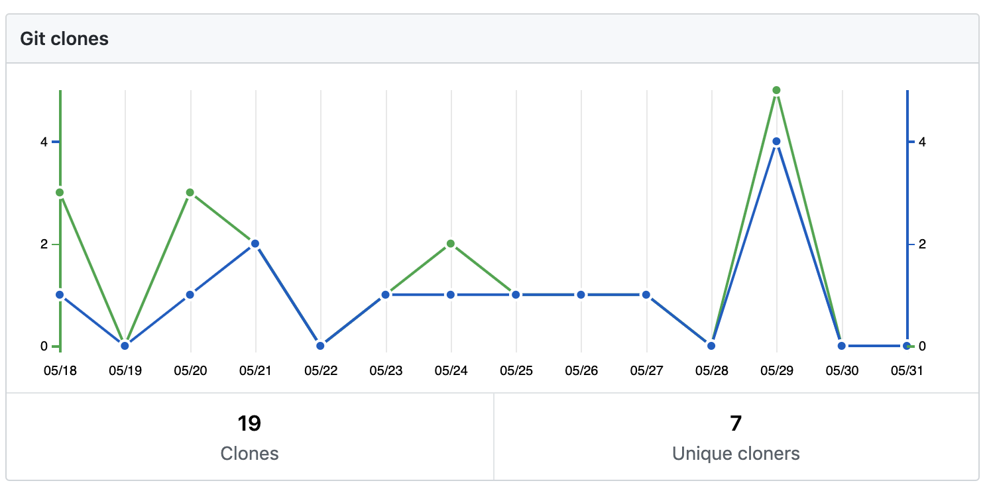
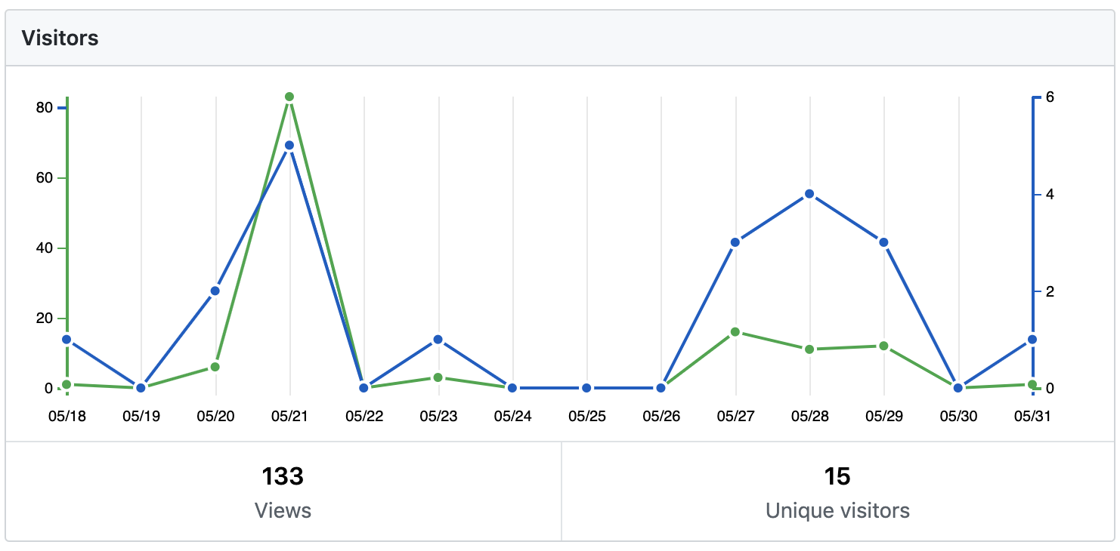

Slide 12
zephyrtransport.org
RSG Inc.

