Slide 1
VisionEval Family of Strategic Planning Tools Open Source Project
Tara Weidner, ODOT Transportation Planning Analysis Unit
TRB Planning Applications Conference
Sunday, June 1, 2019

Slide 2
What? Why?
Open Source, Modular, Strategic Planning Tool Framework
Exploratory tool for assessing risk/uncertainty in scenario planning visioning
Use more detailed traditional tools to implement vision
Common Need: Support Long Term Multi-sector Policy Conversations
Broad inputs: transport-land use, ITS, new modes & policies, uncertainties (resilience)
Broad outputs: GHG, household costs, mode usage, health
Many possible futures (quick run time)
Robust analytical framework
First order effects, trade-offs
Forecast risk & uncertainty
Intended & unintended consequences of actions
Sketch model
VisionEval combines approaches…
quick, what-if, no network
micro-simulate
HHs/Vehicles
Activity
Based model
Integrated
model
economy, land use
& feedback
…balancing
rapid computation &
accurate representation
Notes:
The Regional Strategic Planning Model (RSPM) aims to occupy the niche between more aggregate sketch planning tools and more complex LUTI models. Sketch planning tools are primarily driven by correlation or univariate elasticities, but unable to reflect the interconnectedness between different urban phenomena, while full-fledged disaggregate models integrated with travel demand models aim at capturing the interdependence in the urban system at the cost of model complexity, detail, and run time. Advanced Activity-Based models capture interacting policies by microsimulation of each individual's daily trips by purpose using a detailed multi-modal network. Traditional travel demand models incorporate the network but policies and their interactions are limited by an aggregate treatment of the average behavior of "groups" of individuals.
RSPM uses microsimulation and interacting model components to enable better accounting of policy interactions and the social and spatial heterogeneity of effects than do sketch planning tools. The advantage of a microsimulation approach is in the interpretability of model results and the flexibility in introducing additional disaggregate variables and utilizing alternative model structures [@donnelly_nchrp_2010; @waddell_integrated_2011]. At the same time, RSPM simplifies the disaggregate modeling approach from that of more complex LUTI models. RSPM forecasts only overall travel based on urbanized area travel conditions and household attributes, avoiding network detail that leads to long run times. Thereby striking a balance between rapid computation and accurate representation of how different types of household will change travel behavior in response to policies and investments. These simplifications enables more comprehensive analysis consistent with the uncertainties inherent in long range planning , and by allowing a larger set of factors and many more scenarios to be evaluated in a timely manner. This enables the planning decision space and potential policy tradeoffs to be broadly explored. It also enables the development of web-based interactive decision-support tools to give planners and decision-makers the ability to better understand prospects and tradeoffs and resilience to alternative futures [@gregor_rvmpo_2016].

Slide 3
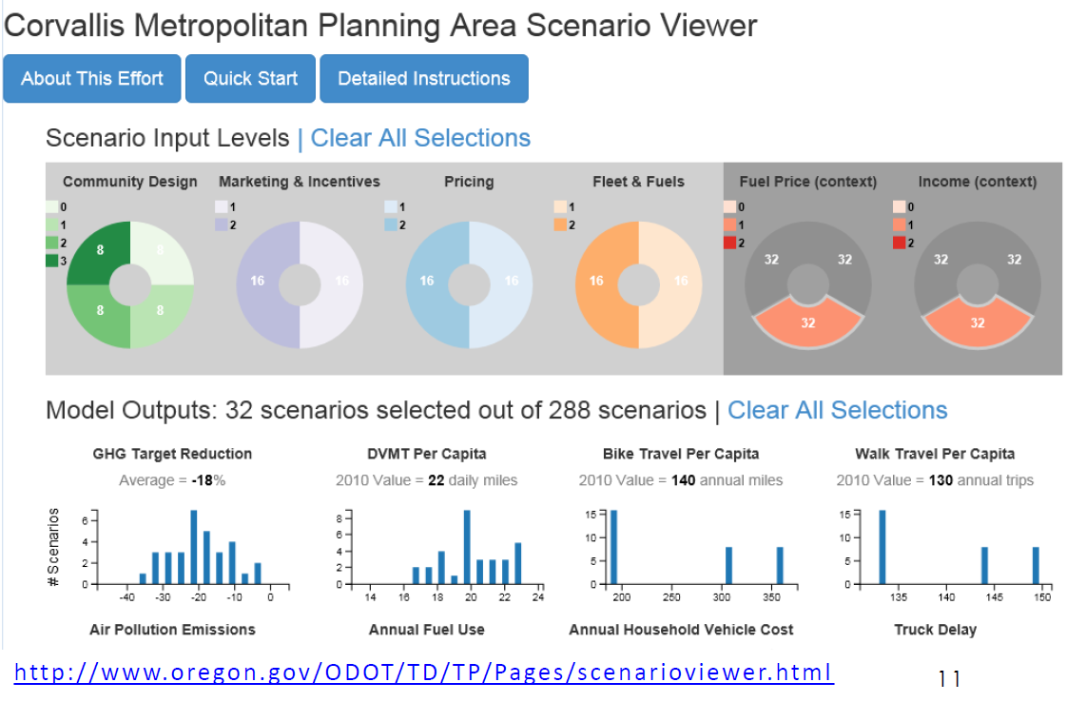
Viewer explores many futures
http://www.oregon.gov/ODOT/Planning/Pages/PTV-SV.aspx?sv=CAMPO

Slide 4
What exactly?
User-friendly open source tool
Conduct strategic evaluations
Visualize range of possible outcomes.
Modular, scalable
Flexible to address new concerns/risks (e.g. health and accessibility indicators, emerging modes, pricing)
Open Science approach
Open Source license (Apache)
3-year pooled fund
Consolidate/extend the model
Collaborative forum
FHWA/Volpe Host,
User funding/governance
Website & Github Wiki
Github code & download/install
Documentation, Tutorials
Contributor Review process & criteria
Future Roadmap
FHWA Pooled Fund (Charter)
Lead Agency
TAC
TAC Working Group
Contractor weekly sprints
Notes:
Modular – so can share across family tools; flexible so can be customized & exten
Open science approach: Reproducible – data and source code included

Slide 5
Champions
Constructive Dissonance balances competing goals
“create possibilities”
▪ National tool
▪ Big/small users
▪ National datasets
▪ Enable initiatives
▪ User friendly
FHWA
Volpe
Pooled Fund
of Agencies
(State/MPOs)
“partner efficiency”
▪ Tool maintenance, upgrades
▪ Consistency
▪ Credibility
▪ Cost savings
▪ Consultant flexibility
▪ Easy to use, defaults
▪ Share best practices
“sell products”
▪ Develop/apply
▪ Multiple client use
▪ Legacy code issues
Consultants
Academics
“research”
▪ National tool
▪ Estimation datasets
▪ Modular
▪ Code standards

Slide 6
Our Random Walk….
Set the Stage
2010-2014 Growing Family
2 ODOT Tools, 2 Federal Tools
➔ How to share upgrades? Broaden user base?
Triggers ➔ Identify common need for new tool
State mandate (GHG), Federal initiatives (SHRP2)
Unmet tool niche (non-modelers), Multi-agency, multi-sector collaboration
How to develop
Champions ➔ core group of people who take “ownership”
Open Communication ➔ Involve others at every turn
Peer Exchanges – ODOT GHG planning tool, Conference workshops, Pilot users group
Pilots –Framework proof-of-concept, Contributor review team, Documentation plan
White Papers – Mission/Goals/Vision, Open Source Governance Lit Review
Roadmap of future plans
Creative funding ➔ Nothing is free…
Federal
SHRP2 Research program (Tool with pilot application & Lead adopter grants)
FHWA Pooled Fund (process for collaboration with lead agency)
TMIP (webinars, tool support forum, peer review)
Other
Research programs (DOT & University )
Inter-agency IGAs (between agencies)
Consultants (marketing budgets)

Slide 7
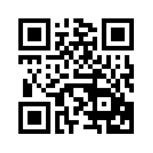
Tara Weidner, ODOT, tara.j.weidner@odot.state.or.us Jeremy Raw, FHWA, jeremy.raw@dot.gov Thank You!
JOIN US!
Pooled Fund
FHWA-Volpe
DOTs MPOs
▪ OR  Ohio  Las Vegas
▪ MD  NC  Atlanta
▪ WA  CA  Houston
Visioneval.org
9/20/19 VisionEval Training (4-8hrs)
@ Transportation & Community Summit, PSU, Portland, OR

