Slide 1
ActivitySim An open platform for activity-based travel modeling
17th TRB National Transportation Planning Applications Conference
Moving Governance Concepts into Practice: A Roundtable Discussion
Sunday, June 2nd, 2019 3:30 PM – 5:00 PM
Pavilion Ballroom E

Slide 2
Who? Consortium Partners

Slide 3
Consortium Partners - Timeline
The Founding Partners (2013-2014):
Atlanta Regional Commission
Metropolitan Transportation Commission
San Diego Association of Governments
The Additional Partners:
Metropolitan Council (2019)
Oregon Department of Transportation (2019)
Puget Sound Regional Council (2015)
San Francisco County Transportation Authority (2015)
Southeast Michigan Council of Governments (2018)
Notes:
ARC, MTC & SANDAG approached AMPO for project management in Summer of 2013
RFP Sept. 2013
Kick-off Meeting Feb. 2014
Importance of Champions

Slide 4
What? ActivitySim
The mission of the ActivitySim project is to create and maintain advanced, open-source, activity-based travel behavior modeling software based on best software development practices for distribution at no charge to the public.
The ActivitySim project is led by a consortium of Metropolitan Planning Organizations (MPOs) and other transportation planning agencies, which provides technical direction and resources to support project development. New member agencies are welcome to join the consortium. All member agencies help make decisions about development priorities and benefit from contributions of other agency partners.
Notes:
To me, one of the most critical and fundamental reasons for the success of this project is the willingness of not only the consortium partners, but also the team at RSG, to contribute to the overall project and share knowledge and resources with each other on a regular basis.
The wealth of expertise amongst the group allows for each respective agency to move through implementation in their own region in a more effective and efficient manner.

Slide 5
How? Organizational Structure
Consortium Partners
Shared ownership through a cooperative consortium.
AMPO Research Foundation
Funding pooled through the AMPO Research Foundation.
RSG
Engage with consultant to develop a common open-source activity-based travel behavior modeling platform.
Notes:
AMPO handles RFP and Contract responsibilities
All partner agencies have a voice in development of RFP, selection of Contractor, and the development of the scope of work and prioritized tasks

Slide 6
How? Development and Implementation
ActivitySim
Utilize best-in-class scientific computing Python/CC++ libraries such as pandas and numpy.
Build and maintain software in a completely open manner: online, open source, documented, tested, and managed.
Begin replacing the modeling software in use at each partner agency.
Notes:
The last several years have focused on development. We are now ready to move into implementation beginning with ARC and SEMCOG.

Slide 7
Where? Open and Online
www.activitysim.org
Notes:
Discuss how and where to find. Everything is open and online, including code, meeting notes, phases of project, etc.

Slide 8
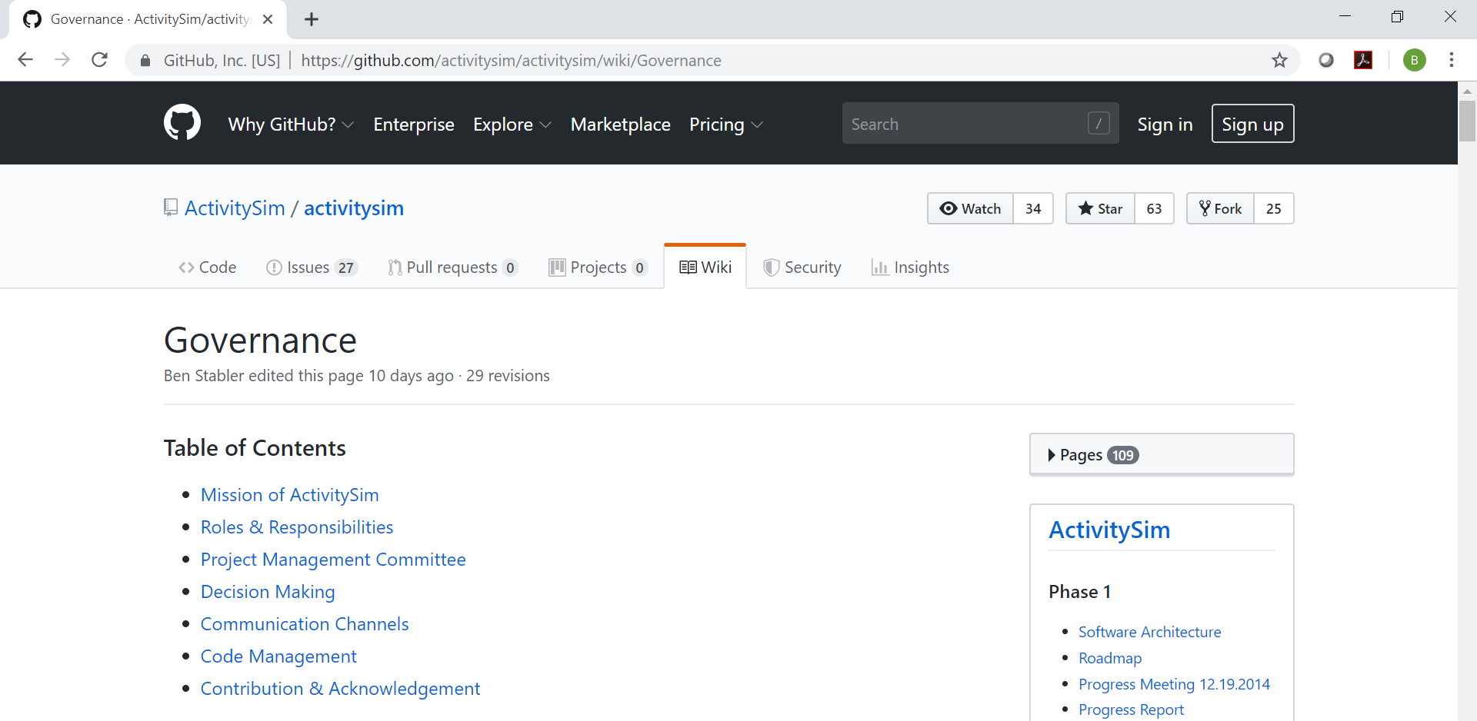
Where? Governance (Meritocracy)
Governance: https://github.com/activitysim/activitysim/wiki/Governance
Notes:
Briefly discuss Governance structure.
ActivitySim is a meritocracy. We invite everyone to contribute to the code and project. Currently, the financial contributors make the decisions as there is an MOA in place through the end of 2021. We are exploring expansion options following the expiration of the MOA. We do ask that contributors given write access to the code sign a disclosure form so as to avoid any litigation, etc.

Slide 9
Why? Common Needs and Goals
Activity-based Models are complex and expensive.
There is/was an identified need within the community to reduce the overall costs of maintenance and development of innovative new model components associated with isolated model implementations.
By pooling funds to develop an open source common platform, ActivitySim will significantly reduce the overall cost for agencies.
In addition to pooling financial resources, the Consortium shares a wealth of knowledge and experience with and amongst each other with the overall goal of advancing the state of the practice.
The hope is that not only will each partner benefit from ActivitySim, but so will the industry.
Notes:
ActivitySim is agnostic to region or location. The basic premise is that anyone that is interest can pick it up and customize it for their respective region. We are also working on building in affiliated packages, such as PopSim, and cost/benefit.

Slide 10
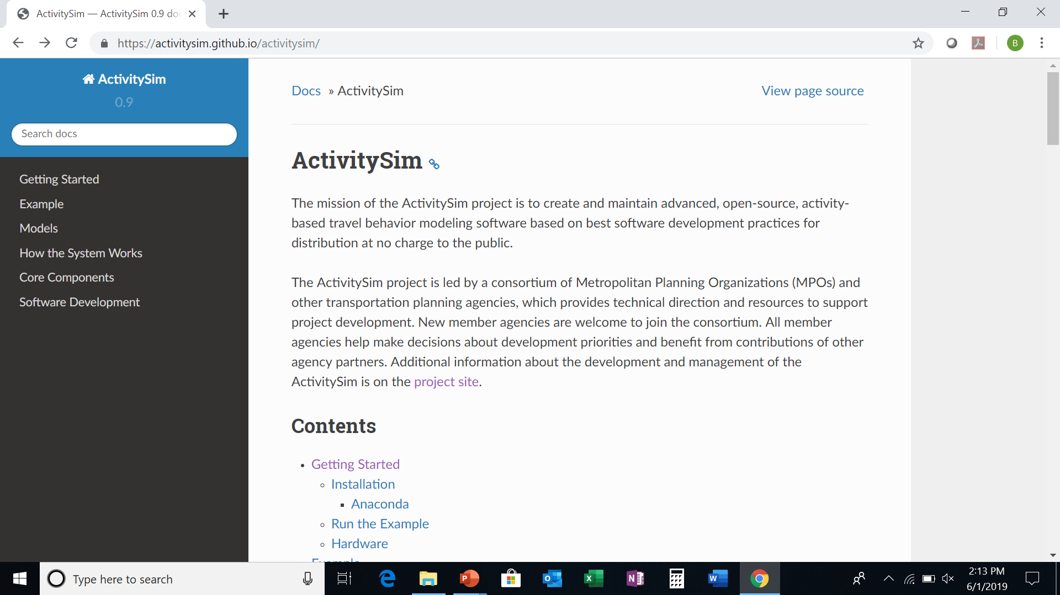
Join Us!
Visit our Getting Started page to learn more!
Questions? Please contact me or any of the Partners.
Bill Keyrouze, AMPO
bkeyrouze@ampo.org
Thank You!
www.activitysim.org

