Slide 1
Project NCHRP 08-111: Effective Decision-Making Methods for Freight-Efficient Land Use
TRB Planning Applications Conference

Slide 2
Project Overview
Goal:
To develop effective decision-making methods to advance freight efficient land-uses (FELU)
Objectives:
To quantify and evaluate the impact of land-use practices and policies to support efficient movement of all modes of freight
To develop quantitative and qualitative land-use assessment tools (e.g., models, guide) to assist local, regional, and state land-use and transportation decision makers to support efficient movement of freight

Slide 3
Land-Use and Freight Initiatives
Land-Use and Freight Initiatives are complementary:
Freight Efficient Land Use initiatives are primarily intended to foster efficiency across supply chains; however, in doing they could prompt community opposition
Freight initiatives, in turn, could be used to mitigate the negative impacts of these FELU initiatives, facilitating adoption and implementation
To identify land-use initiatives:
Interviewed 19 freight, transportation, and land-use experts
Conducted extensive literature review on land-use and freight initiatives
Reviewed land-use decision-making process

Slide 4
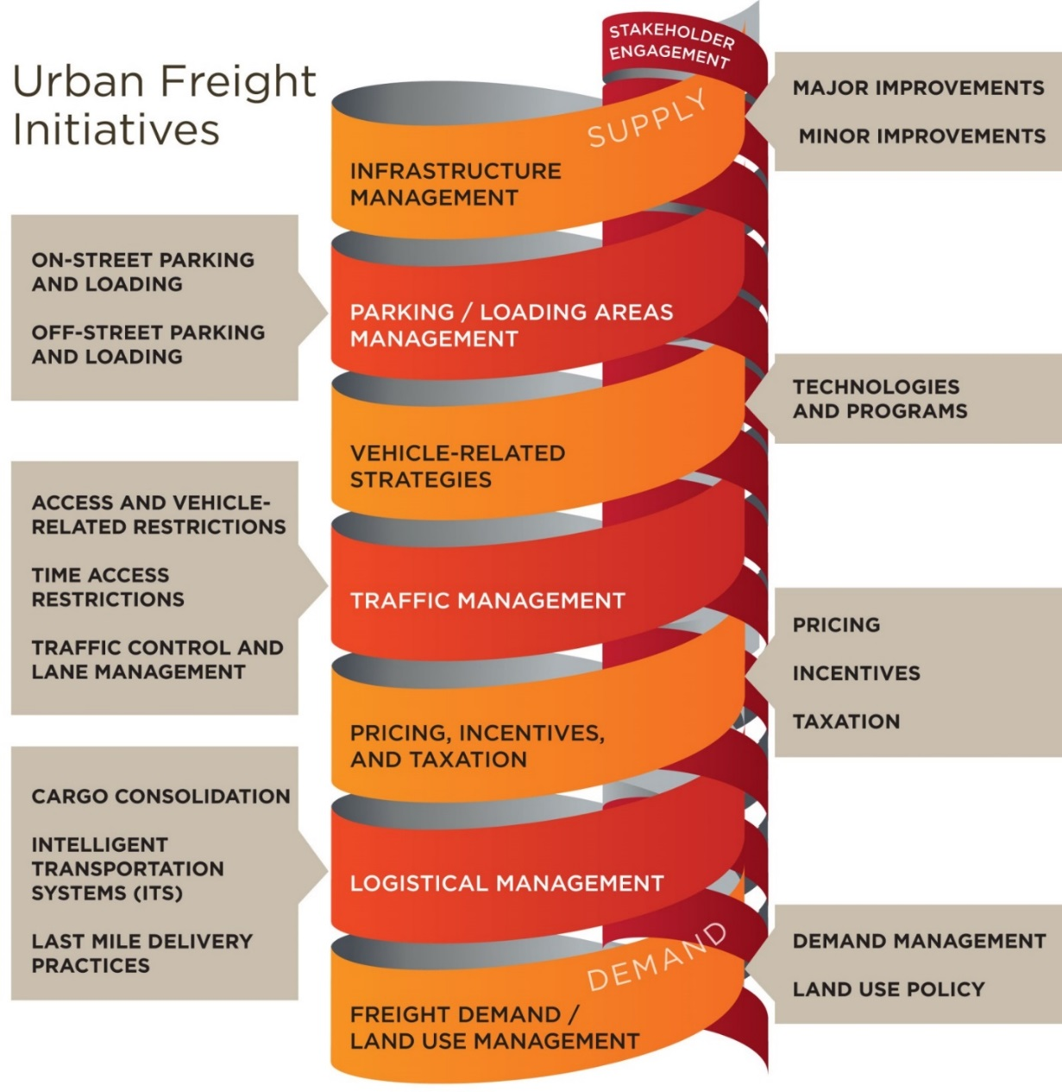
Freight Initiatives

Slide 5
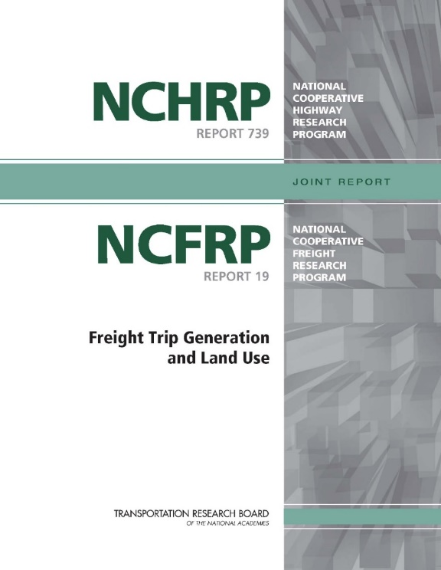
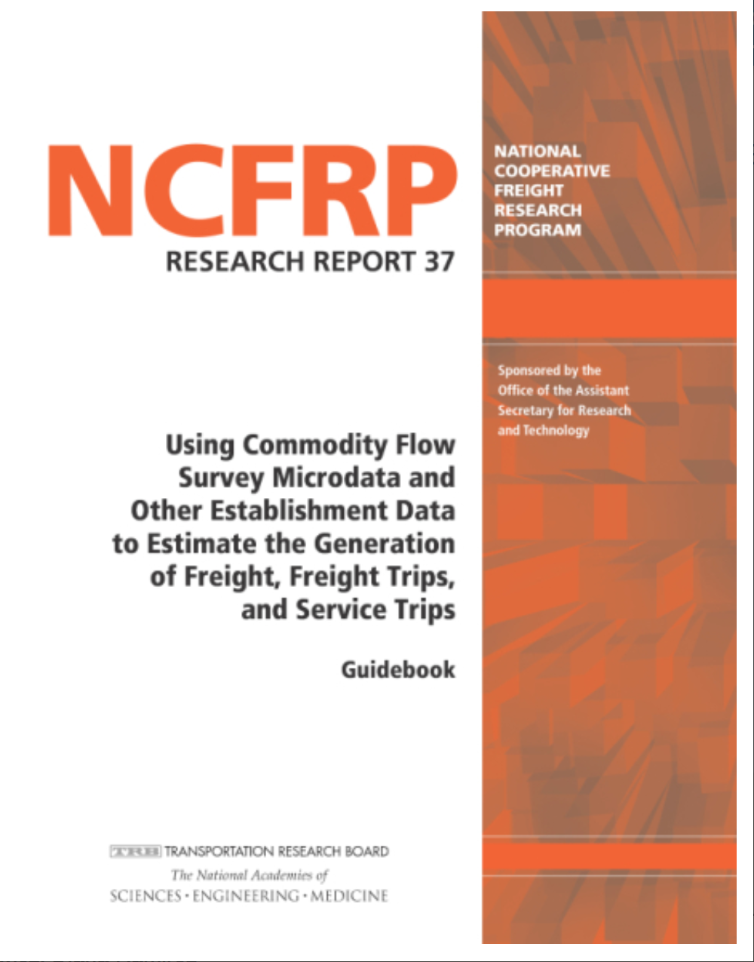
Background
For more than 15 years:
Collected thousands of surveys
Establishment level
Estimated freight-trip generation models
Establishment-level
Economic based
Developed aggregation techniques
Validated them
Good models, though imperfect
Transferable in US conditions

Slide 6
Characterization of Supply Chains
Characterized 13 different types of supply chain
Gasoline and Petroleum Fuels; Aggregate-based Construction Materials; Pharmaceutical and Biotechnology; Retail Drug Store; Hospital; Soft Drink Beverage; Urban Wholesale Food; Supermarket; Food Services; Big Box Retailers; Retail Apparel; Waste Management; Parcel Delivery
Selected from NCFRP Report 14
Identified typical facility types and mode of transport
Identified the agents involved at the various levels of supply chains (e.g., global, regional, local)

Slide 7
Parcel Deliveries
Airport
Global
International Supplier
National/ Regional
Regional Consolidation Center / Distribution Center
Airport
Supplier
Sorting Facility
Metropolitan
Airport
Drop-off Point
Local
Collection Point
Office
Home
Urban Area
Metropolitan Area
Country Area

Slide 8
Food Services
International Vendor
Global
International Gateway
Vendor Plant & DC
Domestic Producer
National/ Regional
Rail Station
International Gateway
Regional DC
Metropolitan
Broadline Warehouse
Specialize Warehouse
Satellite Yard
Local
Restaurants
Urban Area
Institution
Metropolitan Area
Country Area

Slide 9
Moving Freight-Efficient Land Use Forward
Forming new partnerships
State DOTs
MPOs
Freight Industry Representatives
Freight Researchers and Consultants
Local Land Use Planning Staff
Local Land Use Planning Resources
Knowledge of how local land use works
New regulatory and incentive tools
Freight Research Resources
New data sources
New visualizations to improve understandings of challenges and solutions

Slide 10
Relevant Land Use Initiatives
Land use initiatives identified
Regulatory Controls
Building Codes
Zoning Codes
Overlay Zones
Form-based Zones
Hybrid Zoning Codes
Discretionary Approaches
Policy Tools
Quasi-regulatory Tools
Design Guidelines
Planned Unit Developments
Subdivision Regulations
Comprehensive Plans
Master Plans
Business Improvement District
Commercial Reservation Service

Slide 11
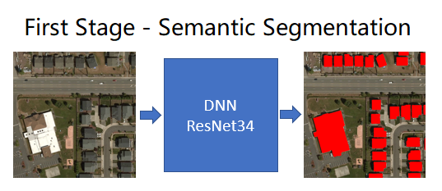
New Source of Building Footprint Data
https://github.com/Microsoft/USBuildingFootprints

Slide 12
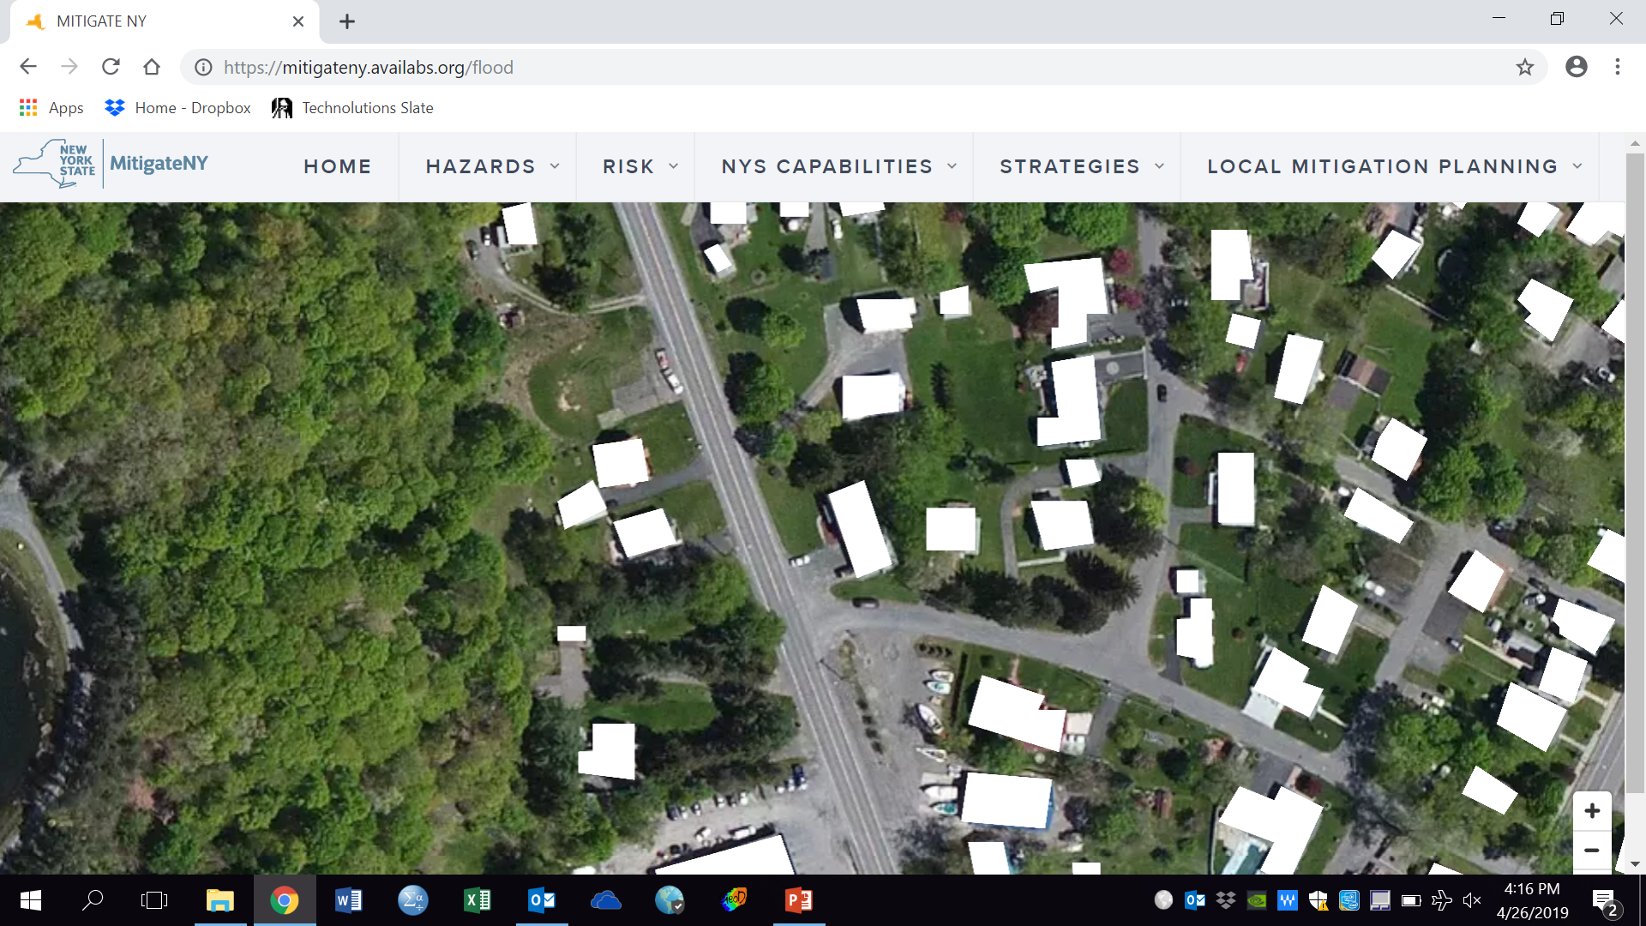

Slide 13
Benefits and Challenges
Benefits and Challenges
Uses of Footprint data:
For first and last mile analysis
Allows land use planners, transportation planners, and industry stakeholders to share understandings of the issues.
Clarifies relationships between structure and local road network when overlaid on aerial photos.
Only an image
Can be combined with GIS parcel data with attributes on properties.

Slide 14
Digitized Parcel Data/Attributes Table
Attributes can include: Property Owners, Total acreage, Year Structure Built, Tax Classification, Building Type, Square footage of built space.

Slide 15
Proprietary or State-based Employer Data
Attributes include: NAICs code, number of employees, firm address, longitude/latitude.
Can be visualized and merged with parcels.

Slide 16
Adding Freight Movements to Parcels
NCFRP Reports 19 and 37 provide estimation parameters for freight generation (FG), freight trip generation (FTG), and service trip generation (STG) using NAICS codes.
Cross-walk NAICS code information (from commercial source e.g., Dunn & Bradstreet, InfoUSA) to LBCS function codes.
Aggregate truck trip estimates to specific geographic units that inform freight movements (e.g., zones).

Slide 17
New Forms of Zoning Regulation
Use of Form-based Zoning to overcome shortcomings of traditional Euclidean (single use) zoning.
Form-based Zoning ignores or moves freight activities to the outer-edges of urbanized areas.
Hybrid Zoning includes urban freight activities and provides developers of freight-oriented structures and sites, with guidance to accommodate the needs of freight and surrounding communities.

Slide 18
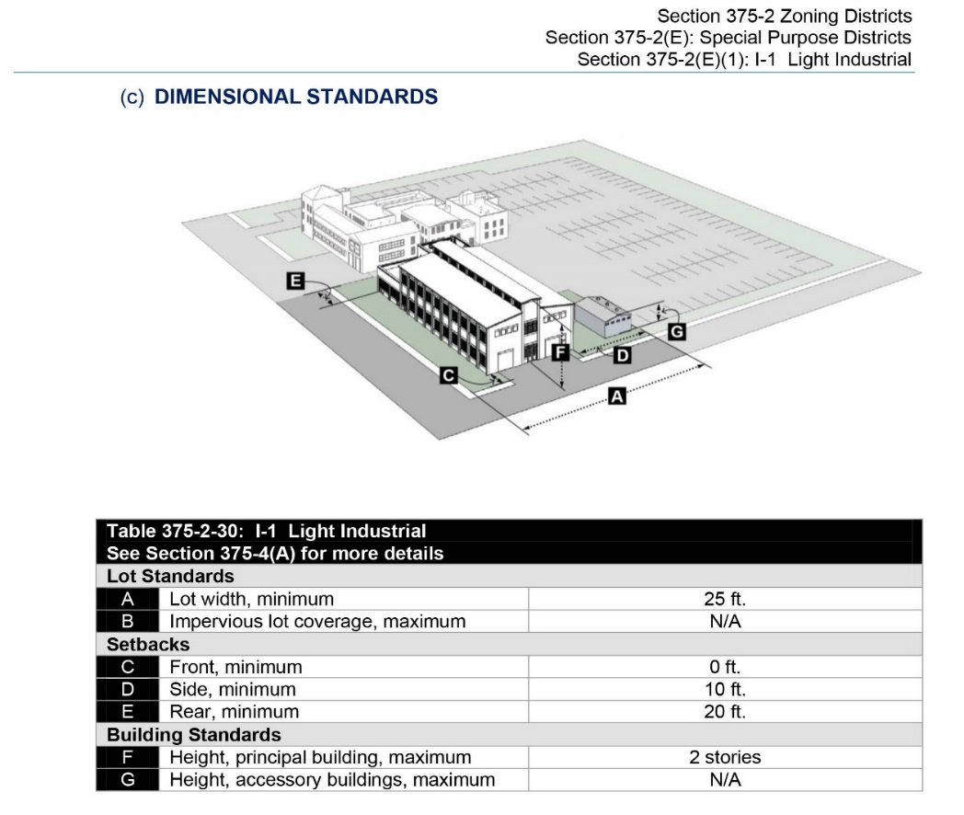
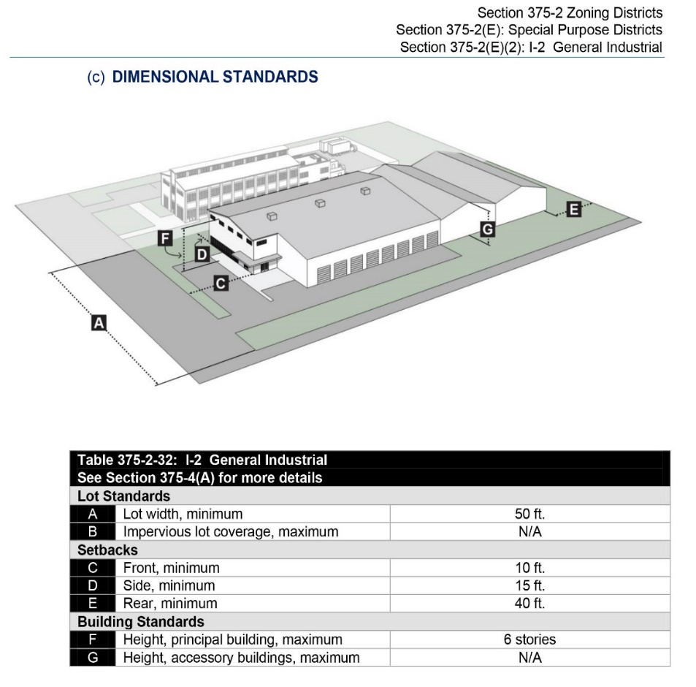
Hybrid Zoning for Active Freight Functions
Source: Clarion Associates. (2017). Albany, New York: Rezone Albany.

Slide 19
Questions?

