Slide 1
Freight Forecasting in the 21st Century—Data Needs & Why
Oregon (Portland) Metro Research Center
Jeff Frkonja, Director
June 2019

Slide 2
Agenda
Why forecast models?
How do such models work?
What data do we need for such models?
What might future models need to deal with?

Slide 3
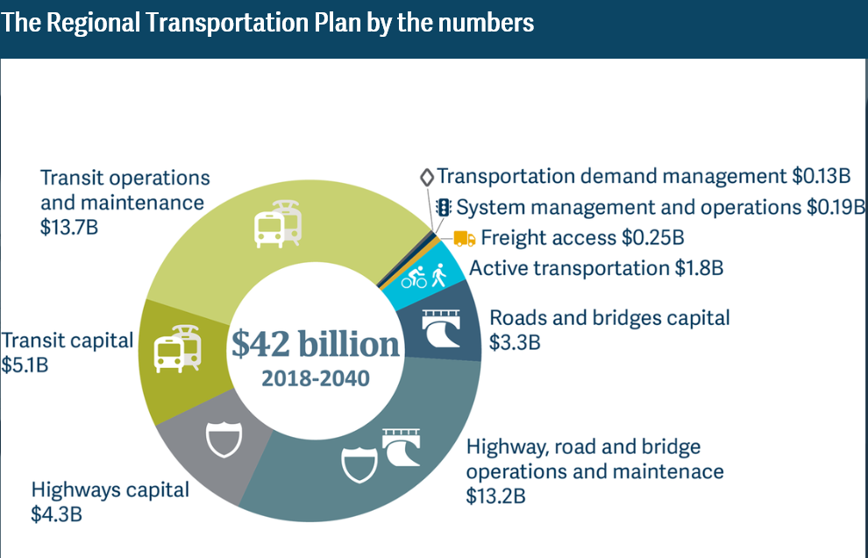
Why models?
Public sector is primary transport system investor.
Public sector investment decisions depend on federally-mandated state and regional planning.
Mandated planning depends on econometric models for decision-support.
Source: 2018 Regional Transportation Plan. Oregon Metro. 2018
Notes:
The short answer to the question is that if we’re going to spend $42 billion of the public’s money (double that in many other U.S. urban areas!) then we had better be careful how we do so.

Slide 4
Why freight sub-models?
Freight utilization is up in all modes!
Freight issues now top-of-mind:
“Retail revolution”
Curbside management
Freight infrastructure needs in a limited funding environment
Happiness…
Images courtesy of Getty, Yummy Bazaar
Notes:
Krishnan and Annie showed some great data that drives home my first point: freight utilization of the entire transport system is up.
For example, my wife orders a particular brand of Italian coffee via Amazon—her last order arrived in three different boxes from three different sources (yes, she drinks a LOT of espresso!)
If our models are going to be relevant to their future decision-support roles, they have to help us answer some key policy questions/issues.

Slide 5
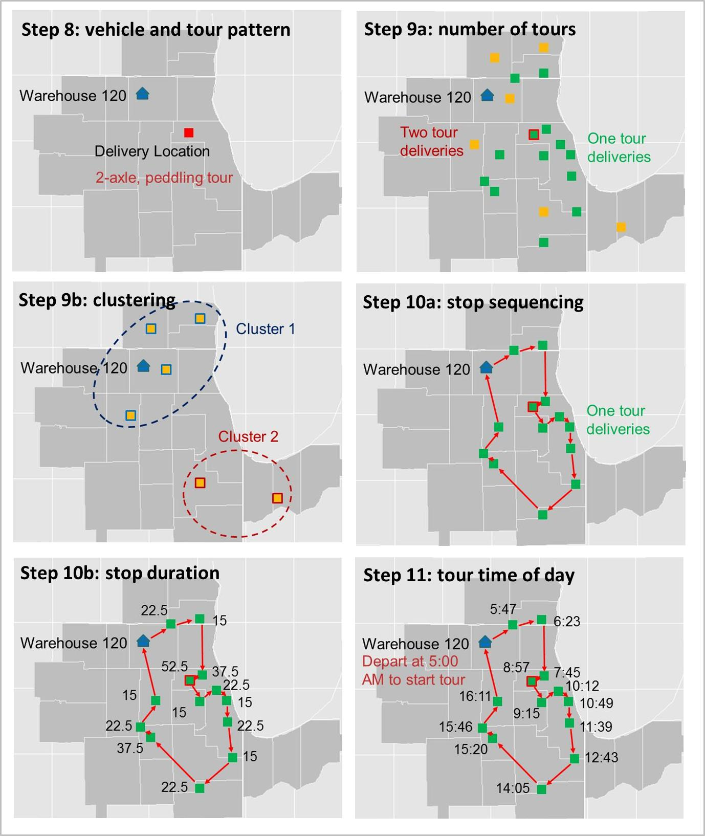
Freight models micro-simulate individual truck “tours” in a national and local context, including stops at residences for delivery
Source: Metro Freight Submodel Final Report, v12. RSG. 2018

Slide 6
What data do the models need?
Traditionally:
Establishment surveys
Carrier surveys
Intercept surveys
Traffic counts
Lots of hand waving
Images courtesy of Wikipedia, Tenor.com

Slide 7
What data do the models* need?
In the 21st Century…
Commodity flows (in detail by type, origin, destination)
Flow data for other modes (rail, air, water)
Individual truck tour data (contents, stops, routes, timing)
ATRI
E-Roads
* Regardless of model form (econometric, AI/ML)

Slide 8
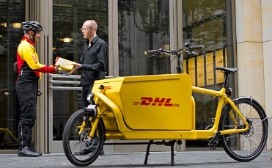
Emergent freight modes:
Private local air (Intel is already flying Hillsboro to PDX)
Bicycles (don’t laugh, it’s being done in Europe)
For-hire (e.g. Uber, Lyft)
Self-driving trucks
Drones
Speculations on future model needs
Images courtesy of Getty, Invensis

Slide 9
Jeff Frkonja Director, Metro Research Center
On behalf of the folks who did the real work:
Chris Johnson
Kyle Hauger
Bud Reiff
RSG, Inc.

Slide 10
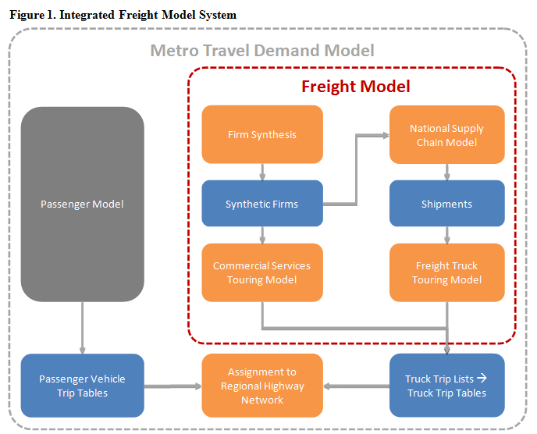
Freight models think nationally and locally
Source: Metro Freight Submodel Final Report, v12. RSG. 2018

Slide 11
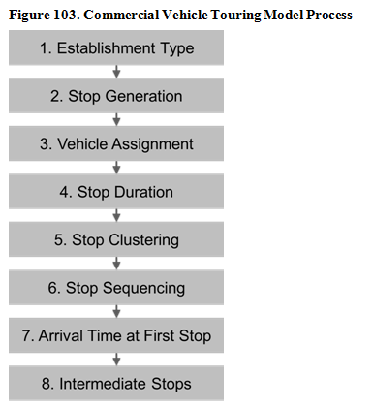
Freight models simulate last-mile delivery as part of the “Commercial Services” model element
Source: Metro Freight Submodel Final Report, v12. RSG. 2018

