Slide 1
Exploratory Scenario Planning in the Long Range Transportation Planning Process: The Atlanta Region’s Analysis Experience
17th TRB Transportation Planning Application
June 2019

Slide 2
The Atlanta Region’s Historic Growth Patterns and Low Transit Use Creates Unique Challenges
2nd Largest Geographic Urban Area in the Nation (in square miles); Lower-density in Nature
Rapid Growth Brings 90,000 New Residents Per Year (2017)
Most Residents Travel Outside of Their Home Communities to Work
Limited Transit Options Place an Overreliance on Driving Alone

Slide 3
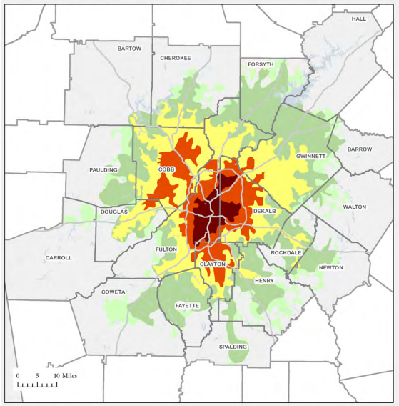
Since 1950 the Atlanta Region has Expanded Faster than Any Large Area in the Nation
Region Today
5.6 million people
2.9 million jobs
Region 2040
1950
8.1 million people
4.0 million jobs
1970
1990
2000
2010

Slide 4
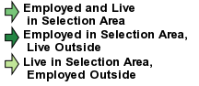
60% of Gwinnett County’s Employed Residents (over 206,000) Work Outside of the County
Source: US Census Bureau

Slide 5
There is no single path to “Win the Future”

Slide 6
Notes:
Also, our transportation planning is more inclusive than ever. So, we try to embrace with other territories such as strategic policy analysis, economic, housing, equity, water, environmental, resilience, and health, you just name it.

Slide 7
World Class Infrastructure
REGIONAL TRANSPORTATION PLAN (RTP)
RTP is a 20+ year long range plan that is updated every 4 years
Ensuring a comprehensive transportation network
Developing walkable, vibrant communities
Building the region as a global hub of innovation and prosperity
Healthy Livable Communities
Competitive Economy

Slide 8
Trips created by Demand and Supply
Demand (Population and Employment)
Supply (Network & Assignment Model)
Notes:
This is how we create demand and supply trip tables. Two aspects are all important and we have to understand the linkage.
Here is one issue I would like to stress. The transportation model is heavily depending on population and employment with small geography.
If we ask around demographer and economist, they will tell us how that future forecast is not solid.
So, again, we have to remember what we predict based on pretty unstable foundation. How much we can rely and how much confidence do we have? Well, we have think about this very seriously.

Slide 9
“Normative” scenario development process
SHIFTS IN LAND USES
EXISTING
MODEL RESULTS
NEW TRANSPORTATION OPTIONS

Slide 10
Many type of Travel Demand Models
Trip
3 Step
4 Step
Hybrid
Hybrid-Tripbased
Hybrid-Tourbased
Tour
Aggregated Simple Tour based
Disaggregated Tour based
Activity
Standard
Advanced 4 step
Enhanced
Advanced
Notes:
There are many types of travel demand models. There is not one perfect model design. It has to be good for your purpose and needs.
The most important element is how we understand and we use the tool wisely.
My humble opinion, any model form is good as long as we understand the result and use that data well.

Slide 11
Notes:
We are very well aware of accelerating growth in technology. Given the speed of this fast technology changes, we all have to admit that we can’t predict future for 20 or 30 years later.
No model is good enough for this no matter the tools and data.

Slide 12
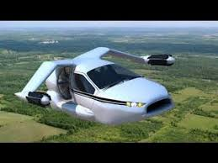
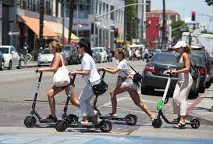
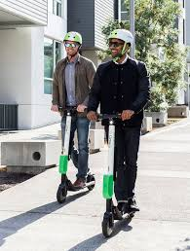

Slide 13
Exploratory Scenario Planning
Allows us to look at current and projected issues from multiple perspectives so our plans are dynamic and resilient.

Slide 14
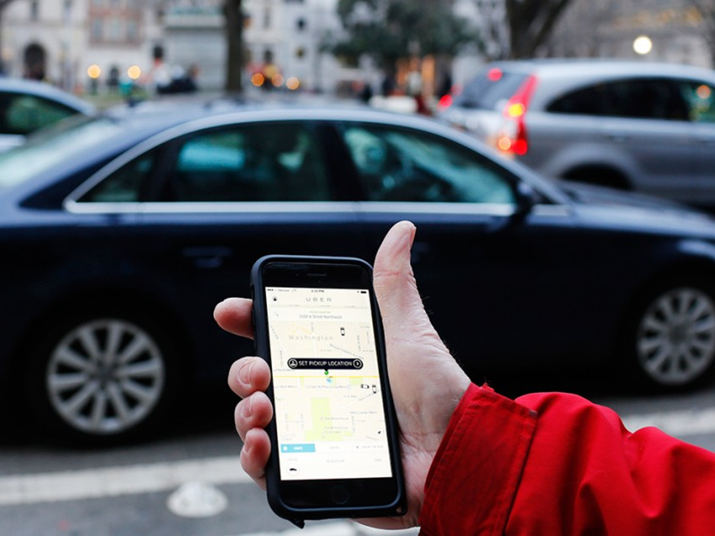
Key themes from Stakeholder Advisory Committee
Mobility options are changing/expanding with advent of autonomous vehicles and ride hailing services
New business models are disrupting transportation logistics
Migration patterns are increasingly more complicated and impactful

Slide 15
Key Drivers of Change for the Atlanta Region
Water Supply
Autonomous Vehicles
Climate Change Regulations
Aging of the Population
Transportation Finance Structure
Intelligent Infrastructure/Technology
Spatial, Racial, and Economic Equity
Port Traffic
Ridehailing/
Carsharing
Notes:
These are the nine key drivers…

Slide 16
Drivers Woven Together to Form Alternate Futures
?
Notes:
4 alternate futures that echoed the framework of Impacts 2050 but created futures for the Atlanta region

Slide 17
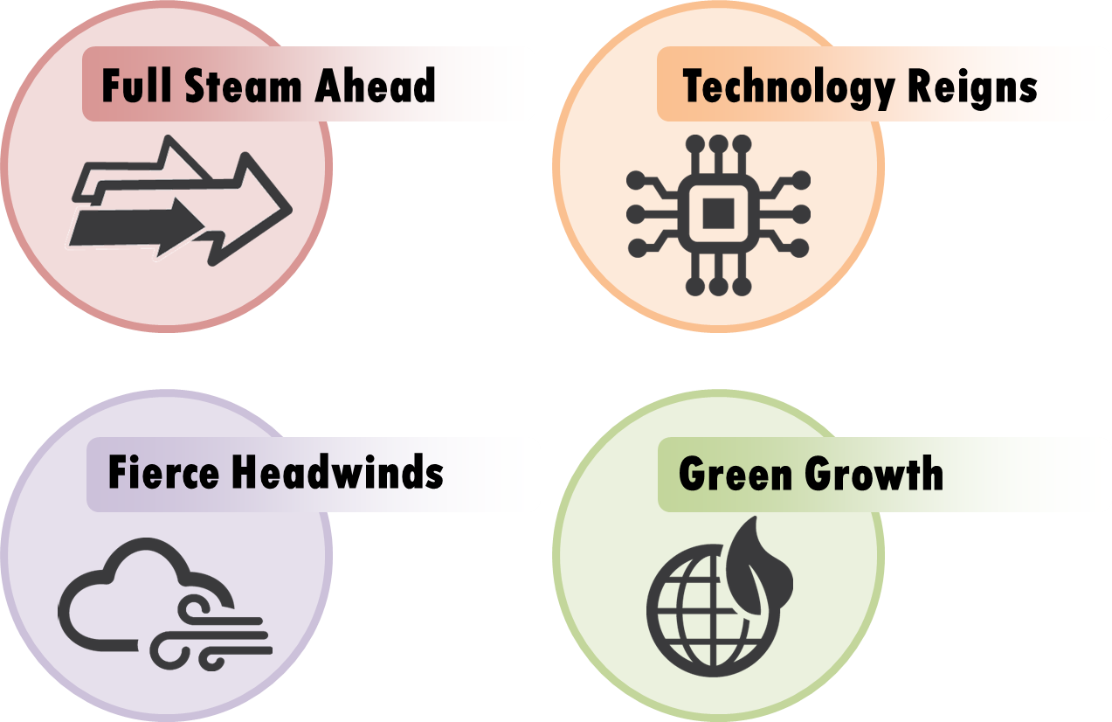
Identifying relationships between drivers is key to the development of alternate futures

Slide 18
Four Alternate Futures (2050) for the Region
FULL STEAM AHEAD
FIERCE HEADWINDS
TECHNOLOGY REIGNS
GREEN GROWTH

Slide 19
Alternate futures analyzed
4
Baseline alternate futures
324 vs. 2
4
Key variables
Arterial lane miles
Transit service
Autonomous vehicles and car service use
Congestion charges
3
Settings per variable
Alternate futures to explore
High
Medium
Low

Slide 20
Analysis process
Annual CO2 Emissions
(total and per capita)
Transit ridership
(total and per capita)
Walking/bicycling trips
(total and per capita)
Annual hours of delay
(per capita)
Vehicle miles traveled
(per capita)
Vehicle operating cost
(per capita)
Social cost of transportation
(per household)
324
Alternate Futures
RSPM

Slide 21
The actual future? Nobody knows.
Plausible Futures
Actual Future (?)

Slide 23
Personalized Alternate Futures
Notes:
We plan to use the scenario planning exercise and today’s conversation to begin to inform the planning process for the next long range plan update in 2020. However, we hope to expand the conversation beyond this building. With this in mind, we are planning to launch an online scenario planning visualization game…

Slide 24
Kyung-Hwa Kim
kkim@atlantaregional.org
470-378-1562
Performance Analysis and Monitoring Manager
Atlanta Regional Commission

