Slide 1
Use of a Response Surface Model to Quantify Forecasting Error Intervals for Disparate Impacts Analysis
John Gliebe, Boston MPO
June 4, 2019

Slide 2
Background
Long-range transportation plan (LRTP) disparate impact disproportionate burden (DIDB) policy
Applies to set of projects in LRTP as a group
Could the build scenario adversely affect minority and/or low-income populations?
2018: 3 working group mtgs, 1 public workshop
Set of metrics to measure impacts
Account for uncertainty in forecasts

Slide 3
Potential Metrics
Accessibility (highway and transit)
Jobs
Retail amenities
Healthcare facilities
Higher education
Mobility (highway and transit)
Average travel time
Environmental (highway)
Congested VMT
Carbon monoxide

Slide 4
Why Study Uncertainty?
Does the difference between no-build and build scenarios exceed the statistical error in the regional forecasting model?
“It's tough to make predictions,
especially about the future.” ― Yogi Berra

Slide 5
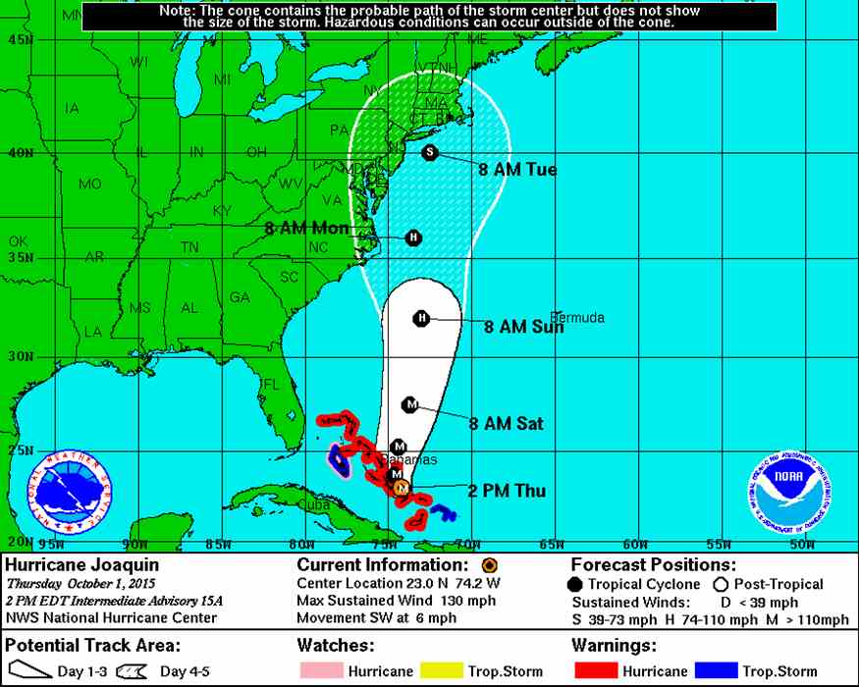
Uncertainty in Forecasting
Cone of Uncertainty

Slide 6
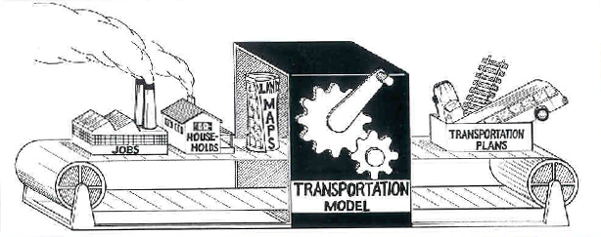
Sources of Uncertainty in Regional Travel Forecasting
Forecasting human behavior!
Projecting to the future! (2040)
Model is a complex assembly of data inputs, assumed behaviors, statistical relationships, and algorithms
Notes:
1. Demographics (HH, Jobs)
2. Costs/Payment
3. Response sensitivity (mode bias, VOT, OVT, peak spreading)
4. Transit service frequency
5. System capacity assumptions (lanes, pkg, tran, VDFs)
6. Trip generation rates

Slide 7
Effect of Uncertainty on Metrics Relatively “High” Variance
-/+ 25%
-/+ 7%
“High” Variance

Slide 8
Study Steps
1
Identified 18 key drivers of
regional model uncertainty
2
Ran experiments varying
key inputs, collected metrics
3
Estimated meta models
from results of experiments
4
Made 1000s of predictions
using meta models
Derived forecasting error
intervals from predictions
5

Slide 9
Example of Estimated Meta Model
Average Highway Travel Time in Minutes for Low-Income and Non-Low-Income Groupings
Linear regression

Slide 10
Example of Simulated Predictions
Average Highway Travel Time in Minutes for Low-Income and Non-Low-Income Groupings
-13.1%
-13.1%
Number of simulated outcomes
-13.3%
+13.3%
Minutes per trip
Forecasting error interval

Slide 11
Hypothetical: Travel Time for Minority Population
No-build scenario output
Build scenario output
5 min.
0
5
10
15
20
25
15 percent (forecasting error) X 20 minutes = 3 minutes
Is 5 minutes > 3 minutes? Yes. Projected impact.

Slide 12
Discussion
Produced forecasting error intervals to be “plugged” into the policy analysis framework
Not all metrics are useful for determining statistically significant impacts—large uncertainty
Not all inputs are useful for modeling uncertainty—some revealed to have little impact on results

Slide 13
Questions

Slide 14
Reserve Slides

Slide 15
Technical Details
Normalized inputs as -/+ % delta from starting values
Latin hypercube sampling
Model input setup and output scripts linked to sampling plan variables
Triangular distributions for simulation

Slide 16
18 key inputs (drivers of uncertainty)
Auto operating costs
Transit fares
Toll costs
Value of time
Household sizes
Job locations
Transit mode bias
Walk/bike mode bias
Trip length sensitivity
Transit wait/walk sensitivity
Transit service frequency
Park-and-ride lot supply
Roadway capacities
Congestion-delay sensitivity
Peak spreading factors
Work trip generation
Non-work trip generation
Truck trip generation

