Slide 1

Consistency Guarantee of Transportation Modeling Calibration and Validation Using Multi-Source Data in a Computational Graph Approach
Xuesong Zhou, xzhou74@asu.edu
School of Sustainable Engineering and the Built Environment
Arizona State University, USA
Co-author:
Postdoc scholar at ASU: Dr. Xin Wu;
Southeast University, China： Dr. Qixiu Chen
Notes:
Good morning everyone. Thanks, chairman,
It’s my honor to be here. Firstly, I apologize that Dr. Xuesong Zhou cannot be here due to a temporary change in his arrangement.
Let me introduce myself. My name is Wu Xin. I am a postdoc researcher from Arizona State University, I arrived at the USA and joined the Team of Dr. Zhou last year. I am very happy to be here and have the chance to introduce our recent progress of two basic methodologies developed for future data-driven traffic management.

Slide 2
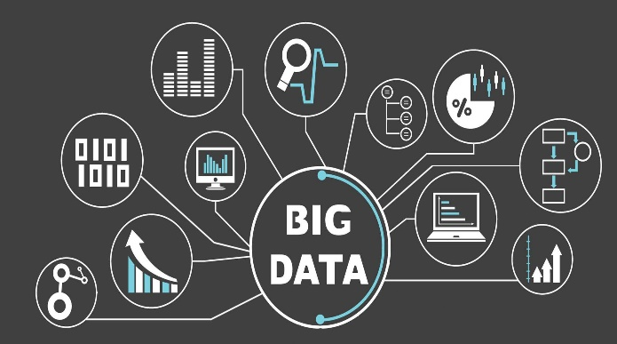

C
ontents
1. How to consistently use heterogeneous data sources to estimate traffic demand and obtain reasonable estimates
Challenges in planning modal calibration with multiple data sources
What is Deep Learning from our model calibration perspective?
What is layered computation graph anyway?
Why we need a new type of volume delay function?
Steps for developing BPR-X function in our model calibration
2. How to use Surveillance data to calibrate a volume delay function with dynamic characteristics.
Notes:
Our two key problems that will be discussed today is as follows:
1. How to consistently use heterogeneous data sources to estimate traffic demand
2. How to use Surveillance data to calibrate a volume delay function with dynamic characteristics.
The first problem is a critical part of this presentation. The second problem is about some latest research interest of our team.

Slide 3
Challenges in planning modal calibration with multiple data sources
Notes:
Firstly, let us show some challenges in data-driven planning.

Slide 4
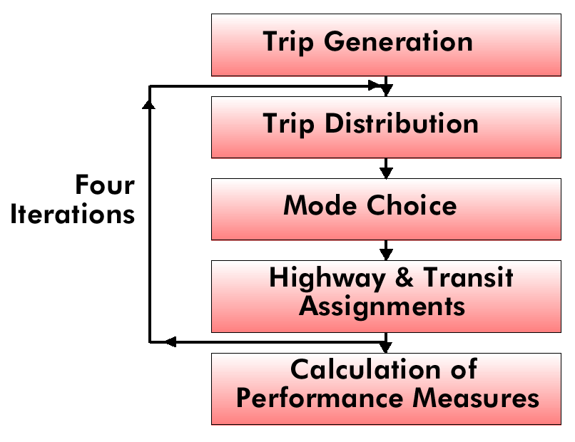
4-step process in transportation modeling field
Land use
Zonal Demographics
Highway and Transit
Network Development
Employment by type
# of HH
HH by size, income
auto availability
Travel Time Matrix TT_{i,j}
Spatial distribution of population and employment
HH income
Auto availability
HH size
Parking cost
Notes:
In the field of transportation modeling, travel demand is represented sequentially by 4-step traveler choice decisions:
trip generation, trip distribution, mode split, and traffic assignment.
Traditionally, the household survey data are usually used in trip generation step.
Feedback of travel time is usually required to update it.

Slide 5
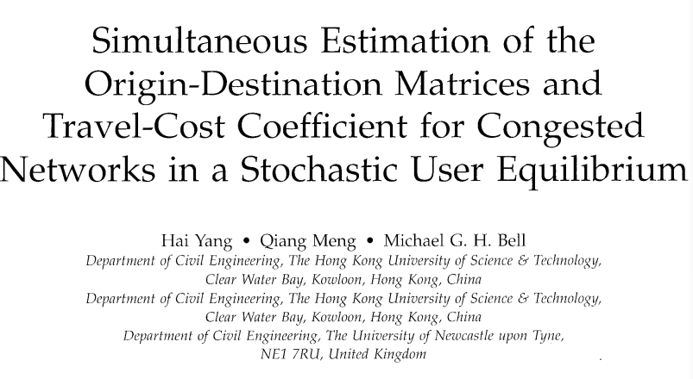
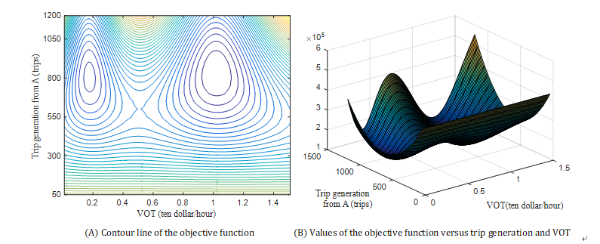
Is a combined analytical 4-step model easy to calibrate?
Traffic demand flow estimation (TDFE) problem (Simultaneous estimation problem of traffic demand flows and behavior coefficients) using different data sources:
  Sequential step methods:
  1.Linear regression model; Fundamental units
  2. Gravity model; ODME problem
  3. Traffic assignment/ Stochastic network loading
  4. Discrete choice model
  A. Usually only use single data sources for each step
  B. Sequential decisions without feedback
Different levels of demand variables
Data sources
Trip generation
Spatial distribution
Route choices
Behavioral utilities
Traditional Survey
Big data sources
Non convex
Hard to solve
Notes:
It is a very big challenge to built up a comprehensive model to integrate the four steps and the feedback until now.
Traditionally, the four steps often use different types of model
In literature, the reason for the difficulty is caused by a problem of non-convexity, which means the objective function has multiple local minimums and cannot know which one is the global minimum.

Slide 6
Why do we need to integrate different types of data sources in the integrated model？
Survey methods used in current planning practice do not provide up-to-date time-dependent demand inputs
Emerging sensing technologies
Trip generation
Residential Survey
Trip distribution
Cell Phone Data
Advanced surveillance technologies offer more reliable and less costly channels to provide real-time traffic flow measurements with different data structures
Floating Car Data
GPS Data
Behavior and Dynamic Traffic state
estimation
Path flow
Different types of data correspond to the different levels of demand variables
Link flow
Sensor Count Data
Data fusion
Multiple Big Data Sources with different data structures
Notes:
Now the difficulty might be solved using the emerging big data sources to improve the observability of our traffic systems. Faced with multiple data sources from the emerging big data environment, planners critically need a consistent framework to structurally estimate different layers of travel demand by integrating different types of data sources.
The data sources include household data, cell phone data, floating car data, (Or GPs trajectory data), and sensor data
There are two new pieces of knowledge we can know:
A. The first is that compared with other data sources, survey data have some disadvantages. But the new data can provide more real-time and detailed information. However, it should also be noted that the traditional household data are also important, as it can provide more geographic and demographic characteristics of travellers .
B. We find that the resolutions of the data are quite different, which might correspond to different levels of traffic demand variables

Slide 7
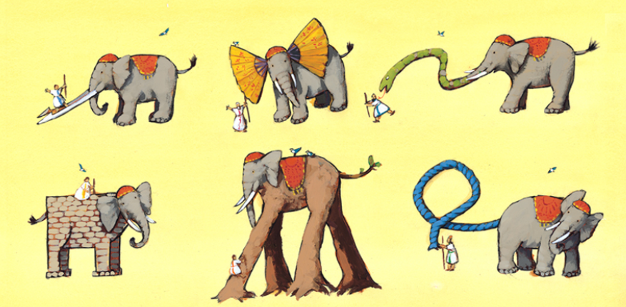
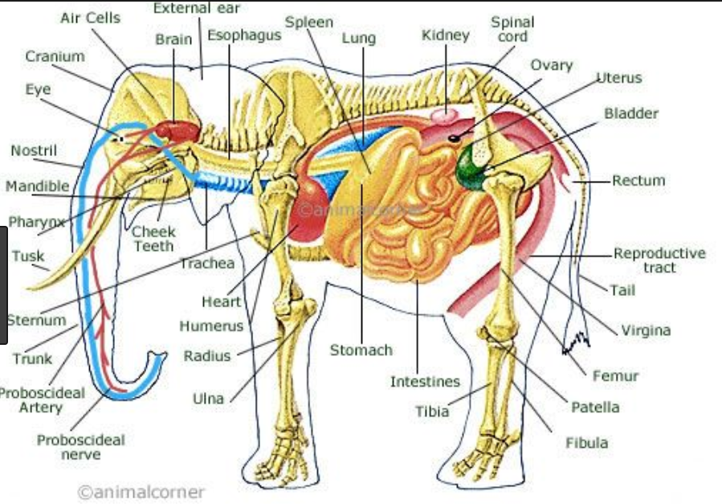
What kinds of models do we need in model calibration?
Integrate domain knowledge with different traffic measurements
Automatic Vehicle Location
Domain knowledge from transportation modeling
Household
Surveys
Smart card data
Cell phone data
Social location data
Loop detector data
Simultaneous models to estimate different levels of traffic demands (trip generation, trip distribution, route choices etc.)
Data driven models that can integrate different data sources.
Explainable models that combine emerging technologies with domain knowledge in transportation modeling.
4. An iterative framework includes both a feed forward and feedback process.
Notes:
Then What kinds of models do we need? We listed four points.
● Simultaneous models to estimate different levels of traffic demands including trip generation, trip distribution, route choices, traffic assignment and so on
● We want it o be a data-driven model that can integrate use different data sources.
● Explainable models with domain knowledge in transportation modeling.
● An iterative framework includes both a four-step progress and feedback process.

Slide 8
What is Deep Learning from our model calibration perspective?
Notes:
Then I will introduce what we learn from the community of AI

Slide 9
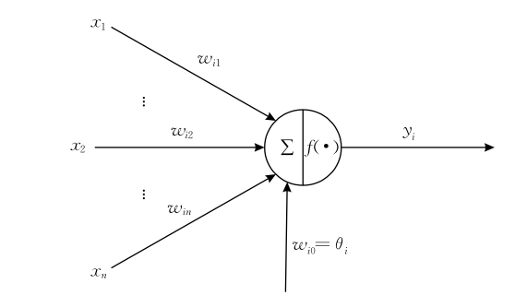
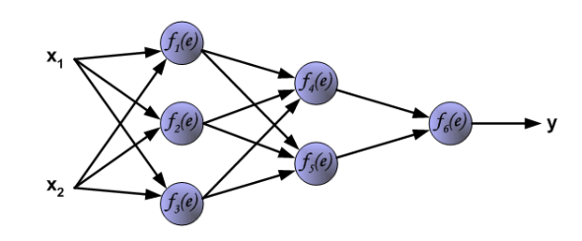
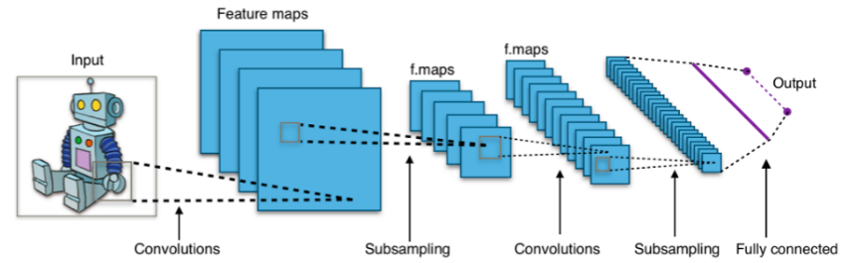
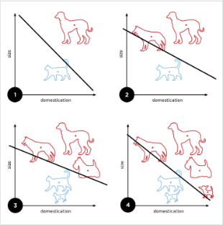
What can we learn from AI field?
1. Hierarchical structure of artificial neural networks
Brief history of deep learning
McCulloch-Pitts (1943)
Neuron of brain function
Rosenblatt
(1956)
Perceptron ADA-LINE
Stochastic gradient descent
Rumelhart et al.
(1986)
Multi-layer distributed representation
Back propagation algorithm
Hinton et al.
(2006)
The last ten years Convolutional networks
Sensor observations
Links
Paths
Zones
Can we think like this?
ODs
Figure source: http://galaxy.agh.edu.pl/~vlsi/AI/backp_t_en/backprop.html
Notes:
Here is a very brief history of deep learning
We find that the neural network actually has a very old history and revived in this century because of the development of application of convolution neural network in visual identification.
Here we focus on the very old framework that was developed in 1986
Which is the distributed and layered representation of neural networks?
Here is the layered network
Our thought is: we can treat the first layer is zones of trip generation, the second layer is OD pairs, and, the paths which pass the links. The outputs of the neural network are actually the observations provided by different traffic measurements
Can we think it like this?

Slide 10
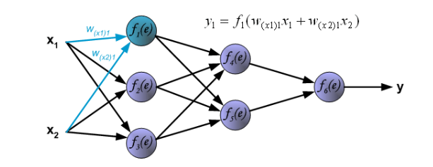
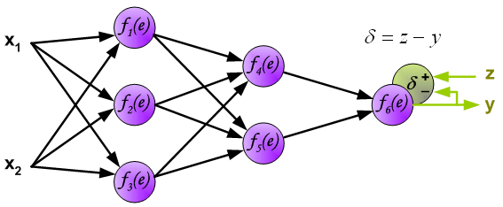
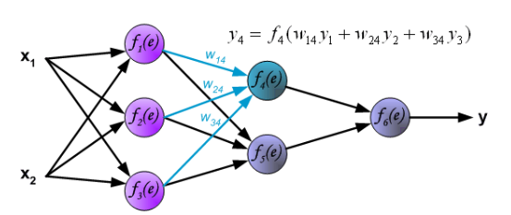
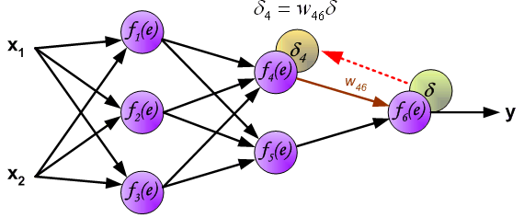
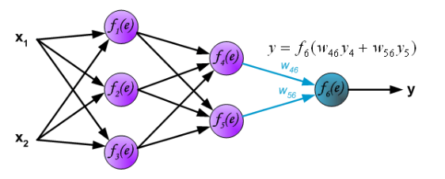
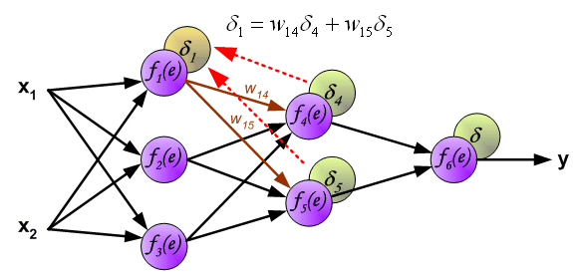
2. Forward and Backward propagation
Forward propagation
Backward propagation
Source: http://galaxy.agh.edu.pl/~vlsi/AI/backp_t_en/backprop.html
Notes:
There is a very famous algorithm, called forward passing and backward propagation.
Then the forward passing can be served as the traditional four-step process. The flows are assigned layer by layer.
the backward propagation is the feedback process. The error signals can be propagated layer by layer in a backward fashion.

Slide 11
Example of our thought
Notes:
Here is an example of there are 4 nodes
The person travels from node I to node 2 and node 4,
Then the paths pass through the links

Slide 12
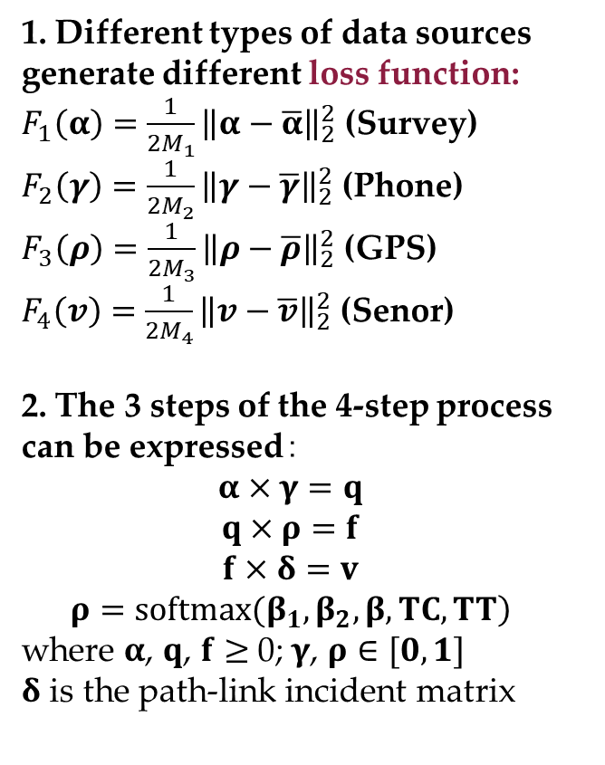
Explainable representation in an explicit form
1. Different types of data sources generate different loss function:
$F_{1}\left(α\right)=\frac{1}{2M_{1}}{\left\|α−\overline{α}\right\|}_{2}^{2}$ (Survey)
$F_{2}\left(γ\right)=\frac{1}{2M_{2}}{\left\|γ−\overline{γ}\right\|}_{2}^{2}$ (Phone)
$F_{3}\left(ρ\right)=\frac{1}{2M_{3}}{\left\|ρ−\overline{ρ}\right\|}_{2}^{2}$ (GPS)
$F_{4}\left(v\right)=\frac{1}{2M_{4}}{\left\|v−\overline{v}\right\|}_{2}^{2}$ (Senor)
2. The 3 steps of the 4-step process can be expressed$：$
$$α×γ=q$$
$$q×ρ=f$$
$$f×δ=v$$
$$\left.ρ=softmax(β_{1},β_{2},β, TC,TT\right)$$
where $α$, $q$, $f$ $≥$ 0; $γ$, $ρ∈[0,1]$
$δ$ is the path-link incident matrix
We can directly use forward and back propagation algorithm to solve it
How to incorporate more complex behavior models in the structure?
Notes:
Then we can map different types of data on the structure.
The trip generation layer is mapped by household survey data
The od distribution layer is mapped by cell phone data. After map matching.
As we cannot know the traffic mode of the cell phone data, we use the od split rate of data to do calibration
The path layer can be mapped by float car data to know some path proportion.
The link layer can be mapped by sensor data.
These are the error function
The network can be expressed easily by the constraints

Slide 13
What is layered computation graph anyway?
Notes:
Actually, we can directly solve the optimization model using
forward and back propagation algorithm in the field of deep learning
Further, if we want to incorporate more complex behavior models in the structure? For example, the logit model and so on.

Slide 14

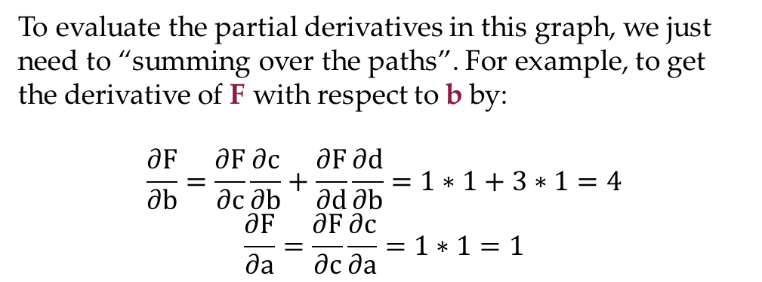
How to incorporate more complex behavior models in the structure?
Our secret weapon: Computational graph approach
An acyclic graph to express composite mathematical formulations
(A generalization of Artificial Neural Network )
A technique for calculating derivatives quickly
(A generalization of Back propagation algorithm)
To evaluate the partial derivatives in this graph, we just need to “summing over the paths”. For example, to get the derivative of F with respect to b by:
$$\frac{∂F}{∂b}=\frac{∂F}{∂c}\frac{∂c}{∂b}+\frac{∂F}{∂d}\frac{∂d}{∂b}=1∗1+3∗1=4$$
$$\frac{∂F}{∂a}=\frac{∂F}{∂c}\frac{∂c}{∂a}=1∗1=1$$
Adapted from ：http://colah.github.io/posts/2015-08-Backprop/
Notes:
We can solve it using the tool named computational graph
The computational graph is a graph to express composite mathematical formulations
Many machine learning method, such as support vector, neural network, and also traditional logistic regression and linear regression are in nature computational graphs.
The computational graph can be used to decompose a complex mathematical optimization function into a series of elementary operations and then calculate the derivatives quickly.

Slide 15
Layered computational graph
Big data driven Transportation Computational Graph (BTCG)
Notes:
This is the computational graph of the hierarchical model.
A little complex? Actually not, it now can be built up simply using tensor flow developed by Google to solve it

Slide 16
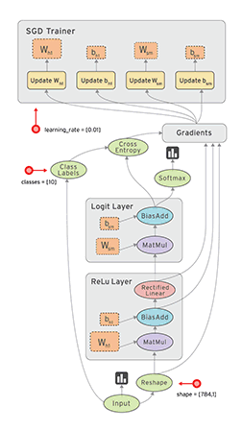
Big data driven transportation computational graph (BTCG) to implement back propagation algorithm
Automatic differentiation (AD) is a method to calculate the derivatives of the loss function with respect to the demand variables in a BTCG .
Derivatives were derived in a computational graph, using principles of dynamic programming (DP) (like calculating the shortest path using label correcting algorithm).
Gradient descent with Back Propagation (BP) algorithm is not guaranteed to find the global minimum of the error function. However, multi-sample-based stochastic gradient descent (SGD) can be used to overcome the limit to some extent.
“AD+DP+BP” can be achieved easily using existing popular data programming tools such as TensorFlow, Theano etc.
An illustrative computational graph from:
https://www.tensorflow.org/guide/graphs?hl=zh-cn
Notes:
The key technique in Computational graph is automated differentiation (AD)
Gradient descent with Back Propagation (BP) algorithm \
can be achieved easily using existing tools such as tensorFlow
modularization

Slide 17
Case 1: Sioux Falls network
Survey data(5 samples)
Cell phone data(20 samples)
Floating car data(7 samples)
Sensor data(13 samples)
Convergence curves
Notes:
We have done a case study using the network of SF. The household data, cell phone data float, and sensor are assumed hypothetically.
This is the convergence curve

Slide 18
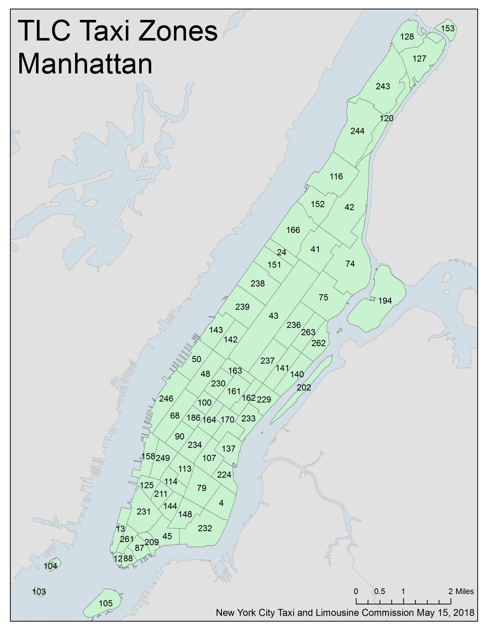
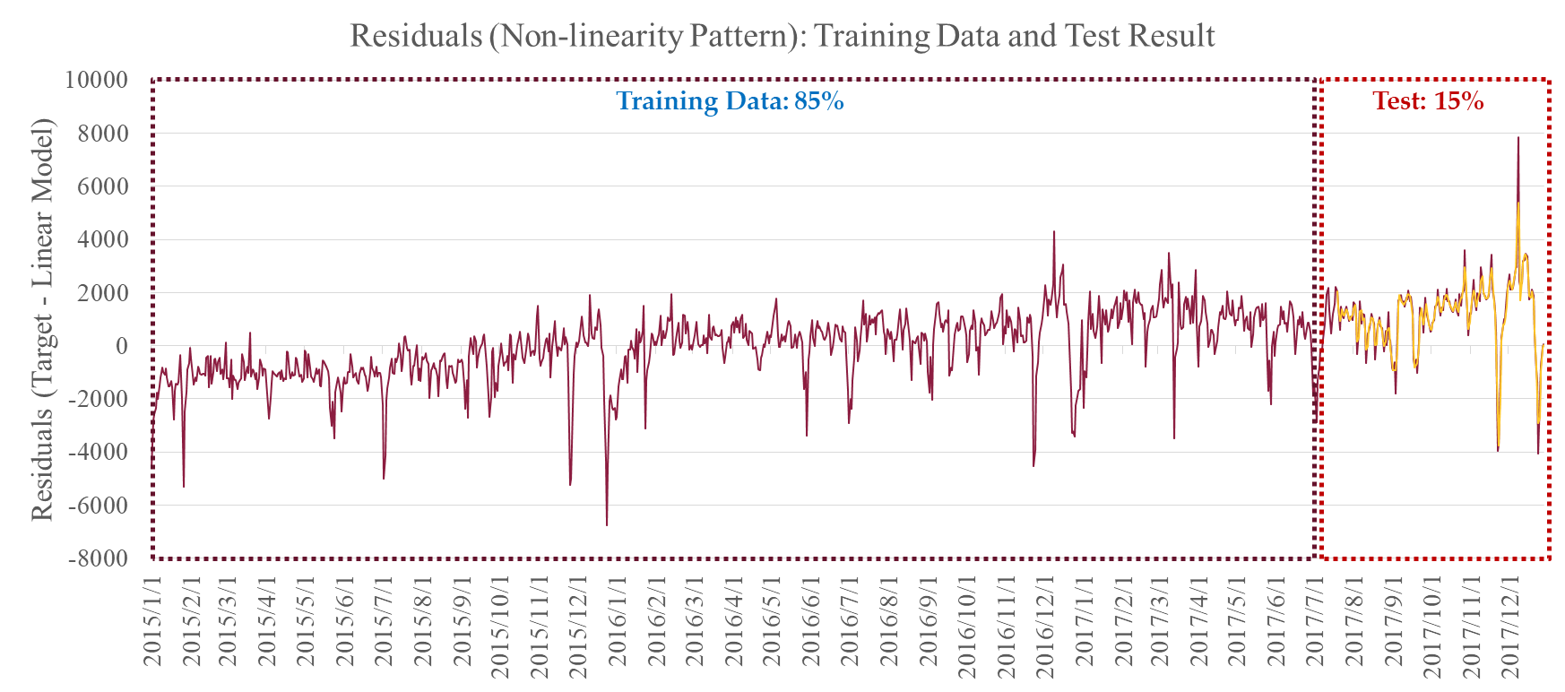
Case 2： New York
Three Years Total Trips Transition in Murray Hill, Manhattan
 | Market Segment
Mobility Service | Yellow Taxi | For-hire Vehicle
2015 | 84.65 % | 15.35 %
2016 | 73.11 % | 26.89 %
2017 | 64.19 % | 35.81 %
170: Murray Hill
In collaboration with the team of Dr. Ram Pendyala from ASU
Notes:
We now attempt to do the case study based on the real-world data from Newyork
We are now collaborating with the team of Dr. Pendyala from AS, as they have the household survey data and some taxi data.
The paper will be submitted soon.

Slide 19
Why we need a new type of volume delay function?
BPR-X function
Notes:
Now I want to change to another topic. We are doing in recent days
Which is name a new BPR functions
We call is BPR-X funtion

Slide 20
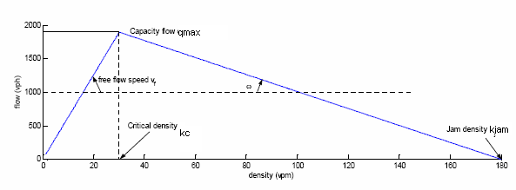
Volume-delay function (VDF)
BPR volume-delay function
  Widely used in static traffic assignment
  Fail to capture queue evolution, building-up, propagation, dissipation
  Fail to represent a bottleneck with low flow but high travel time
Notes:
we widely use BPR volume-delay function in static traffic assignment
But it actually have some drawbacks
Fail to capture queue evolution and its propagation
Fail to represent a bottleneck with the low flow but high travel time shown in fundamental diagrame

Slide 21
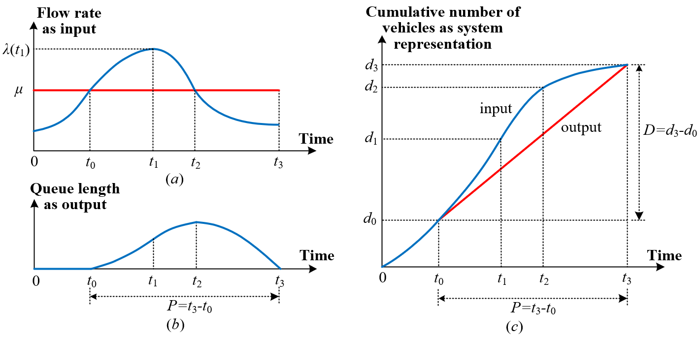



Model
Newell (1982) (Second order for inflow rates)
  Assumption: quadratic inflow rate $λ\left(t\right)=λ\left(t_{1}\right)+λ′\left(t_{1}\right)∙\left(t−t_{1}\right)+\frac{λ^{′′}\left(t_{1}\right)}{2}{(t−t_{1})}^{2}$
= 0
= -ρ
Cubic form: Third order for inflow rates
$$λ(t)=λ(t_{1})+λ^{′}(t_{1})(t−t_{1})+\frac{1}{2}λ^{″}(t_{1}){\left(t−t_{1}\right)}^{2}+\frac{1}{6}λ^{‴}(t_{1}){\left(t−t_{1}\right)}^{3}$$
= 0
= -γ₁
= -γ₂
$$λ^{′}(t1)=0$$
$$λ\left(t\right):inflow rate at time t$$
$t_{0}:$start time of congestion period
$t_{1}$: time index with maximum inflow rate
$t_{2}$: time index with maximum queue length
$t_{3}$: end time of congestion period
μ: discharge rate (or capacity)
P: congestion duration, which equals to $t_{3}$- $t_{0}$
D: total demand during the whole congestion
period, which equals to μP
Notes:
Our idea is to directly calibrate the cumulative arrival and departure curves
We assume that the curve of the inflow rate is the blue line
And the curve of the outflow rate is the read line
Here the red line is a constant, which means the capacity is not changed
This is the cumulative inflow and outflow curves
The slopes of the curves are the inflow rate and outflow rate
The difference between inflow and outflow is the queue length
Then we directly use a polynomial function to calibrate the curve inflow rate
Newell actually have done it good using the second order function
We can also use the third order function or cubic form

Slide 22
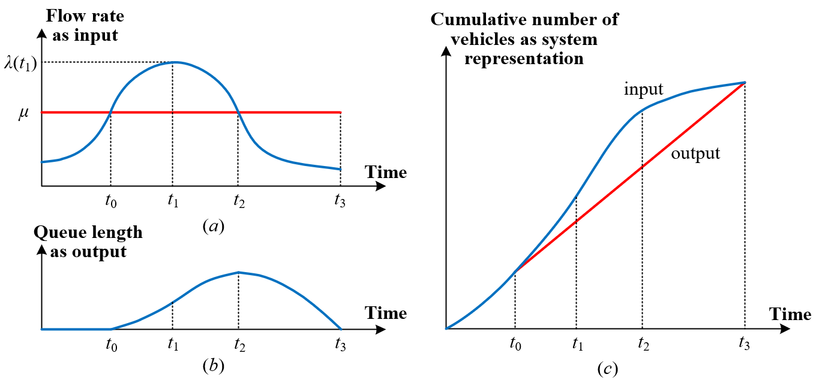
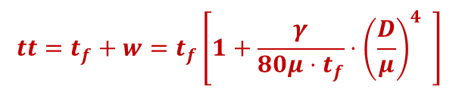
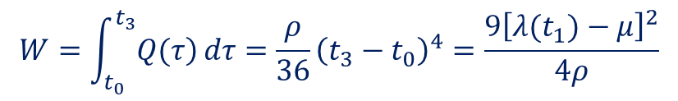


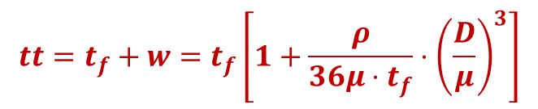
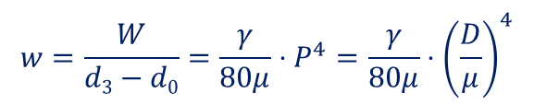
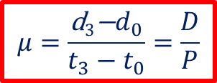
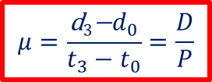
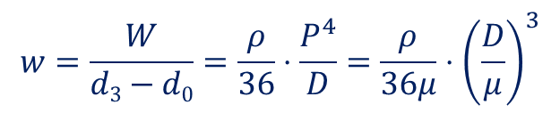
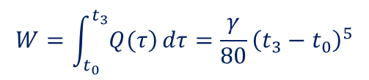
Model: Second order for inflow rates
Newell (1982)
  Total delay: W
$$W=\int_{t_{0}}^{t_{3}}{\left.Q(τ\right)}dτ=\frac{ρ}{36}{\left(t_{3}−t_{0}\right)}^{4}=\frac{9{\left[λ(t_{1})−μ\right]}^{2}}{4ρ}$$
$$w=\frac{W}{d3−d0}=\frac{ρ}{36}⋅\frac{P^{4}}{D}=\frac{ρ}{36μ}⋅{\left(\frac{D}{μ}\right)}^{3}$$
$$μ=\frac{\text{d}\text{3}\text{−}d_{0}}{t_{3}−t_{0}}=\frac{D}{P}$$
Average delay:
Average travel time function:
$$tt=t_{f}+w=t_{f}\left[1+\frac{ρ}{36μ⋅t_{f}}⋅{\left(\frac{D}{μ}\right)}^{3}\right]$$
  Only two parameters:$ρ,μ$
Model: Third order for inflow rates
$$W=\int_{t_{0}}^{t_{3}}{\left.Q(τ\right)}dτ=\frac{γ}{80}{\left(t_{3}−t_{0}\right)}^{5}$$
Total delay: W
$$w=\frac{W}{d3−d0}=\frac{γ}{80μ}⋅P^{4}=\frac{γ}{80μ}⋅{\left(\frac{D}{μ}\right)}^{4}$$
Average delay:
Similar to BPR function
Difference -> D is the demand during the oversaturated period.
$$μ=\frac{\text{d}\text{3}\text{−}d_{0}}{t_{3}−t_{0}}=\frac{D}{P}$$
$$tt=t_{f}+w=t_{f}\left[1+\frac{γ}{80μ⋅t_{f}}⋅{\left(\frac{D}{μ}\right)}^{4} \right]$$
Average travel time function:
  Only two parameters: $γ,μ$
Notes:
Then interestingly, we find that we can derive the formulation of
Delay and average travel time function
We find that if the inflow rate is second order the
The travel time function is third-order
Further, if the inflow rate is third order
Then the average travel time is fourth flow
Which is very similar to BPR function
The difference here is D is the demand during the oversaturated period and
Mu here is capacity.

Slide 23
Case study of BPR-X in Phoenix
Notes:
Good morning everyone. Thanks chairman,
It’s my honor to have a chance to be here

Slide 24
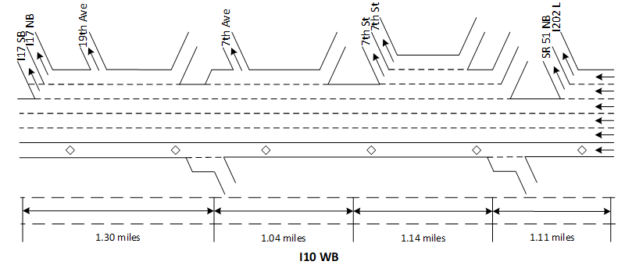
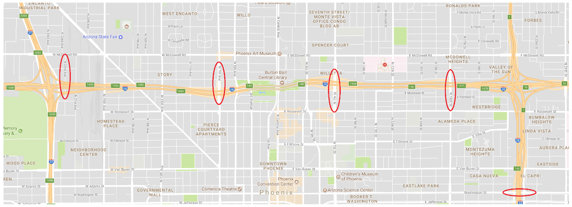
BPR-oriented Queue Approximation in Phoenix
Calibration results:
Detector | Description
Loop detectors | 78, 84
Location | I-10 freeway corridor, Westbound direction
Traffic data collected | Speed (mph) and volume (vehicle/5 minutes)
Traffic data collection period | Year: 2016 Months: January Interval: 5 minutes (from 00:00 to 23:55)
137
78
139
84
78
139
137
78
84
Underground tunnel
Notes:
We have done a case study in Phoenix
We use the data collected from station 84

Slide 25
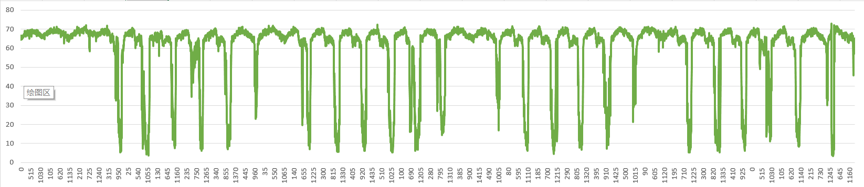
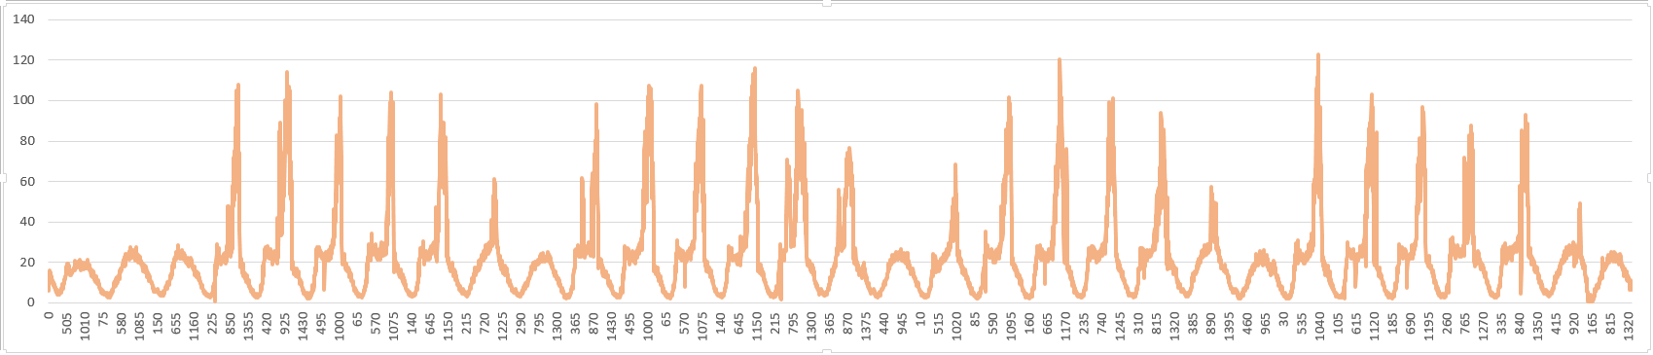
BPR-oriented Queue Approximation in Phoenix
Station 84
Detector | Milepost | Lane description
84 | 145.681 | - Ramp: Entrance from 7th Street - HOV - Lane 1, Lane 2, Lane 3, Lane 4
84
Speed of 30 days
(January, 2016)
Density of 30 days
(January, 2016)
Select weekdays of January, 2016
Notes:
I collected the data of weekdays in Jan 2016

Slide 26
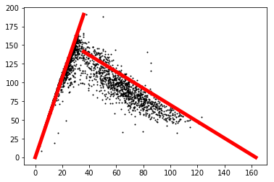
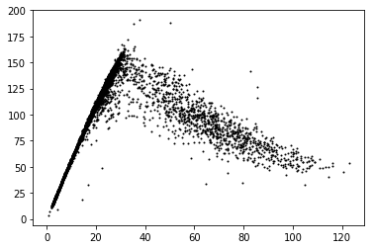
BPR-oriented Queue Approximation in Phoenix
Calibration results (January):
Flow (veh./(5min*lane)
Flow (veh./(5min*lane)
Density (veh./(mile*lane)
Jam density = 163 veh/(mile*lane)
Backward speed = -0.79 mile/5min = - 12 mile/hour
Max flow = 190.75 veh/(5 min*lane) = 2,289 veh./(hour*lane)
Free flow speed = 63.9 mile/hour
Critical density = 35.8 veh./(mile*lane)
Density (veh./(mile*lane)
Notes:
Here the fundamental diagram of the station 84
And we calibrate some basic parameters of the scatters
Include jam density, free flow speed, and critical density
Where the critical density is the most important

Slide 27
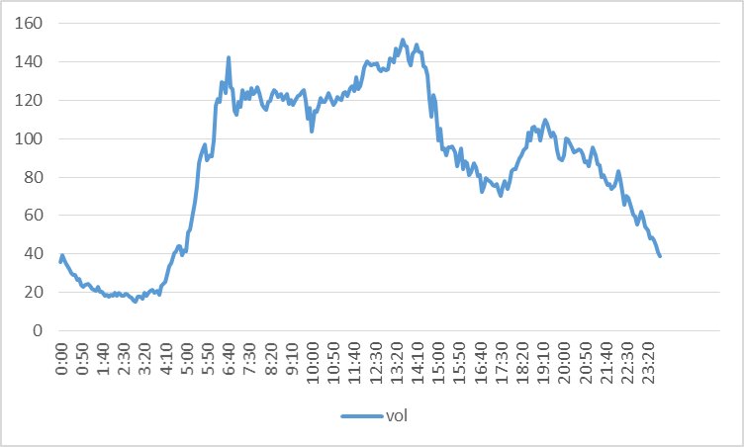


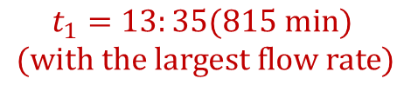
BPR-oriented Queue Approximation in Phoenix
Calibration results (Station 84, Weekdays in January 2016):
Step 1: Determine period $t_{1}$
Avg. Daily Evolution of Flow rate
$$t_{1}=13:35(815 min)$$
$$(with the largest flow rate)$$
$$λ(t)$$
time
Assume the time with the largest flow rate as $t_{1}$
Notes:
This figure shows the avg daily evolution of flow rate
Then use the figure we can find the t1 which means the time with the largest inflow rate

Slide 28
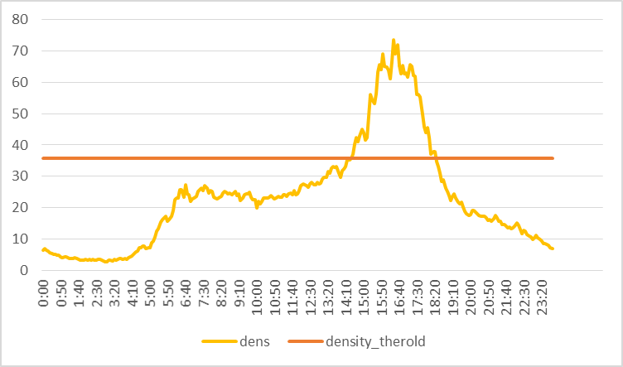
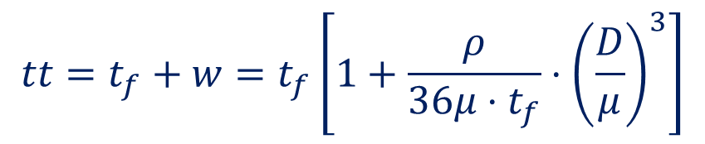

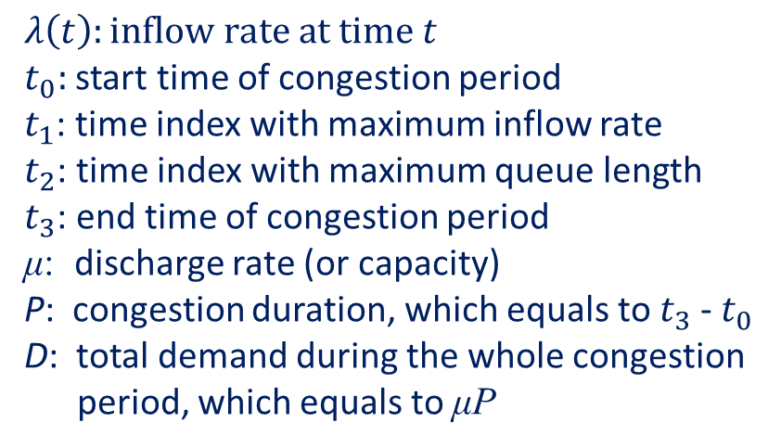
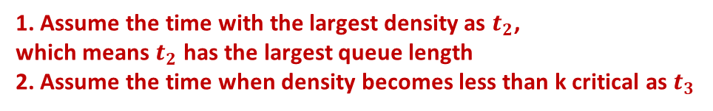
BPR-oriented Queue Approximation in Phoenix
Calibration results (Station 84, Weekdays in January 2016):
Avg. Daily Evolution of Density
Step 2: Determine the $t_{2},t_{3}$
$$t_{2}=995 min$$
$$(with the largest queue length)$$
Critical density
= 35.8 veh./(mile*lane)
$$t_{3}=1105 min$$
$$(less than k critical)$$
$$P=t_{3}−t_{0}$$
1. Assume the time with the largest density as $t_{2}$,
which means $t_{2}$ has the largest queue length
2. Assume the time when density becomes less than k critical as $t_{3}$
Notes:
This figure shows the average daily evolution of density
We assume the time with the highest density is the time with the longest queue.
The time when the density becomes lower than the critical density (35) indicates the time when the queue disappeared

Slide 29
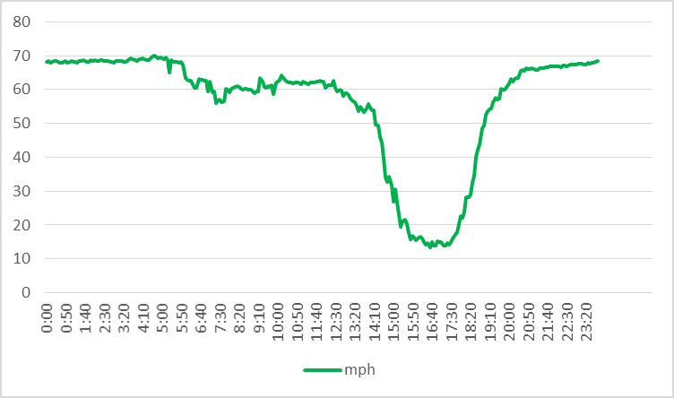
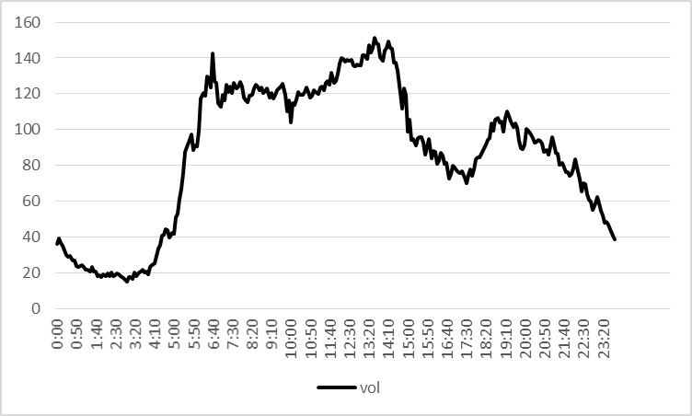
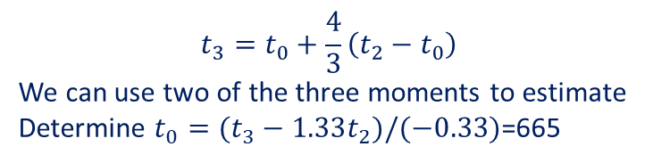
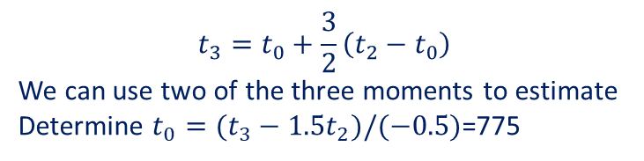

BPR-oriented Queue Approximation in Phoenix
Calibration results (Station 84, Weekdays in January 2016):
Avg. Daily Evolution of Speed
Step 2: Determine the $t_{2},t_{3}$
Step 3: Determine the $t_{0}$, and $P$
1. Newell’s Quadratic form:
Period determined by Quadratic form formulation
$$t_{3}−t_{0}$$
$$t_{3}=t_{0}+\frac{3}{2}\left(t_{2}−t_{0}\right)$$
We can use two of the three moments to estimate
Determine $t_{0}=(t_{3}−1.5t_{2})/(−0.5)$=775
$$t_{3}−t_{0}$$
Period determined by cubic form formulation
According to different forms of formulations,
we can determine different congested periods
Avg. Daily Evolution of Flow rate
$$P from 775 min \left(12:55\right) to 1105 min\left(18:25\right)$$
2. Cubic form:
$$t_{3}=t_{0}+\frac{4}{3}\left(t_{2}−t_{0}\right)$$
We can use two of the three moments to estimate
Determine $t_{0}=(t_{3}−1.33t_{2})/(−0.33)$=665
$$t_{3}−t_{0}$$
Period determined by Quadratic form formulation
$$t_{3}−t_{0}$$
Period determined by cubic form formulation
$$P from 665 min \left(11:05\right) to 1105 min\left(18:25\right)$$
Notes:
Then we can use the following formulation to estimate the time t0 which means the time of queue is generated.
The formulation can be obtained by math derivation. You can find in Newell’s paper
The formulation can be obtained by math derivation. You can find in Newell’s paper
However, if we use different forms of polynomial functions, Then the estimates of t0 are different.

Slide 30



BPR-oriented Queue Approximation in Phoenix
Calibration results (Station 84, Weekdays in January 2016):
  Step 4: Estimate the outflow rate using the volume passing Station 78
1. Newell’s Quadratic form:
The average flow rate between time 𝟕𝟕𝟓 𝐦𝐢𝐧 (𝟏𝟐:𝟓𝟓) and 𝟏𝟏𝟎𝟓 𝐦𝐢𝐧(𝟏𝟖:𝟐𝟓)
$μ=111 veh./5min$= $1,332 veh./hour$
R²=0.98
Outflow
time
2. Cubic form:
The average flow rate between time 𝟔𝟔𝟓 𝐦𝐢𝐧 (𝟏𝟏:𝟎𝟓) and 𝟏𝟏𝟎𝟓 𝐦𝐢𝐧(𝟏𝟖:𝟐𝟓) $μ=111 veh./5min$= $1,332veh./hour$
If we calibrate the cumulative flow counts at Station 78, we have 𝜇=113 veh./5min=1,356veh./hour
78
Underground tunnel
Notes:
Then we use the data collected from station 78 which is downstream of station 84 to know the outflow rate. Using Linear regression.

Slide 31




BPR-oriented Queue Approximation in Phoenix
Calibration results
Cubic form
Quadratic form
inflow
inflow
Cumulative arrival and departure
outflow
outflow
Cumulative arrival and departure
$μ=106 veh./5min$= $1,272 veh./hour$
$μ=111 veh./5min$= $1,332veh./hour$
time
$μ=111 veh./5min$= $1,332veh./hour$
$μ=106 veh./5min$= $1,272 veh./hour$ (minor adjustment for flow balance)
Notes:
Then we can calibrate the arrival and departure cumulative curves.
In cubic form and in second order form

Slide 32


BPR-oriented Queue Approximation in Phoenix
Calibration results of cubic form
Calibration results of quadratic form
$$ρ=4−104$$
$P=335min$s
$$R2=0.75$$
$ρ=1−10$⁶
$P=440min$s
$$R2=0.76$$
data
data
estimates
estimates
Queue length
Queue length
Notes:
By calibrating, we can have the estimates of queue length

Slide 33




BPR-oriented Queue Approximation in Phoenix
Calibration results of quadratic form
$t=t_{f}+w=t_{f}\left[1+\frac{ρ}{36μ⋅t_{f}}⋅{\left(\frac{D}{μ}\right)}^{3}\right]$= $t_{f}\left[1+\frac{ρ}{36μ⋅t_{f}}⋅P^{3}{\left(\frac{D/P}{μ}\right)}^{3}\right]$
=$α$
Which is the $α$ in the traditional BPR function
$ρ=4−104 ; P=335min$s (67 five mins); $R2=0.75$
Free flow speed = 63.9 mile/hour =1.065mile/min
Free flow travel time =1.04 mile /(1.065 mile/min)=0.98min
$α=\frac{ρ}{36μ⋅t_{f}}⋅{\left(P\right)}^{3}$= 0.15
W=0.98 min + 0.15*0.98 min=1.127 min
Notes:
Then the result is if we use the quadratic form inflow rate function
Then the travel time function is the third order
The alpha of BPR function is 0.15

Slide 34




BPR-oriented Queue Approximation in Phoenix
Calibration results of cubic form
$t=t_{f}+w=t_{f}\left[1+\frac{ρ}{80μ⋅t_{f}}⋅{\left(\frac{D}{μ}\right)}^{4}\right]$= $t_{f}\left[1+\frac{ρ}{80μ⋅t_{f}}⋅P^{4}{\left(\frac{D/P}{μ}\right)}^{4}\right]$
=$α$
Which is the $α$ in the traditional BPR function
$ρ=1−106 ; P=440min$s (67 five mins); $R2=0.76$
Free flow speed = 63.9 mile/hour =1.065mile/min
Free flow travel time =1.04 mile /(1.065 mile/min)=0.98min
$α=\frac{ρ}{80μ⋅t_{f}}⋅{\left(P\right)}^{4}$= 0.03
W=0.98 min + 0.03*0.98 min=1 min
Notes:
If we use the fourth order then
The alpha of BPR function is 0.03
We are now still do the research now

Slide 35

Thanks
Our paper:
Wu, X., Guo, J., Xian, K., & Zhou, X. (2018). Hierarchical travel demand estimation using multiple data sources: A forward and backward propagation algorithmic framework on a layered computational graph. Transportation Research Part C: Emerging Technologies, 96, 321-346.
https://www.sciencedirect.com/science/article/pii/S0968090X18306685
https://www.researchgate.net/publication/325131295_Hierarchical_travel_demand_estimation_using_multiple_data_sources_A_forward_and_backward_propagation_algorithmic_framework_on_a_layered_computational_graph
Our codes:
For educational and research purposes, one can find the Matlab and Python source code for small networks at
https://github.com/xzhou99/BTCG or
https://github.com/Grieverwzn/Big-data-driven-computational-graph--BTCG-/tree/master/TFDE_Sioux%20Falls_multiple.
Supported from NSF CMMI#1538569, Improving Spatial Observability of Dynamic Traffic Systems
Notes:
These are the paper we have published on TRC about computational graph

