Slide 1
Implementing Reliability Measures in the ARC ABM
Matt Stratton (WSP)
Surabhi Gupta (WSP)
Peter Vovsha (INRO)
Guy Rousseau (ARC)
6/4/2019
Notes:
Mention that we have two measures: link-level reliability and OD level
Mention SHRP2 Projects by name:
- C04 “Improving Our Understanding How Highway Congestion and Pricing Affect Travel Demand”
- L04 “Incorporating Reliability Performance Measures in Operations and Planning Modeling Tools”

Slide 2
Project Overview
Work funded by FHWA SHRP2 L04 grant
Build consistent practical methods for:
Link-level reliability function
Generalized cost (VDRF – Volume-Delay Reliability Function) for path building
OD trip reliability measures
Requirements:
Account for partial correlation between travel times on different links
Compatible with link-based static assignment (w/o route enumeration) and path-based DTA

Slide 3
SD or Variance? That is the Question
SD (σ) is additive for perfectly correlated link times:
Roads w/o intersections & demand is persistent through the length of the road
SD can be added to VDF and skimmed
Variance (σ²) is additive for independent link times:
Roads with intersections & substantial demand turnover through the length of the road
Variance can be added to VDF and skimmed

Slide 4
Volume-Delay-Reliability Function
$$time=VDF+\left(δ×SD+\left(1−δ\right)×MSD\right)$$
$$δ − Correlation Coefficient$$
SD – Standard Deviation of Time
Estimated by facility type
Adopted Form:
CI = Mean congested time / free-flow time
Interaction with Lanes, Lane Change and Stops/Signal/Yield upstream/downstream
MSD – Marginal Standard Deviation of Time
MSD is proportional to the squared SD (or Var) of the link and inversely proportional to the SD of the entire route

Slide 5
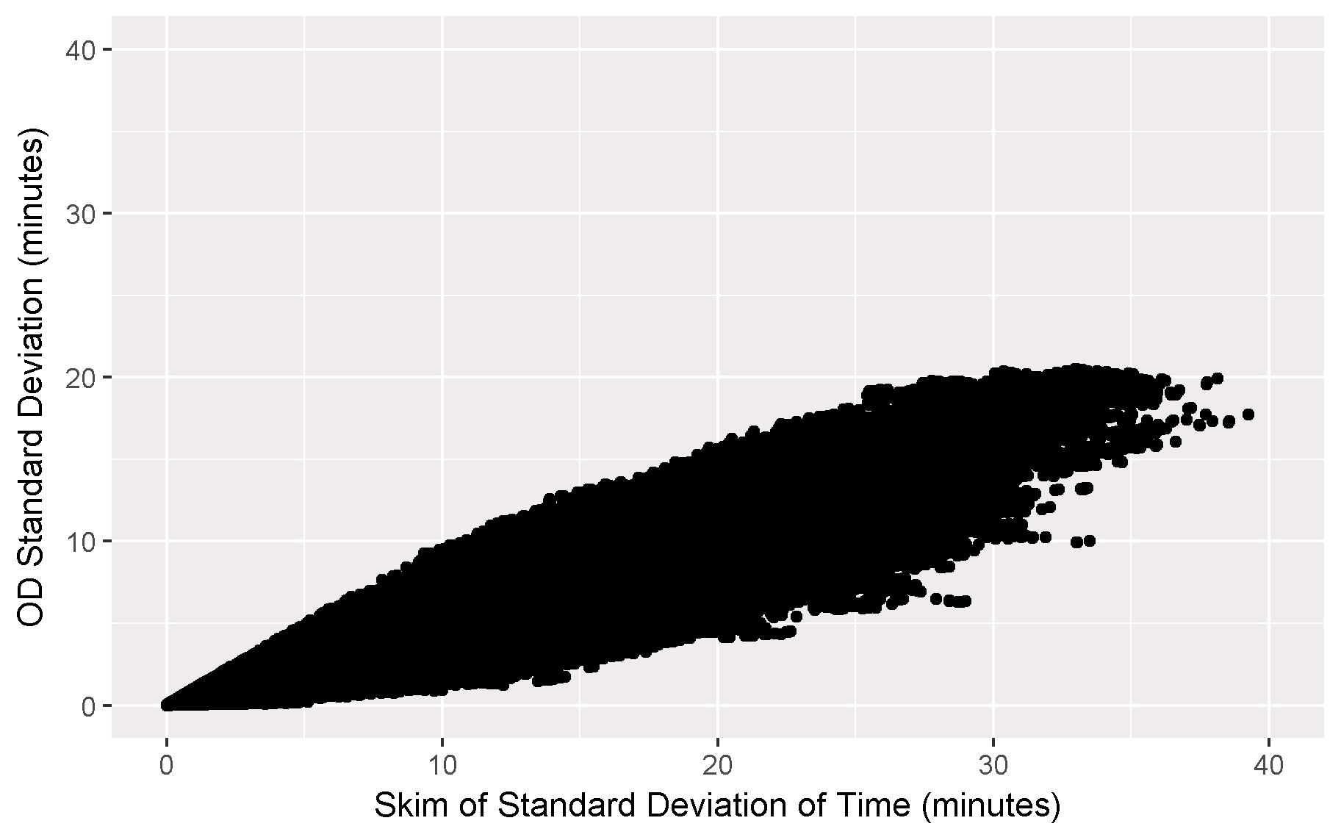
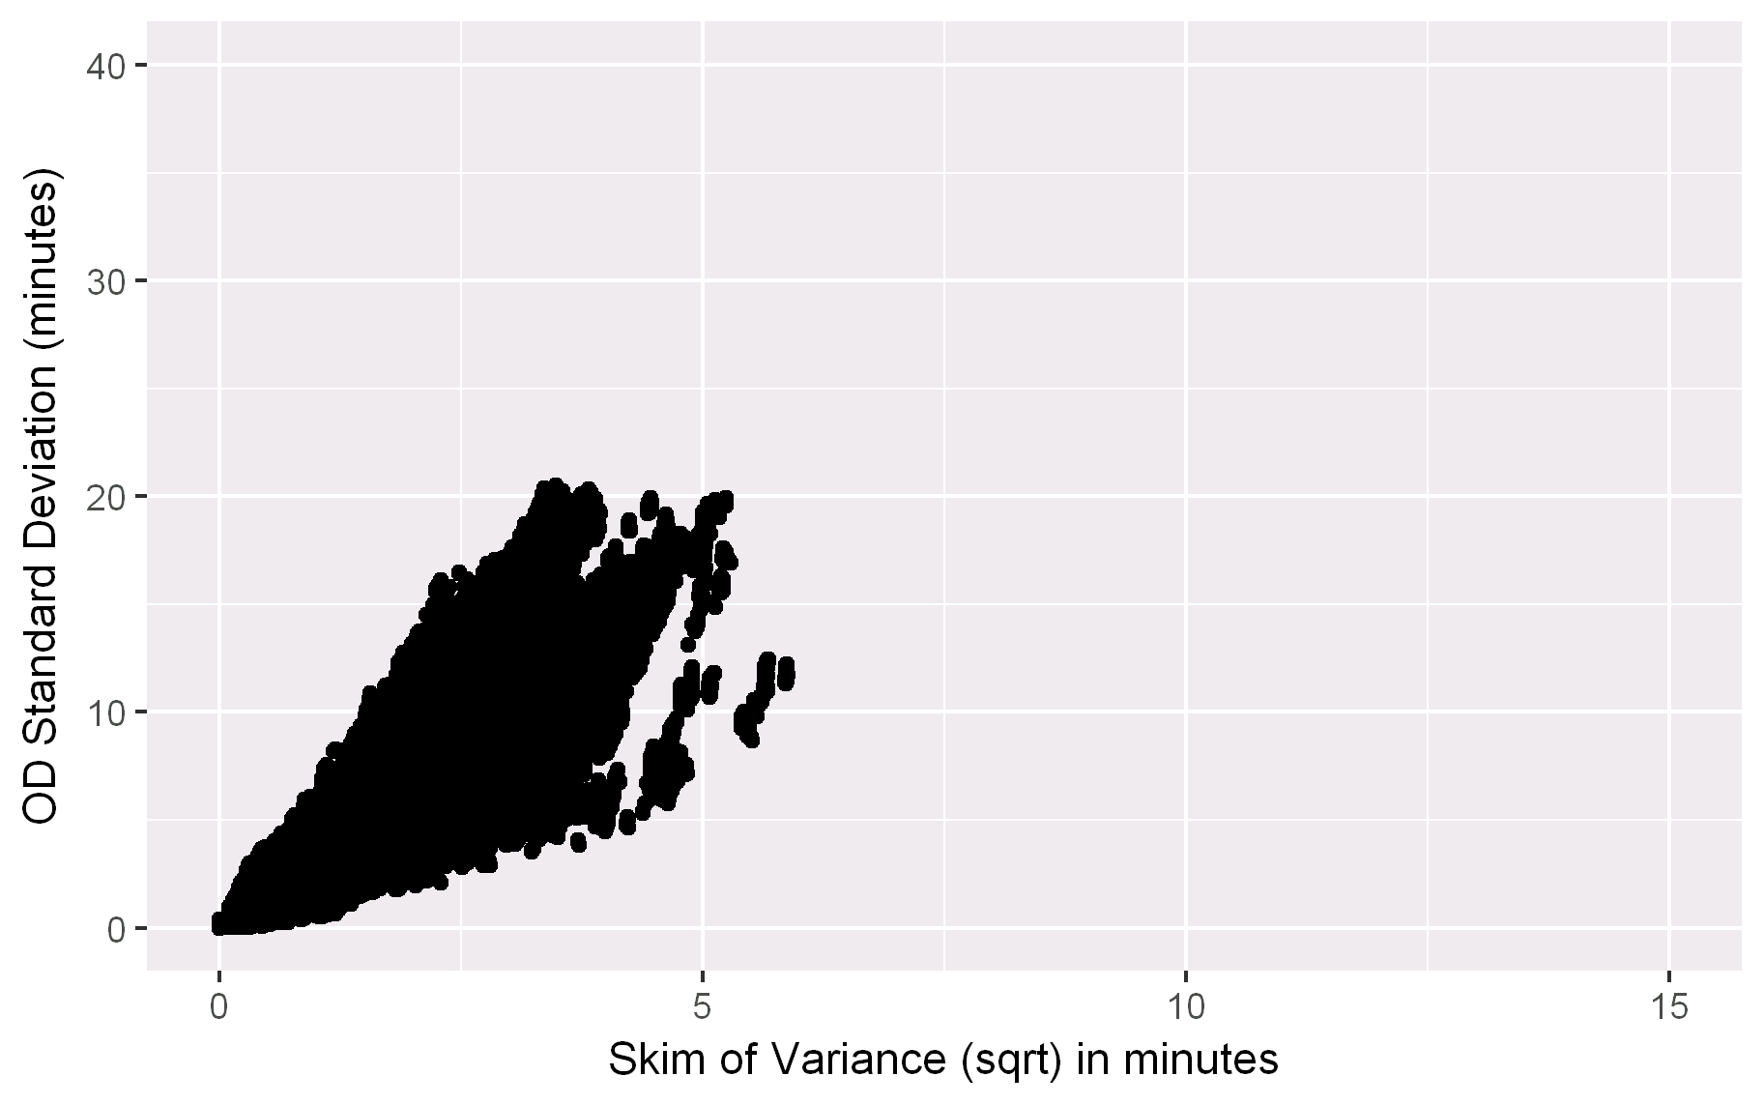
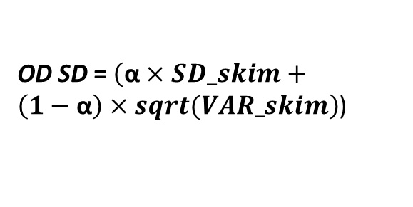
OD Skim of Link SD (SD_skim)
Perfectly correlated link travel times
Upper bound
OD SD
Requires a measure of demand correlation (α) along the path
OD Skim of Link Variance (VAR_skim)
Independent link travel times
Lower bound
OD SD = $\left(\text{α}×SD_skim+\left(1−\text{α}\right)×sqrt(VAR_skim\right)$)
Negative Correlation

Slide 6
Demand Correlation ($\text{α}$) Estimation
OD SD ~ α$×$Skim Link SD + $\left(1−\text{α}\right)×$Sqrt (Skim Link Variance )
OD SD = SD(OD Travel Time[epoch][Date])
Skim Link SD = OD Skim of Link SD
Sqrt (Skim Link Variance) = sqrt(OD skim of Link Variance)
Measure of Link Demand Correlation:
α = D*(b + d*F + e*(CI - 1))
Variable | Notation | Coeff | T-stat
Demand commonality (D) | b | 0.5364 | 592.8
Freeway Proportion (F) X Demand Commonality (D) | d | 0.2764 | 244.3
(Congestion Index-1) X Demand Commonality (D) | e | 0.3320 | 301.1
R² |  | 0.925

Slide 7
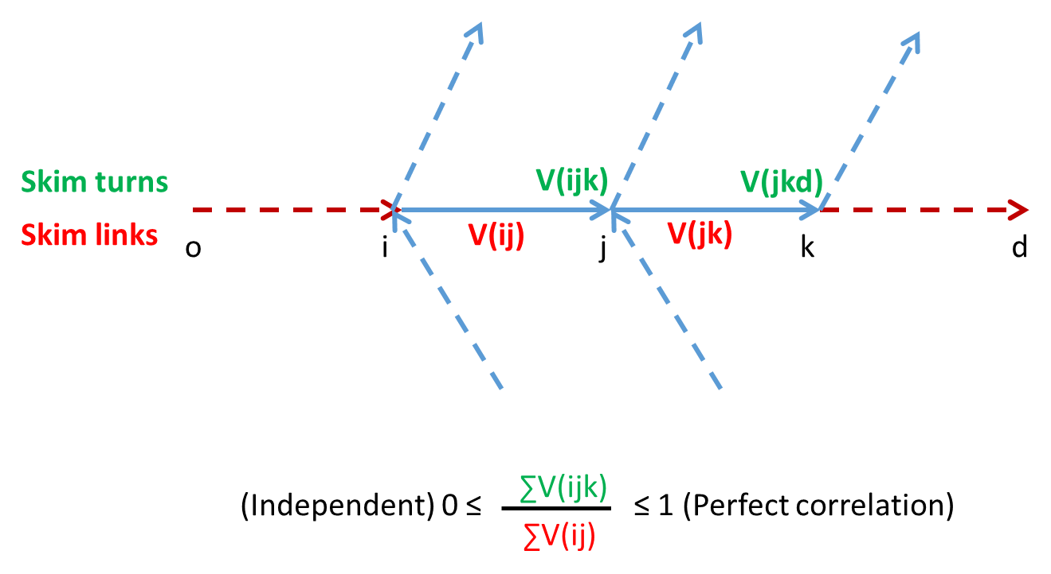
Demand Commonality Skims (between consecutive links)
Notes:
On an average, the demand commonality is between 0.4-0.6 for most links in the region.

Slide 8
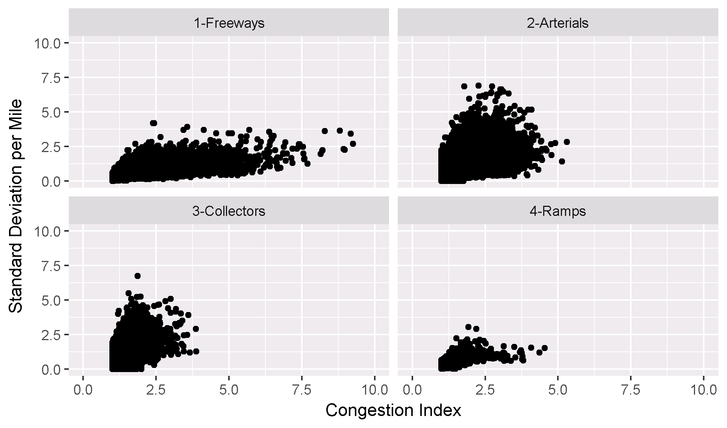
Data Source
INRIX Data, October 2015
Weekdays only
46,000 links
Time/speeds averaged with 15 minute intervals
Notes:
With outliers removed

Slide 9
Cube Implementation
Demand from Mode Choice
Run Highway Assignment
Compute Link Level SD
Calculate Marginal SD
Update Generalized Cost
Compute Demand Commonality Factor and OD Correlation Measure
Link-Level Reliability Measure
Loop of Highway programs to calculate Reliability Measures
MSA on Link Reliability Measure
Convergence within 2-3 reliability loops

Slide 10
Contact
Guy Rousseau
GRousseau@atlantaregional.org
Surabhi Gupta
Surabhi.Gupta@wsp.com
Peter Vovsha
peter@inrosoftware.com
Matt Stratton
Matt.Stratton@wsp.com

