Slide 1
SF Travel Demand Webtool
Project, Visualize and Document Travel Demand in Seconds
Amelia Baum
University of California, Berkeley
Bhargava Sana, Drew Cooper | SF County Transportation Authority
Dan Wu, Manoj Madhavan, Sherie George | SF Planning Department
Notes:
I’m Amelia Baum, a City Planning student at UC Berkeley, and I’m here with Dan, Manoj and Sherie from the SF Planning Dept.
Today I’m introducing a new webtool that we have built at the San Francisco Planning dept to project, visualize and document travel demand instantly. The tool streamlines the arduous process of looking up ITE trip generation rates manually and performing analyses in individual spreadsheets, by automating error prone analyses and creating instant, compelling visualizations. The tool’s inputs and assumptions have been tailored specifically to the city of San Francisco and incorporates new travel behavior patterns such as Transportation Network Company trips

Slide 2
Developing Project Goals: Essential Questions
Notes:
Before I get to the tool I’ll briefly talk about the motivations behind this project

Slide 3
Goals of the Webtool
Visualize and Report Quickly and Accessibly
3
Predict Future Travel Demand Impacts
2
Measure Behavior
Number of Trips
Travel Mode
Destination
1
Notes:
Travel demand forecasting is all about predicting the magnitude and nature of the travel generated by a new development by trying to figure out the number of trips people take to and from it, how they travel and where they go
For the SF planning department, there are 3 key components of this analysis: measuring existing travel patterns from similar types of developments, predicting travel demand impact of future developments by scaling and combining measured behavior, and presenting this information in a way that is accessible and accurate

Slide 4
Who might be interested in this information?
planner
consultant
resident
local office holder
Notes:
This information is relevant for a diverse group of stakeholders. Within the department, planners use this information to analyze potential environmental impacts of new developments, which is a stringent planning requirement in California. The private consultants that work with planners spend a lot of time running these numbers for their own reports and analyses. This information is also valuable to stakeholders outside of the industry to anyone who wants to understand how new development will effect transportation infrastructure in their city.

Slide 5
Bringing it all Together
Trip Generation
Average number of trips by time of day (PM Peak or daily) by land use.
Ways People Travel
Mode choice: transit, automobile, rail, etc.
Common Destinations
To which districts do people go and where do they travel from?
Notes:
The tool uses an industry standard for projecting travel demand, combining information about the avg number of trips generated by different land use types at different times of day, mode split information about how people tend to travel in different geographic areas, and surveyed information about people’s travel origins and destinations

Slide 6
Existing Challenges and Opportunities
Lack of Transparency and consistency
Utilize Effective Data Visualization
Cumbersome data analysis process
Make interface easy to access and use
Update Travel Demand assumptions and inputs
Outdated Data
Notes:
We wanted to develop this tool to help rectify a few key challenges faced by the department in utilizing this information. The data previously used for travel demand calculations was outdated and didn’t represent forms of new mobility such as TNCs. We updated the travel demand methodology to use new, more accurate data sources, and designed an interface that is easy to use, and visualizes data in a clear and interesting way. Automating the data analysis process eliminates errors that can be hard to find and difficult to remedy, and the transparent calculations make the analysis useful for technical reporting.

Slide 7
Webtool Development
Notes:
Now that we know why this is useful, I’ll describe a bit about how the tool was developed. For a more detailed description of the development process, come visit our booth later where you can take the tool for a spin yourself

Slide 8
Data
System
JSON data stored by SFCTA and accessible via API
Programming
Prospector suite of web tools from the SFCTA
Developed in Javascript using Leaflet
Notes:
The tool was developed primarily using leaflet, a javascript library for web mapping and visualization, and is situated within a suite of other webtools developed by the SFCTA, using a streamlined development pipeline called Prospector that they have created. The tool is also a fantastic example of interagency collaboration, which allowed for innovative and efficient development.
The data that the tool access is stored by the SFCTA and accessible via and API in a JSON format. This means that the tool to updates automatically whenever the back end data changes

Slide 9
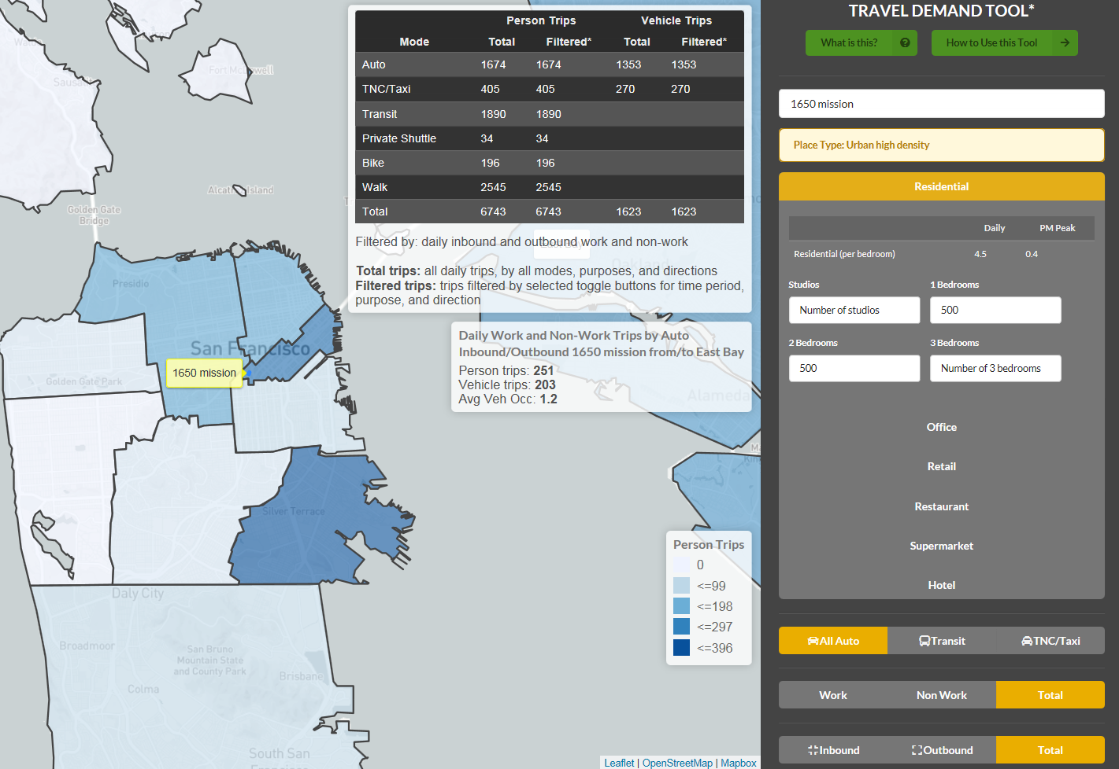
Notes:
Users input address, tool automatically locates place type
Users input the square footage and or square footage for up to 6 land use types, the mode type

Slide 10
Notes:
The tool generates tables detailing the number of person and vehicle trips according to the given specs
Talk about avoiding human error, having it be automated

Slide 11
Notes:
Trip concentrations are aggregated based on one of the three geographic areas, specified by the user
Darker color = the more trips that are inbound or outbound of that region

Slide 12
https://sftraveldemand.sfcta.org/
https://sftraveldemand.sfcta.org/

Slide 13
Thanks!
Bhargava Sana, Drew Cooper, SFCTA
Manoj Madhavan, Dan Wu, Sherie George, SF Planning
Come visit our poster for a live demo using active projects from the City of SF!
Questions? Contact me at amelia.baum@berkeley.edu

