Slide 1
Incorporating Transportation Network Companies and Autonomous Vehicles into San Francisco’s Activity-Based Model
Presented by Dan Tischler
TRB Transportation Applications Conference
June 3, 2019

Slide 2
Overview – Modeling TNCs and AVs
Added TNC as a new mode in the SF-CHAMP ABM
Explored model sensitivity to various future TNC and AV scenarios
Used existing tools and data
Daysim capabilities, past research/modeling, TNC data
New survey data is coming soon
Rich source of TNC data
Support re-estimation

Slide 3
Acknowledgements
Consultants
Mark Bradley, RSG
Joel Freedman, RSG
Dave Ory, WSP
John Helsel, WSP
SFCTA
Joe Castiglione
Linda Meckel
Bhargava Sana
Drew Cooper

Slide 4

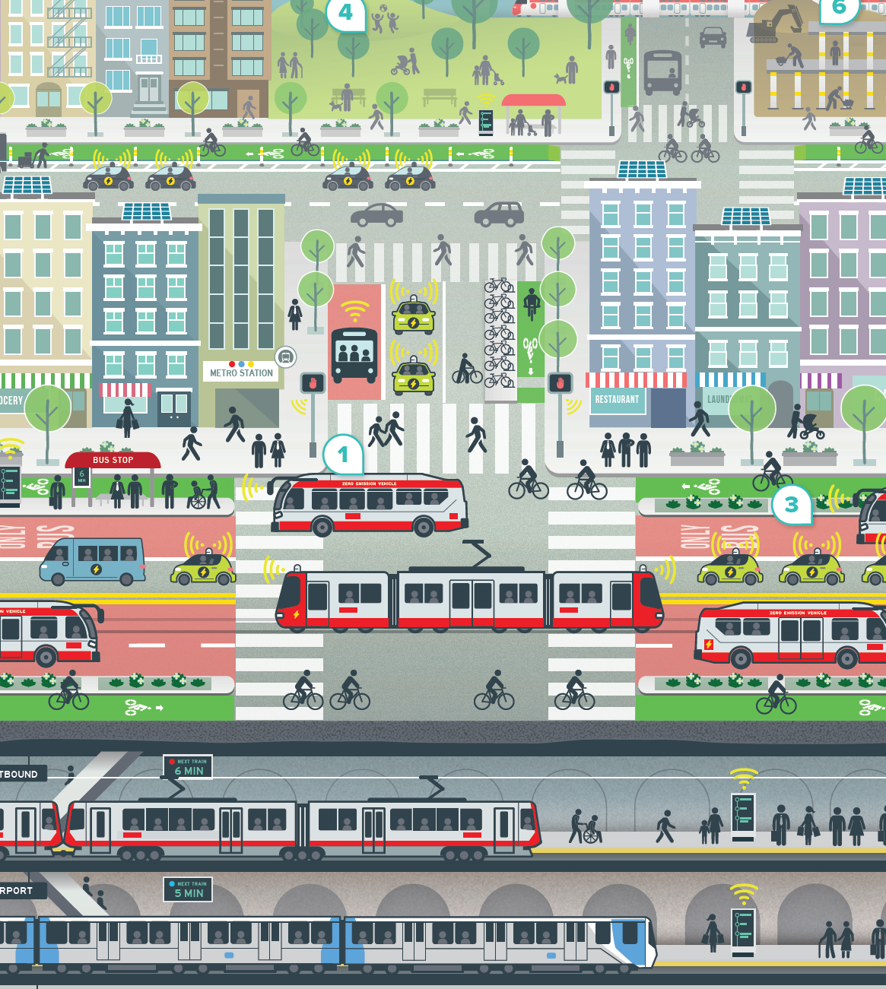
Multi-agency transportation planning effort
Long term visioning / scenario planning
Travel model-intensive future year analysis
Sensitivity tests of emerging/future transport changes
TNCs and AVs selected as top priorities for exploration
connectsf.org

Slide 5
Model representation - TNC
New tour and trip mode
A single ride-hail product (no pooled rides, premium vehicles)
Occupancy assigned for assignment, not modeled (assert proportions by tour purpose)
In service TNC trips assigned in three passenger occupancy classes
Fixed number of out-of-service TNC trips, based on TNCs Today data
TNCs are either all human-operated or all autonomous
TNC mode choice parameters:
    Mode constant, neighborhood density, fixed and variable ride cost, age

Slide 6
Model representation - AV
AV is an option in auto availability choices
HHs can own conventional autos or AVs
AV treated differently in mode choice model
AV ownership sensitivities:
    Income, age, commute time
AV mode choice:
    In-vehicle time discount factor

Slide 7
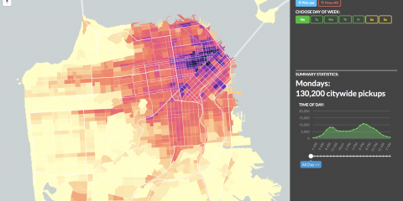
TNC validation data
TNCs Today (2017) Report
Vehicle trips by origin, destination, and time
Out of service vehicle trips
  Other TNC data:
  NHTS 2017
  SFMTA Travel Decision Survey
www.sfcta.org/projects/tncs-today

Slide 8
TNC validation
 | Observed | Estimate | Error
Intra-SF TNC vehicle trips | 181,000 | 173,000 | -8,000 (-4.4%)
SF TNC mode share* | ~4% | 8% | 2x observed
Bay Are TNC mode share* | 1.1% | 2.0% | 1.8x observed
Peak period TNC trip share | 28.9% | 34.6% | 1.2x observed
Evening / late night TNC trip share | 43.7% | 16.8% | 4/10 of observed
* Lower confidence obs.

Slide 9
TNC validation – TNC trip origins
Red: Est > Obs
Blue: Est < Obs
Overconcentration of estimated TNC trip origins in dense and jobs-rich areas

Slide 10
Incremental sensitivity testing scenarios
# | Scenario | Change
1 | 2040 baseline with TNCs | 2040 land use and transportation network
2 | TNC market matures | TNCs slightly more available, cheaper, and higher occupancy
3 | Personal AV, moderate adoption | AVs exist; 25% IVT discount; more appeal to younger groups
4 | Higher personal AV adoption | AVs are more attractive; no age differentiation
5 | TNCs become AV, moderate sharing | TNCs automate; are more attractive; prices fall 50%;
6 | Higher sharing | Ride-sharing increases
7 | AVs increase road capacity | Freeway cap up 20%; surface street cap up 10%

Slide 11
SF trip mode share

Slide 12
SF person trips

Slide 13
SF person travel distance (mi.)
Driving distance 36.2m mi
Up nearly 60%
Driving distance
22.8m mi
S1 to S7:
SF VMT up 46%
SF speed down 14%

Slide 14
SF vehicle occupancy (drive, AV, TNC)

Slide 15
Auto ownership, veh./HH

Slide 16
Closing Thoughts
Lessons
Assumptions lead to wildly divergent scenarios
In some cases both scale and direction of potential changes is unclear (roadway capacity)
More new questions than settled
Next Steps
TNC HH survey underway
Estimate mode choice models (including TNCs) with new survey data
Address out-of-service TNC activity
“Drivers of Change” research

Slide 17
Thank you.
Questions?
sfcta.org

Slide 18
Overview – Definitions
TNC = Transportation network company (Uber / Lyft), ride-hail
AV = Autonomous vehicle (assume level 5)
ABM = Activity-based (travel demand) model
SFCTA = San Francisco County Transportation Authority
SF-CHAMP = SFCTA’s ABM. Newest version uses Daysim

