Slide 1
Using Big Data in Transit Market Research - Findings from Los Angeles
Presented at:
Transportation Planning Applications Conference
June 4, 2019

Slide 2
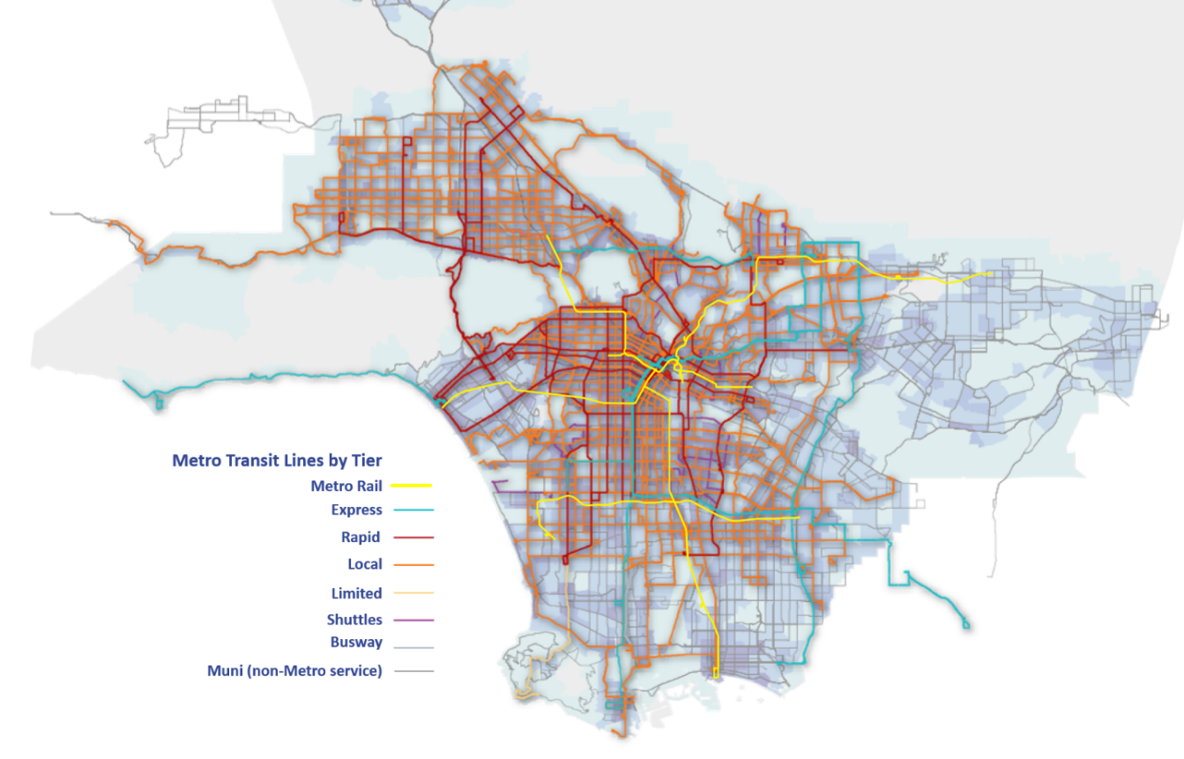
Background & Study Motivation
LA Metro is the third largest transit agency in the US with over 1.2 million boardings/day
140 operational bus lines
6 rail lines
27 regional affiliate bus services
Bus service has not changed in the past 25+ years – activity locations and travel markets have changed considerably

Slide 3
Understanding the Transit Market
Mine rich, voluminous smart farecard data and perform advanced analytics to answer key questions:
Who are our riders? Define customer segments
Where and why do these riders travel? Profile travel markets by geography, purpose, time-of-day, distance
What are the transit market shares? Comprehensive performance indicator by inferring overall travel using granular location-based services data
How competitive is transit w.r.t auto in terms of travel time? Tipping point where transit market shares drop

Slide 4
Measuring Transit Competitiveness
Metro Open Trip Planner
Transit Path & Travel Times
Transit Competitiveness
Trips
Highway Travel Times
Google
Traffic API
TAP card data to explain TRANSIT travel market
Cell phone data to explain TOTAL
travel market

Slide 5
Transit Customer Segments
Usage Frequency
# of Farecards
Count of Boardings
>150 Transactions
152,532
5%
43,680,893
52%
50 – 150 Transactions
248,851
22,027,882
Frequent
9%
26%
10 – 50 Transactions
552,374
12,585,194
20%
15%
Occasional
7%
<10 Transactions
1,905,501
5,614,072
66%
Infrequent
100%
100%
TOTAL
2,859,258
83,908,041

Slide 6
Competitiveness of Relative Travel Times
When driving
is over twice as fast, transit is less competitive
Transit Market Share
14%
12%
10%
8%
6%
4%
2%
0 – 1
2-2.25
1-1.25
3-3.25
5-5.25
1.5-1.75
2.5-2.75
3.5-3.75
4-4.25
4.5-4.75
Transit to Drive Time Ratio

Slide 7
Transit service designed around longer commute trips
Transit Share
7%
6%
16%
Short trips represent our largest potential market
5%
16%
4%
3%
2%
46%
22%
1%
% of total trips
0-1 mi
1-5 mi
5-10 mi
10+ mi
Trip Distance

Slide 8
Key Takeaways
Short Distance
Long Distance
Frequency
Speed
Commute Trips
Metro is successful here and should continue to focus on this travel market.
8% of all trips
5% transit market share
8% of all trips
9% transit market share
Peak Hour
Metro is not competing well in our biggest potential market and needs to rethink service to better capture short trips.
Other Trips
60% of all trips
2% transit market share
24% of all trips
4% transit market share
All Day

Slide 9
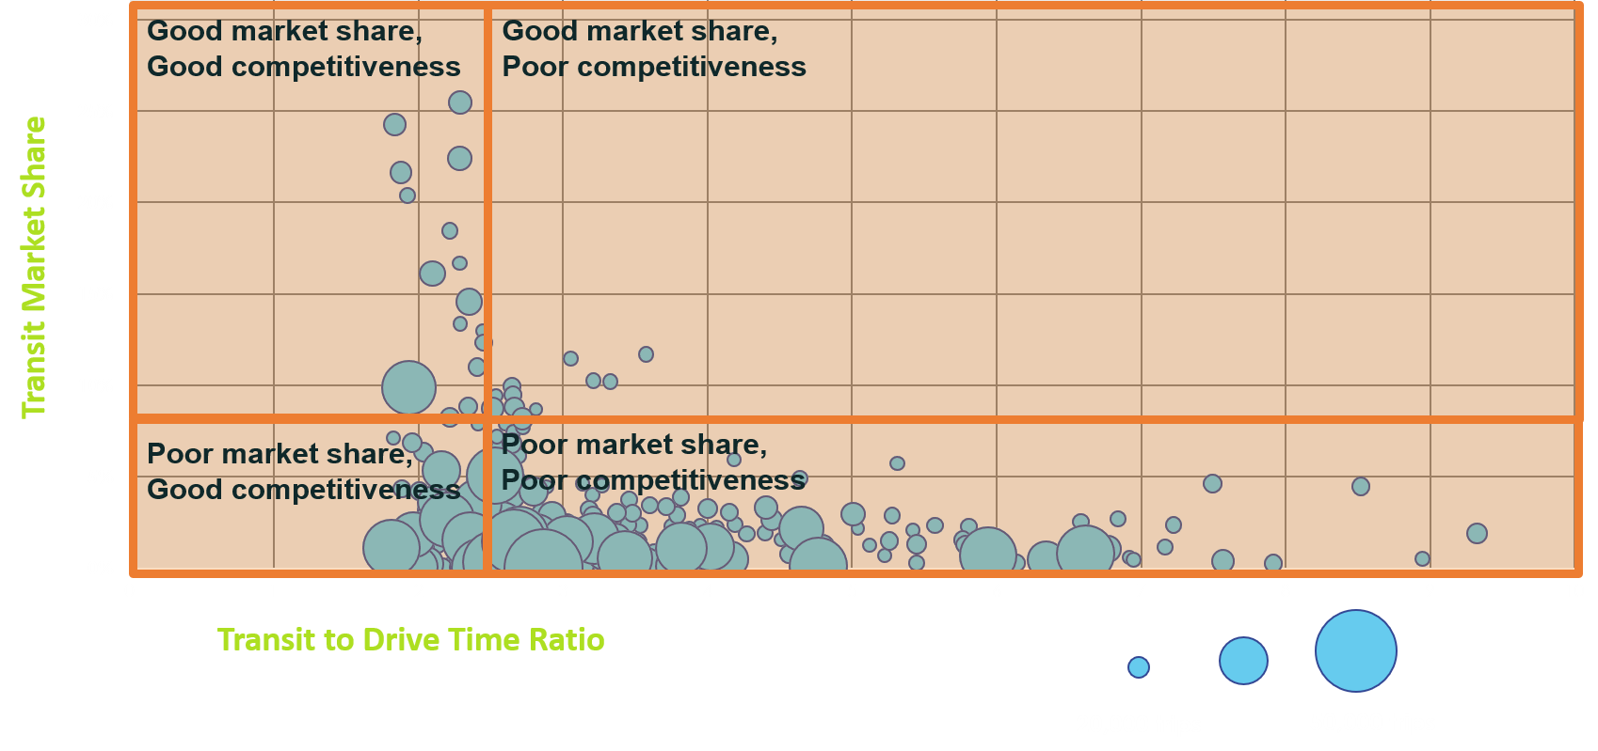
Transit Market Profiles (Strategic Planning)

Slide 10
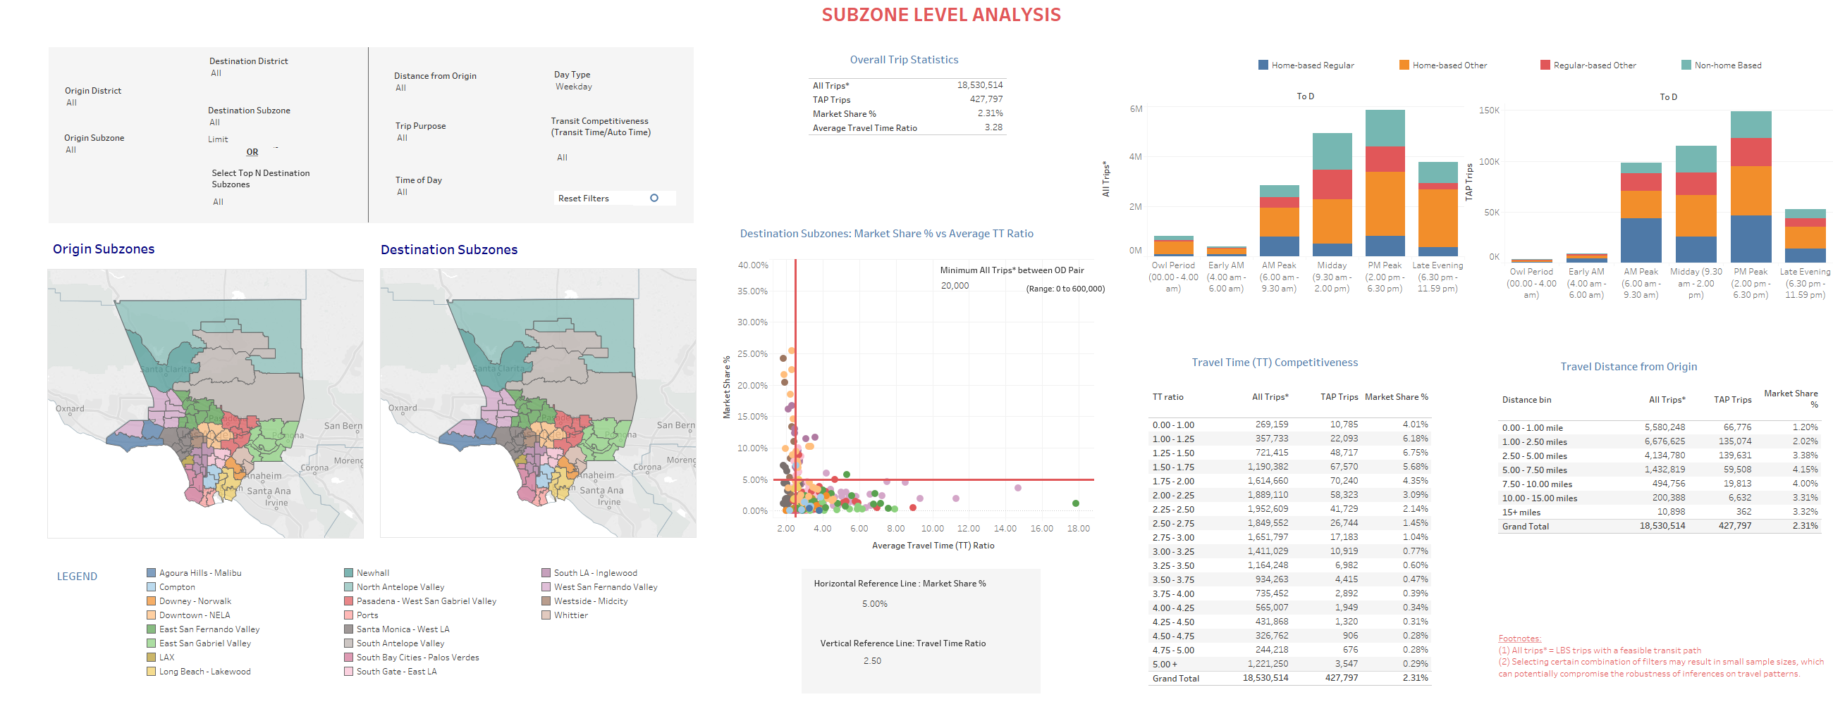
Transit Market Insights Dashboard
1
2
4
5
3
Market Performance segmented along various dimensions
Travel Market Overview
Spatial Visualization of OD
Transit Market Profiles
5
Spatial and Trip Characteristics Filter
2
3
4
1

Slide 11
Impacts
At the forefront of innovation: What transit agencies can get from big data
Understanding total travel vs transit market share and travel time competitiveness are indicators of transit success
Data driven toolkit to quantify market performance can be updated and maintained for future adjustments beyond initial study
Before and after-analysis
Service planning
Alternative Analysis

Slide 12
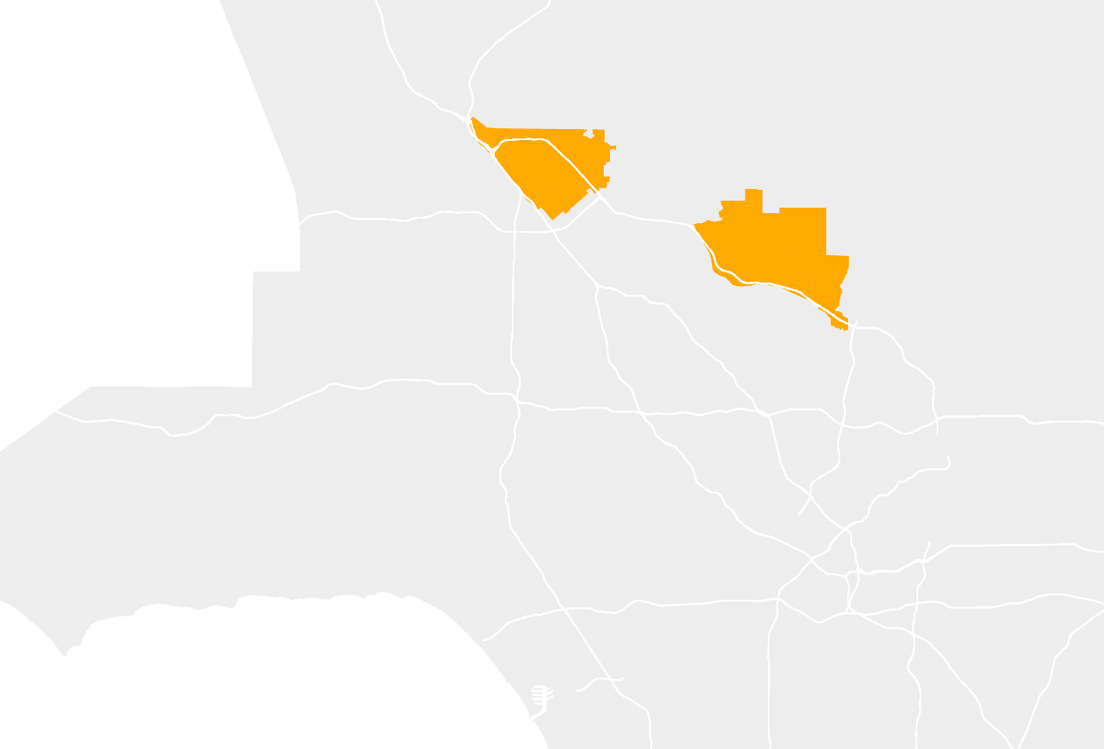
Redesign in Action
Sylmar/San Fernando
Sylmar/San Fernando Key Facts
60%
Sunland/La Crescenta
Trips: 380,000 trips
Market Share: 1.4% market share
Mileage: 76% of trips under 2.5 miles
Travel time competitiveness: 3.25-3.50
3%
27%
60% of trips occur within the area
27% of trips are to the Valley
1% of trips are to Downtown LA
3% of trips are to Sunland/La Crescenta
Percentages do not equal 100%. Additional trips dispersed throughout the County.
1%

Slide 13
Redesign in Action
Sylmar/San Fernando
Sunland/La Crescenta Key Facts
2%
Sunland/La Crescenta
Trips: 325,000 trips
Market Share: 0.7% market share
Mileage: 44% of trips under 2.5 miles
Travel time competitiveness: 3.00-3.25
60%
6%
60% of trips occur within the area
2% of trips are to Sylmar/San Fernando
11% of trips are to the Valley
1% of trips are to Downtown LA
8% of trips are to Glendale
6% of trips are to Pasadena
11%
8%
1%
Percentages do not equal 100%. Additional trips dispersed throughout the County.

Slide 14
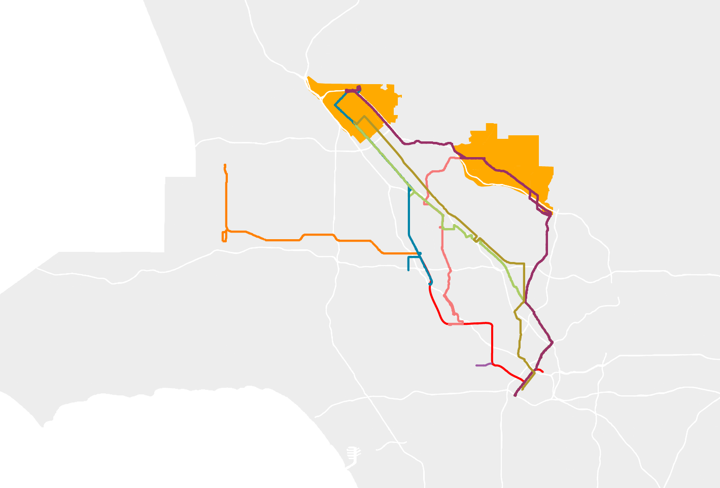
Redesign in Action
Only 2-3% of trips travel between Sylmar and Sunland
Existing Transit
Line90/91
Line 92
Line 94/794
Line 222
Line 224
Line 901 (Orange Line)
Red Line
North Hollywood Station
Only one route connects to North Hollywood, every 12-21 min
No connection to North Hollywood Station
Only 1% of trips go all the way to Downtown

Slide 15
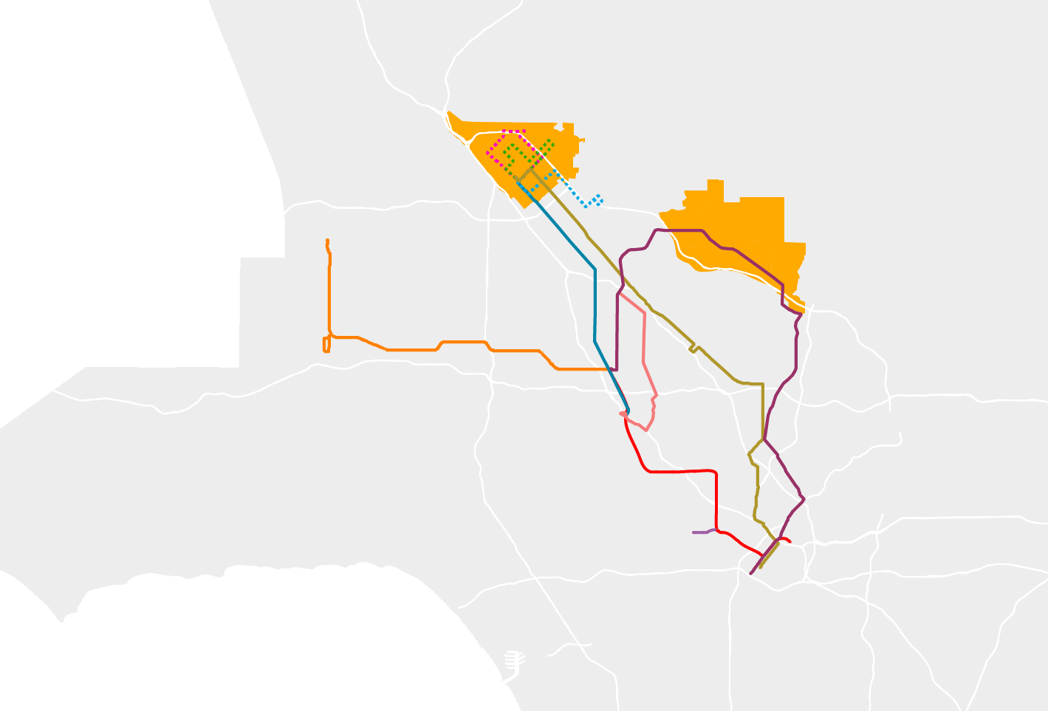
Redesign in Action
New circulators to address short-distance travel
Modified Service
Line90/91
Line 92
Line 222
Line 224
Sylmar Shuttle 1
Sylmar Shuttle 2
Sylmar Shuttle 3
Line 901 (Orange Line)
Red Line
North Hollywood Station
Increase frequency to every 10 minutes all day
Direct connection to North Hollywood
Fewer routes go Downtown, feed Red Line, frees up resources

