Slide 1
Modeling Bicycle Route Choice in Travel Models
Binny Paul
June 4, 2019

Slide 2
Background
BICYCLE TRANSPORTATION
No more only a recreational mode
Now a utilitarian alternative for short to medium distance trips
Access and egress connection for public transport
Significant impact on air quality, energy use and public health
Receiving more policy interest and funding support
CHALLENGES IN TRAVEL MODELS
Simulate bicycle travel more realistically
Include sensitivities necessary for planning
Assess benefits of investments in bicycle infrastructure

Slide 3
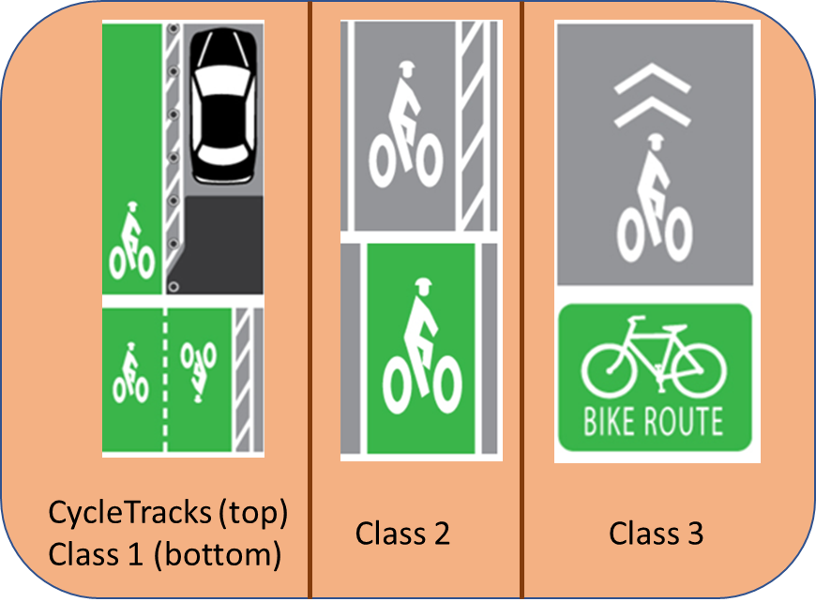
Bike Route Choice Model
The parameters on distance traveled on different types of bicycle facilities were assembled from results from various bike route choice models (Portland Oregon, San Francisco, and Monterey Bay Association of Governments).
Variable | coefficient (Miles) | “Minutes” PER MILE
Arterial with no bike lanes | -1.05 | 6
Arterial with class I bike lanes | -0.348 | 2.0
Arterial with class II bike lanes | -0.544 | 3.1
Arterial with class III bike lanes | -0.858 | 4.9
Cycle Tracks | -0.424 | 2.4
Arterial without bike lane wrong-way | -3.445 | 19.7
Freeway | -9999 | 999

Slide 4
Trip-based vs. ABM Implementation
MAG Trip-based Model
~3K TAZs
Planning Network
Bike Access for Transit
Fresno COG ABM
~22 K MAZs (Census Blocks)
All Streets Network
vs.
Bicycle Generalized Cost Parameters (“Minutes” Per Mile)
Bike Skims
Mode Choice
Bike Assignment
Bicycle PATH TYPE | MAG | Fresno COG
Multi-Use Path – Paved | 2.0 | 2.0
Multi-Use Path – Unpaved | 5.5 | -
Bike Lane | 3.1 | 3.1
Bike Route | 4.9 | 4.9
Paved Shoulder | 5.5 | -
None | 6 | 6

Slide 5
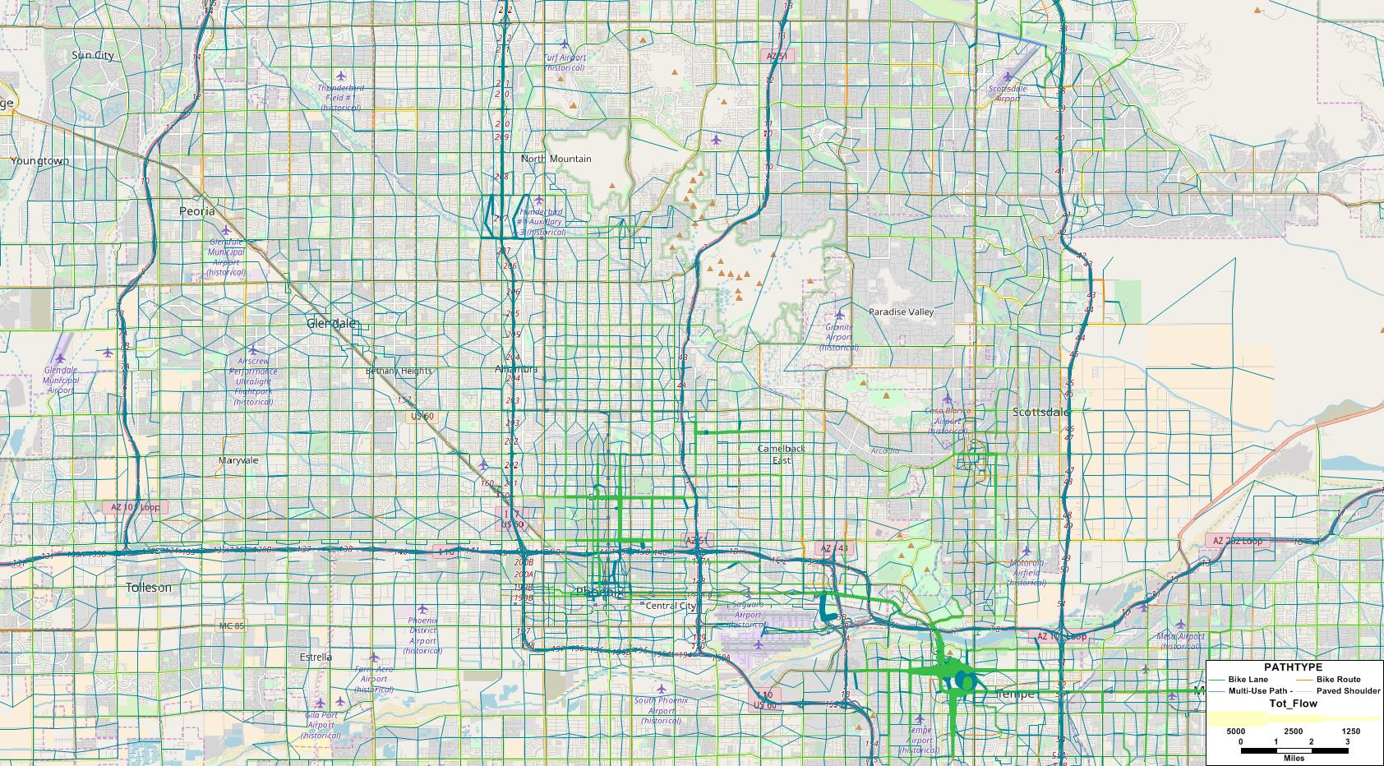
MAG Trip-Based: Bike Assignment

Slide 6
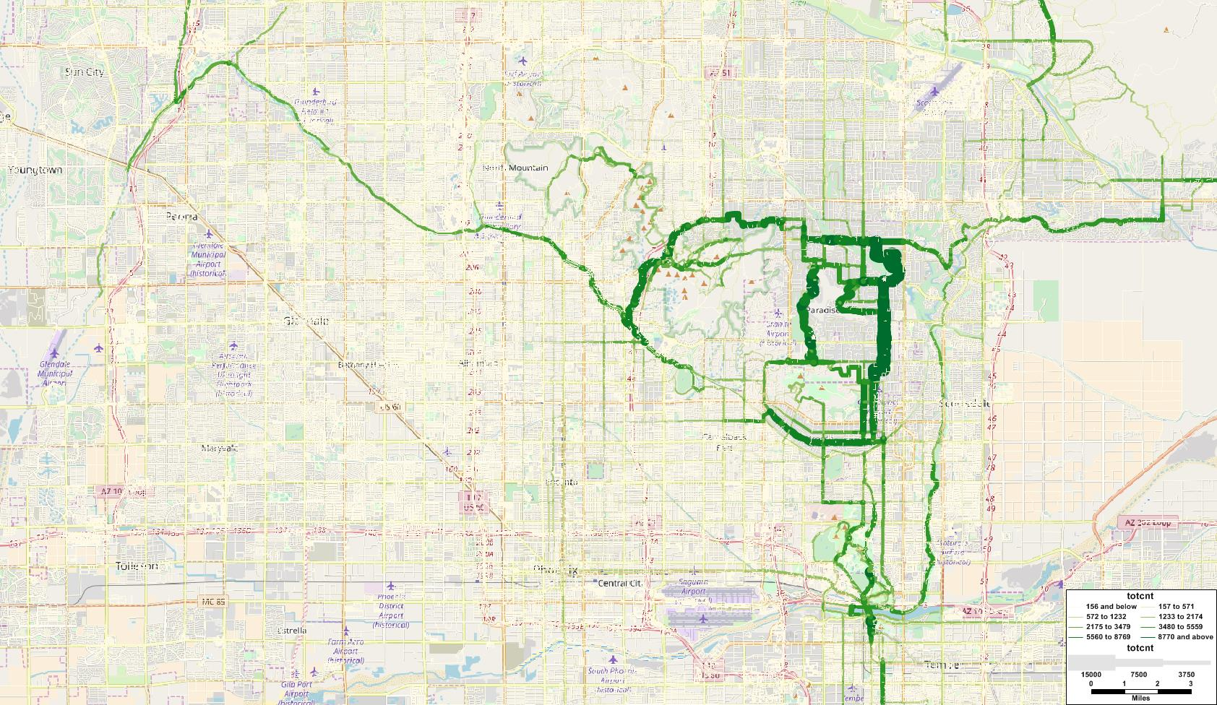
Strava Bicycle Map for Phoenix

Slide 7
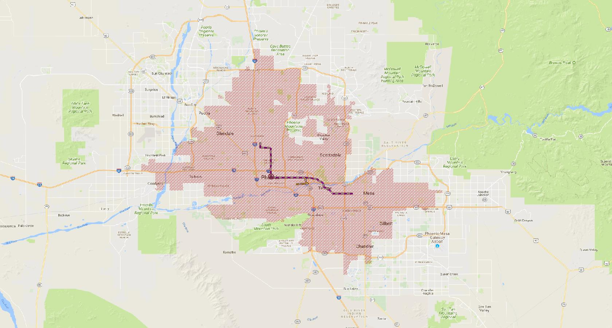
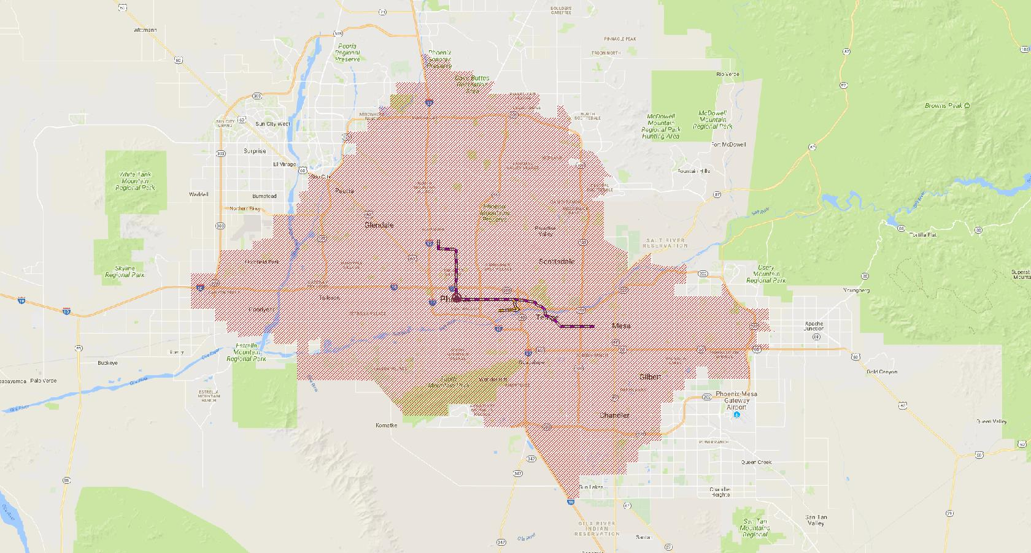
MAG TBM – Non Motorized Transit Accessibility
Walk
PM period, accessibility from a downtown zone via Urban Rail (with a possible Bus Transfer)
Bike

Slide 8
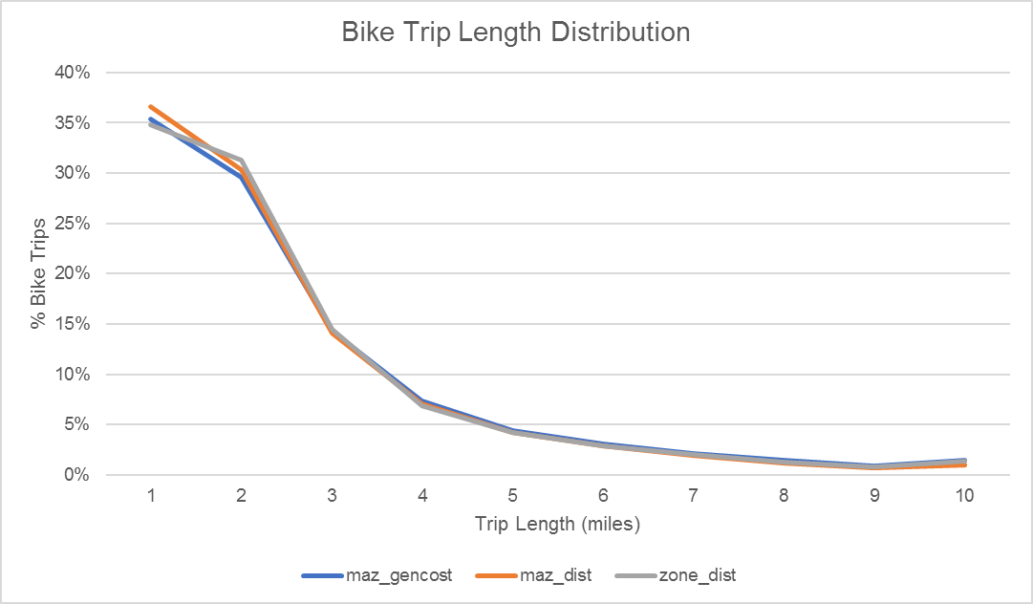
Fresno ABM – Bike Skims at Different Geography
Avg. Trip Length (Miles)
Zone_DIST | Maz_dist | MAZ_GenCost
2.05 | 1.96 | 2.08
maz_gencost – MAZ to MAZ using generalize cost function
maz_dist – MAZ to MAZ using shortest distance
zone_dist – TAZ to TAZ using shortest distance

Slide 9
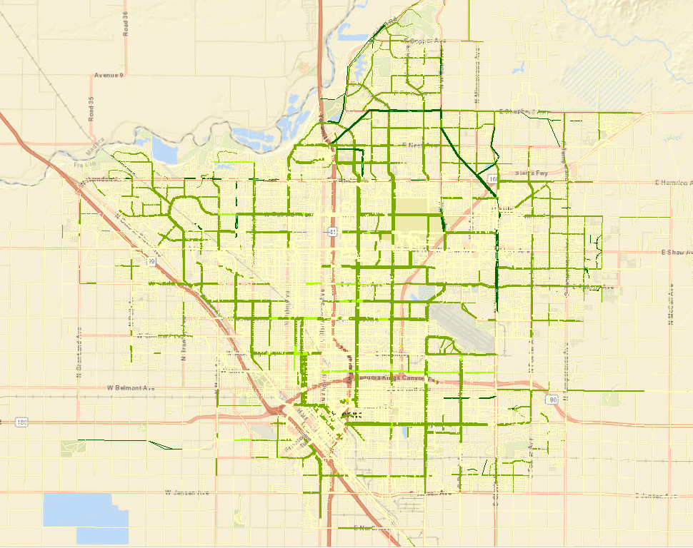
Fresno ABM – Bike Assignment

Slide 10
Conclusions
A higher resolution network + micro-zone level land use results in a more realistic representation of bicycle travel
Detailed representation of bicycle infrastructure can improve sensitivity
Addition of bike-access to transit allows more realistic representation of transit path choice
The models show appropriate sensitivity to change in bike facility parameters
Travel models represent mainly utilitarian bicycle trips. Strava data consists mostly of recreational bike trips
Would benefit from more bike count data for validation
Models can be used for policy design and bike infrastructure planning

Slide 11
BINNY PAUL
NAGENDRA DHAKAR
CONSULTANT
CONSULTANT
Binny.Mathewpaul@rsginc.com
Nagendra.Dhakar@rsginc.com

