Slide 1


Dissecting the Texas Special Generators (SG) Travel Survey Data
 | Stella Nepal Associate Transportation Researcher TTI Transportation Planning Program
EFFORT
PROCESS
DATA
2019 TRB Planning Applications Conference, Portland, OR, June 4, 2019

Slide 2


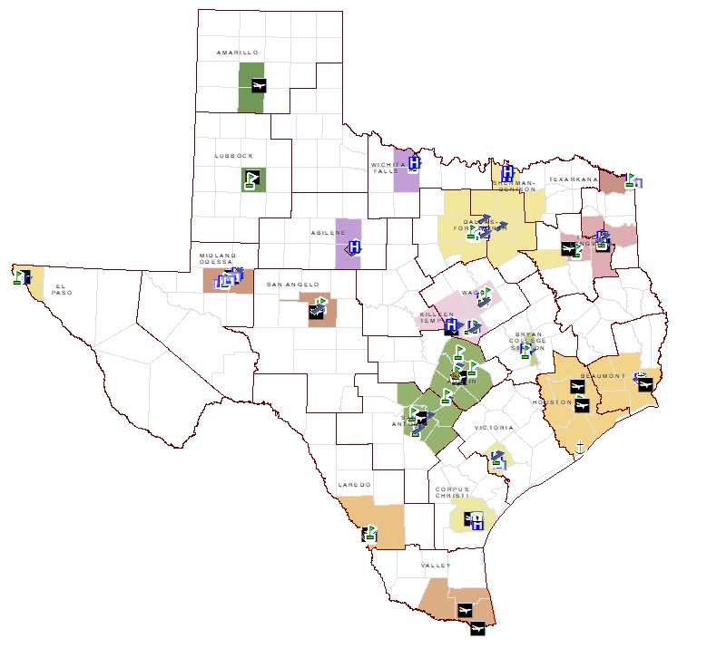
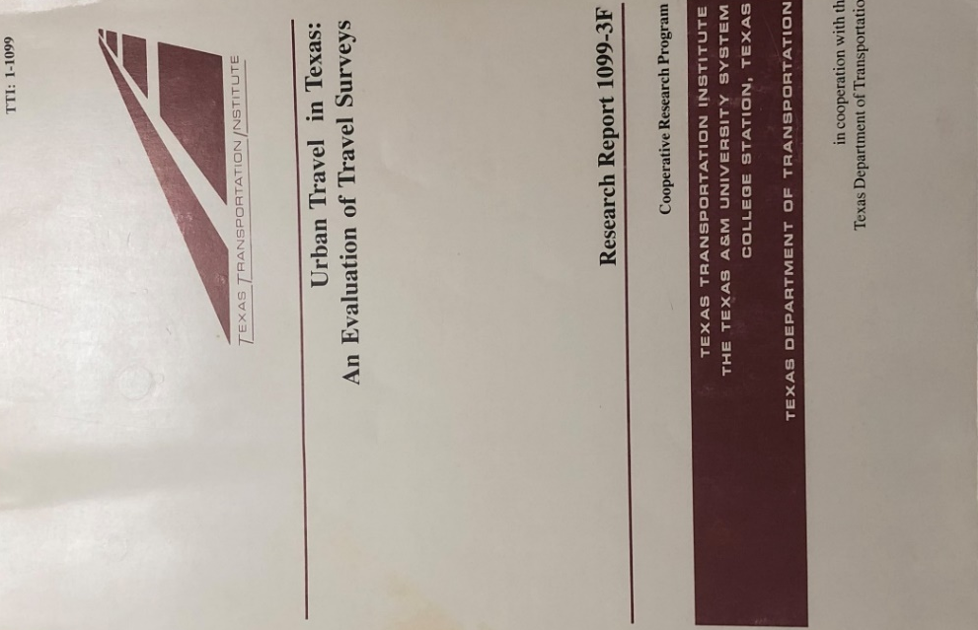
SG Travel Survey Efforts in Texas
Texas SGs

Slide 3
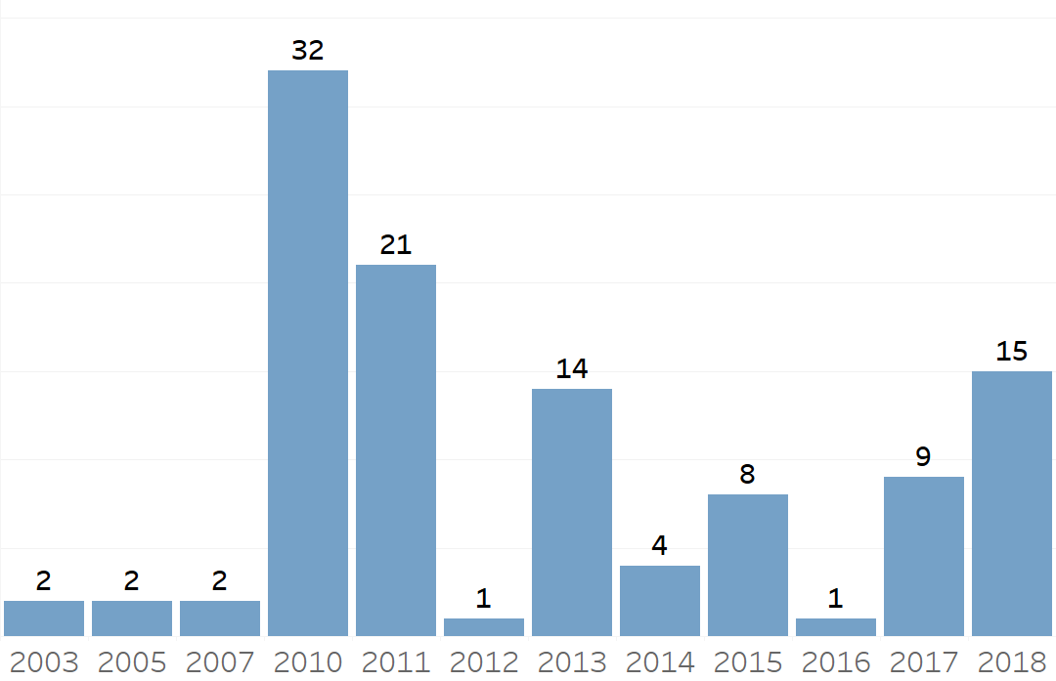
SG Surveys (2003-2018)
17 Universities/14 Colleges
12 International/5 Regional
19 Hospitals
24 Regional Malls
5 Industrial
3 Military
7 Other

Slide 4
SG Planning and Implementation Process
Site identification and prioritization
Survey bid process and vendor selection
TxDOT/TTI/Vendor roles
Timeline from start to finish
Data analysis and technical report

Slide 5
SG Data Collection
Sample Site Plan
Establishment data
Counts
Intercept interviews
Survey Date: 9/27/2018
Site hours: 7:00 AM-7:00 PM

Slide 6
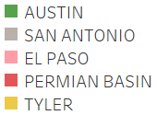
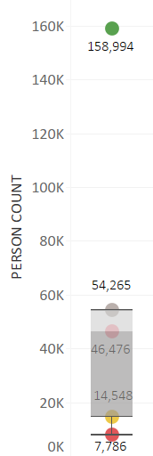
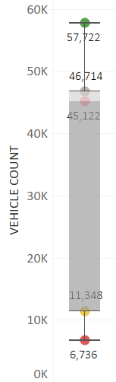
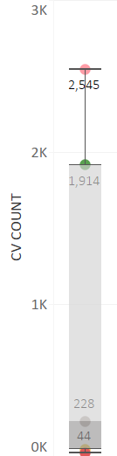
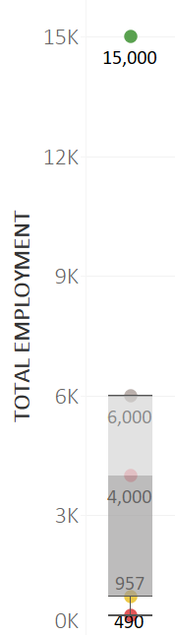
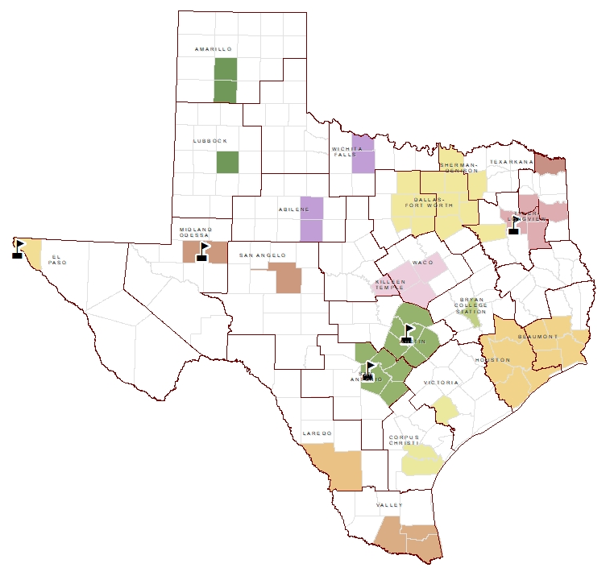
SG Data Analysis
University of Texas

Slide 7
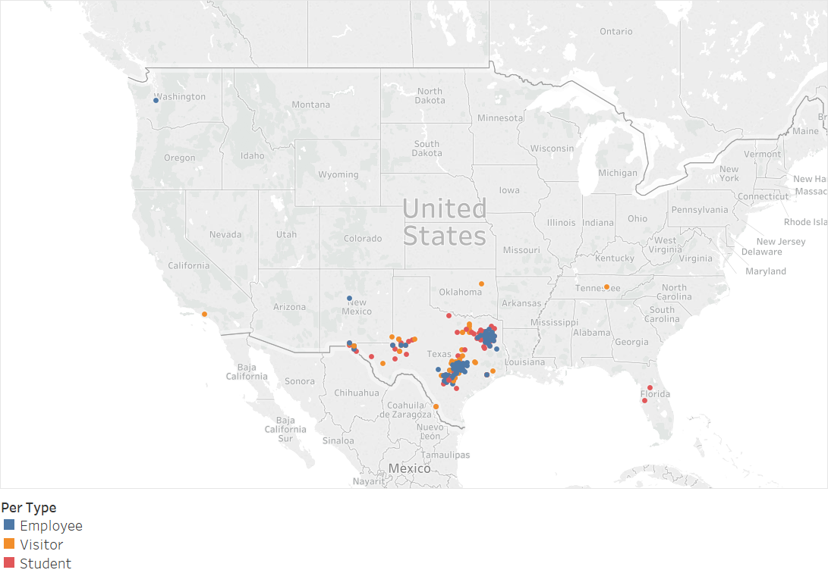
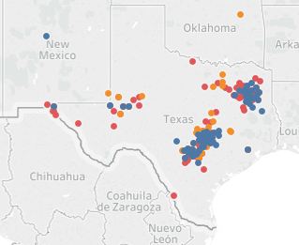
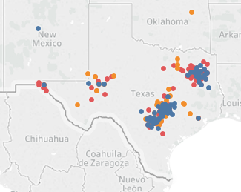
Snapshots of UT Trip Characteristics
Residence
Origins
Destinations
AUSTIN
SAT
ELP
PB
TYL

Slide 8
UT Modes of Travel
STUDENTS
EMPLOYEES
VISITORS
AUSTIN | 85%, 2% | 3% Walk, 3% Bike, 7% Transit Bus
SAT | 93%, 3% | <1% Walk or Bike, 2% TB, 1% Other
ELP | 90%, 5% | 5% Other
PB | 97%, 1% | 1% Walk, 1% Transit Bus
TYL | 96%, 3% | <1% Walk or Bike
AUSTIN | 79%, 7% | 5% Walk, 3% Bike, 3% Transit Bus
SAT | 82%,11% | 2% Bike, 5% Transit Bus
ELP | 63%, 6% | 13% Walk, 13% Transit Bus, 6% Other
PB | 93%, 4% | 3% Other
TYL | 69%, 23% | 8% Walk

Slide 9
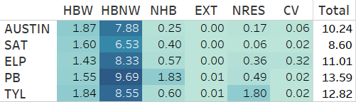
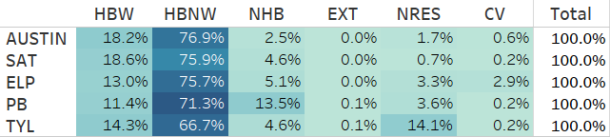
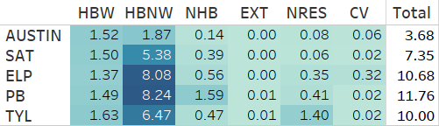
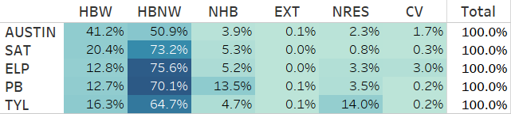
UT Attraction Rates
Person Trips per Employee
Distribution of Person Trip Attractions
Auto-Driver Trips per Employee
Distribution of Auto-Driver Trip Attractions

Slide 10
Questions & Insights
This space is intentionally left blank.

Slide 11


Acknowledgements
TRB Conference Planning Committee for the Fellowship grant
Janie Temple & Christeen Pusch - Texas Travel Survey Program
Ed Hard, Mark Ojah & Byron Chigoy – Transportation Planning Program
Kevin Hall – Travel Forecasting Program
David Pearson (retired) – My Mentor
Stella Nepal
519-8974508
s-nepal@tti.tamu.edu

