Slide 1
Traffic and Revenue Forecasts for I-95 Express Lanes in South Florida
Phani Jammalamadaka, PE, PMP
Ozge Cavusoglu, PhD, PTP
Negaar Minaei
June 4, 2019

Slide 2
Overview
Background
Travel Demand and Toll Diversion Modeling
Results

Slide 3
95-Express Lane Phases and Opening Dates
Phase 1
stretches about 7 miles from the GGI to SR 112/SR 836.
NB ELs have been in operation since December 2008 and the SB ELs since Jan 2010.
FDOT extended 95-Express into Broward County, known as Phase 2
in operation since October, 2016.
Phase 3
will open in sub-phases. All Phase 3 segments are planned to be open by July 2024.

Slide 4
Current Project Configuration of 95-Express
Segment 1
Segment 2
Segment 3
N
Rev. Dr.
A. Jackson Jr.
Blvd.
(95th St.)
Exit 8A
Phase 1
Phase 2
SR 858
(Hallandale
Beach Blvd.)
Exit 18
I-395/
SR 836
Exit 2D/3A
I-195/
SR 112
Exit 4
62nd St.
Exit 6A
SR 934
(79th St.)
Exit 7
SR 924
(119th)
Exit 9
SR 860
(Miami Gardens Dr.)
Exit 14
Ives Dairy Rd.
(203rd St.)
Exit 16
SR 820
(Hollywood Blvd.)
Exit 20
6
4
5
4
4
4
4
4
5
4
4
3
5
5
5
5
2
1
2
1
2
2
1
2
1
2
Match Line A
Match Line A
6
4
5
4
4
4
4
4
5
5
3
4
5
5
5
5
69th
Exit 6B
SR 922
(125th)
Exit 10A
Golden Glades
Interchange
Exit 12A
Miami-Dade Co.
Broward Co.
SR 824
(Pembroke Rd.)
Exit 19
SR 822
(Sheridan St.)
Exit 21
SR 848
(Stirling Rd.)
Exit 22
SR 818
(Griffin Rd.)
Exit 23
I-595/
SR 862
Exit 24
Park
& Ride
SR 838
(Sunrise Blvd.)
Exit 29
SR 816
(Oakland
Park Blvd.)
Exit 31
SR 870
(Commercial Blvd.)
Exit 32
Cypress
Creek Rd.
Exit 33
SR 814
(Atlantic Blvd.)
Exit 36
SR 834
(Sample Rd.)
Exit 39
I-75/
SR 869/
SW 10th
Exit 41
Copans Rd.
Exit 38
5
5
4
4
5
5
5
4
4
4
4
1
1
HOV Lanes
HOV Lanes
HOV Lanes
Match Line A
1
1
5
5
5
4
SR 736
(Davie Blvd.)
Exit 26
5
5
5
4
4
4
4
SR 842
(Broward Blvd.)
Exit 27
Phase 2
Phase 3
LEGEND
Segment 1
Segment 2
Segment 3
0
Number of Managed Lanes/HOV Lanes
0
Number of General Purpose Lanes Auxiliary lanes
One Direction Toll Gantry
Two Direction Toll Gantry
One Direction Data Gantry

Slide 5
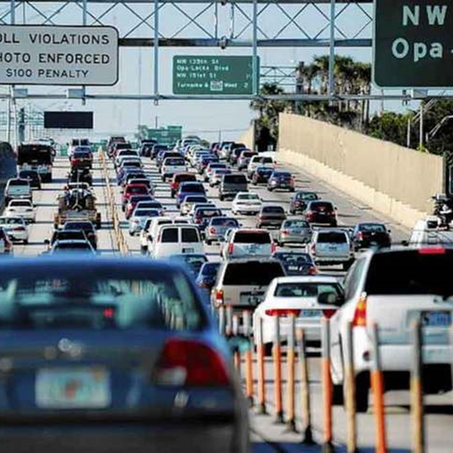
95-Express Segment 1 (Phase 1) Peak Period Toll Rate Trends
PM Peak - Northbound
NB PM Peak Rates Frequently Hit Max Toll of $10.50
AM Peak - Southbound
Source: FDOT SunGuide 95 Express Monthly Operations Reports

Slide 6
Trend in Average Peak Period Speeds General Purpose (GP) Lanes 95-Express Phase 1 - 6-Month Moving Average
GP Lanes SB
GP Lanes NB
NB GP Lanes Before Express Lanes
2013
2014
2015
2016
2017
2018
Source: FDOT SunGuide 95 Express Monthly Operations Reports

Slide 7
Trend in Average Peak Period Speeds Express Lanes 95-Express Phase 1 - 6-Month Moving Average
AM Peak - Southbound
PM Peak - Northbound
Target Minimum Express Lanes Speed
Threshold Speed for Minimum Toll Charge
2013
2014
2015
2016
2017
2018
Source: FDOT SunGuide 95 Express Monthly Operations Reports

Slide 8
Travel Demand and Toll Diversion Modeling

Slide 9
Express Lanes Time of Day (ELToD) Model Version 4
ELToD Model is a forecasting tool developed by the Florida’s Turnpike Enterprise (FTE) in collaboration with AECOM, RSG, and HNTB
Incorporates a Dynamic Traffic Assignment (DTA) Model
Predicts the share of express lanes traffic by utilizing a binary logit choice model, which includes value of time and value of reliability
Estimates the associated dynamic toll rates for the express lanes based on the defined toll pricing policy curves

Slide 10
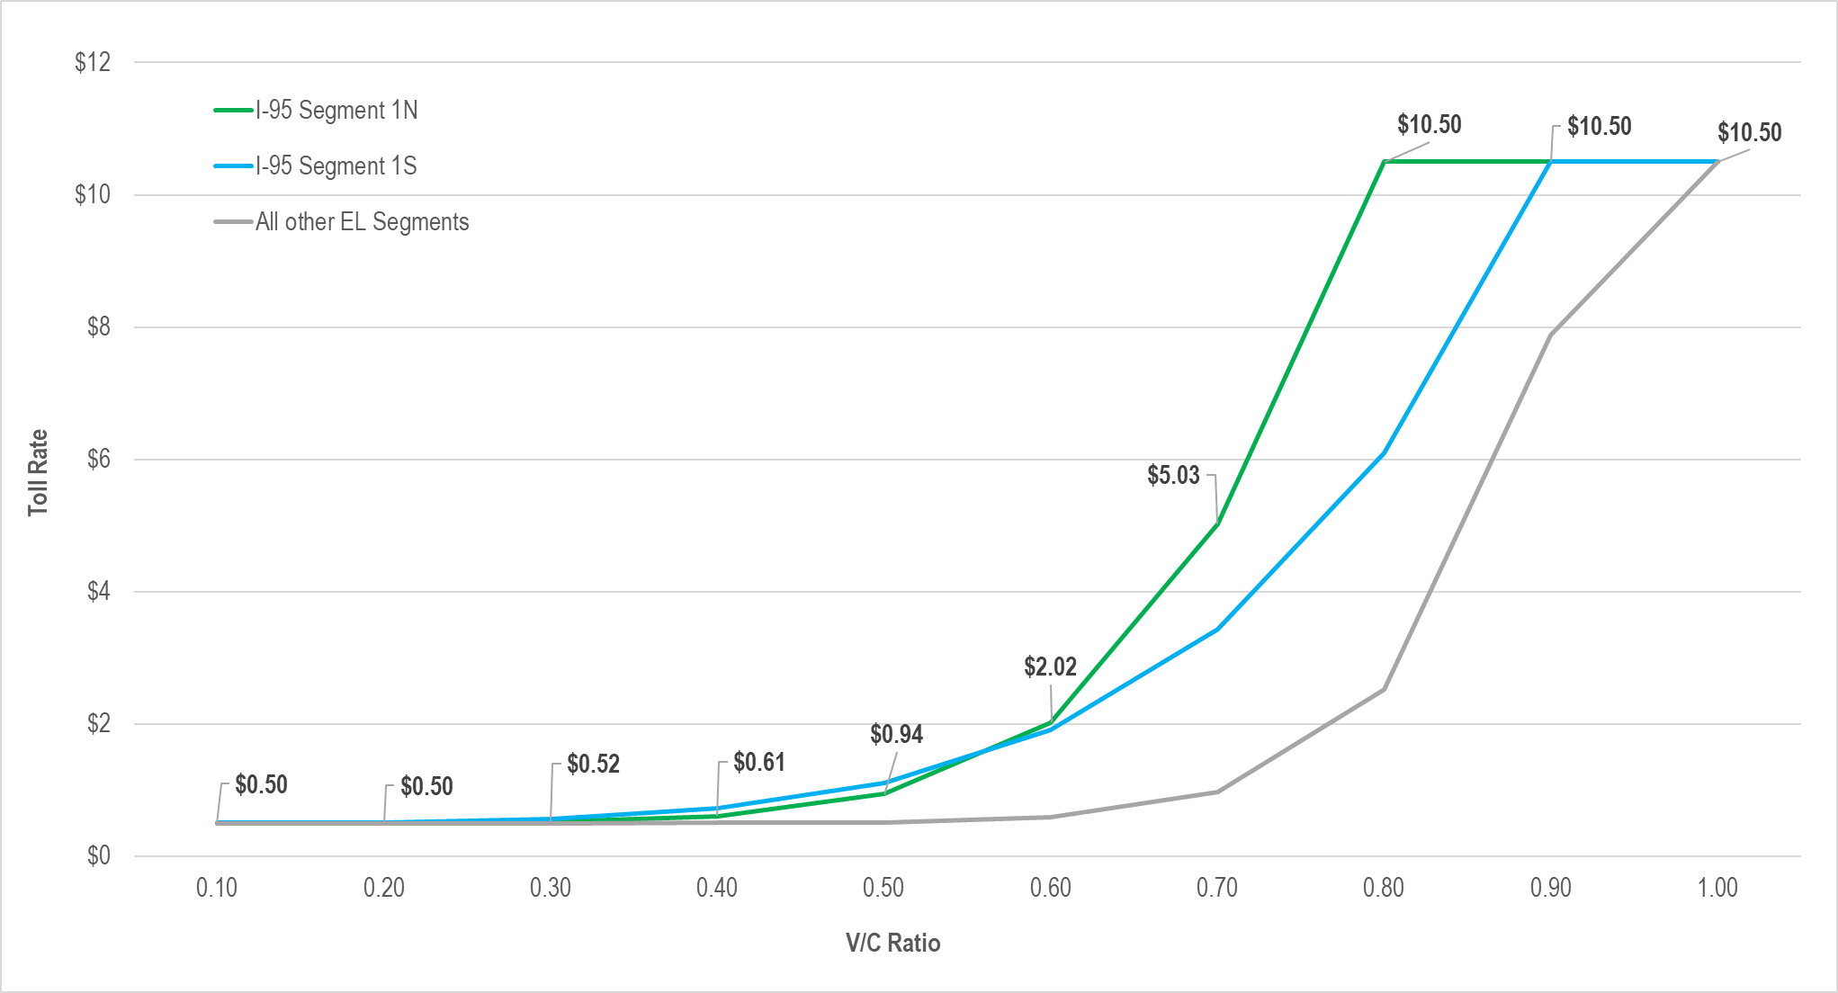
Adjusted Study Toll Pricing Curve Assumptions

Slide 11
ELToD Model Features¹
Toll Choice Model
Decision making during trip via decision making nodes.
Dynamic Toll Rates for Express Lanes
Static tolls used for toll facilities on the network.
15-minute Trip Tables
$$Express Lane Share= \frac{1}{1+ e^{(−1∗\left(β_{Constant} +{ β}_{Time}∗Time + β_{Toll}∗Toll +β_{Reliability}∗Reliability)\right)}}$$
$$βConstant=Toll Constant Coefficient$$
$$βReliability=ReliabilityRatio∗β_{time}$$
$$βTime=Time Coefficient$$
$$Reliability=γ_{r}∗delay∗{\left(distance\right)}^{{−η}_{r}}$$
$$βToll=Toll Coefficient$$
$$η_{r}=Reliability Distance Coefficient (ETA)$$
$$βReliability=Reliability Coefficient$$
$$γ_{r}=Reliability Time Coefficient (Gamma)$$
¹ ELToD Model v2.1 User Guide and Documentation. Florida Department of Transportation (FDOT), March 2016.

Slide 12
Perceived Time in ELToD Model
Perceived Time¹: ELToD model takes into account perceived time of travelers.
Max: defines the maximum travel time weight for the model.
k: determines how rapidly the travel time weights increase as the V/C ratio approaches the midpoint value for each network link.
v/c: V/C ratio for the Travel Time Weight is being calculated
Mid: defines the V/C ratio at which the travel time weights reach their midpoint value.
$Travel Time Weight= \frac{Max −1}{1+ e^{(−k∗\left(v/c−Mid)\right)}}$+1
¹ ELToD Model v2.1 User Guide and Documentation. Florida Department of Transportation (FDOT), March 2016.

Slide 13
South Florida T&R Modeling Overview
ELToD v4 modeling platform
Regional model – all study corridors in one network along with other Express Lanes (ELs) in South Florida
Calibrated to reflect recent trends (2017, 2018, and 2019)
Traffic, tolls, speeds, roadway capacities
Extensive iterative regional and corridor level calibration
30-year T&R forecast
Baseline Forecast
Risk Adjusted Forecast using Monte-Carlo analysis
Planning Level T&R Study - not intended for use in support of bond financing

Slide 14
Full-build Configuration of 95-Express
Segment 1
Segment 2
Segment 3
N
Rev. Dr.
A. Jackson Jr.
Blvd.
(95th St.)
Exit 8A
SR 858
(Hallandale
Beach Blvd.)
Exit 18
I-395/
SR 836
Exit 2D/3A
I-195/
SR 112
Exit 4
SR 934
(79th St.)
Exit 7
Phase 1
Phase 2
62nd St.
Exit 6A
SR 924
(119th)
Exit 9
Golden Glades
Interchange
Exit 12A
SR 860
(Miami Gardens Dr.)
Exit 14
Ives Dairy Rd.
(203rd St.)
Exit 16
SR 820
(Hollywood Blvd.)
Exit 20
6
5
4
5
SR 826 EW ELs
4
4
4
4
4
Turnpike ELs
4
4
3
5
5
5
5
2
2
1
2
2
1
2
2
2
1
2
2
1
2
Match Line A
6
4
5
4
4
4
4
4
5
5
3
4
5
5
5
5
69th
Exit 6B
SR 922
(125th)
Exit 10A
Turnpike ELs
SR 826 EW ELs
Miami-Dade Co.
Broward Co.
SR 824
(Pembroke Rd.)
Exit 19
Segment 4
Segment 5
Segment 6
Segment 7
Segment 8
SR 822
(Sheridan St.)
Exit 21
SR 848
(Stirling Rd.)
Exit 22
SR 818
(Griffin Rd.)
Exit 23
I-595/
SR 862
Exit 24
Park
& Ride
SR 838
(Sunrise Blvd.)
Exit 29
SR 816
(Oakland
Park Blvd.)
Exit 31
SR 870
(Commercial Blvd.)
Exit 32
Cypress
Creek Rd.
Exit 33
SR 814
(Atlantic Blvd.)
Exit 36
SR 834
(Sample Rd.)
Exit 39
Copans Rd.
Exit 38
5
5
4
4
5
5
5
4
4
4
4
2
2
2
2
2
Match Line A
2
2
2
2
2
Match Line B
5
5
5
4
SR 736
(Davie Blvd.)
Exit 26
5
5
5
4
4
4
4
Phase 2
Phase 3
SR 842
(Broward Blvd.)
Exit 27
Phase 3A-1
Phase 3A-2
Segment 9
Segment 10
Phase 3C
Phase 3A
Segment 11
Segment 12
LEGEND
Segment 1
Segment 2
Segment 3
Segment 4
Segment 5
Segment 6
Segment 7
Segment 8
Segment 9
Segment 10
Segment 11
Segment 12
I-75/
SR 869/
SW 10th
Exit 41
SR 810
(Hillsboro Blvd.)
Exit 42
Palmetto
Park Rd.
Exit 44
SR 808
(Glades Rd.)
Exit 45
SR 794
(Yamato Rd.)
Exit 48
SR 806
(Atlantic Ave.)
Exit 52
Congress Ave.
Exit 50
Linton Blvd.
Exit 51
4
4
4
4
4
5
5
5
5
2
2
2
1
0
Match Line B
HOV Lanes
Number of Managed Lanes/HOV Lanes
0
2
2
2
1
Number of General Purpose Lanes Auxiliary lanes
4
4
4
4
4
5
5
5
5
One Direction Toll Gantry
Broward Co.
Palm Beach Co.
Two Direction Toll Gantry
Phase 3B-1
Phase 3B-2
One Direction Data Gantry

Slide 15
2018 Study Methodology
Base year (2017) ELToD model calibration
Reviewed hourly traffic counts on ramp and mainline locations from FDOT’s website; screenline counts were added
Developed updated detailed count profile for 95-Express/595-Express (including detailed count patterns at GGI), and profile along I-75/SR 826
Several iterations of Origin/Destination Matrix Estimation (ODME) and model calibration performed
ODME included 8 network wide screenlines

Slide 16
2018 Study Methodology (Cont'd)
24 different ELToD calibration runs
Toll Constants at each Decision Making Node were updated for every 15-min for all model years.
Toll Pricing Curves updated
Speeds/capacities on arterials updated
Capacities on general purpose lanes and express lanes updated
PCE factor updated for trucks
Dynamic Traffic Assignment (DTA) module update
Reviewed 95-Express, 595-Express and 75-Express trends in terms of traffic, toll, revenue, and operations through April/May 2018

Slide 17
2018 Study Methodology (Cont'd)
Future Year models
2018, 2019, 2021, 2023, 2024, 2028, 2030, 2035, and 2045
2028 Model Year run with and without GGI improvements, including TPKE/SR 826 EW ELs
2030 Model Year run with and without Sawgrass Express 10th St extension
Base year trip table adjustments carried to future years
Network updates to reflect latest phasing on 95-Express and 75-Express, and other ELs on the network (Turnpike, HEFT, Sawgrass)
Post-processing adjustments were applied after performing reasonableness checks

Slide 18
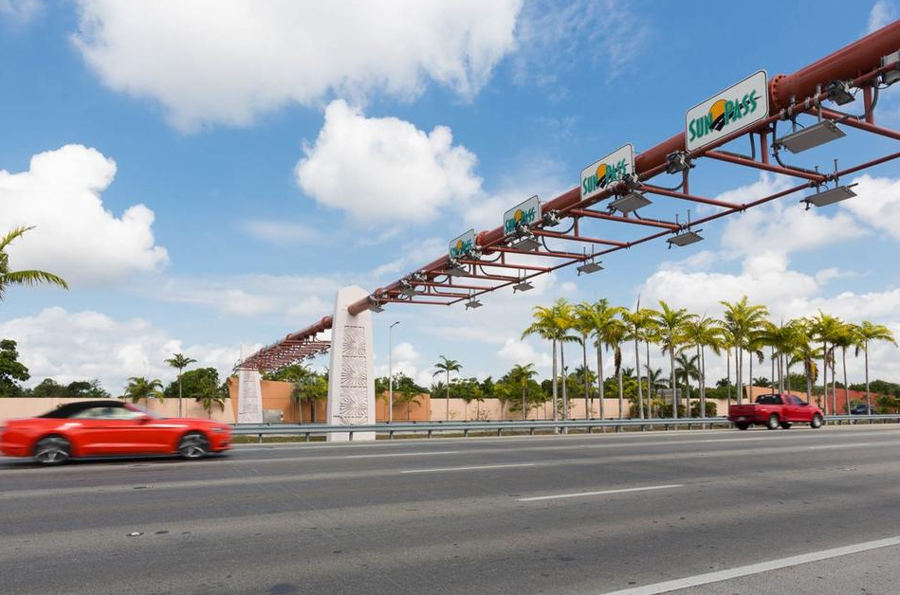
Results

Slide 19
Calibration Results
Differences between corridor demand after ODME and after ELToD runs, which significantly impacted EL volumes. Screenline counts were added to ODME to solve this issue

Slide 20
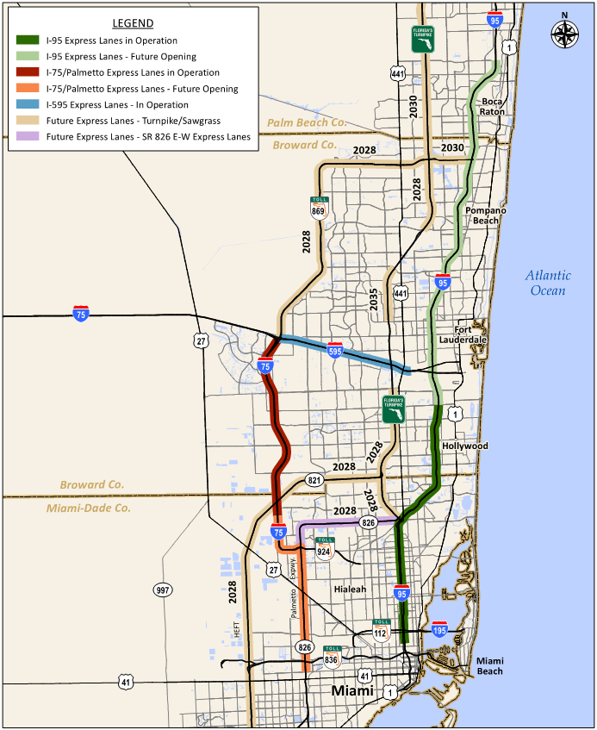
Other Express Lanes in South Florida
Modeled by 2028
Golden Glades Interchange (GGI) Improvements
HEFT Express Lanes
Sawgrass Express Lanes
SR 826 Express Lanes East West Extension
Turnpike Express Lanes – GGI to Griffin Rd and Atlantic Blvd. to Sawgrass Expressway
Modeled by 2030
Sawgrass Express Lanes SW 10th St. Extension
Turnpike Express Lanes - Sawgrass Expressway to Hypoluxo Rd.

Slide 21
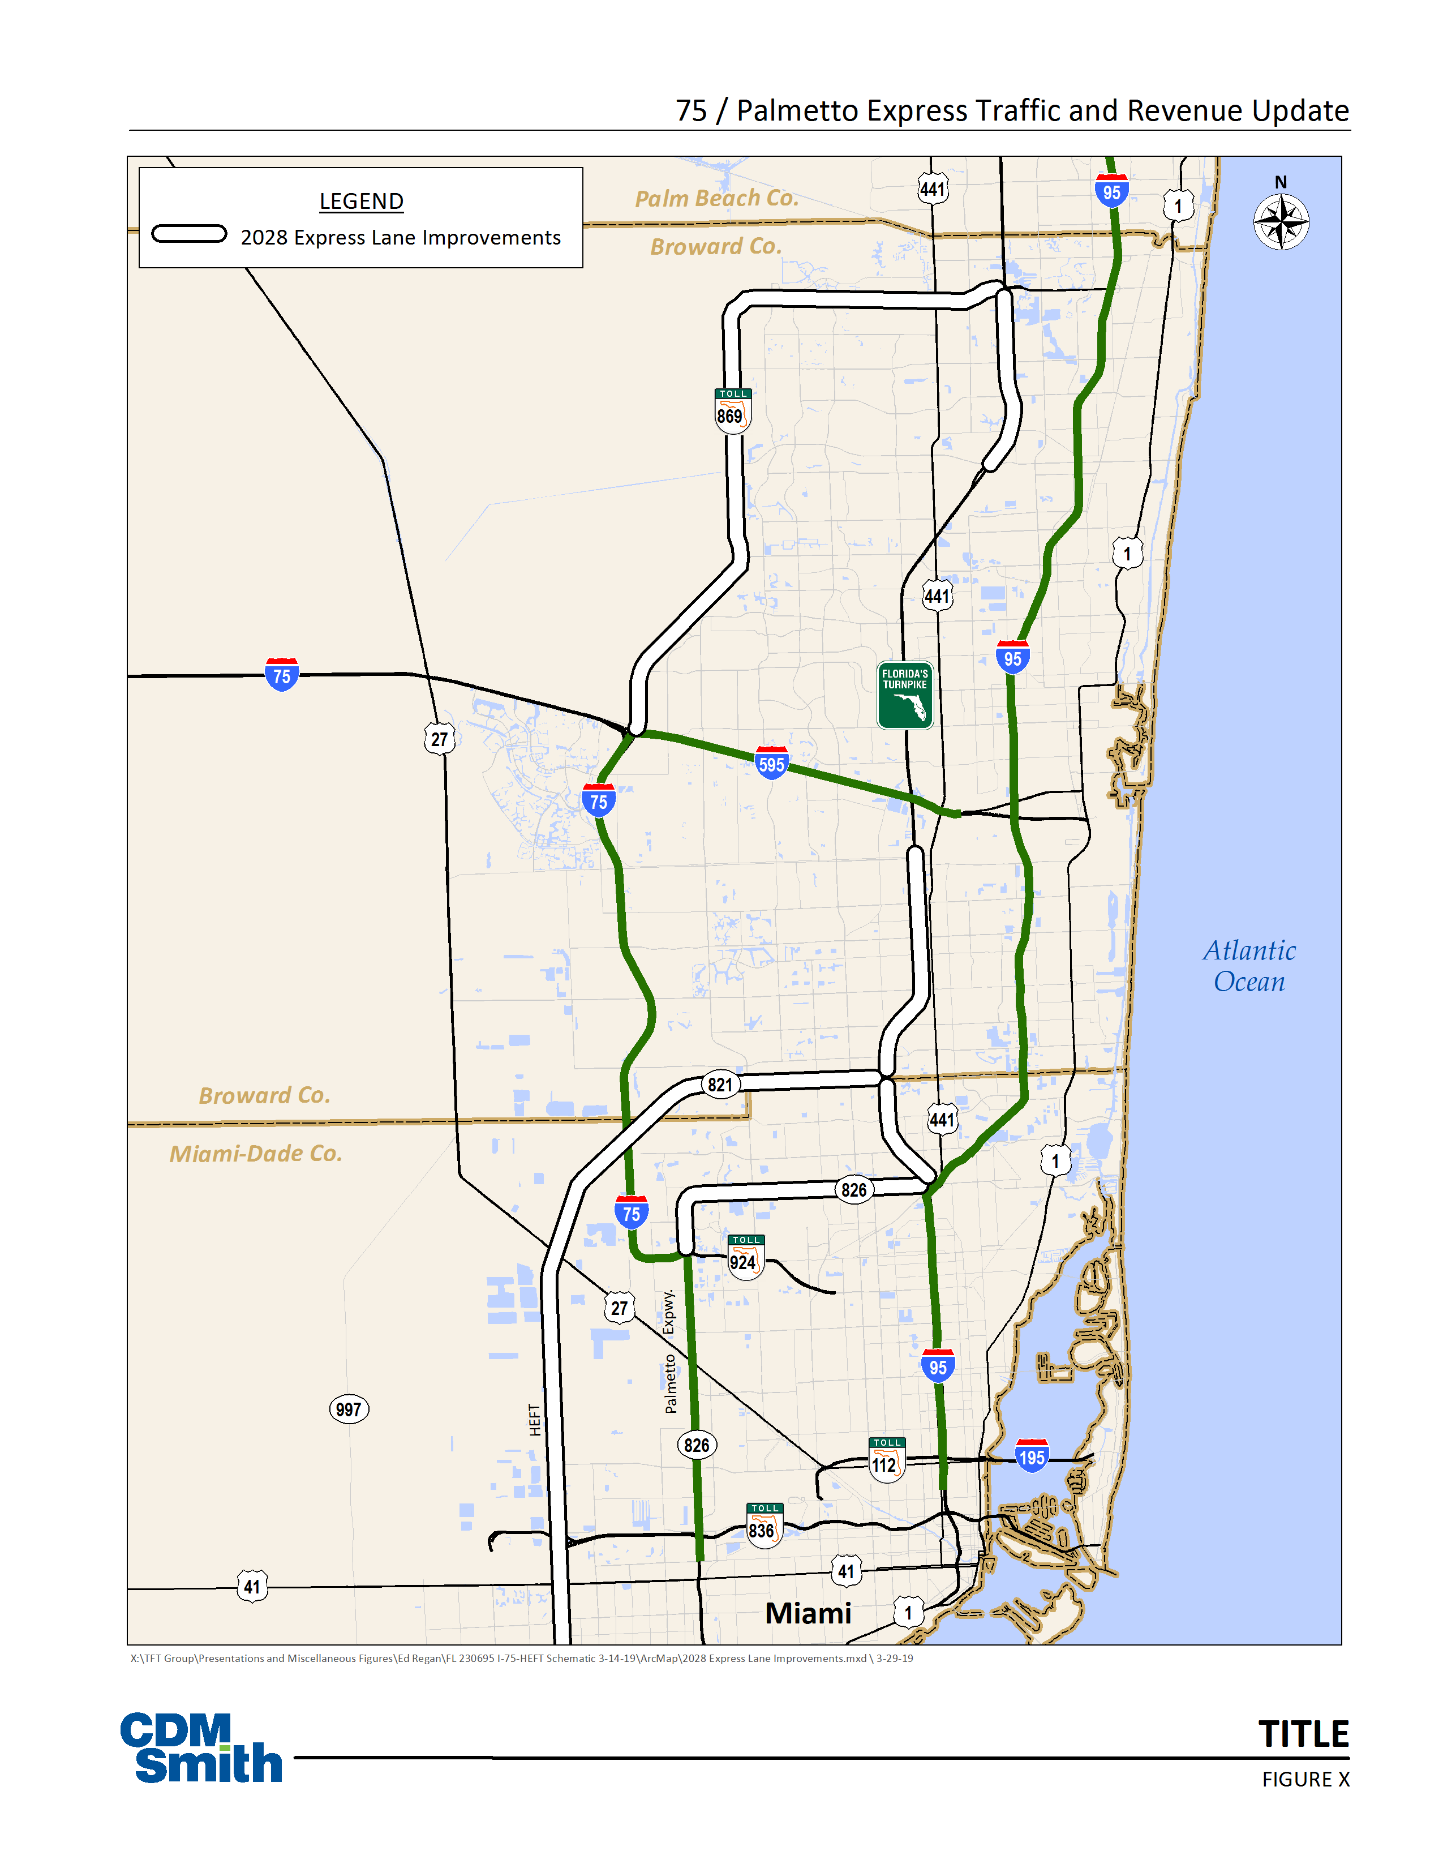
Comparative Results for Model Year 2028
LEGEND
Traffic Decrease
Traffic Increase
Revenue Decrease
Revenue Increase
2028 Express Lanes Improvements
95-Express Phase 1 NB
Due to improvement of GGI bottleneck, increase in traffic but decrease in revenue (as tolls required to maintain free-flow speeds decrease)
595-Express and 75-Express
Drop in traffic and revenue due to opening of SR-826 E/W EL and HEFT EL
Palmetto/SR-826 Express
Increase in traffic and revenue due to opening of SR-826 E/W EL

Slide 22
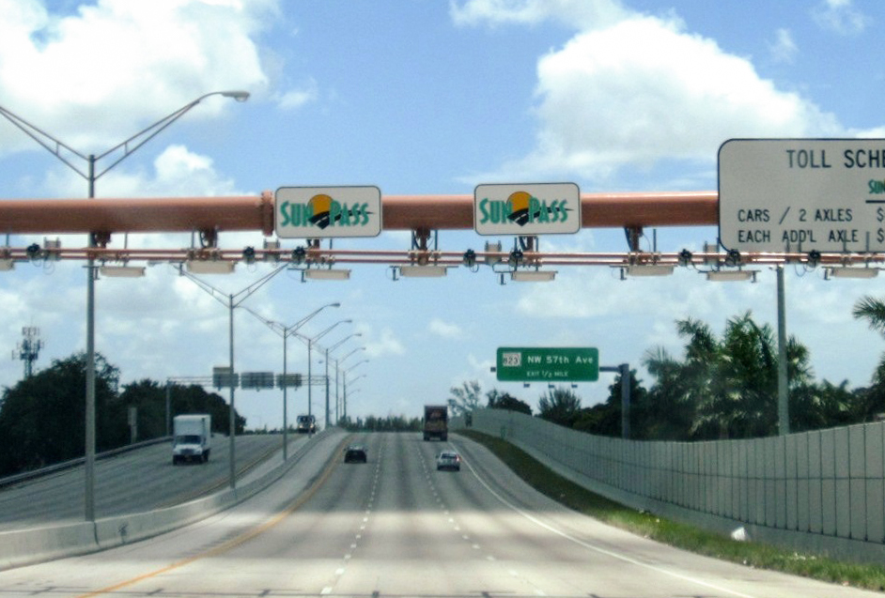
Thank you!

