Slide 1
Visitor modeling Using big data
Transportation Planning Applications Conference
June 4, 2019

Slide 2
Motivation and Overview
Planning resources typically focused on residents
Visitor travel often ignored
Mobile phone data
Includes visitors
Massive sample sizes
Relatively inexpensive
Case Study
Los Angeles Region
Location-Based Services (LBS) data
6-months, 22 million devices
Home locations nationally
Using this data we can develop visitor travel metrics

Slide 3
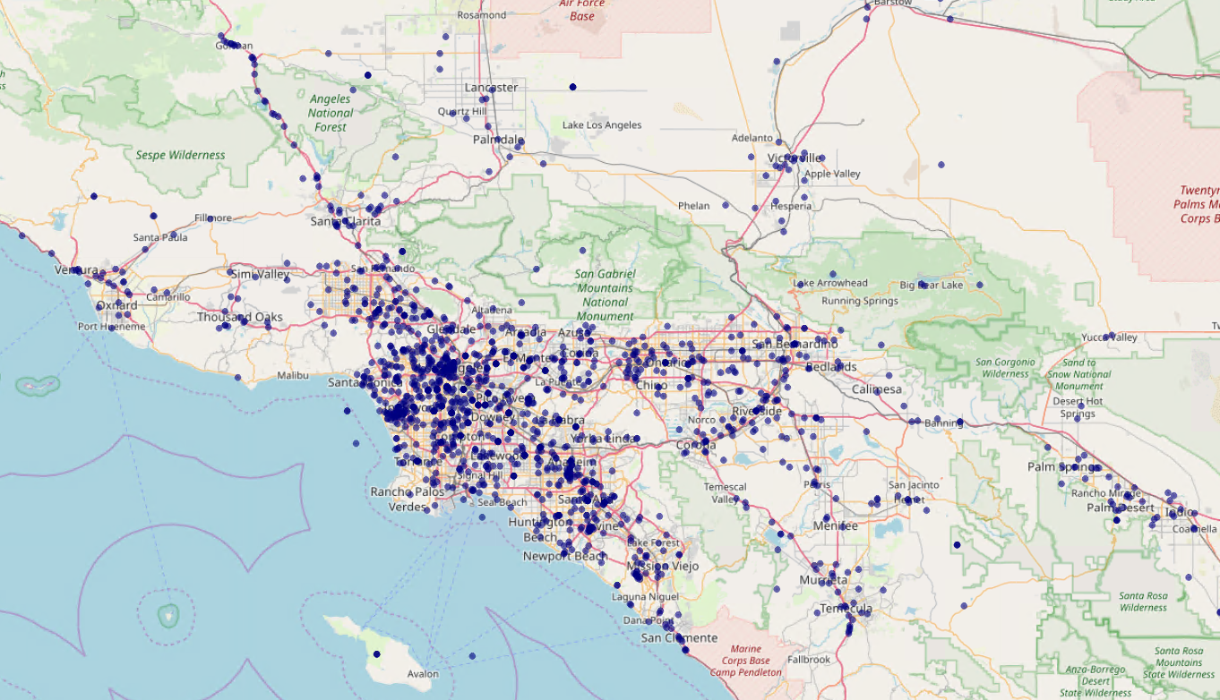
First Time in the Region

Slide 4
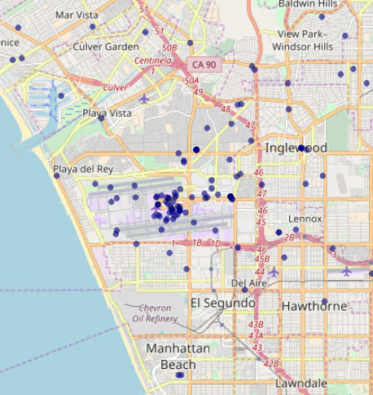
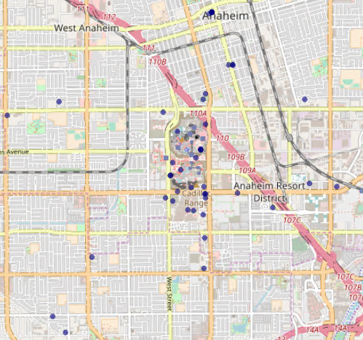
First Time in the Region

Slide 5
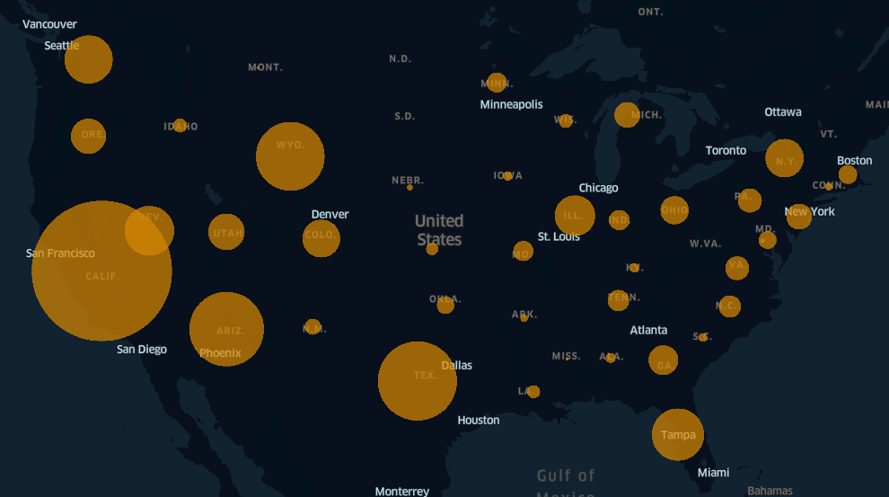
Visitor Home States

Slide 6
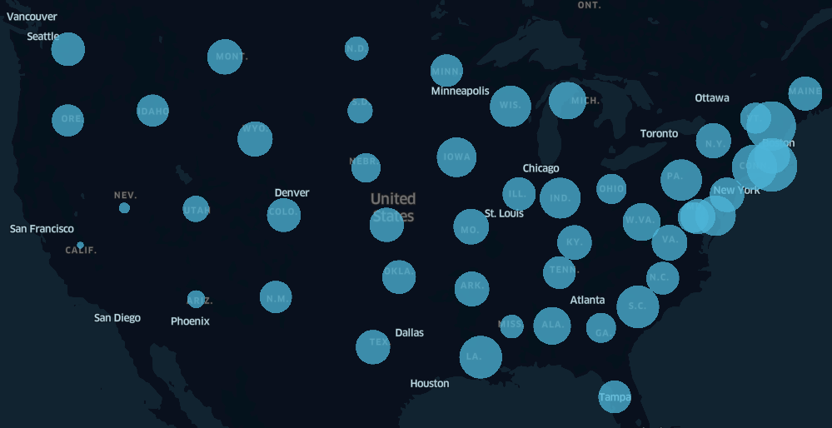
Length of Visit
Average Length of Visits: 4 days
Average visits Per Device: 1.8

Slide 7
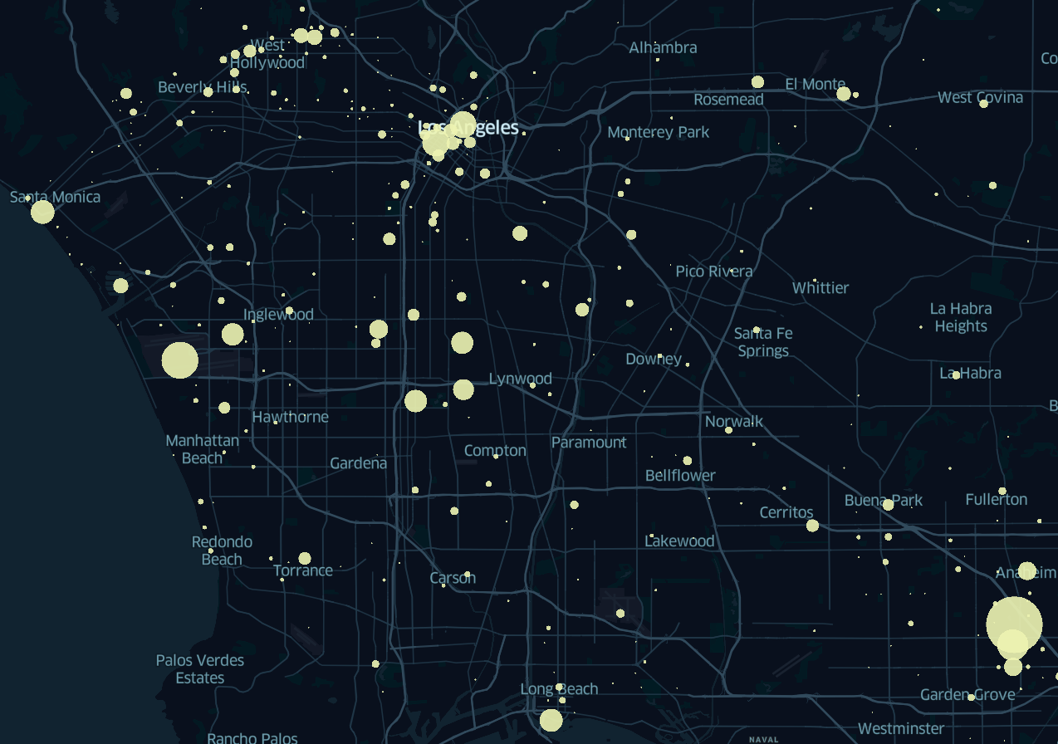
Overnight Stays

Slide 8
Visitor Arrival and Departure Day of Week

Slide 9
Visit Arrival Day by Departure Day
Arrival /Departure Day | Mon | Tue | Wed | Thu | Fri | Sat | Sun | Total
Mon | 0.5% | 1.5% | 2.4% | 3.1% | 2.3% | 1.2% | 0.8% | 11.8%
Tue | 0.8% | 0.9% | 1.7% | 2.2% | 2.3% | 1.6% | 1.1% | 10.5%
Wed | 1.6% | 1.1% | 0.6% | 1.6% | 2.2% | 2.8% | 2.5% | 12.4%
Thu | 3.0% | 1.8% | 0.7% | 0.5% | 1.6% | 3.0% | 5.3% | 16.0%
Fri | 5.1% | 3.2% | 1.3% | 0.8% | 0.9% | 3.3% | 7.5% | 22.0%
Sat | 3.5% | 3.7% | 1.7% | 1.0% | 0.9% | 1.5% | 4.2% | 16.5%
Sun | 1.5% | 2.1% | 2.3% | 1.6% | 1.6% | 1.1% | 0.6% | 10.8%
Total | 15.9% | 14.2% | 10.7% | 10.9% | 11.8% | 14.5% | 22.0% | 100%

