Slide 1
Segmented University Models in the WATS and CAMPO TDMs
Stephen Tuttle (RSG)
Vince Bernardin, PhD (RSG)
Mark Ferrall (WATS)
June 4, 2019

Slide 2
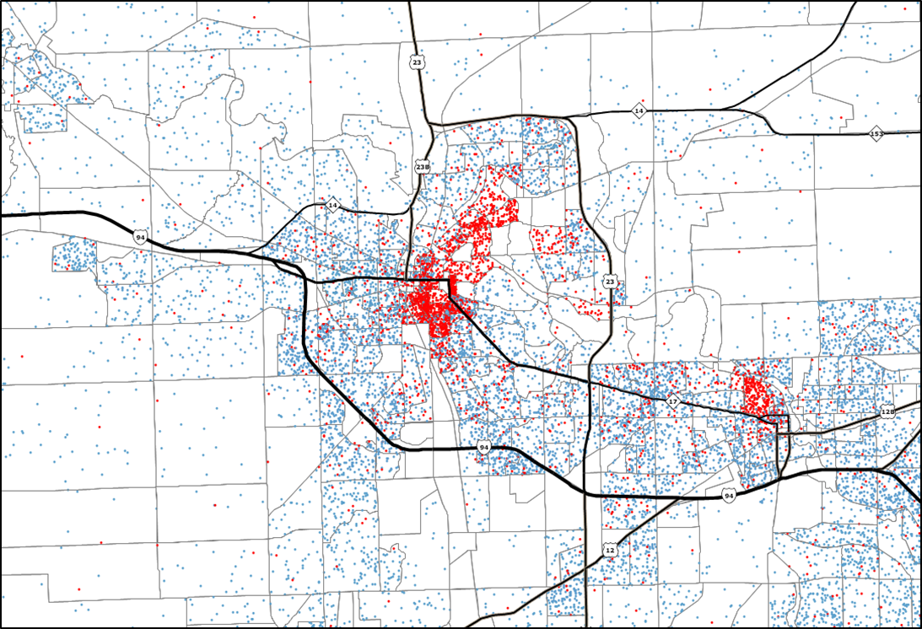
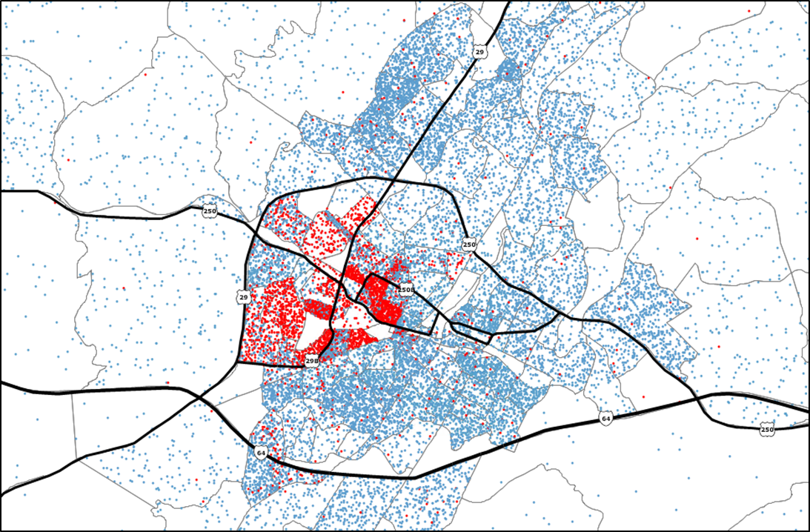
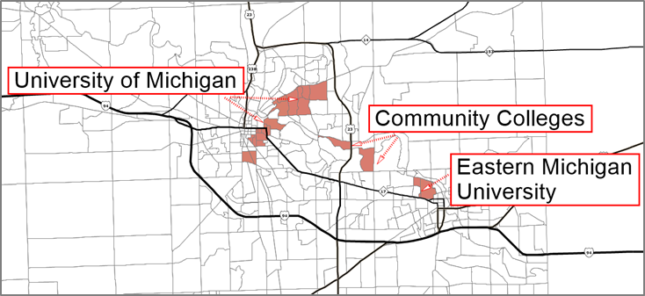
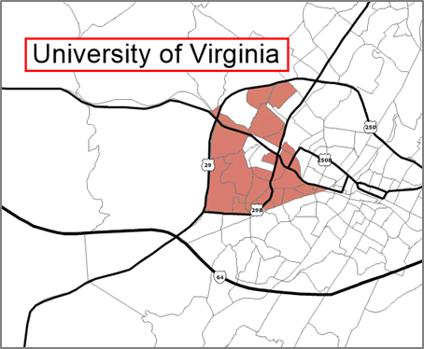
Study Areas
Student population
can be significant
WATS (Washtenaw County, MI)
CAMPO (Charlottesville, VA)
Total Population
362,254
Student Population:
65,133 (total)
19,217 (on-campus)
Total Population
173,280
Student Population:
21,983 (total)
11,761 (on-campus)
WATS Campus
CAMPO Campus

Slide 3
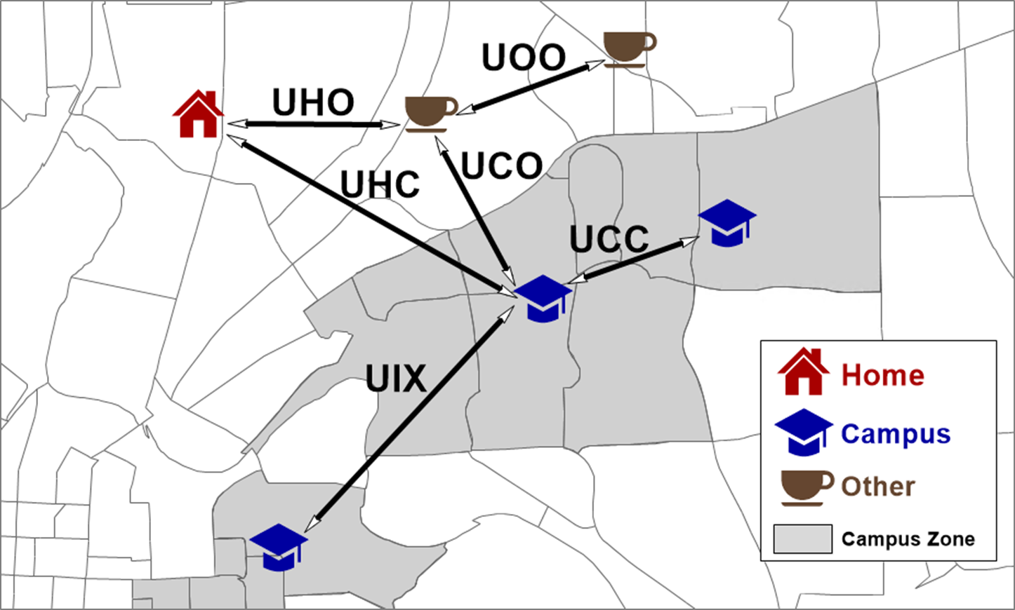
Trip Purposes and Market Segments
Simple improvements over
“HBU” model, while keeping trip/tour framework
Purpose Diagram
Purpose Definitions
UCC – Intra Campus
UIX – Inter Campus
UCO – Campus to Other
UHC – Home to Campus
UHO – Home to Other
UOO – Other to Other
Market Segments
On-Campus
Off-Campus
Part-time

Slide 4
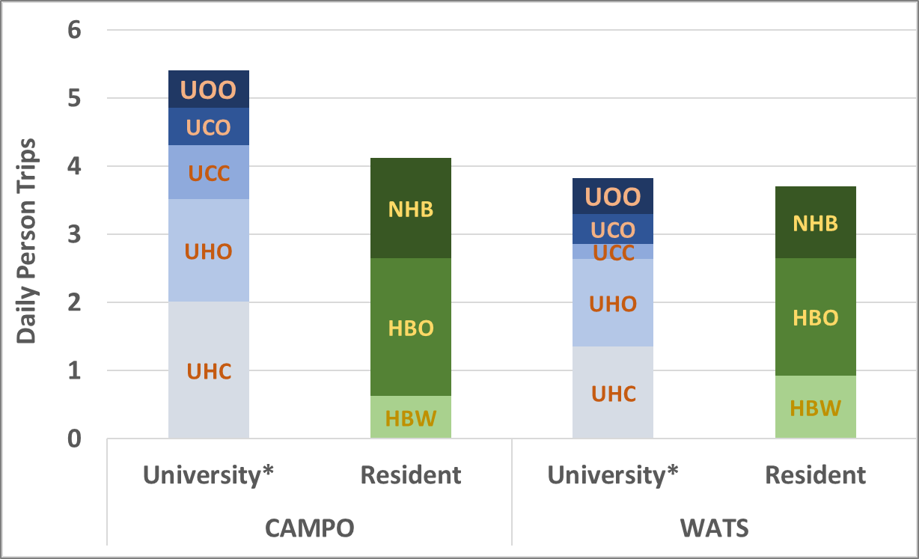
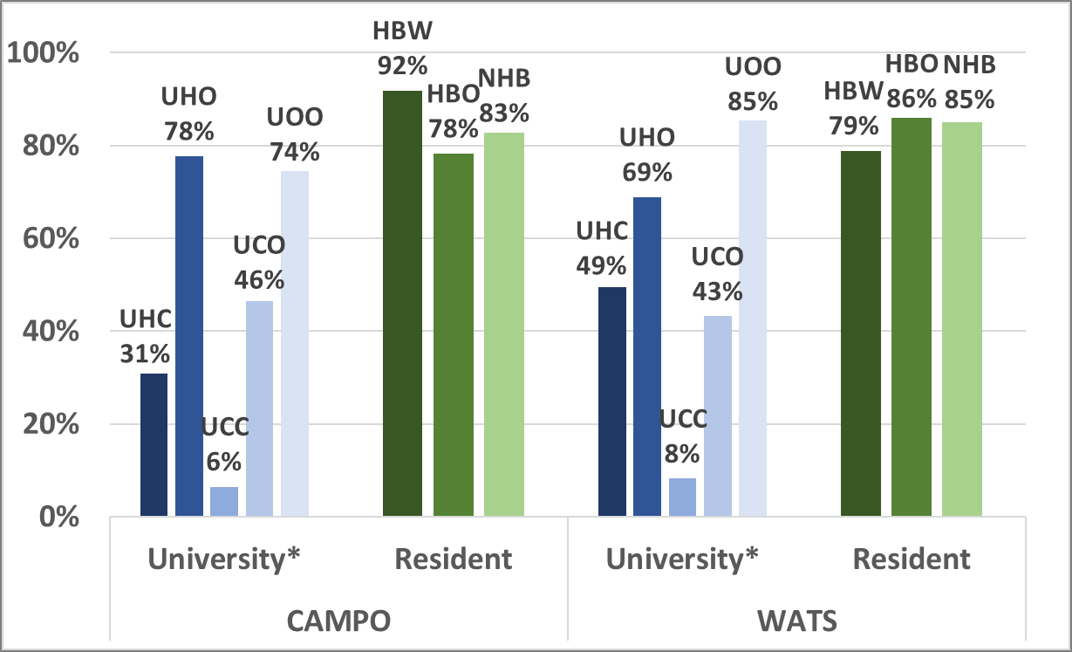
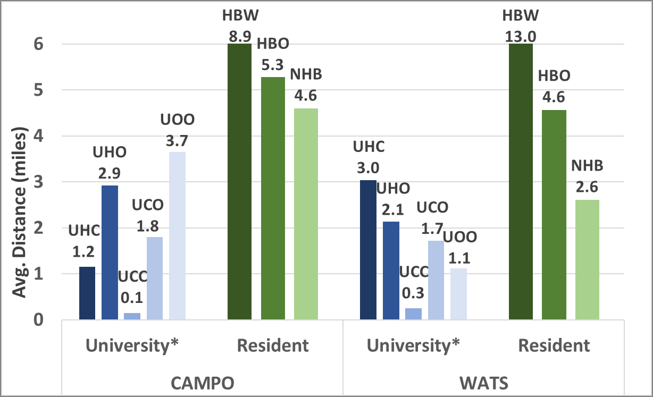
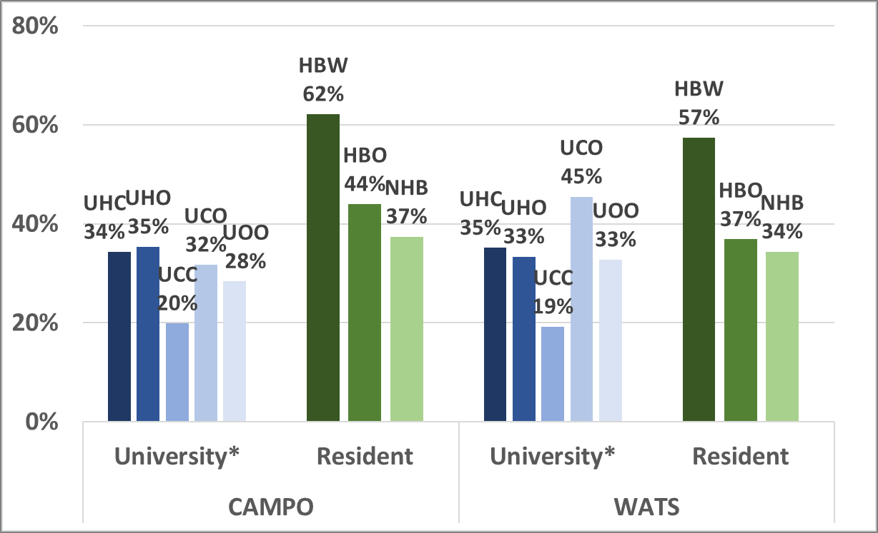
University Student Travel Behavior
Important differences between student and resident travel
Generation
Mode Choice
Data Sources
UVA Student Survey
Households Surveys
AirSage (WATS)
Trip Distances
Peak Period Shares

Slide 5
University Model Design
Trip Generation (Home/Campus-Based)
Trip Distribution
(Home/Campus-Based)
The university and resident demand models are applied separately but include the same major steps.
Trip ends are based on student housing, classroom enrollment, and employment and amenity variables.
Gravity models distribute trips.
Nested logit models predict mode shares.
UOO trips are predicted from UCO and UHO attractions, within a hybrid trip/tour framework.
Fixed factors are used for the time of day split.
Mode Choice
(Home/Campus-Based)
UOO Trip Generation
(Non-home/Non-Campus-Based)
UOO Trip Distribution
(Non-home/Non-Campus-Based)
Time of Day Split

Slide 6
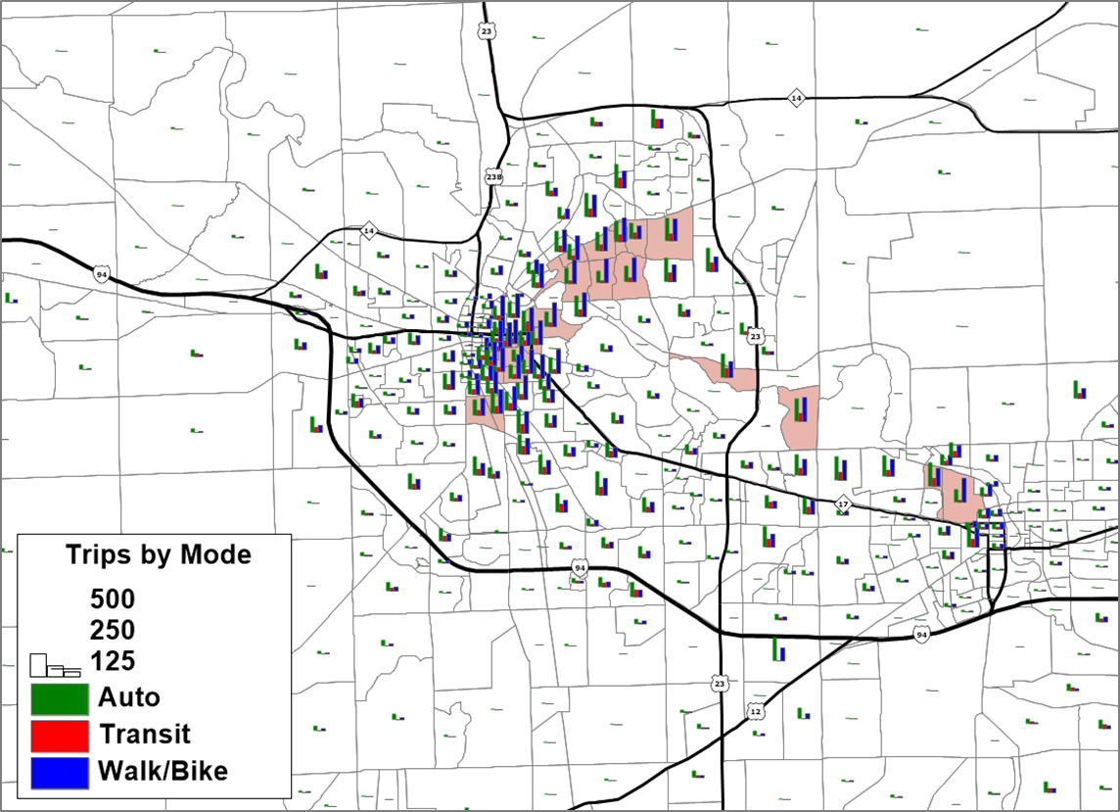
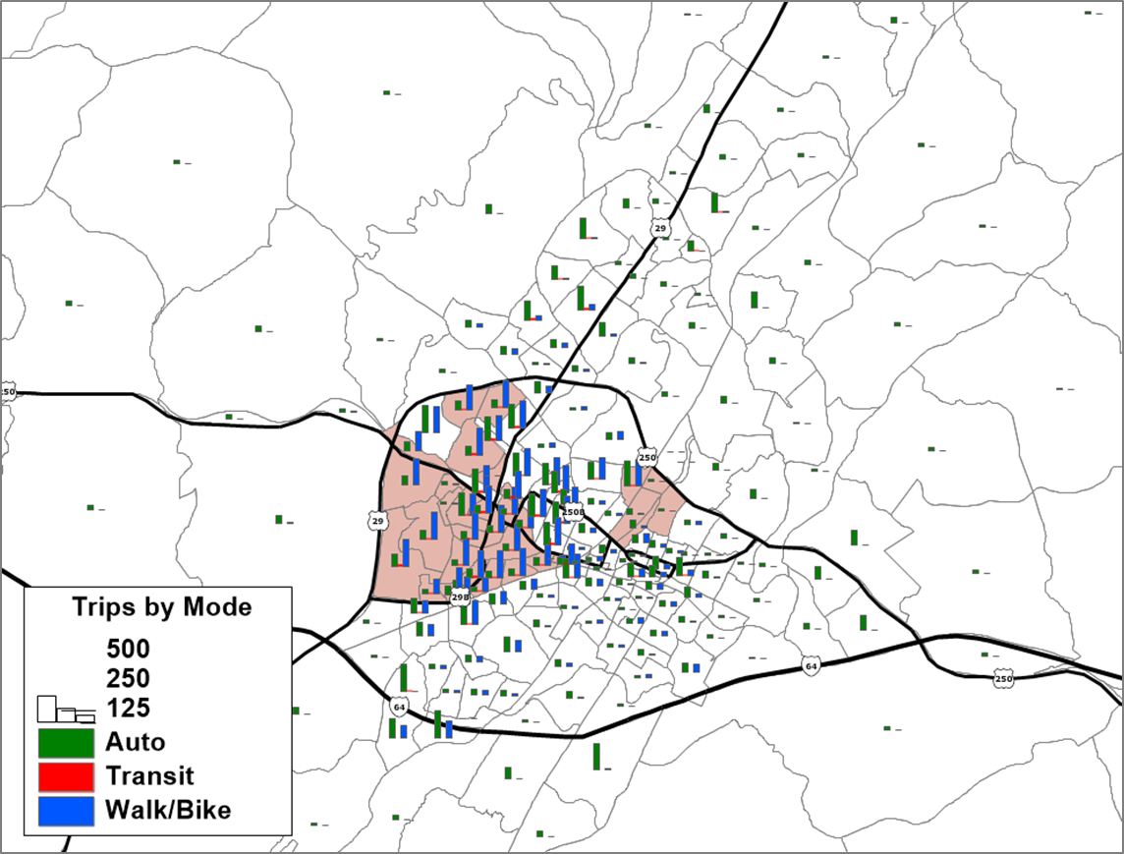
Model Results
More trips near campus,
including many walk/bike
WATS Trips by Mode
CAMPO Trips by Mode

Slide 7
Acknowledgements
Partner Agencies
Washtenaw Area Transportation Study (WATS)
Michigan Department of Transportation (MDOT)
Charlottesville/Albemarle Metropolitan Planning Organization (CAMPO)
Virginia Department of Transportation (VDOT)

Slide 8
Stephen Tuttle
SENIOR CONSULTANT
stephen.tuttle@rsginc.com
312.605.9203
Vince Bernardin, PhD
DIRECTOR
vince.Bernardin@rsginc.com
812.200.2351

