Slide 1
Practical Population Synthesis Enhancements to Support Advanced and Activity-Based Travel Demand Models
Ramachandran Balakrishna
Srinivasan Sundaram
Caliper Corporation
2019 TRB Planning Applications Conference
Portland, OR
3rd June, 2019

Slide 2
Outline
Population synthesis overview
Limitations in current methods
Proposed methodology
Solutions to practical (data) challenges
Illustrative results
Qualitative summary of results

Slide 3
Population Synthesis Overview
Objective
Enumerate a region’s households (HH) and constituent persons
Forms base for advanced travel demand models
Hybrid (trips/tours with some disaggregate aspects)
Activity-Based Models (ABM)
Inputs:
Sample of HH and persons (e.g. ACS PUMS) with attributes
Control totals of desired HH and person variables
HH Size (1,2,3,4+), Income (Low,Med,Hi), Gender (M,F), …
Usually at finer geography than the sample
Outputs:
HH and person tables that aggregate accurately to control totals

Slide 4
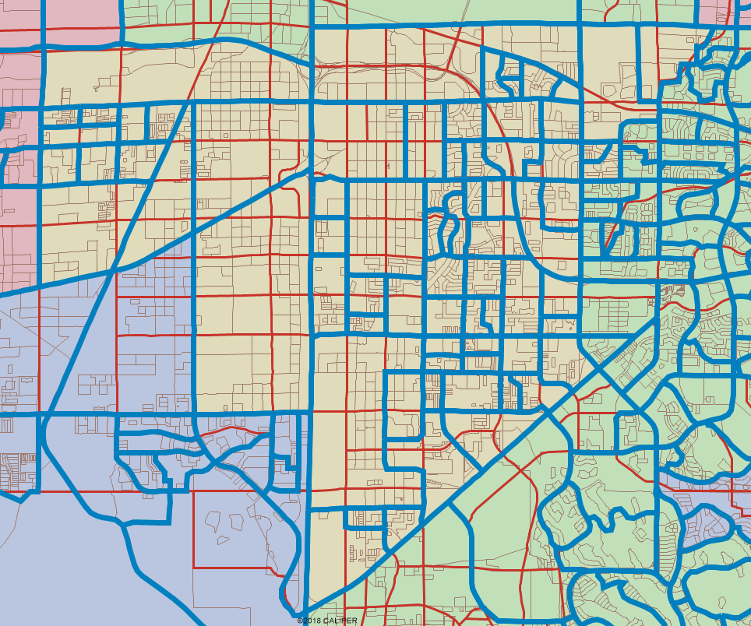
Population Synthesis Overview
Examples of geographic layers

Slide 5
Population Synthesis Overview
Typical synthesis steps
Read (or estimate) weights for each HH in the sample
Select a geographic resolution (e.g. blocks or zones)
For each geographic element
Assemble the control totals across variables of interest
Estimate the number of each sample HH type to include
By matching the HH control totals
(e.g.) Iterative Proportional Fitting (IPF)
Randomly draw from the sample to make up the required #HH
Use weights to derive the sampling probabilities

Slide 6
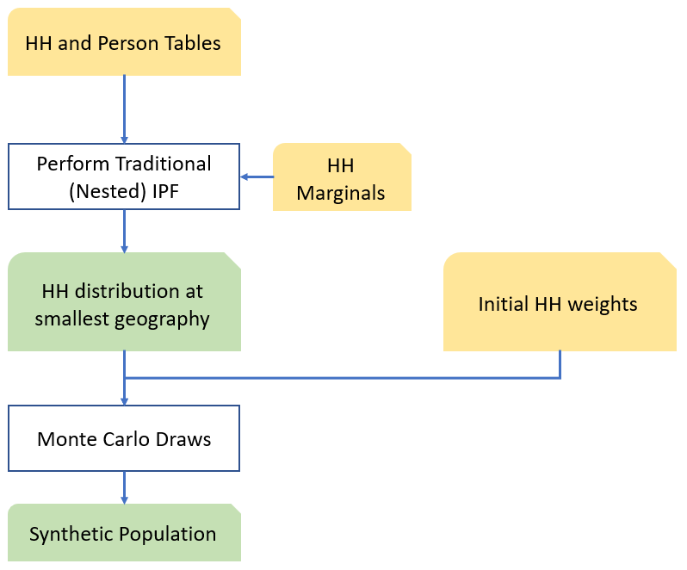
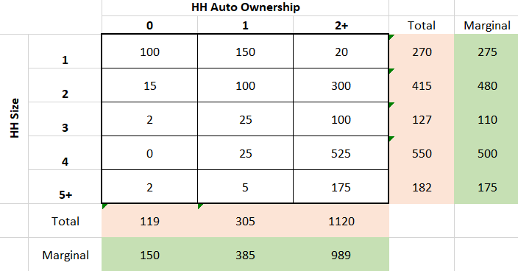
Population Synthesis Overview
Typical synthesis steps (contd.)
Nested IPF handles controls from different geographies
(e.g.) blocks, block groups, zones, …
IPF: Scale rows and columns iteratively to match marginals

Slide 7
Limitations in Current Methods
Methods have largely matched only HH control totals
(e.g.) Size, auto ownership, income
Person totals are left to chance, often fit poorly
But are critical to person-level calculations like in ABMs
(e.g.) Age, gender, work status, …
Fixes have been proposed and tried
Optimization-based methods stay close to initial HH weights
Biased starting weights persist into the synthesized outputs
Modified heuristic methods have created new problems
Sensitivity to sample data scarcity
Long running times (several hours)

Slide 8
Limitations in Current Methods
Iterative Proportional Updating (IPU) heuristic
Joint distribution of all HH and person variables
Exponential increase in number of columns
(e.g.) 4 variables with 3 levels each = 81 columns
Each sample HH contributes to a (small) number of columns
Pros:
Includes each sample HH’s contribution to person variables
Simple: iteratively matches column totals like in IPF
Cons:
Fractionates sample records among large number of columns
Resulting zero-cell, zero-marginal problems need heuristic fixes
Impractical running times
4 hours for 2088 block groups (quad-core proc.)[Ye et. al. (2009)]

Slide 9
Proposed Methodology
Simplify the IPU survey incidence table
Individually match each variable level, not their exhaustive combinations
Zero-cell, zero-marginal instances much less likely
Iterate between column totals like in traditional IPU

Slide 10
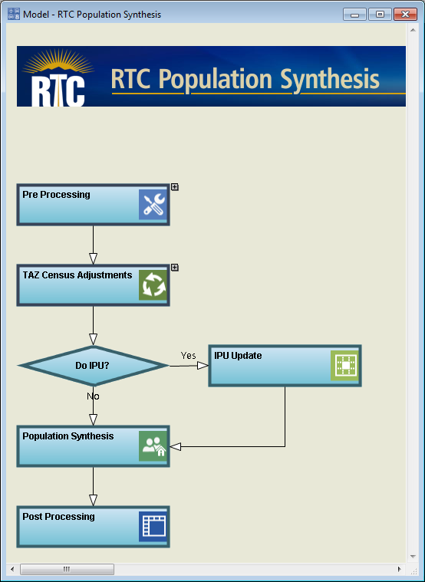
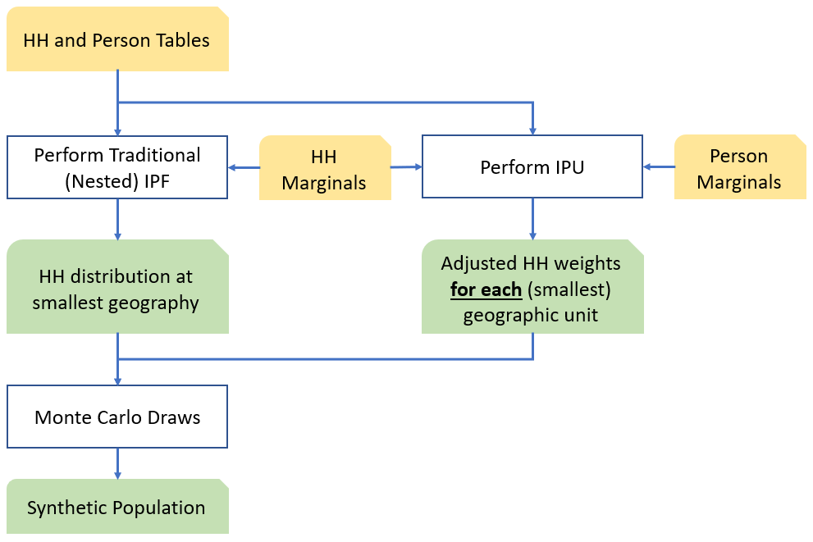
Proposed Methodology
Integrated framework
Implemented as a general feature in TransCAD

Slide 11
Proposed Methodology
Benefits of the new approach
Jointly match both person and HH variables
Improve robustness of estimation
Allow HH weights to change for each geographic unit (e.g. block group)
Highly efficient computations
Approach can also be used to re-weigh HH surveys
Treat entire region as one geographic unit
Improve accuracy of trip-based models

Slide 12
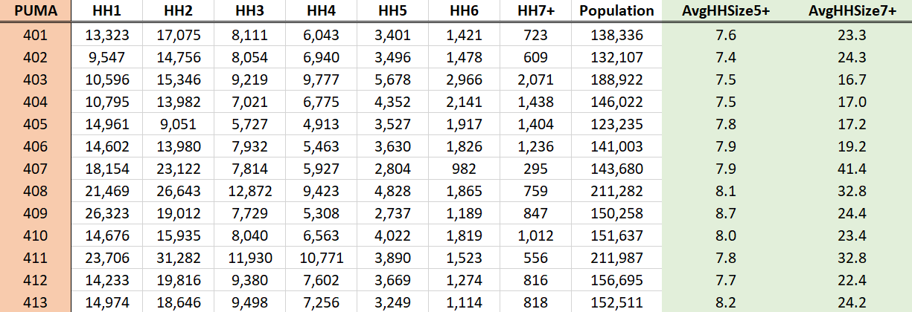
Solutions to Data Challenges
Inconsistencies between HH and person marginals
Result in an infeasible mathematical problem
Can match HH or person variables, but not both
Key issue: Large average HH sizes in the highest bins
Multi-HH need to be split for travel modeling purposes
Corrections need to come from outside these datasets

Slide 13
Solutions to Data Challenges
Database USA records
Available for purchase
Based on a variety of commercial sources including credit card transactions
Contains detailed demographic information
HH counting methods differ between Census, Database USA
Multi-family HH correctly split into functional HH units
Census: 820K, Database USA: 1.15 million
Average 5+ HH size = 5.57
Almost the same for two different states (Nevada, California)

Slide 14
Solutions to Data Challenges
Correction method for marginals
Retain the number of 5+ HH from Census
Infer the 5+ HH population using Database USA average
Compute “excess” population from the 5+ bin
Reallocate the excess to smaller HH sizes
In proportion to Census HH size distribution
Use these new marginals in the synthesis

Slide 15
Illustrative Results: Las Vegas, NV
Without IPU
With IPU

Slide 16
Illustrative Results: Central Coast, CA
Without IPU
With IPU

Slide 17
Qualitative Summary of Results
Modified IPU
Corrects for systematic bias in person variables
Expected to highly impact the outcomes of disaggregate models
Daily household activity patterns
Household interactions
Features practical run times (10 minutes for Las Vegas)
Provides solid platform for advanced travel demand models
Current work: Localizing the impacts of targeted changes to marginals

