Slide 1
An Agile, Data-Driven Ensemble Modeling Framework for the ILSTDM
Vince Bernardin, PhD, Steve Tuttle, Sheng Chen
June 3, 2019

Slide 2
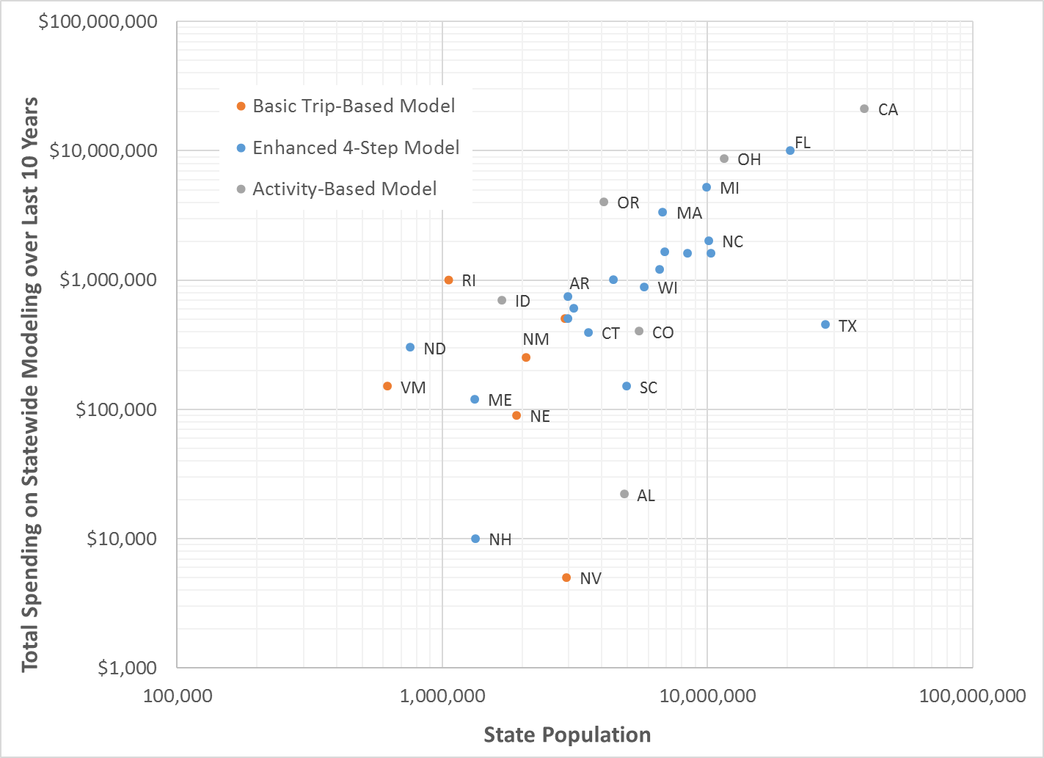
Illinois is investing in a Statewide Model
AVERAGE 10-YR COST OF A STATEWIDE MODEL FOR A “LARGE” STATE
  Enhanced Trip-Based Model: $2,240,000
  Activity-Based Model: $5,690,000
IL
ILLINOIS INVESTMENT IN A STATEWIDE MODEL
  Initial 3-Year Investment: $1,632,840
Average figures and graph from NCHRP 08-36 Task 137 Draft Final Report

Slide 3
Status
Network and Zone Development Tasks Now Complete
On-going
  Development of Future Year Scenarios
  Development of Freight and Passenger Demand Models

Slide 4
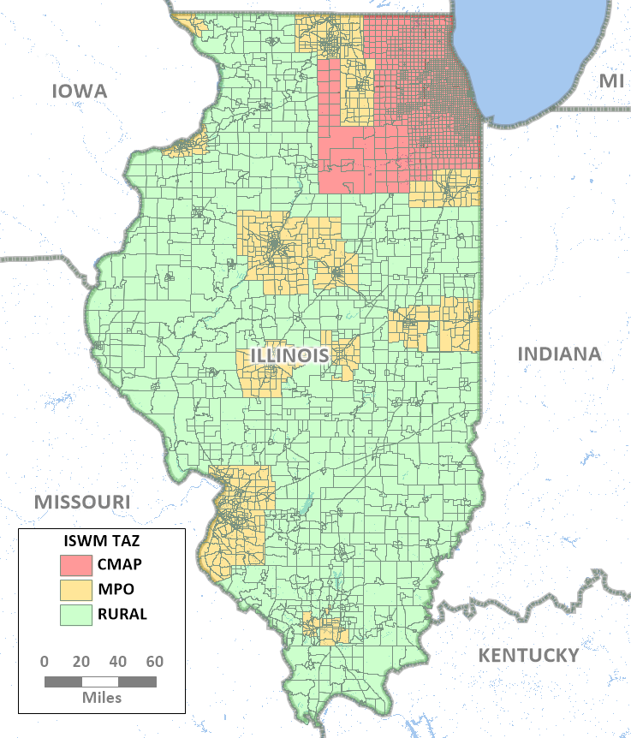
Building on Existing Models
ILSTDM TAZ Inside Illinois
Area | Total TAZs
CMAP Area | 1,752
MPO Area | 1,252
Rural Area | 1,362
Total (Inside Illinois) | 4,366

Slide 5
PHASE 1
TIME: Aug 2019
PRODUCT: ILSTDM v1 will have fixed base and future year demand (OD tables) that can be assigned to the statewide highway network for different highway network investment scenarios

Slide 6
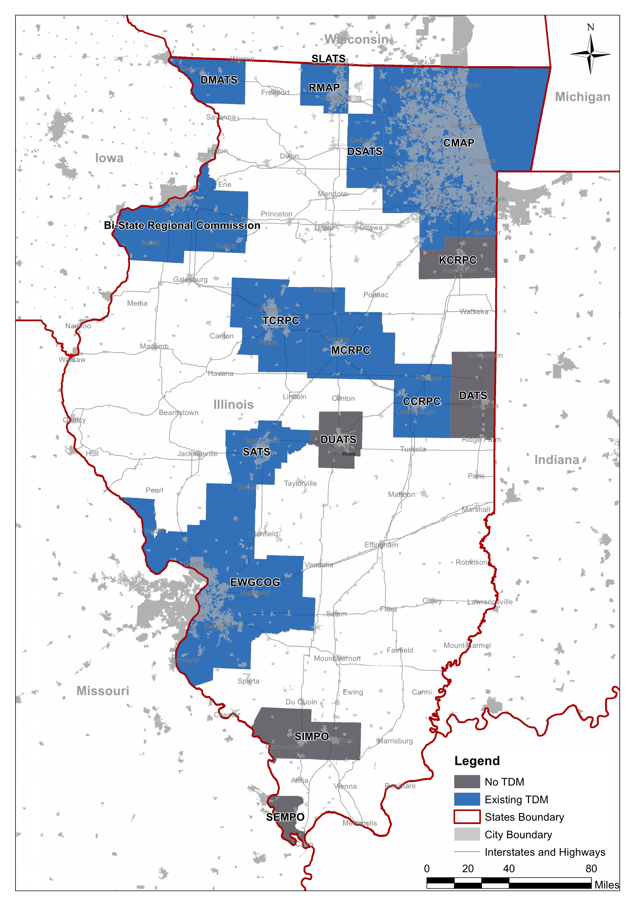
Phase 1 Future Demand
Pivot off of Base OD Data
MPOs – MPO Model OD Growth
  From future E+C trip tables
Rural – Quick Response

Slide 7
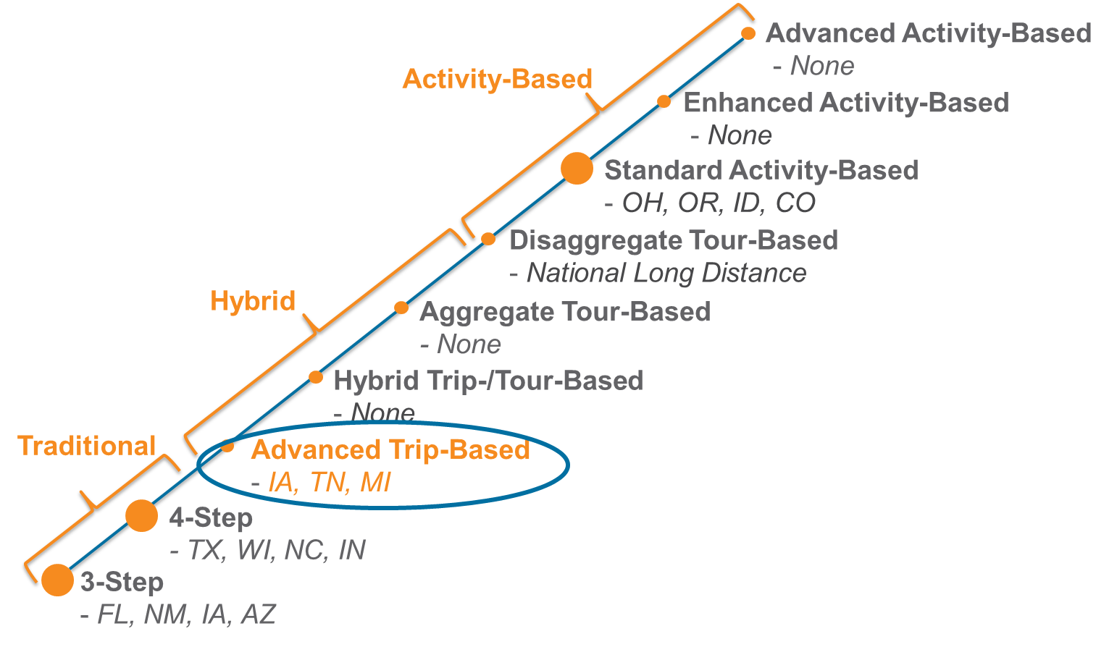
PHASE 2
TIME: Nov 2020
PRODUCT: ILSTDM v2 will
have dynamic advanced
trip-based passenger demand
and commodity flow-based
freight models as well
as the original v1
demand

Slide 8
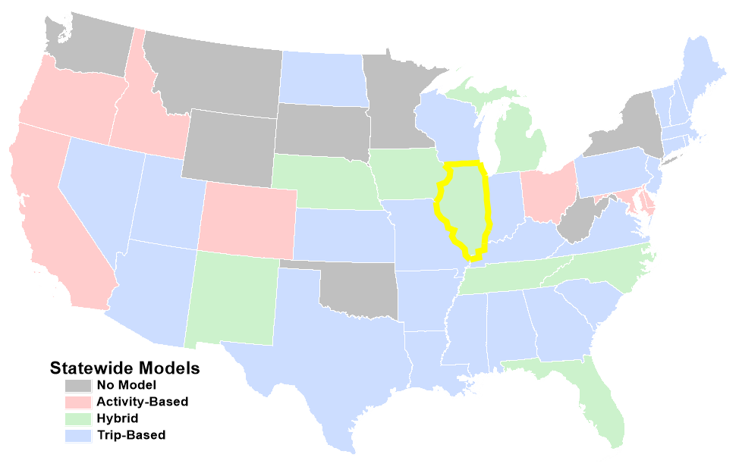
40 States Have Now Developed a Statewide Model!

Slide 9
Model Framework

Slide 10
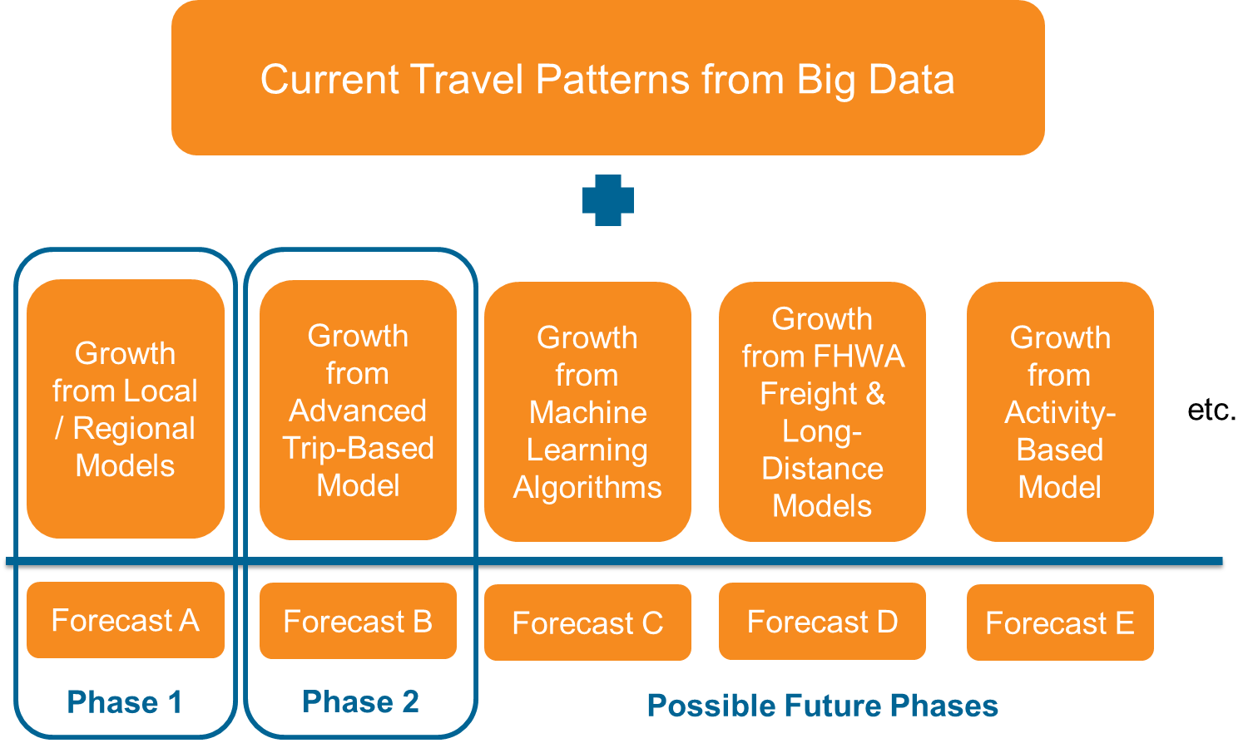
A Phased, Modular, Data-Driven Ensemble Approach

Slide 11

Key insight from machine learning:
Multiple models are better than one

Slide 12
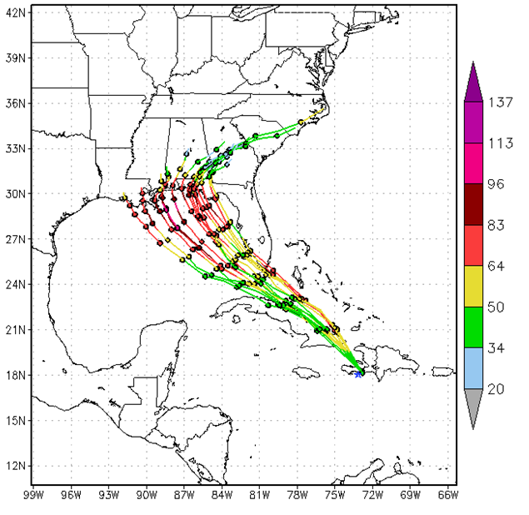
Ensemble Modeling & Forecasting
Combine multiple forecasts into a “consensus” forecast via binding function
Works best with different (uncorrelated) models
Can also “boost” with models in series
Has led to greater predictive validity
(e.g., in meteorology, bioinformatics)
Ensemble Forecast of Hurricane Isaac - noaa.gov
Notes:
DON’T have to throw out our models
AUGMENT existing models with new/more models

Slide 13
All models are wrong, but some are useful.
– George Box
famous statistician

Slide 14
Deep Thoughts…
Different models are wrong in different ways…
Being wrong in multiple ways allows you to better understand how you are wrong…
Multiple models are more useful…
Notes:
When you are wrong in only one way, you have no sense of how you are wrong.

Slide 15
An Old Lesson
“There is no single approach to travel forecasting or set of procedures that is ‘correct’ for all applications.”
– TRB Special Report 288
Notes:
When this was written, I think everyone interpreted this to mean that some agencies would have trip-based models and some would have activity-based models.
Perhaps, the deeper truth is that one model is not enough for any agency.

Slide 16
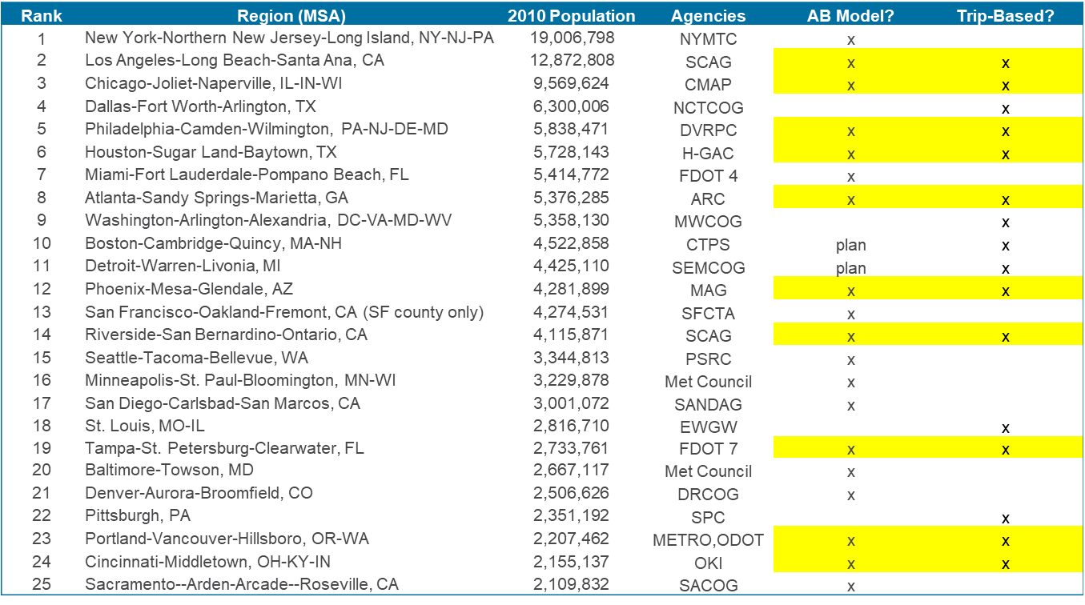
Top 25 MSAs – Using Multiple Models Already
Notes:
Apologize if any of this is not current / accurate – limited fact-checking
Roughly half of agencies with ABMs have two models (TBM & ABM)

Slide 17

Updating Base without Recalibration
Base ODs can be updated without recalibrating demand models

Slide 18
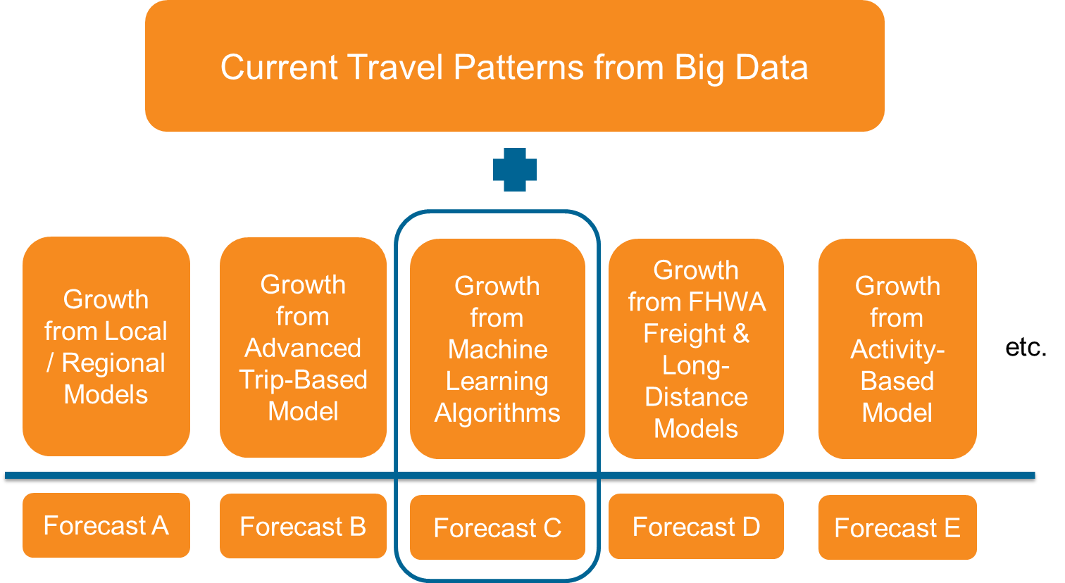
Addressing New Changing Behaviors/Patterns without
System Recalibration
Shopping to Delivery Boosting Model
Adding new modules for new functionality instead of rebuilding
Forecast A’
Forecast B’

Slide 19
Passive Data Development

Slide 20


Leveraging Big Data
General Population Movement Data
  5.5M Monthly Active Users
    42% of population
  1M Daily Active Users
    7.6% of population
Truck GPS Data
  820k Unique Trucks (US)
  700B annual sightings

Slide 21
ATRI Dataset
>1 billion sightings, ~700,000 trucks
Time period | Trucks (raw) | Trucks (kept) | Pings (raw)
February 2018 | 183,176 | 151,671 | 295,534,447
May 2018 | 178,258 | 148,135 | 286,057,818
July 2018 | 178,171 | 149,211 | 305,602,323
October 2018 | 171,577 | 142,767 | 270,425,363
Total | 711,182 | 591,784 | 1,157,619,951

Slide 22
ATRI Processing Results - Unexpanded
~6 million trips,
~360 million VMT overall
Time period | Unexpanded trip count | Distance (mi)
February 2018 | 1,419,789 | 87,443,217
May 2018 | 1,552,876 | 87,486,371
July 2018 | 1,452,520 | 93,530,117
October 2018 | 1,529,128 | 91,784,476
Total | 5,954,313 | 360,244,181

Slide 23
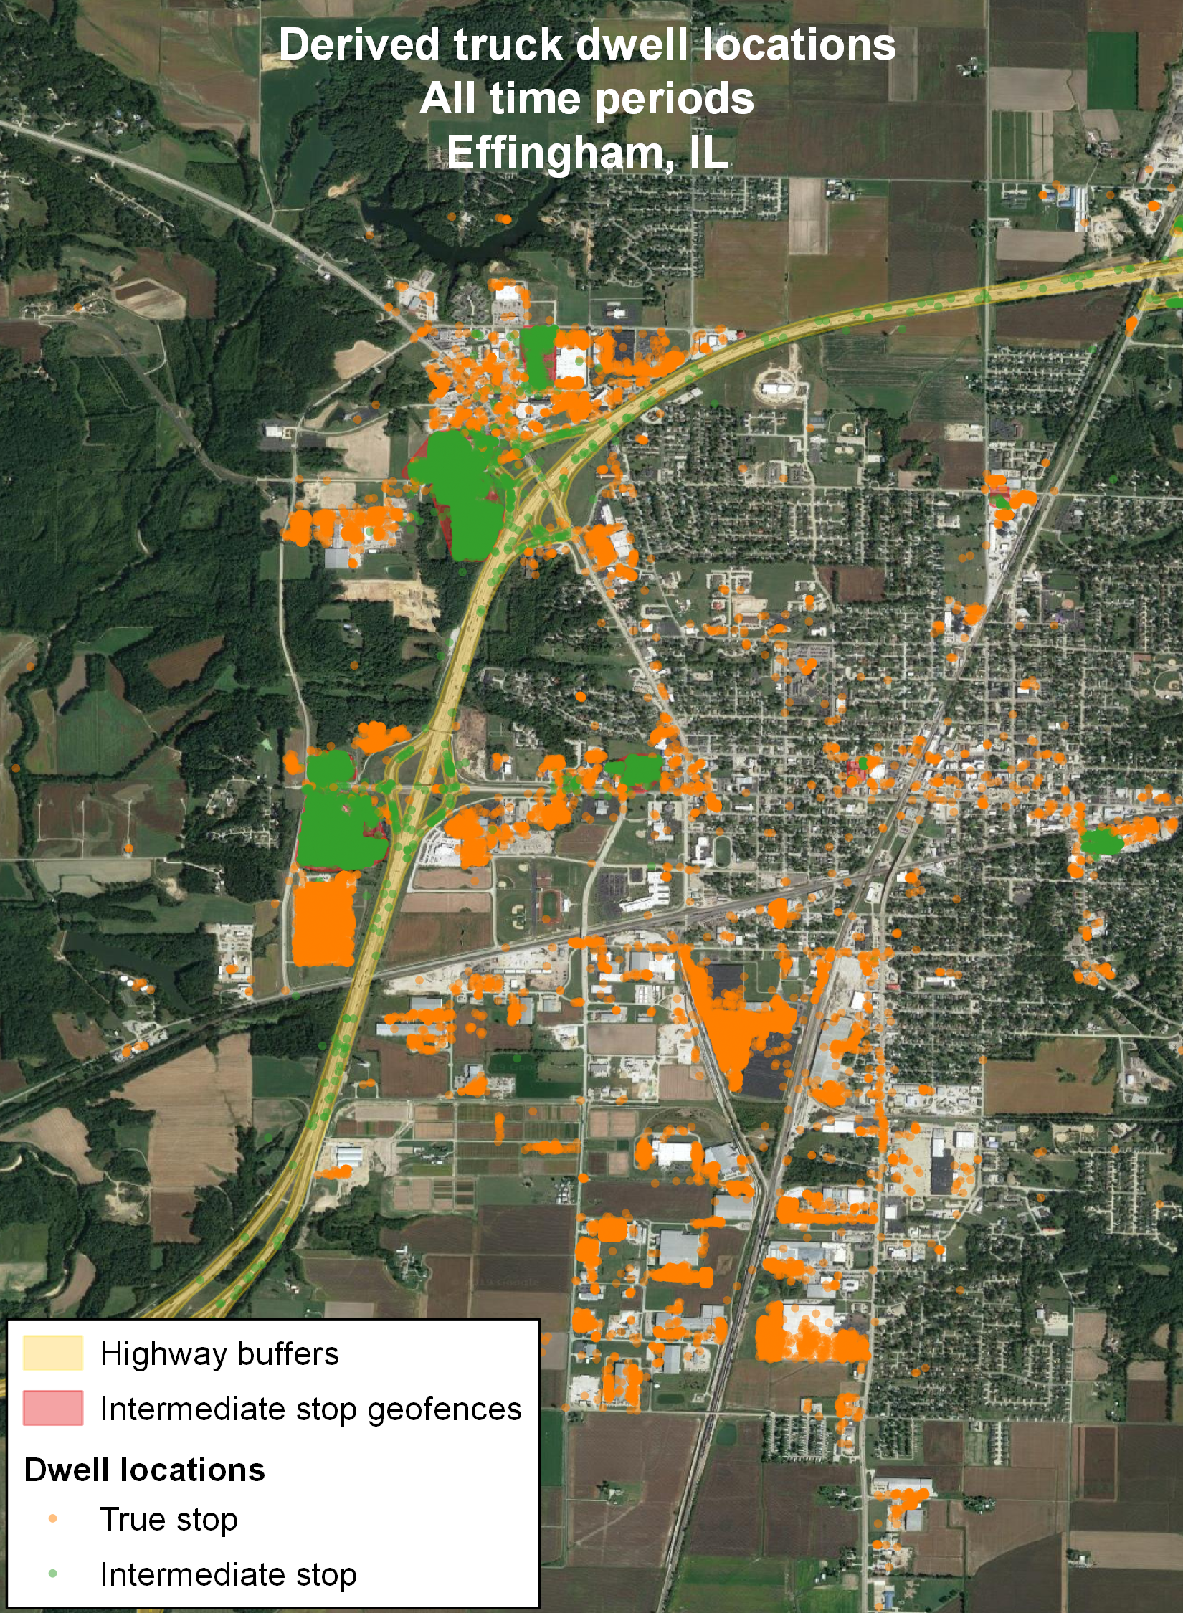
ATRI Processing
Results

Slide 24
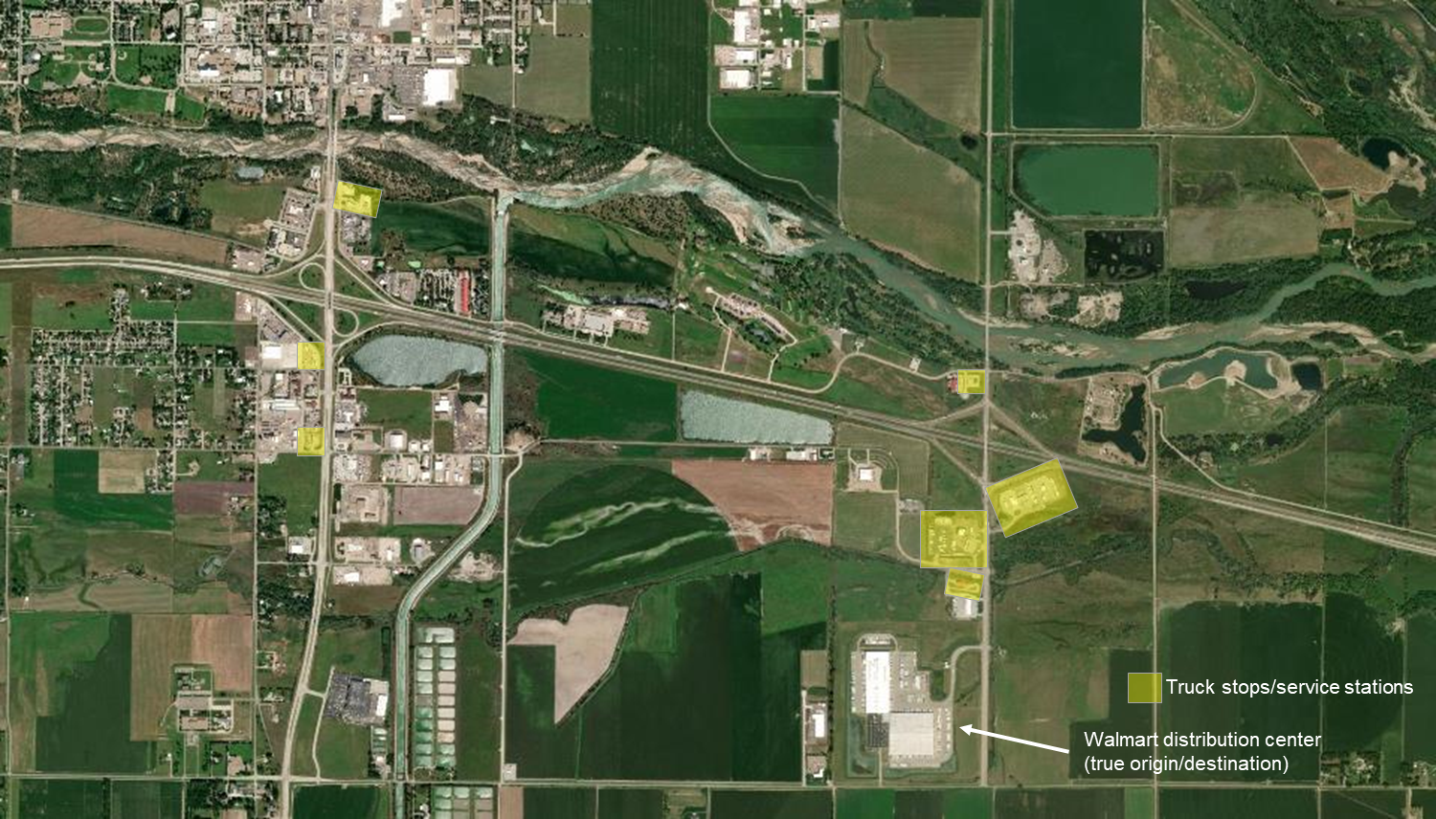
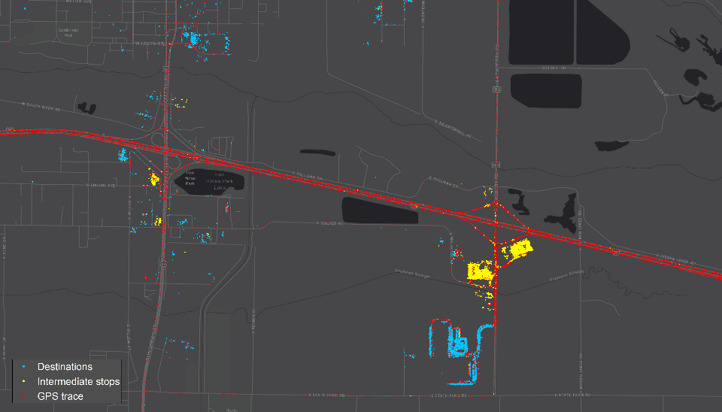
Intermediate Stop Filtering
Geofencing around gas
stations / truck stops, etc.
Filtering stops for fuel, food, etc., necessary for understanding actual long-distance OD demand for both passenger and freight flows

Slide 25
Intermediate Stop Filtering Results
16.4% of trips have at least one
intermediate stop
Time period | Unexpanded trip count | Trips with 1+ intermediate stop
February 2018 | 1,419,789 | 243,426 (17.1%)
May 2018 | 1,552,876 | 237,262 (15.3%)
July 2018 | 1,452,520 | 254,722 (17.5%)
October 2018 | 1,529,128 | 241,284 (15.8%)
Total | 5,954,313 | 976,694 (16.4%)

Slide 26
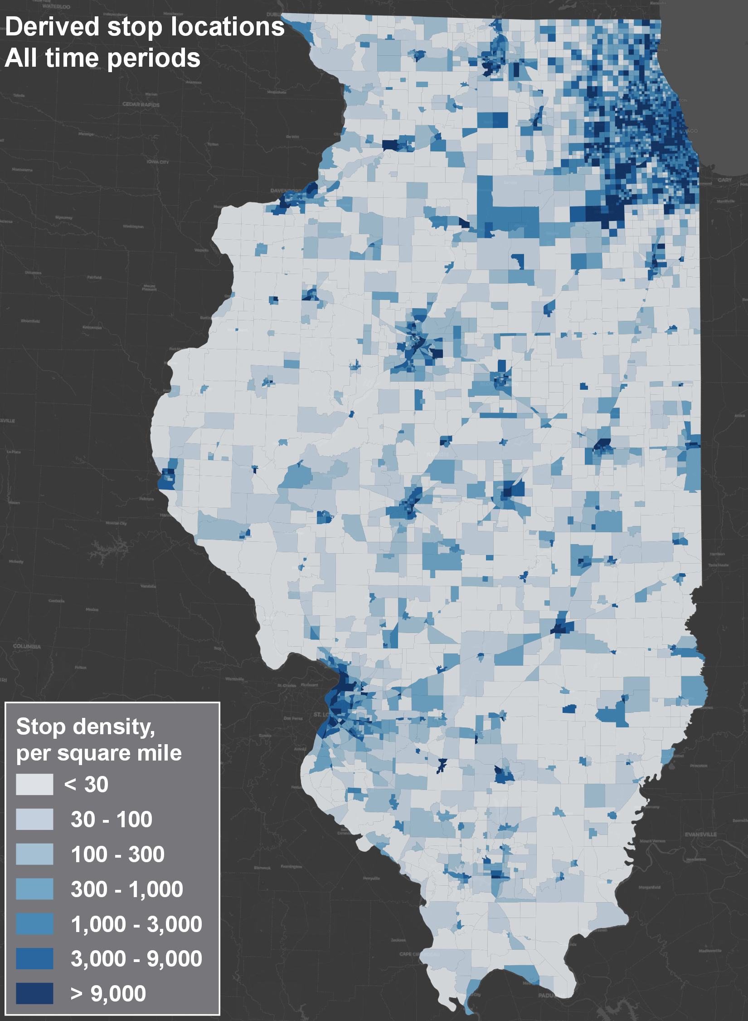
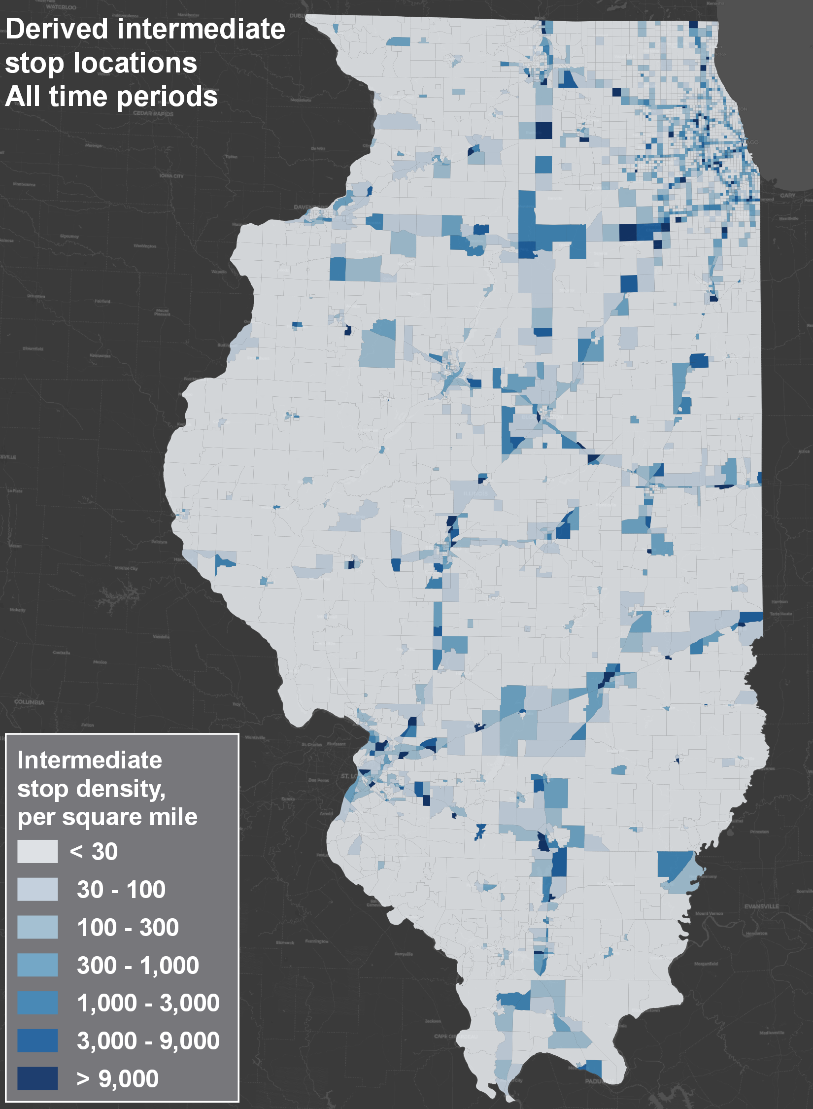
Stop Density Reasonableness Checks

Slide 27
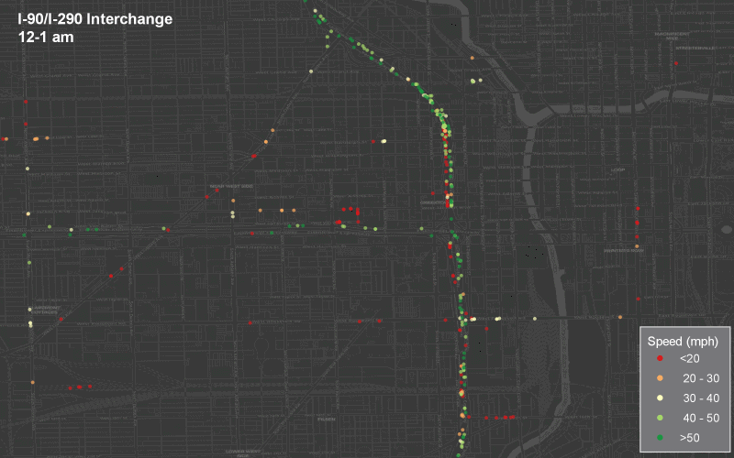
Circle Interchange Bottleneck – 1 day

Slide 28
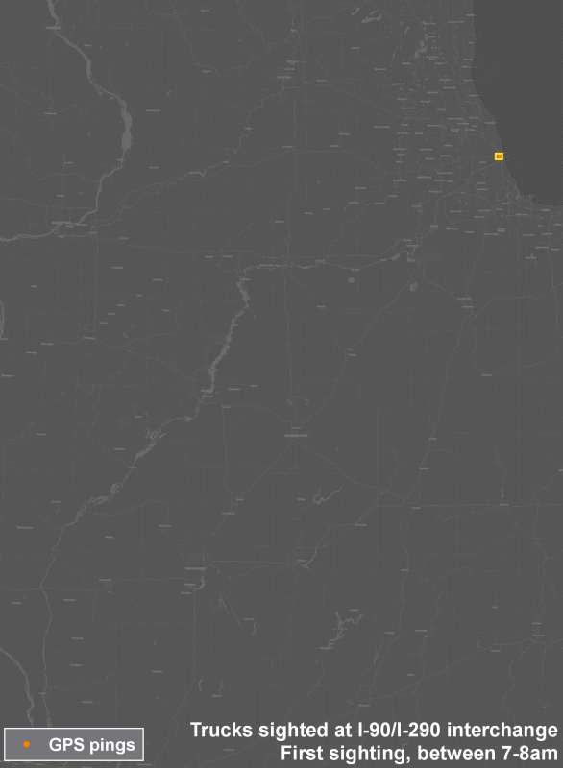
Circle Interchange
– OD Patterns Served

Slide 29
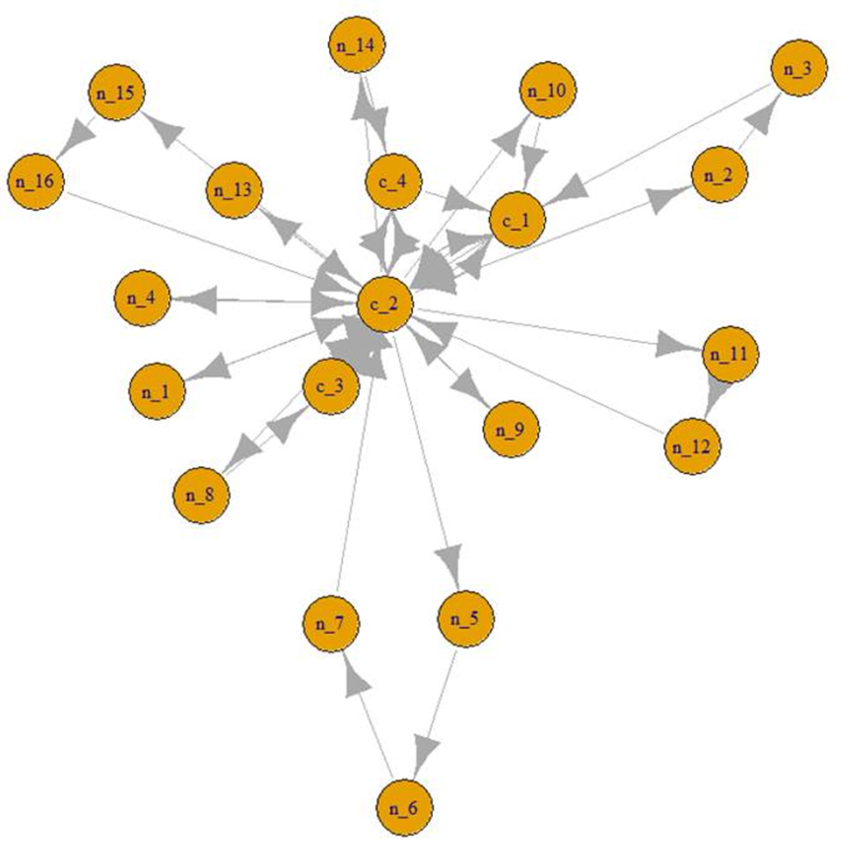
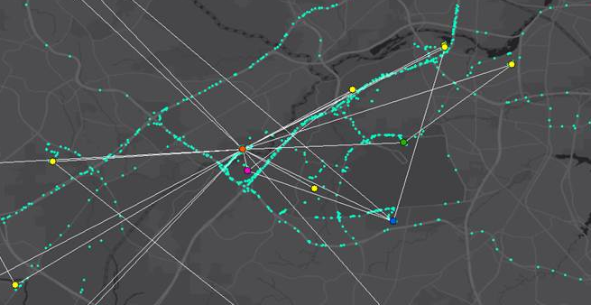
Graph Theory for Residence, Work, Depot Imputation – Basis for Fusion
Topological centrality as primary indicator, overnighting secondary – higher confidence, multi-point fusion

Slide 30
Conclusion

Slide 31
Advantages of a Data-Driven Ensemble Modeling
Improved predictive accuracy
  Based on theory and application to other domains
  Built-in cross-validation
Leverages passive data
Easier to maintain / update
  New ODs, SE data & Projects = New Base Year
  No need for system recalibration
    Even functionality can be added without calibration
  Model can be updated every year
Less waste
  Reuse of early simpler model versions

Slide 32
VINCE BERNARDIN, PHD
SHENG CHEN
DIRECTOR, RSG
ILLINOIS DOT
vince.bernardin@rsginc.com
812.200.2351
sheng.chen@Illinois.gov
312.793.1491

