Slide 1
Using Passive GPS Data to Understand Truck Flows in Nebraska
Steven Trevino, RSG
Theodore Mansfield, RSG
Kaine McClelland, Nebraska DOT
Jason Carbee, HDR Engineering
June 4, 2019

Slide 2
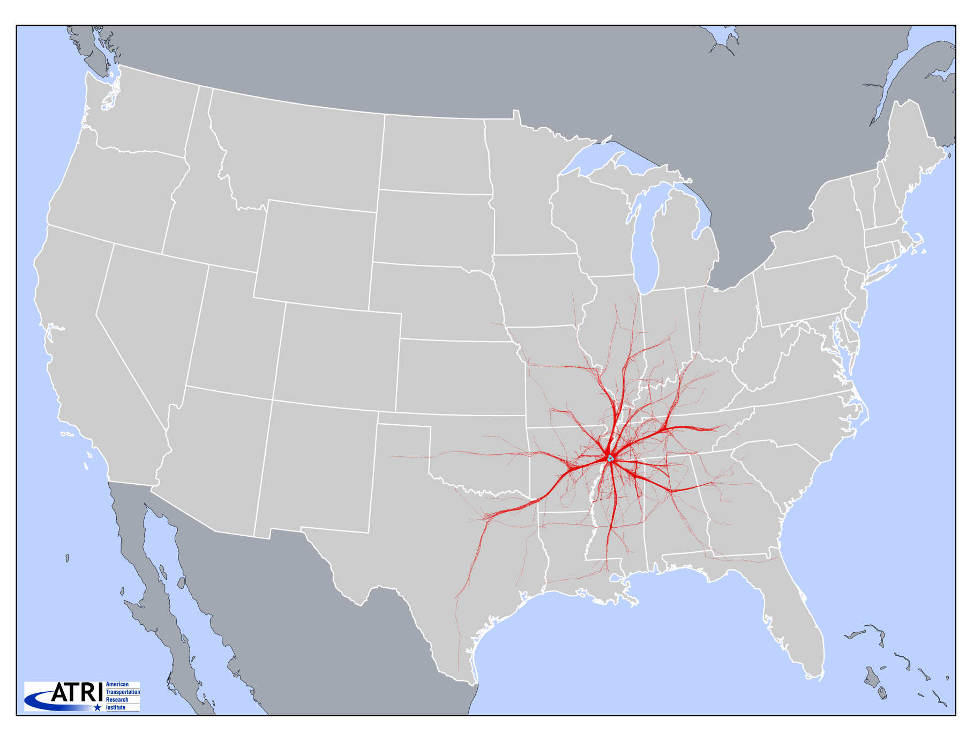
ATRI 1000 Truck Sample – 24 hours

Slide 3
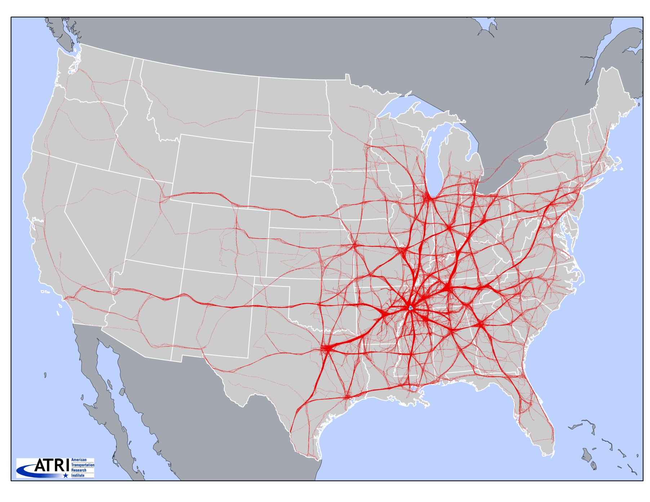
ATRI 1000 Truck Sample – 5 Days

Slide 4
Nebraska Data Sample
8 weeks of data in 2017
Processed into ~1 million heavy truck trips
Period (2017) | Records | Trucks
February | 70,294,954 | 63,602
May | 74,340,094 | 67,412
August | 74,559,053 | 66,776
November | 70,659,705 | 62,988
Total | 289,853,806 | 260,778

Slide 5
Nebraska Data Processing
Remove data anomalies
Distinguish intermediate stops - “true” O-Ds
Data Expansion Practices
  Iterative Screenline Fitting
  Parametric Expansion
  Constrained ODME (as needed)
Notes:
Given the model scale (950 zones, evenly distributed) and total counts (~400 stations) we found we only needed to perform screenline fitting to achieve our expanded results.
Parametric Expansion can take a few different forms, in our Big Data work, we have utilized a genetic algorithm and non-linear regression (to an “observed” ODME result)

Slide 6
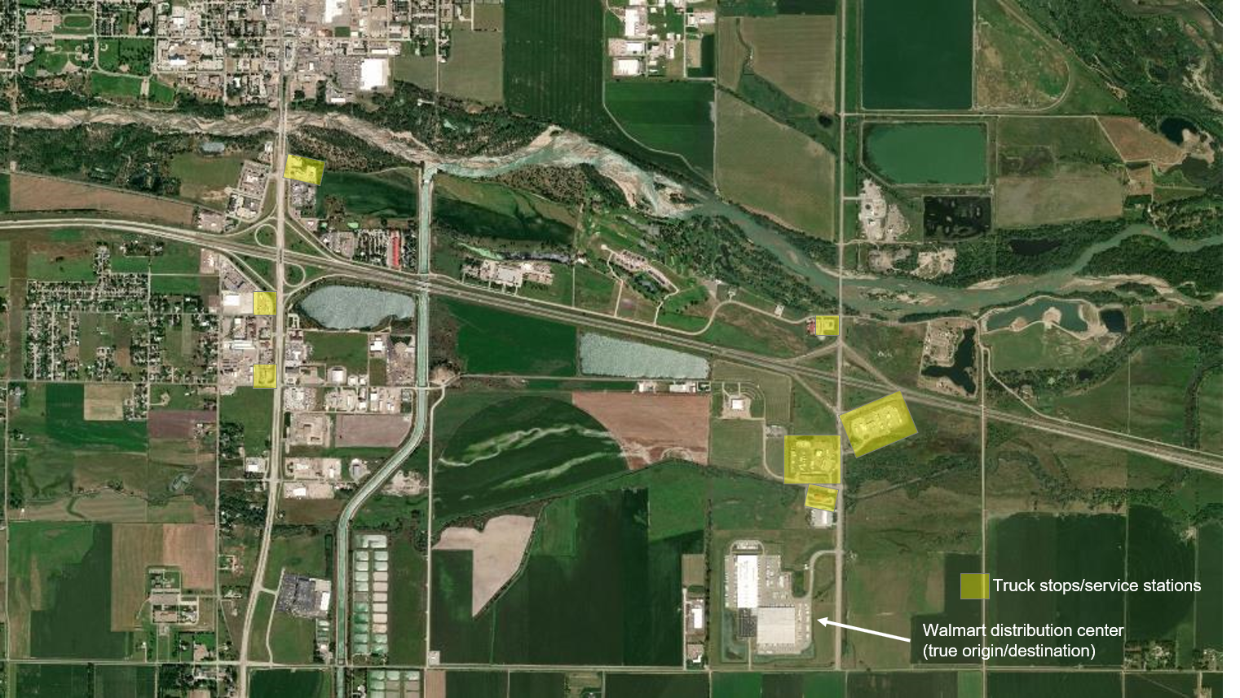
Intermediate Stops

Slide 7
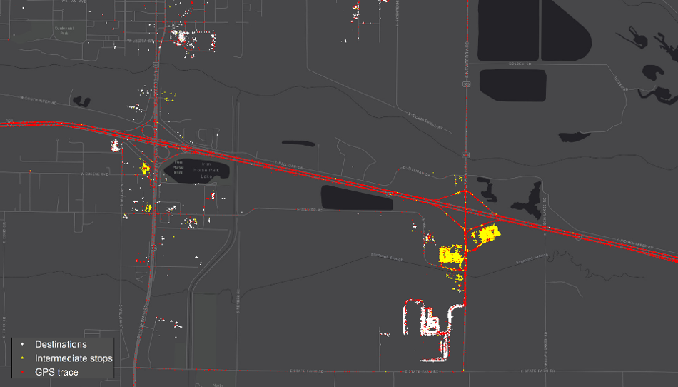
Intermediate Stops
Notes:
On average, we saw 24% of trips with 1 or more intermediate stops

Slide 8
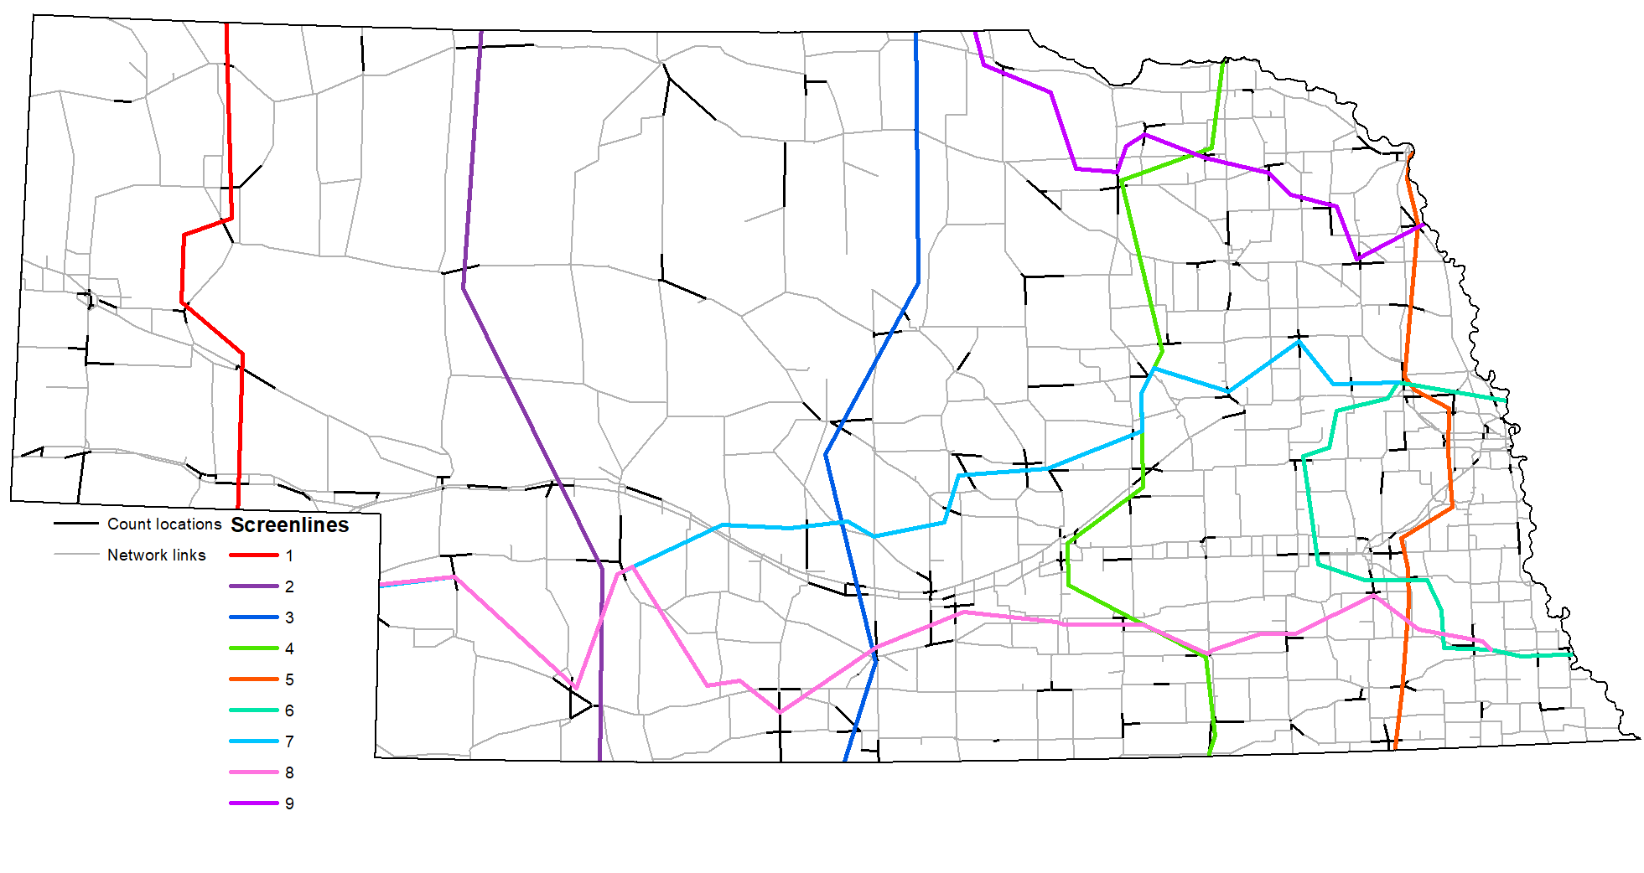
Nebraska Screenlines
Notes:
ISF can theoretically be done without skims, as each screenline does segment the entire O-D set
In our implementation, we used skims to identify which O-D pair utilizes a crossing

Slide 9
Results
Volume Group | Observations | % Error | % RMSE
< 5,000 | 274 | -18.06 | 68.67
5,000 - 10,000 | 56 | 1.52 | 34.09
10,000 - 20,000 | 40 | -3.03 | 31.33
20,000 - 30,000 | 22 | 6.50 | 12.41
30,000 - 40,000 | 6 | 13.58 | 26.87
> 40,000 | 6 | 15.82 | 25.02
Total | 404 | -0.76 | 41.30

Slide 10
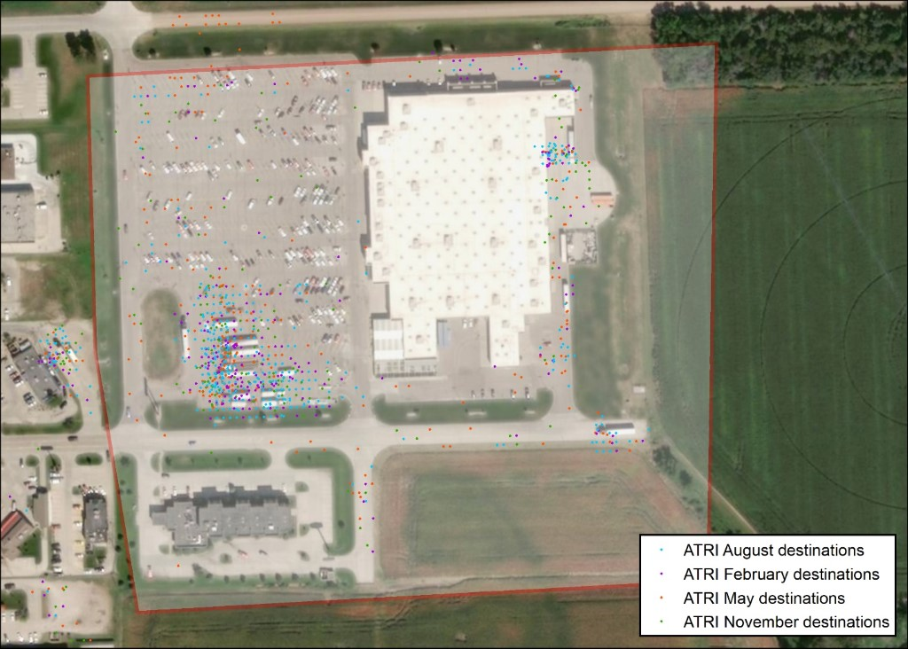
Supplementary Analysis

Slide 11
Contact
Steven Trevino
www.rsginc.com
Consultant
Steven.Trevino@rsginc.com
812.200.2352

