Slide 1
Scenario Modeling of CAVs with Trip-Based Models
Vince Bernardin, PhD
June 3, 2019

Slide 2
All models are wrong, but some are useful.
– George Box
famous statistician

Slide 3
How can trip-based models be useful in planning for CAVs?
Scenario Planning
  structured way for organizations to think about the future using a limited number of scenarios (e.g., best case, worst case, most likely, etc.)
Exploratory Modeling Analysis (EMA)
  simultaneously vary input assumptions across a wide range of future scenarios along key dimensions of uncertainty
  to explore potential outcomes, find critical input assumptions, and identify future policy directions likely to be robust in the face of “deep uncertainty”

Slide 4

Jacksonville EMA Study
Combined ABM-DTA model
Factors explored
  Level of AV ownership among households
  Level of paid rideshare use and corresponding changes in auto ownership
  Amount of dedicated lanes & smart signals
  Level of vehicle automation
Best case: no CAVs
Even without ZOVs, demand increases more than capacity

Slide 5
A Trip-Based Framework for CAVs

Slide 6

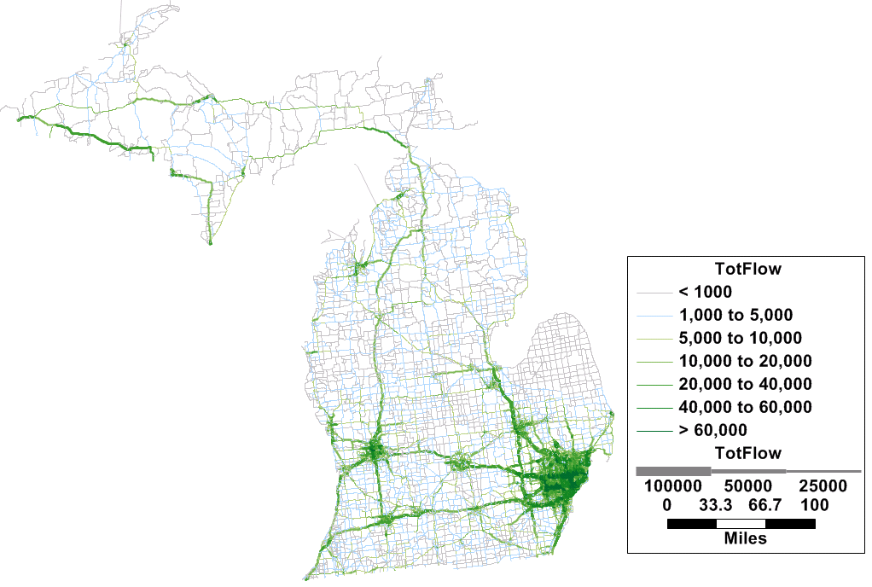
The New Michigan Statewide Model
One of the longest traditions of statewide modeling in the country since early 1970s
Last major update was mid 1990s
New model complete near the end of 2018
  Data-driven approach using AirSage & ATRI
  Advanced trip-based passenger modeling
    Linkage of HB & NHB, LD and Visitor trips
  Commodity-flow based freight modeling
  Summer model

Slide 7
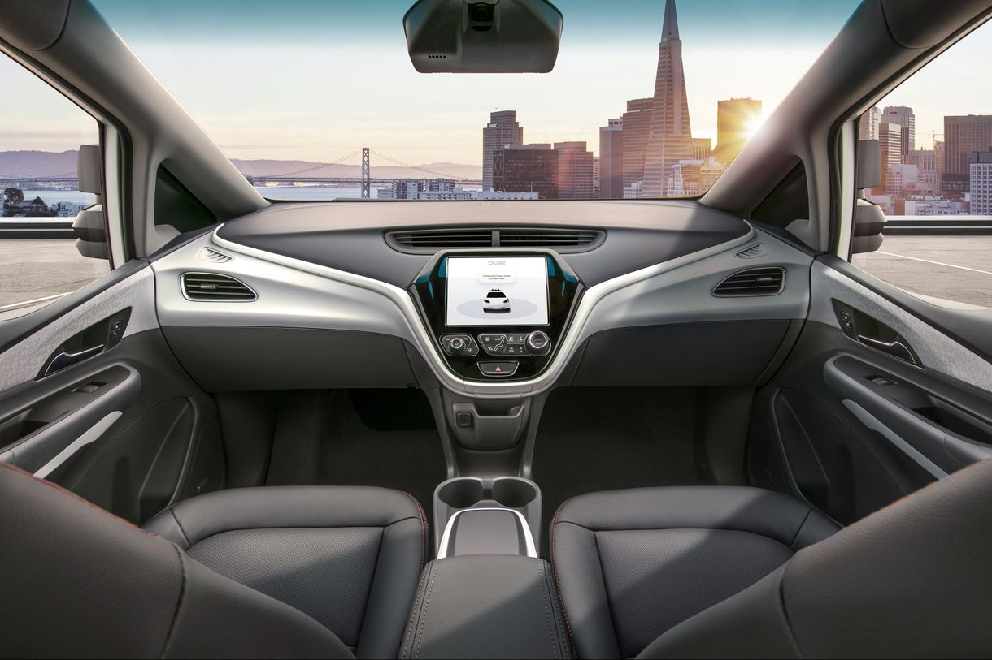
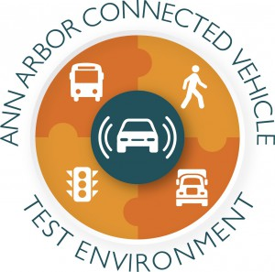
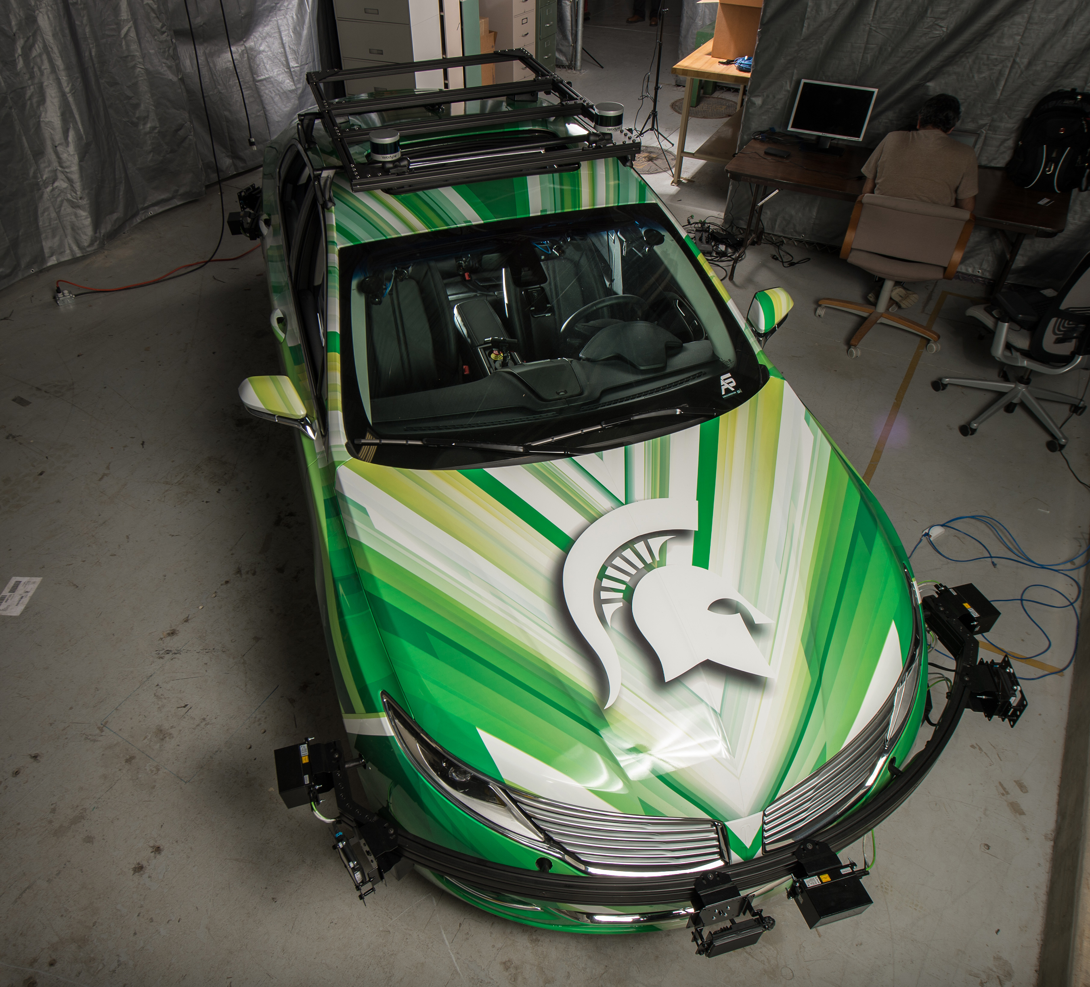
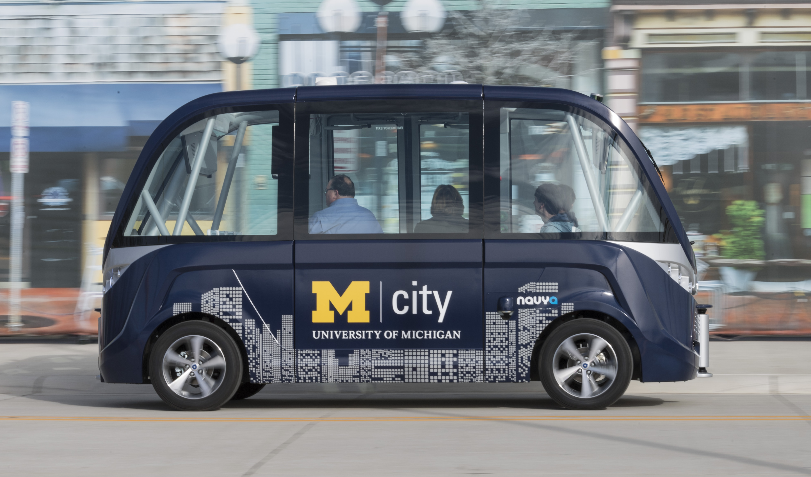
CAVs in Michigan
Home of the Auto Industry
  All auto-makers actively
  investing in CAV technology
Public-Private Partnerships
  Research rapidly moving into reality
    U of M has been using autonomous shuttles for almost a year

Slide 8
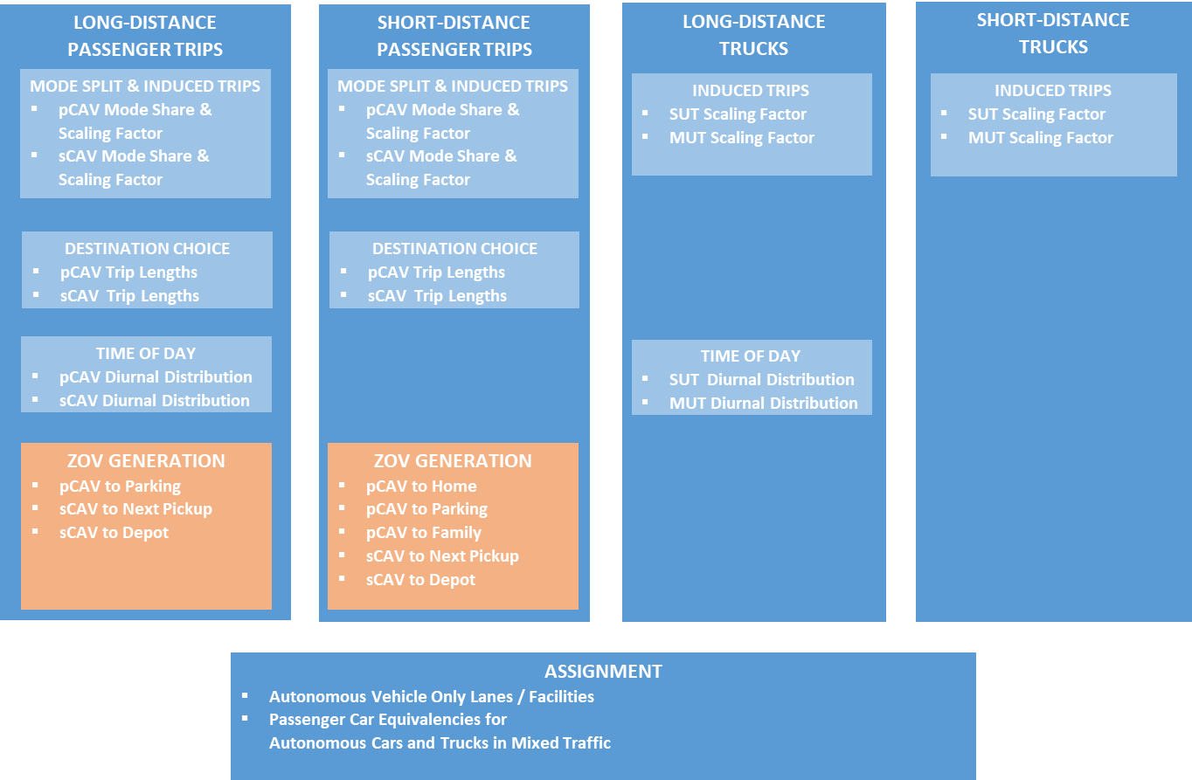
CAVs in Trip-Based Models
Lots of off-model / manual analysis
Michigan statewide model
New factors / market segments + ZOV step

Slide 9
CAVs in Trip-Based
MPO Models
RESIDENT INTERNAL PASSENGER TRIPS
EXTERNAL AND
TRUCK TRIPS
AUTO OWNERSHIP
Overall Ownership Level
Split of Vehicles between CAV vs. Conventional
Lots of off-model / manual analysis
Adapted Michigan framework
Charleston, Charlottesville, & Ann Arbor MPOs
INDUCED TRIPS
Adjust Trip Rates by Seniors, Children, Autos
INDUCED TRIPS
EE & EI/IE Scaling Factors
SUT Scaling Factor
MUT Scaling Factor
DESTINATION CHOICE
Adjust Trip Lengths by CAV ownership
MODE CHOICE
Add MaaS modes
Add CAV / Conv Submodes
TIME OF DAY
Ext Diurnal Distributions
Trk Diurnal Distributions
ZOV GENERATION
HH CAV to Family
HH CAV to Home
HH CAV to Free Parking
HH CAV to Circulate
MaaS CAV to Next Pickup
MaaS CAV to Depot
ASSIGNMENT
Autonomous Vehicle Only Lanes / Facilities
Passenger Car Equivalencies for
Autonomous Cars and Trucks in Mixed Traffic

Slide 10
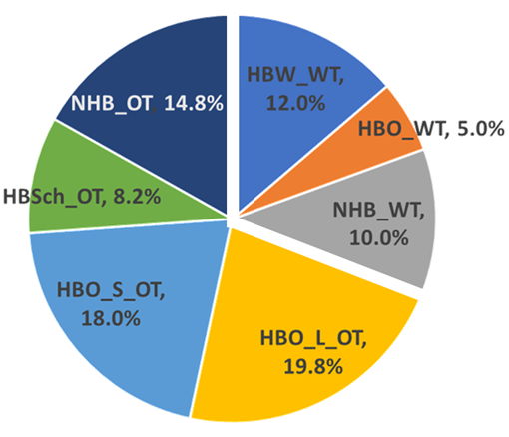
Model Segmentation
VEHICLE OWNERSHIP
  No vehicles
  Vehicles < Adults
    Without CAV
    With CAV
  Vehicles ≥ Adults
    Without CAV
    With CAV
NON-WORK ACTIVITIES SEGMENTED BY DURATION
  Less than 30 min (won’t send vehicle home)
  Greater than 30 min (might send vehicle home)

Slide 11
RESIDENT INTERNAL PASSENGER TRIPS
EXTERNAL AND
TRUCK TRIPS
AUTO OWNERSHIP
Overall Ownership Level
Split of Vehicles between CAV vs. Conventional
INDUCED TRIPS
Adjust Trip Rates by Seniors, Children, Autos
INDUCED TRIPS
EE & EI/IE Scaling Factors
SUT Scaling Factor
MUT Scaling Factor
DESTINATION CHOICE
Adjust Trip Lengths by CAV ownership
MODE CHOICE
Add MaaS modes
Add CAV / Conv. Submodes
TIME OF DAY
Ext Diurnal Distributions
Trk Diurnal Distributions
ZOV GENERATION
HH CAV to Family
HH CAV to Home
HH CAV to Free Parking
HH CAV to Circulate
MaaS CAV to Next Pickup
MaaS CAV to Depot
ASSIGNMENT
Autonomous Vehicle Only Lanes / Facilities
Passenger Car Equivalencies for
Autonomous Cars and Trucks in Mixed Traffic

Slide 12
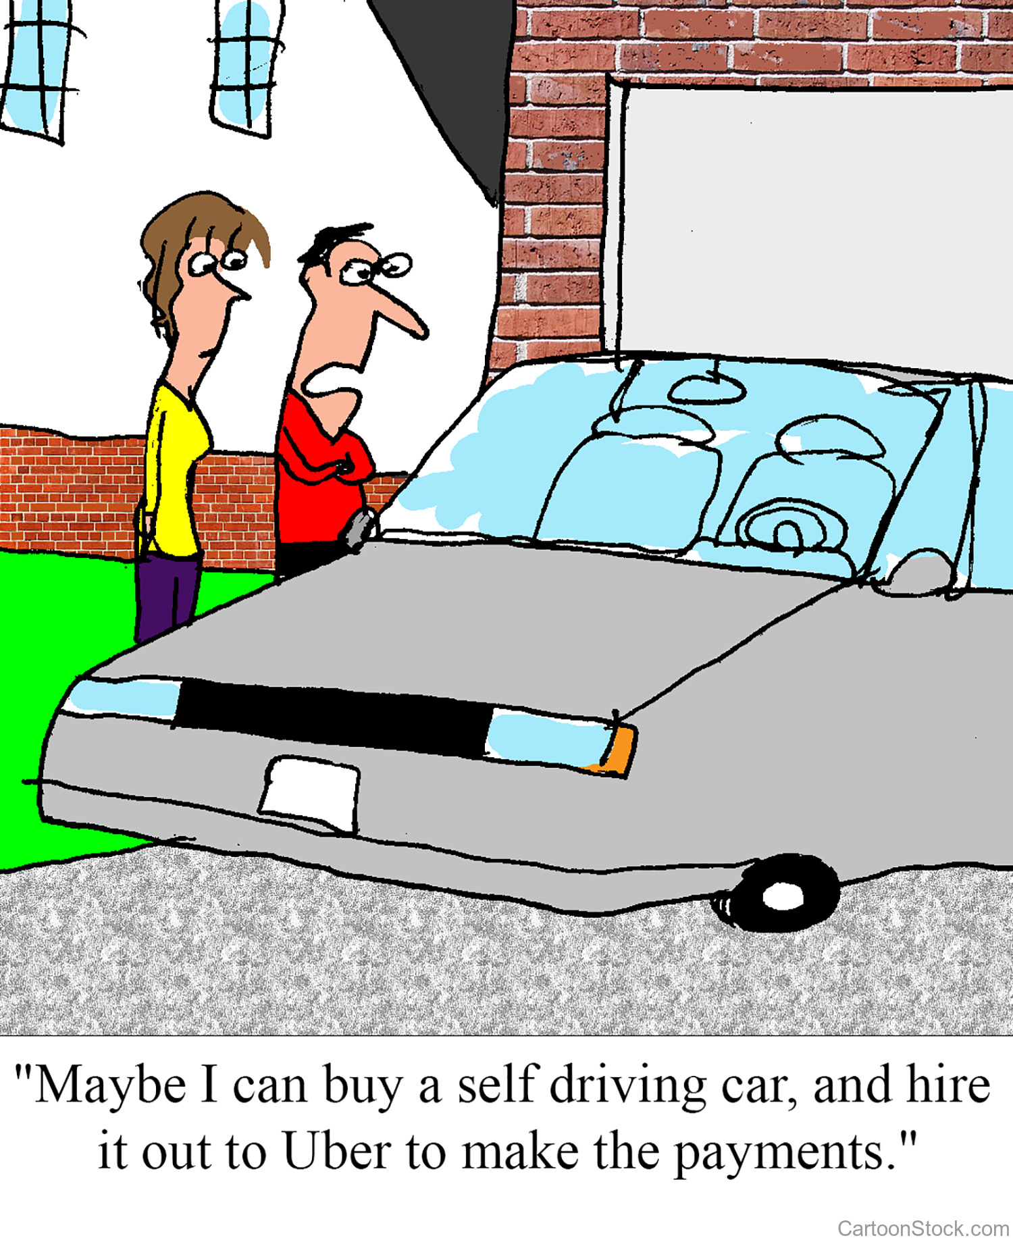
Auto Ownership
Subdivide HH autos into conventional and CAV by income
Decrease overall ownership

Slide 13
RESIDENT INTERNAL PASSENGER TRIPS
EXTERNAL AND
TRUCK TRIPS
AUTO OWNERSHIP
Overall Ownership Level
Split of Vehicles between CAV vs. Conventional
INDUCED TRIPS
Adjust Trip Rates by Seniors, Children, Autos
INDUCED TRIPS
EE & EI/IE Scaling Factors
SUT Scaling Factor
MUT Scaling Factor
DESTINATION CHOICE
Adjust Trip Lengths by CAV ownership
MODE CHOICE
Add MaaS modes
Add CAV / Conv. Submodes
TIME OF DAY
Ext Diurnal Distributions
Trk Diurnal Distributions
ZOV GENERATION
HH CAV to Family
HH CAV to Home
HH CAV to Free Parking
HH CAV to Circulate
MaaS CAV to Next Pickup
MaaS CAV to Depot
ASSIGNMENT
Autonomous Vehicle Only Lanes / Facilities
Passenger Car Equivalencies for
Autonomous Cars and Trucks in Mixed Traffic

Slide 14
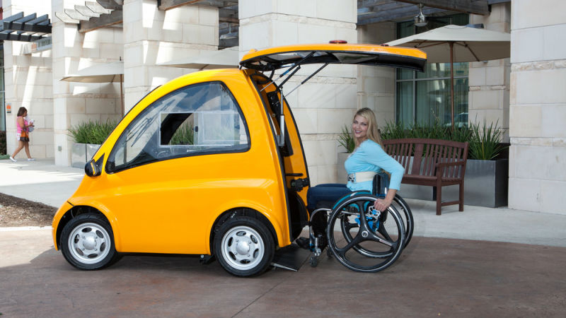
Trip Generation
Scale up trips
to represent
induced demand
Largest increases to
households with:
  Disabled
  Seniors
  Children
More long distance / external trips from reduced lodging cost?
[Also, careful of trip rates by vehicle ownership]
Source: Jalopnik.com

Slide 15
RESIDENT INTERNAL PASSENGER TRIPS
EXTERNAL AND
TRUCK TRIPS
AUTO OWNERSHIP
Overall Ownership Level
Split of Vehicles between CAV vs. Conventional
INDUCED TRIPS
Adjust Trip Rates by Seniors, Children, Autos
INDUCED TRIPS
EE & EI/IE Scaling Factors
SUT Scaling Factor
MUT Scaling Factor
DESTINATION CHOICE
Adjust Trip Lengths by CAV ownership
MODE CHOICE
Add MaaS modes
Add CAV / Conv. Submodes
TIME OF DAY
Ext Diurnal Distributions
Trk Diurnal Distributions
ZOV GENERATION
HH CAV to Family
HH CAV to Home
HH CAV to Free Parking
HH CAV to Circulate
MaaS CAV to Next Pickup
MaaS CAV to Depot
ASSIGNMENT
Autonomous Vehicle Only Lanes / Facilities
Passenger Car Equivalencies for
Autonomous Cars and Trucks in Mixed Traffic

Slide 16

Trip Distribution
Passengers may be willing to travel farther since time in CAVs can be used positively for working, relaxing, sleeping, etc.
User can factor down traveler sensitivity to travel time / impedance

Slide 17
RESIDENT INTERNAL PASSENGER TRIPS
EXTERNAL AND
TRUCK TRIPS
AUTO OWNERSHIP
Overall Ownership Level
Split of Vehicles between CAV vs. Conventional
INDUCED TRIPS
Adjust Trip Rates by Seniors, Children, Autos
INDUCED TRIPS
EE & EI/IE Scaling Factors
SUT Scaling Factor
MUT Scaling Factor
DESTINATION CHOICE
Adjust Trip Lengths by CAV ownership
MODE CHOICE
Add MaaS modes
Add CAV / Conv. Submodes
TIME OF DAY
Ext Diurnal Distributions
Trk Diurnal Distributions
ZOV GENERATION
HH CAV to Family
HH CAV to Home
HH CAV to Free Parking
HH CAV to Circulate
MaaS CAV to Next Pickup
MaaS CAV to Depot
ASSIGNMENT
Autonomous Vehicle Only Lanes / Facilities
Passenger Car Equivalencies for
Autonomous Cars and Trucks in Mixed Traffic

Slide 18

Mode Choice
Add Taxi / TNC mode
Decrease cost
Vary occupancy
Source: Futurism.com
Notes:
This slide is more for MPO models

Slide 19
Mode Choice
Add MaaS mode
Add CAV / Conventional Submodes
Person Trips
Private Auto
MaaS
Transit
Non-Motor
SOV
HOV2
HOV3
SOV
HOV2
HOV3
Walk
MaaS
Drive
Walk
Bike
CAV
Cnv
CAV
Cnv
CAV
Cnv
CAV
CAV
Cnv
CAV
Cnv
CAV
Cnv
CAV
Cnv
Notes:
This slide is more for MPO models

Slide 20
RESIDENT INTERNAL PASSENGER TRIPS
EXTERNAL AND
TRUCK TRIPS
AUTO OWNERSHIP
Overall Ownership Level
Split of Vehicles between CAV vs. Conventional
INDUCED TRIPS
Adjust Trip Rates by Seniors, Children, Autos
INDUCED TRIPS
EE & EI/IE Scaling Factors
SUT Scaling Factor
MUT Scaling Factor
DESTINATION CHOICE
Adjust Trip Lengths by CAV ownership
MODE CHOICE
Add MaaS modes
Add CAV / Conv. Submodes
TIME OF DAY
Ext Diurnal Distributions
Trk Diurnal Distributions
ZOV GENERATION
HH CAV to Family
HH CAV to Home
HH CAV to Free Parking
HH CAV to Circulate
MaaS CAV to Next Pickup
MaaS CAV to Depot
ASSIGNMENT
Autonomous Vehicle Only Lanes / Facilities
Passenger Car Equivalencies for
Autonomous Cars and Trucks in Mixed Traffic

Slide 21
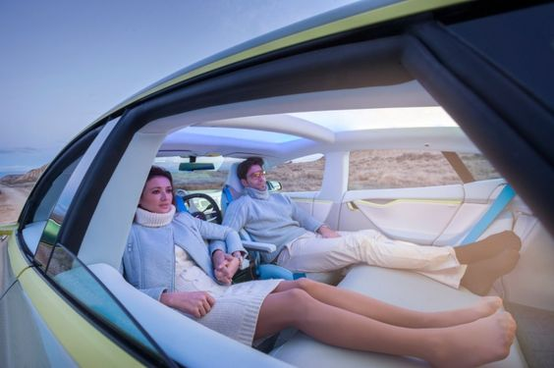
Long-Distance & Trucks
There may be more long distance (external) trips as the cost of travel is reduced
Trucks / long distance travelers may shift to nighttime hours to avoid congestion
Source: theautofuture.com
Long distance travelers may use sleeping hours to travel

Slide 22
RESIDENT INTERNAL PASSENGER TRIPS
EXTERNAL AND
TRUCK TRIPS
AUTO OWNERSHIP
Overall Ownership Level
Split of Vehicles between CAV vs. Conventional
INDUCED TRIPS
Adjust Trip Rates by Seniors, Children, Autos
INDUCED TRIPS
EE & EI/IE Scaling Factors
SUT Scaling Factor
MUT Scaling Factor
DESTINATION CHOICE
Adjust Trip Lengths by CAV ownership
MODE CHOICE
Add MaaS modes
Add CAV / Conv. Submodes
TIME OF DAY
Ext Diurnal Distributions
Trk Diurnal Distributions
ZOV GENERATION
HH CAV to Family
HH CAV to Home
HH CAV to Free Parking
HH CAV to Circulate
MaaS CAV to Next Pickup
MaaS CAV to Depot
ASSIGNMENT
Autonomous Vehicle Only Lanes / Facilities
Passenger Car Equivalencies for
Autonomous Cars and Trucks in Mixed Traffic

Slide 23
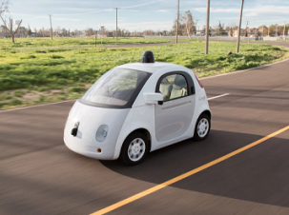
Deadheading / ZOVs
Types of ZOV trips
  Private CAVs
    for car sharing among
    household members (1)
    to avoid paid parking
      by parking at home (2)
      by parking elsewhere (3)
      by circulating instead of parking (4)
  Shared CAVs
    for passenger pick-up/drop-off (5)
    to/from depots (6) (for re-charging / demand response)
Source: driverlesstransportation.com

Slide 24
Private CAV ZOV Modeling Methods
for car sharing among household members
  invert asserted percentage of Os & Ds, gravity model
to avoid paid parking by parking at home
  invert asserted percentage of HB trip ODs for pay TAZs
to avoid paid parking by parking elsewhere
  create trips between pay TAZ & nearest non-pay TAZs as a function of long Ds at pay TAZ
to avoid paid parking by circulating instead of parking
  after assignment, factor up volumes on non-freeway links within buffer of pay TAZ based on short stops

Slide 25
Shared CAV ZOV Modeling Methods
for passenger pick-up/drop-off
  invert all passenger Os & Ds; gravity model
to/from depots (for re-charging / demand response)
  assert depot TAZs with capacities; generate trips by min(difference in demand between periods, charging requirement assumption); gravity between shared CAV Os & Ds and depot TAZ

Slide 26
RESIDENT INTERNAL PASSENGER TRIPS
EXTERNAL AND
TRUCK TRIPS
AUTO OWNERSHIP
Overall Ownership Level
Split of Vehicles between CAV vs. Conventional
INDUCED TRIPS
Adjust Trip Rates by Seniors, Children, Autos
INDUCED TRIPS
EE & EI/IE Scaling Factors
SUT Scaling Factor
MUT Scaling Factor
DESTINATION CHOICE
Adjust Trip Lengths by CAV ownership
MODE CHOICE
Add MaaS modes
Add CAV / Conv. Submodes
TIME OF DAY
Ext Diurnal Distributions
Trk Diurnal Distributions
ZOV GENERATION
HH CAV to Family
HH CAV to Home
HH CAV to Free Parking
HH CAV to Circulate
MaaS CAV to Next Pickup
MaaS CAV to Depot
ASSIGNMENT
Autonomous Vehicle Only Lanes / Facilities
Passenger Car Equivalencies for
Autonomous Cars and Trucks in Mixed Traffic

Slide 27
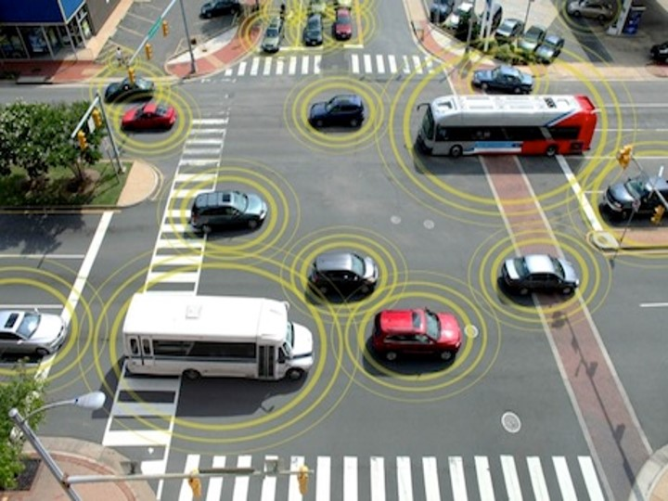
Assignment
Separate autonomous and conventional vehicle classes
User option to have dedicated CAV-only facilities/lanes and assert high capacities
and higher speeds
User option to
assert different
capacity consumption
in mixed traffic
(through PCE factor)

Slide 28
Scenario Planning Example

Slide 29
BURLINGTON, VT
Scenario Planning
Intended to start a conversation about future transportation and traffic implications of the impending CAV future for LRTP
Not used in selecting projects
Two scenarios
  80% CAV, 50% shared, base occupancy
  100% CAV, 65% shared, higher occupancy

Slide 30
BURLINGTON, VT
Scenario Assumptions
5% more HBO for induced person trips
No temporal or destination choice changes
All ZOV types except intra-household sharing
Generous increased capacity assumptions
  Doubling of freeway capacity for 80% scenario
  Tripling of freeway and 50% increase of arterial capacity for 100% scenario

Slide 31
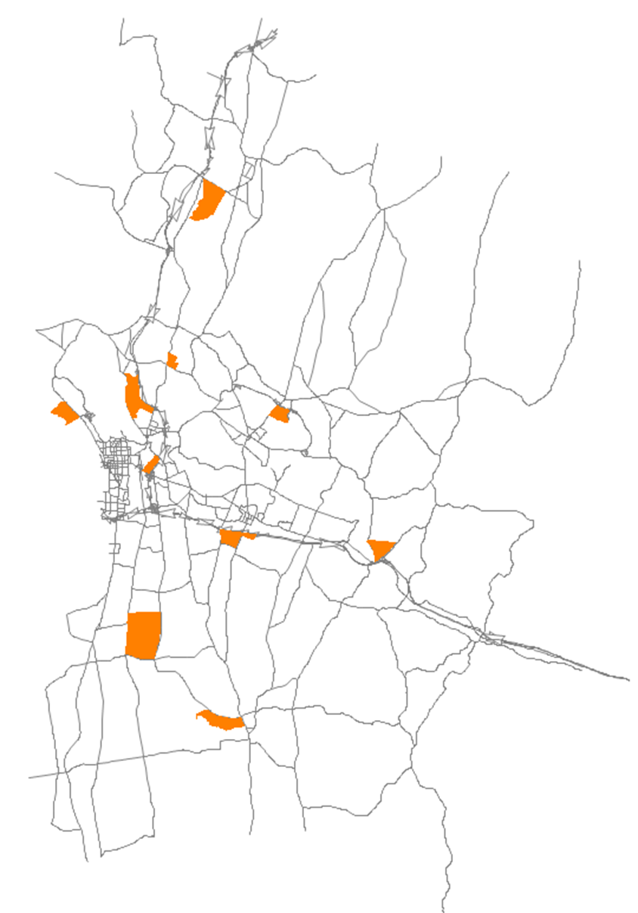
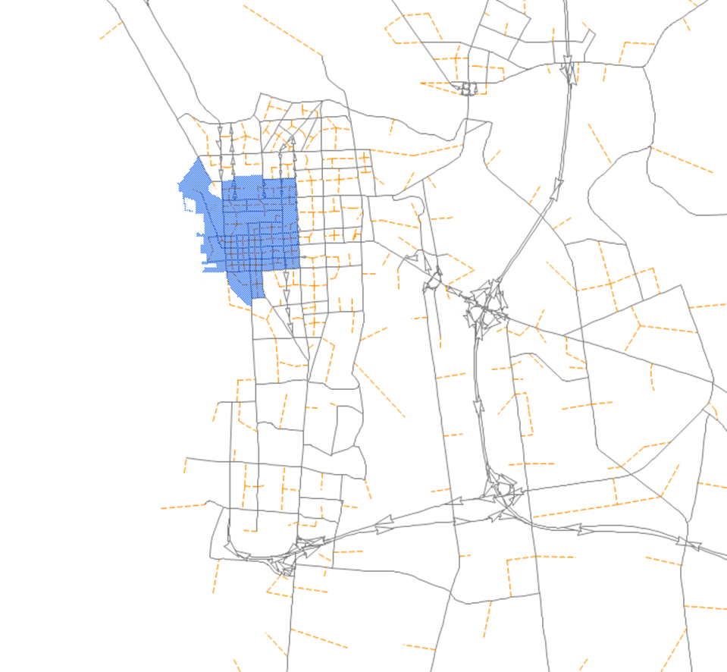
BURLINGTON, VT
Scenario Assumptions
Pay Parking TAZ
Depot TAZ

Slide 32
BURLINGTON, VT
Scenario Results

Slide 33
Conclusions

Slide 34
Parting Thoughts
Trip-based models can be enhanced to capture almost (but not) all dimensions of uncertainty about CAVs
  Add adjustments to all steps
  Add taxi/TNC mode
  Add special ZOV components
They can NOT tell us what will happen
They CAN help us understand
  the range of possible futures
  the relative importance of different factors
  the robustness of policies / investments

Slide 35
VINCE BERNARDIN, PHD
DIRECTOR
vince.bernardin@rsginc.com
812.200.2351

