Slide 1
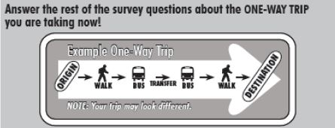
Is this really where you are going?
An Open-Source Tool to Visualize and Validate On-Board Survey Data
Jingyan (Dora) Wu
Data Scientist III
Systems Analysis Group
WSP USA, Inc

Slide 2
Background
Illogical reported locations
Hard to Validate
Transit on-board survey data
Understand transit utilization
Model development & calibration

Slide 3
On-Board Survey Visualization Tool
Developed during recent Southeast Florida Regional Travel Model (SERPM7) calibration, using Miami-Dade Transit On-Board Survey collected between 2012 and 2015.
Open-source, interactive, developed using R Shiny Package.
Reads user input file.
Displays trip origin, destination, boarding, and alighting locations for each record.
Displays route stops using GTFS data.

Slide 4
Application: Model Calibration
1. Identify illogical records;
2. Calibrating model parameters;
3. Deriving Origin-Destination (OD) matrices with more accuracy.

Slide 5
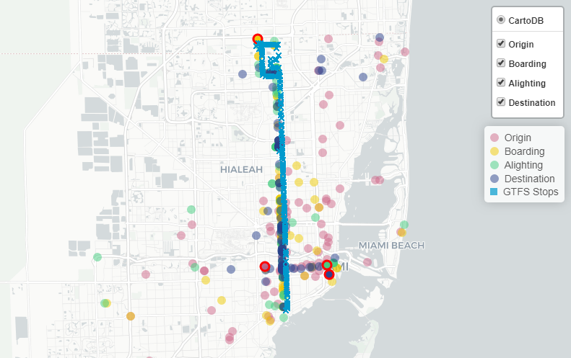
Application: Identify Illogical Records

Slide 6
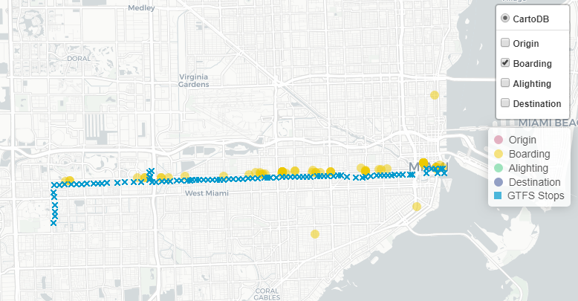
Application: Market Analysis
Example: Miami Flagler Corridor – Route 11 Local Bus - Outbound
Airport
Mall of America
Major City Casino
Downtown
Little Havana

Slide 7
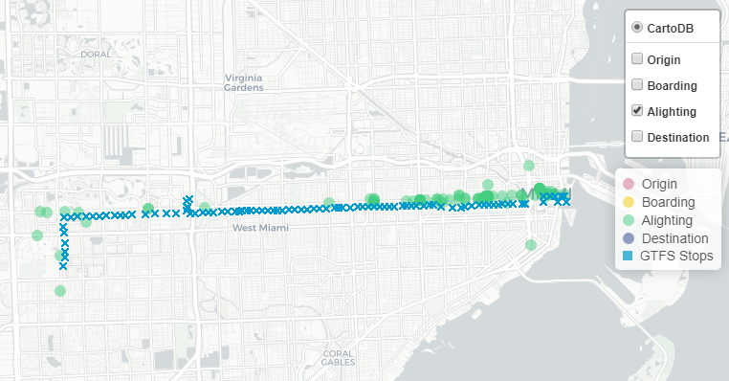
Application: Market Analysis
Example: Miami Flagler Corridor – Route 11 Local Bus- Outbound
Mall of America
Major City Casino
Florida International University

Slide 8
Thank you!
FDOT and Miami-Dade County Government for sharing the data
John Helsel, Dave Ory, Clint Daniels, Rosella Picado, and Raghu Sidharthan, WSP
Please come visit my poster stand to play with the tool!
Download link: https://github.com/wsp-sag/onboard_survey_visualization_tool

