Slide 1
Challenges of Modeling a Closed System: Grand Cayman's Multi Resolution Modeling Platform
TRBAPPCON 2019
Transit, the Universe, and Everything | June 5, 2019

Slide 2
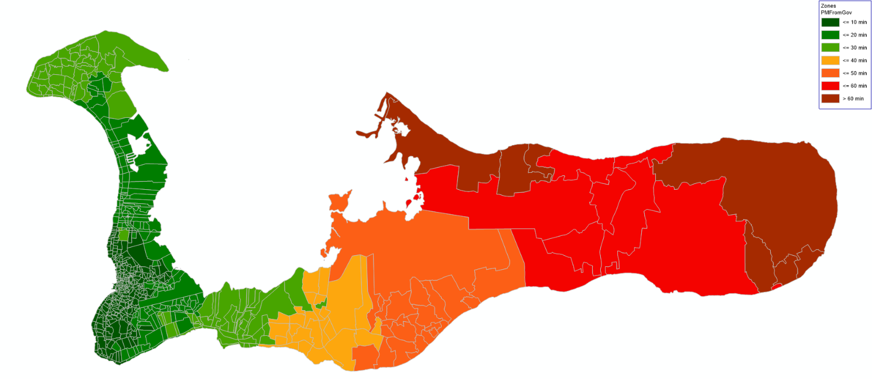
Grand Cayman’s Integrated Modeling System
Travel Demand Model
Island wide travel for residents, visitors and freight
Macroscopic Operations Model
AM and PM peak hour operations
Microsimulation
All modes of travel, detailed evaluations

Slide 3
2016 Arriving Airline Passengers by Month

Slide 4
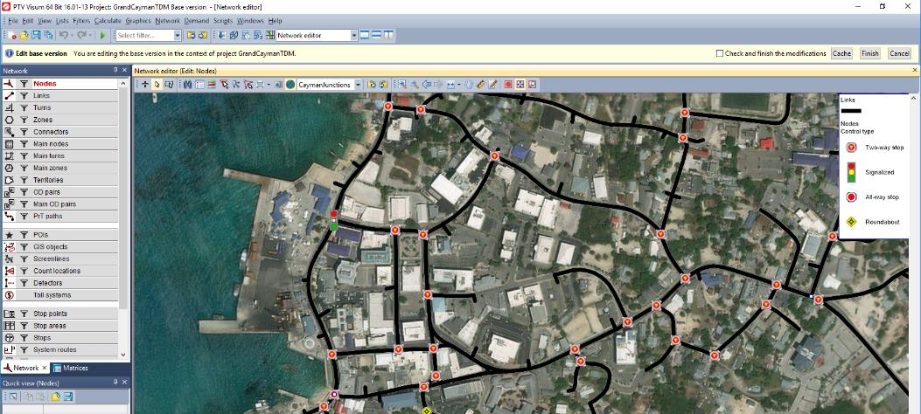
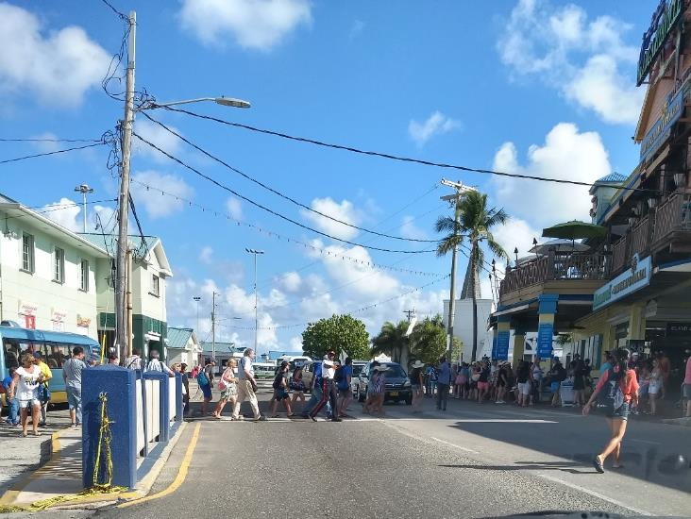
Port Operations: People and Freight

Slide 5
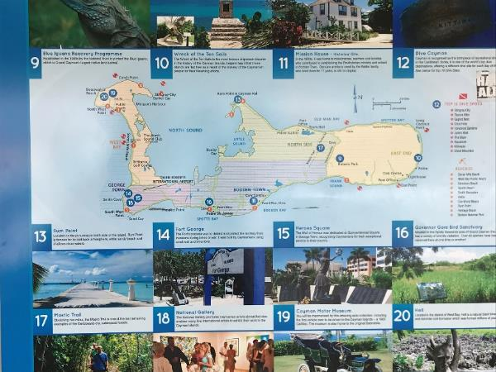
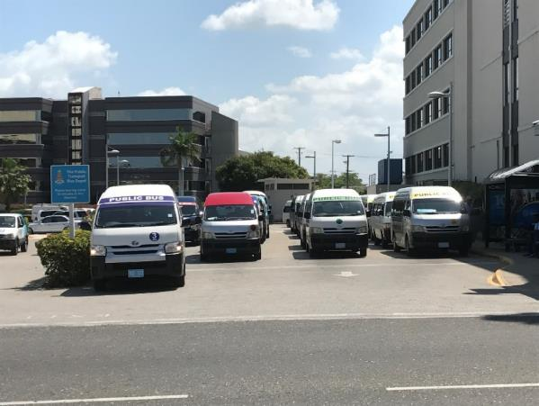
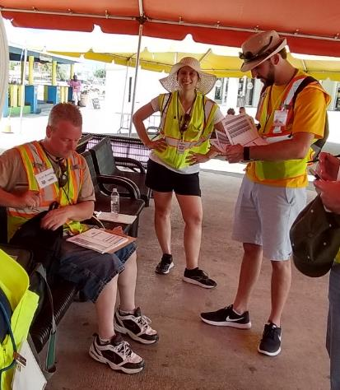
Modeling Unique Aspects of Grand Cayman
Mix of People Traveling
Residents
School Trips
Short Term Visitors (less than a day)
Long Term Visitors (a day or longer)
Road Classifications, 3-lane roundabouts, and congestion
Transit System
Travel Data

Slide 6
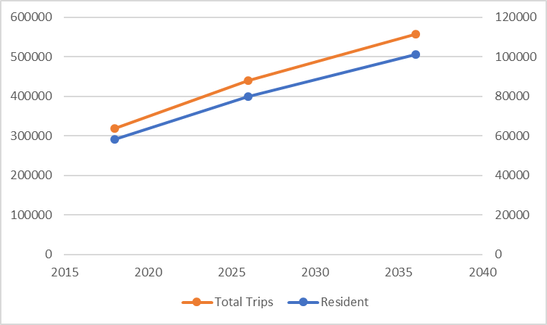
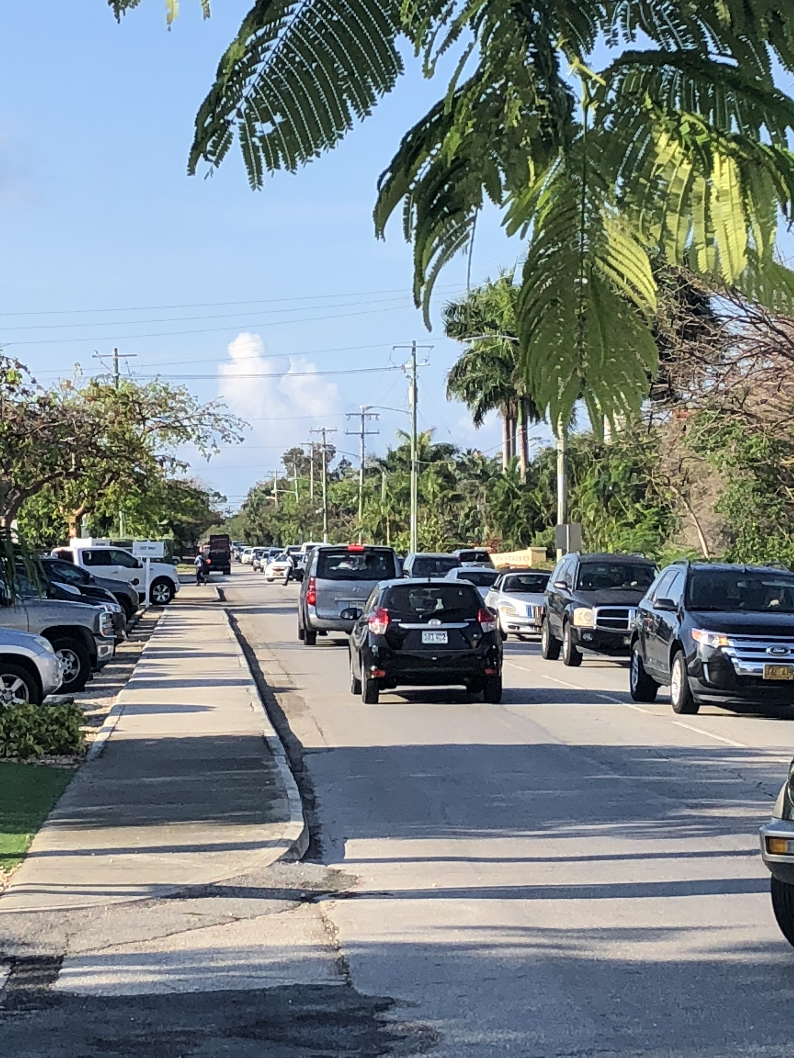
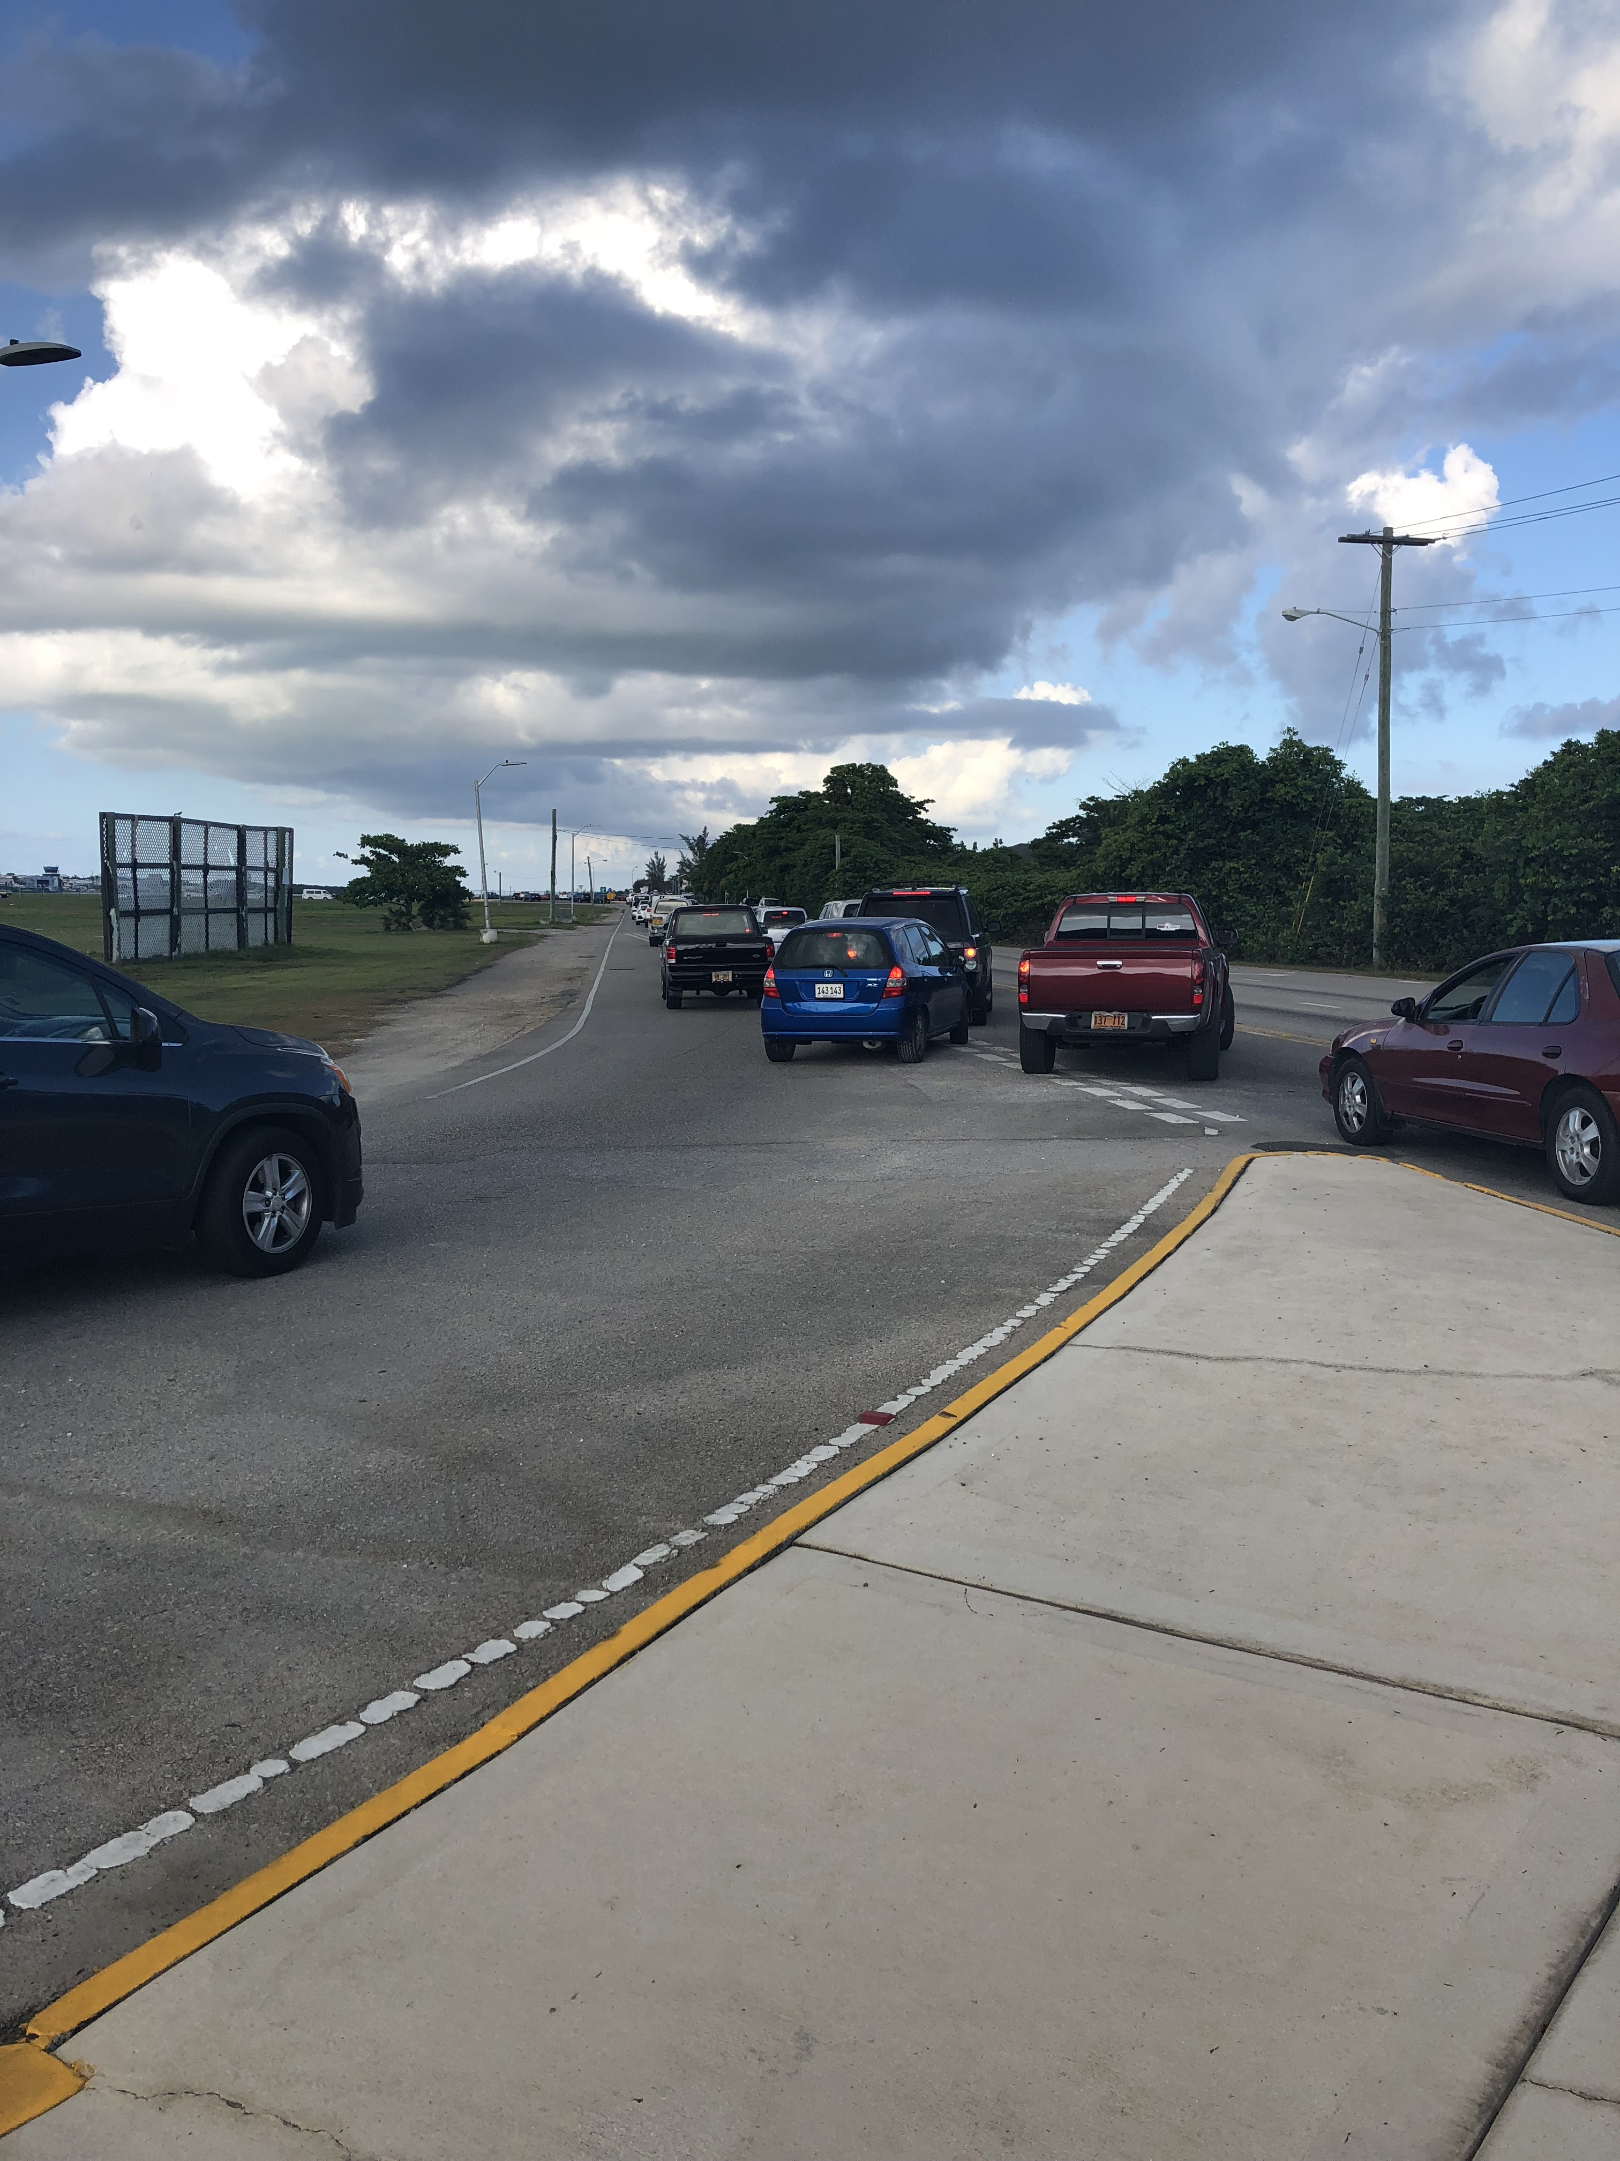
Future Projections
Growth in travel
75% growth in travel by 2036
Increasing growth of visitors annually
Growth in network capacity
2026: 6% growth in lane miles
2036: 10% growth in lane miles

Slide 7
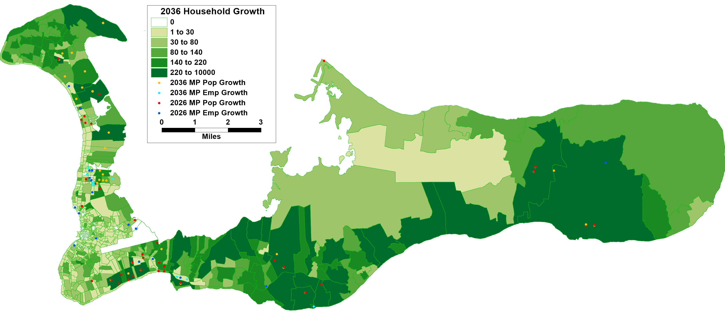
Land Use Changes
Travel Demand Model

Slide 8
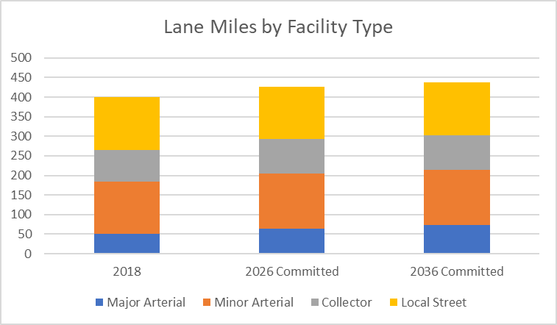
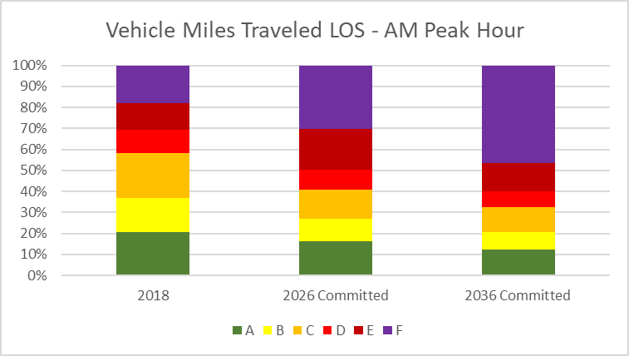
Aggregate Performance Measures
Speed (mph)
Time | Existing | 2026 No-Build | 2036 No-Build
6 - 7 AM | 20 | 14 | 13
7 - 8 AM | 16 | 6 | 6
8 - 9 AM | 16 | 2 | 3
Microsimulation
Travel Demand Model
Macroscopic Operations Model

Slide 9
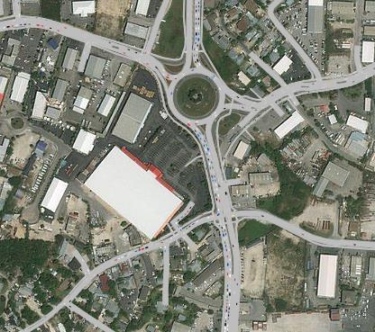
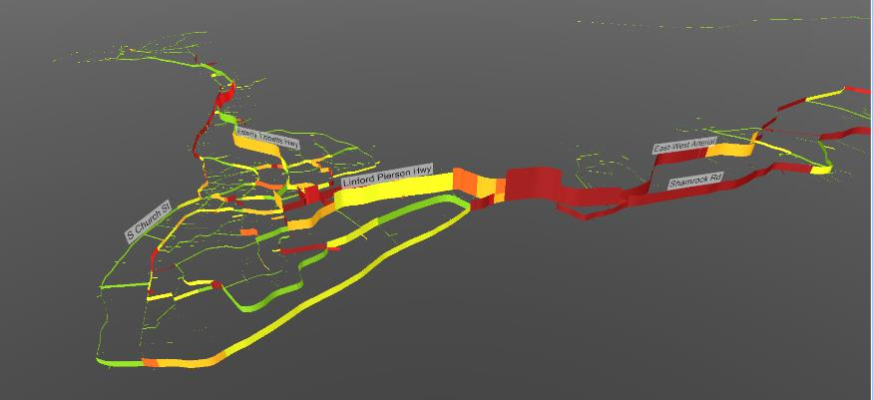
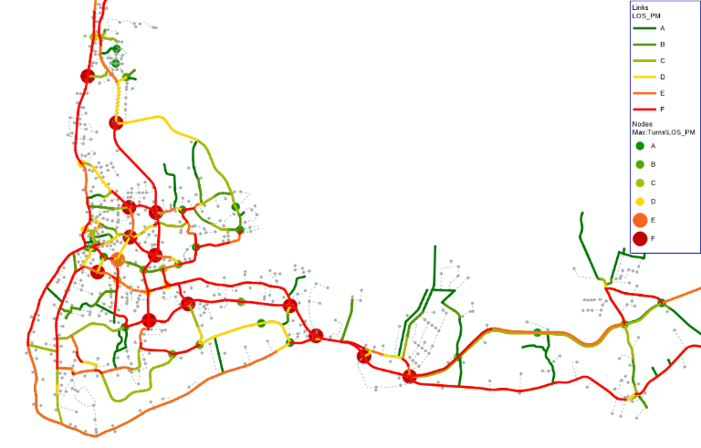
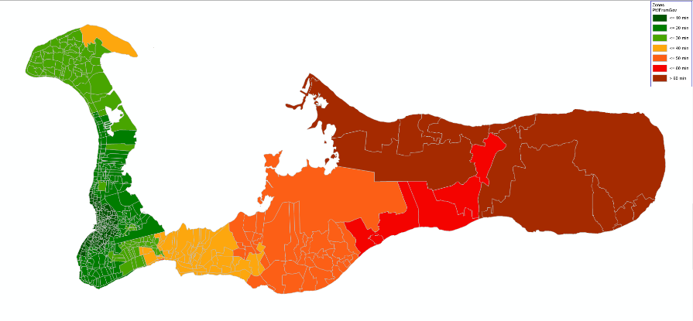
Detailed Performance Measures
Microsimulation
Macroscopic Operations Model
Macroscopic Operations Model
Macroscopic Operations Model

Slide 10
Questions?
Scott Thompson-Graves – sthompson-graves@wrallp.com
Jonathan Avner – javner@wrallp.com
Li Li – lli@wrallp.com
Jeff Moore – jsmoore@wrallp.com
Lindsey Ulizio - lulizio@wrallp.com
Edward Howard - Edward.Howard@nra.ky
Denis Thibeault - Denis.Thibeault@nra.ky

