Slide 1
DYNAMIC REPORTING using R Markdown
Gargi Singh
Texas A&M Transportation Institute

Slide 2
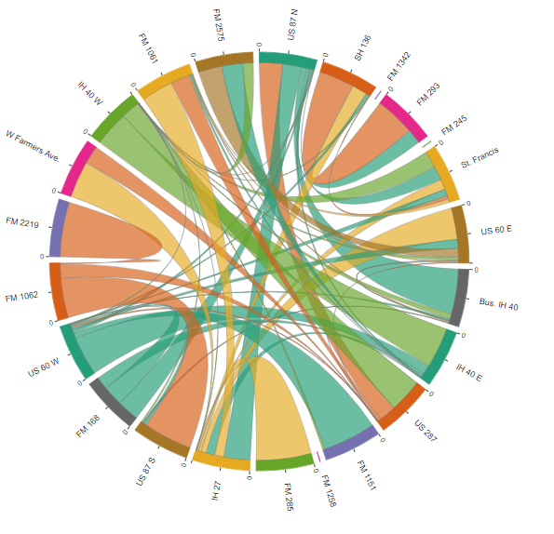
EFFICIENT
Most recent data is used at every run.
Includes static and dynamic information.
Useful when generating similar reports for multiple study areas.
Can be interactive if hosted online.
User friendly
USER FRIENDLY/INTERACTIVE
BETTER VISUALS

