Slide 1

Intrazonal or interzonal? Improving intrazonal travel forecast in a four‑step travel demand model
Park, K. , Sabouri, S., Lyons, T., Tian, G., and Ewing, R.
Presented by:
Reid Ewing
Professor of City and Metropolitan Planning
University of Utah
ewing@arch.utah.edu
Department of City & Metropolitan Planning, University of Utah

Slide 2
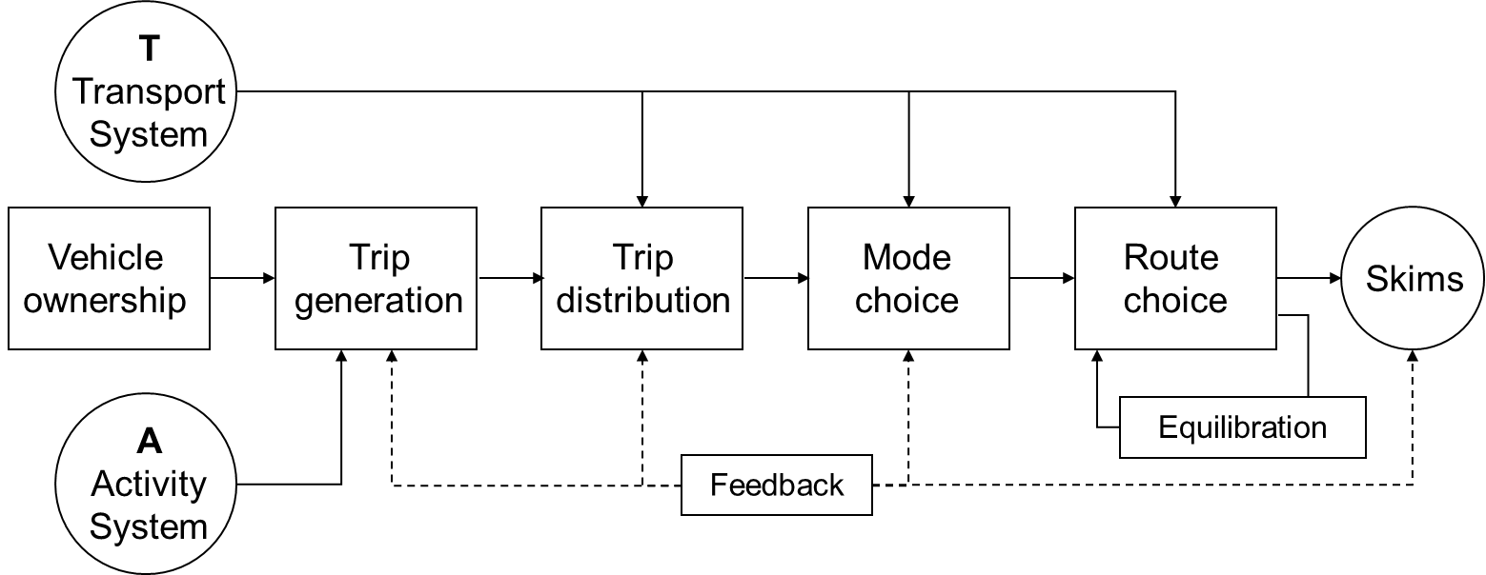
Introduction
Trip distribution: second step of conventional travel-demand models
A major weakness of these models: inaccurate prediction of intrazonal trips
Intrazonal trips are a minor consideration in the four-step travel demand modeling process, despite the fact that they typically amount to 10 percent or more of all trips in household travel surveys.
Four Step Travel Demand Model (Adapted from McNally, 2007)
Department of City & Metropolitan Planning, University of Utah

Slide 3
State-of-the-Practice in Intrazonal Travel Modeling
Results of a survey of 25 randomly selected (taking a stratified random sample) Metropolitan Planning Organizations (MPO):
The four-step process is still dominant.
Most commonly used models for estimating the trip distribution step:
  The gravity model, followed by the destination choice model
The gravity model with nearest neighbor assumptions about intrazonal travel times is still the dominant way of forecasting intrazonal trips.
Crude estimate of intrazonal travel time (nearest neighbor rule)
Example: half of the average travel time to the four closest neighboring zones
Department of City & Metropolitan Planning, University of Utah

Slide 4
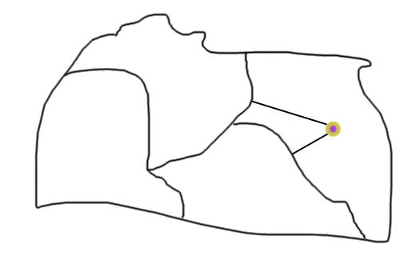
Model Representation

Slide 5
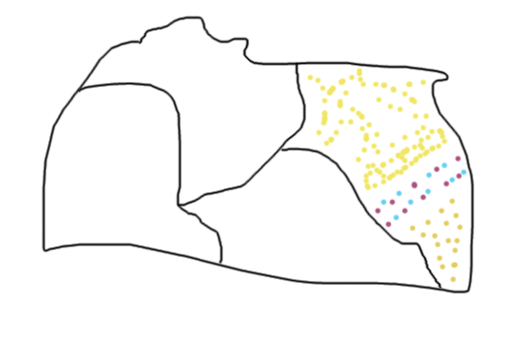
Sprawl Pattern

Slide 6
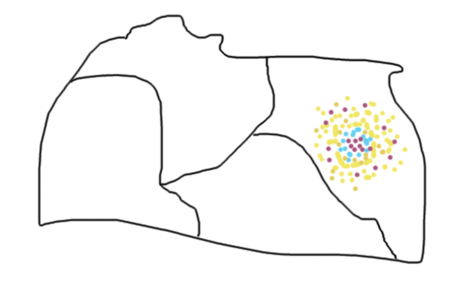
Compact Pattern

Slide 7
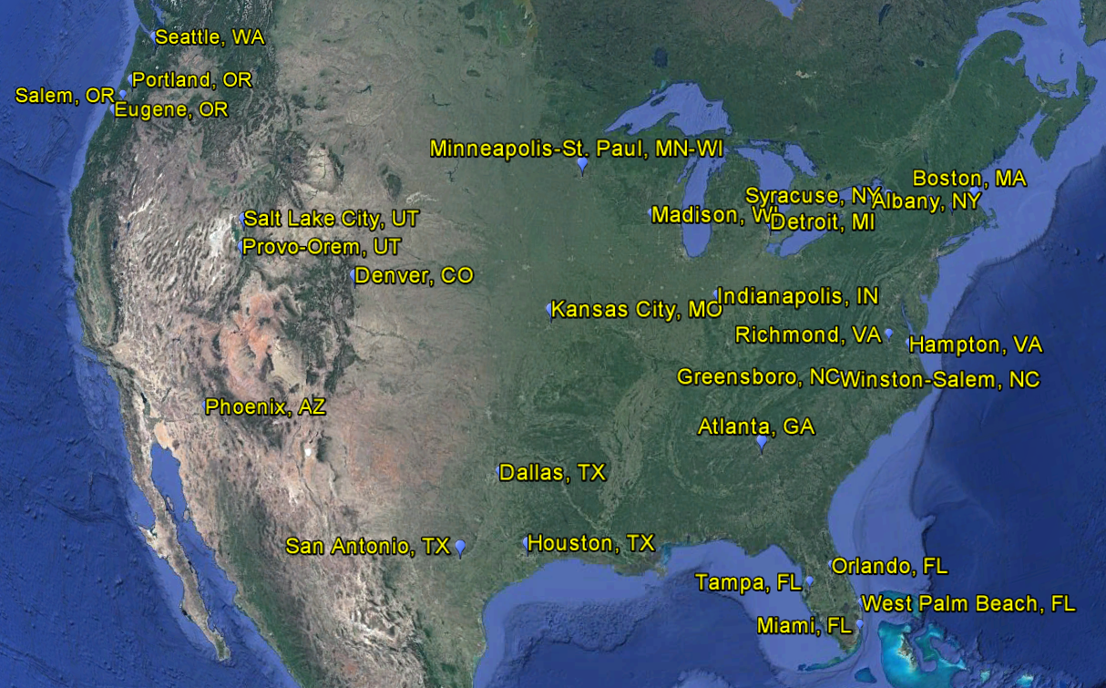
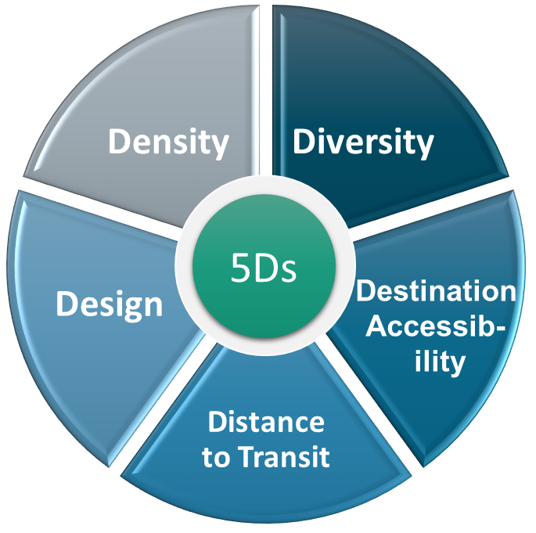
Data and Method
31 regions
850,000 trips
91,000 households
Trip mode, purposes
Trip ends XY
D variables for at household and TAZs
Department of City & Metropolitan Planning, University of Utah

Slide 8
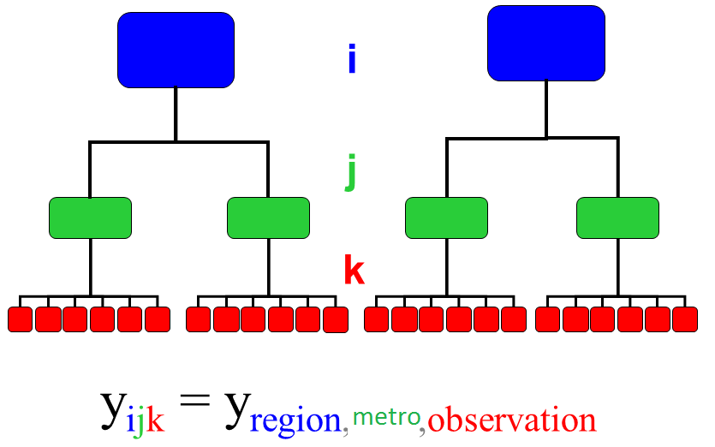
Data and Method
Variable |  | Description
Outcome Variable (level 1: trip)
intrazonal | trip remaining internal to TAZ (1=intrazonal, 0=interzonal)
Explanatory Variables (level 2: TAZ)
area | gross land area of TAZ in square miles
actden | activity density within TAZ (pop+emp per square mile)
entropy | land use entropy within TAZ
jobpop | job-population balance within TAZ
intden | intersection density within TAZ
pct4wy | percentage of 4-way intersections within TAZ
stopden | transit stop density within TAZ
pctemp10a | percentage of regional emp within 10 minutes by car
pctemp30t | percentage of regional emp within 30 minutes by transit
totpop | total population within TAZ
totemp | total employment within TAZ
Explanatory Variables (level 3: region)
regpop000 | Regional population in thousand
regemp000 | Regional employment in thousand
regpopden | Regional population density (population per square mile)
3-level binary logistic regression for each trip purpose
Region, TAZ, Trips
Department of City & Metropolitan Planning, University of Utah

Slide 9
Model Results
Different D variables are shown to be significant predictors of intrazonal trips for different trip purposes.
Total employment (demographic variable) is positively associated with the share of intrazonal trips for all five trip purposes.
Total population (demographic variable) is positively associated with the share of intrazonal trips for home-based-shopping, home-based-other, and non-homebased-non-work purposes.
Area size has a positive association with the intrazonal trip likelihood for home-based-work, home-based-shopping, home-based-other, and non-homebased-non-work trips.
Department of City & Metropolitan Planning, University of Utah

Slide 10
Model Results
Activity density is positive and significant only in non-home-based-work model.
A land use diversity variable, job-population balance, is positively related to the share of intrazonal trips for all home-related trip purposes but home-based-work trips.
Destination accessibility—the percentage of jobs available within 10-min, 20-min, or 30-min by car or 30-min by transit—is negatively associated with the share of intrazonal trips for all five trip purposes.
The more jobs immediately outside of the given TAZ, the more likely a trip crosses the zone boundary for specific trip types.
The percentage of four-way intersections—is positively associated with intrazonal trip likelihood only for home-based-shopping and non-home-based-work trips.
Lastly, regional variables are not statistically significant in any models, and so were dropped.
Department of City & Metropolitan Planning, University of Utah

Slide 11
Conclusion
Intrazonal trips cannot be ignored, due to the impact they have on important aspects of transportation, such as congestion and pollution.
We developed an approach to enhance the conventional gravity model for predicting intrazonal trips by including more built environment D variables and using a more robust modeling method.
The results of this study could be used in travel demand modeling practice, especially in the hundreds of medium- and small-sized MPOs.
Two regional MPOs, Wasatch Front Regional Council (WFRC) and Mountainland Association of Governments (MAG), are incorporating our models into their four-step models.
Estimation based on 31 region database:
The models have external validity, and are generalizable for future changes on land use and transport toward more compact, mixed-use, and transit supportive developments.
Department of City & Metropolitan Planning, University of Utah

Slide 12
Thank You

