Slide 1
Understanding Travel Using big data
Transportation Planning Applications Conference
June 4, 2019

Slide 2

Motivation and Overview
Intercept surveys are difficult and expensive to conduct
NJDOT interested in understanding the visiting pattern and profile of NJ Scenic Byways visitors
Mobile phone data
  Includes visitors
  Massive sample sizes
  Relatively inexpensive
Processed raw data & developed visitor characteristics by merging with ACS data

Slide 3
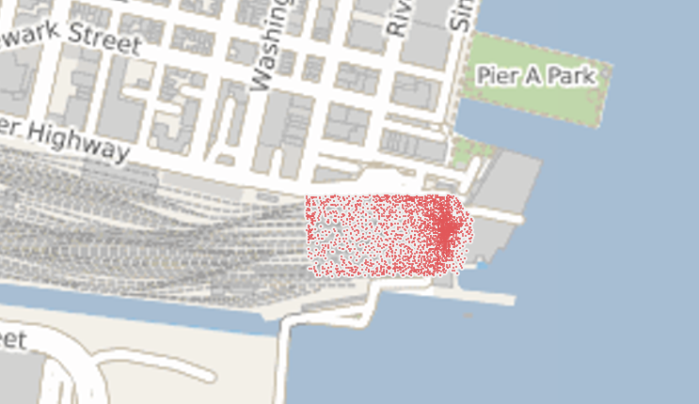
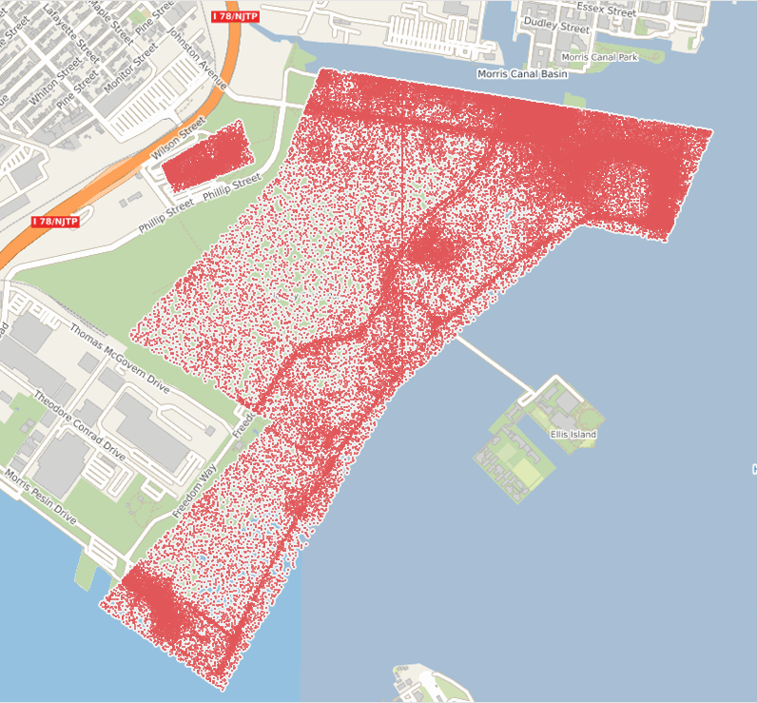
Geofencing Data
Geofencing shown around points of interest. Higher activity can be noticed around walking paths and tracks.

Slide 4
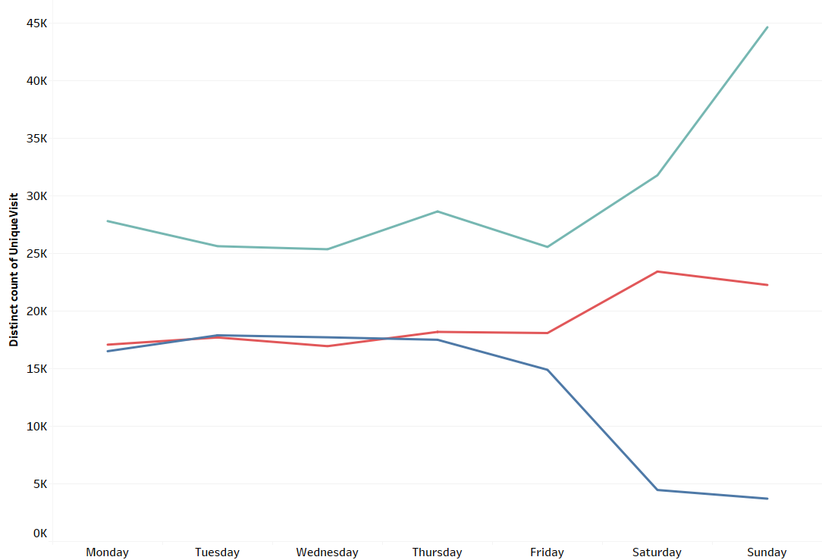
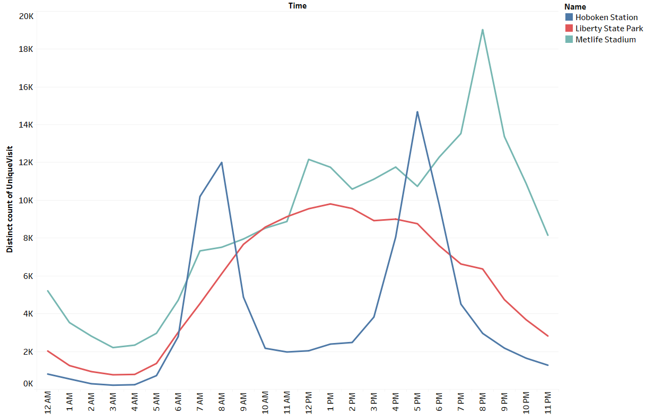
Temporal Variation

Slide 5
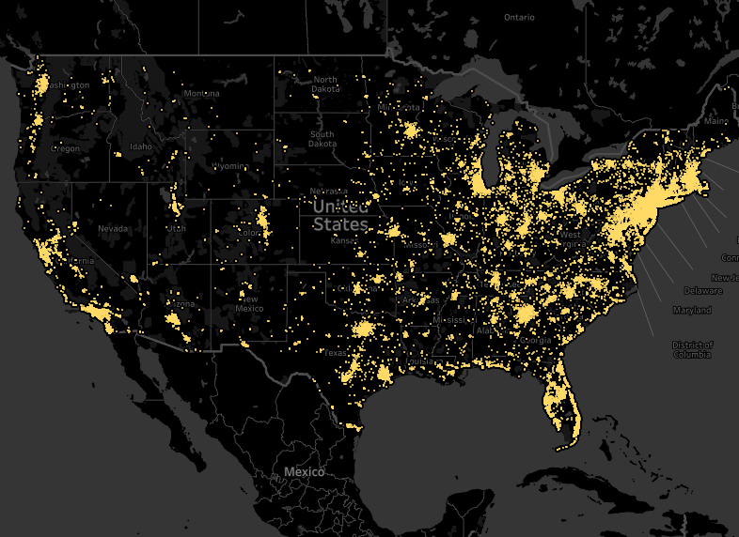
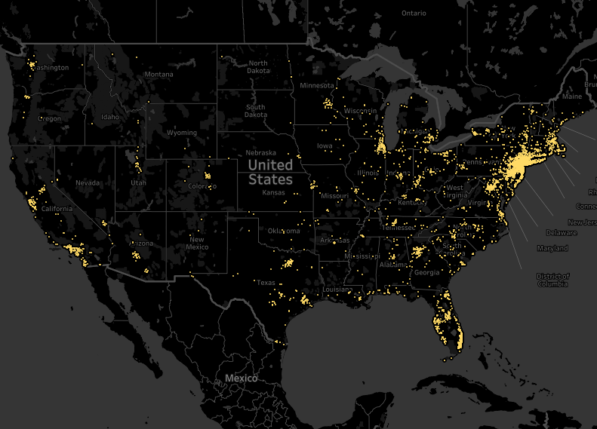
Home Location
At least one trip to Liberty State Park
More than one trip to Liberty State Park

Slide 6
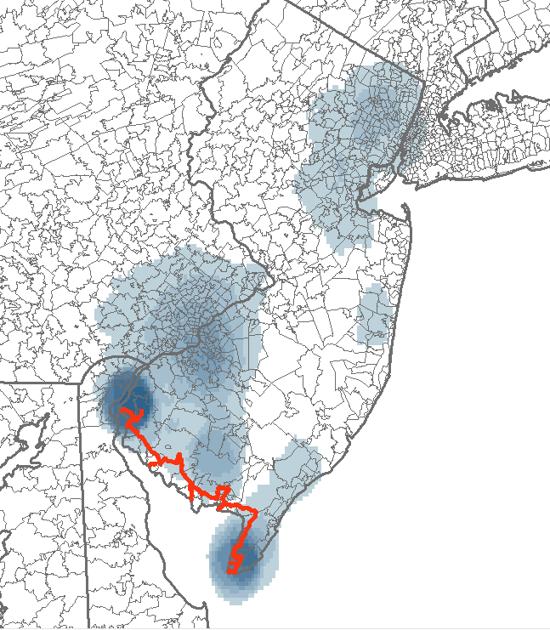
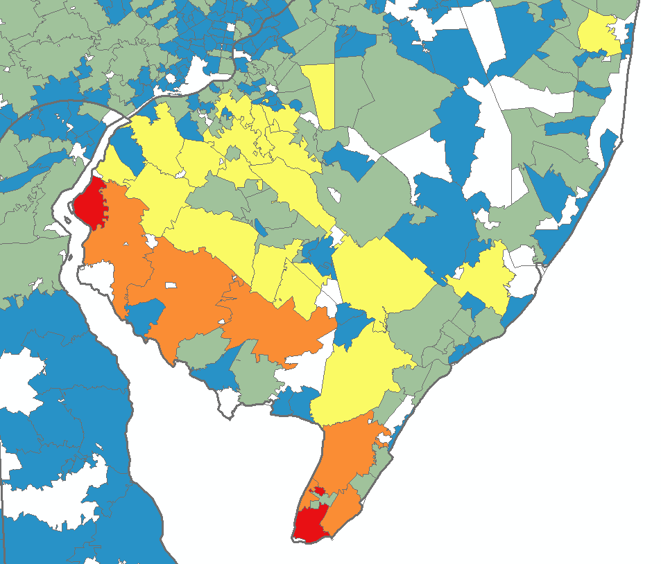
Device Locations – Bayshore Heritage Byway

Slide 7
Survey vs LBS Data
Notes:
The survey which contained 22 questions, focused predominantly on four areas:
1. The respondents’ familiarity with the Scenic Byway Program.
2. Information sources that the respondent used to find and get to the byway.
3. Information regarding the survey respondent’s trip (origin, destination, frequency of visit, etc.).
4. Questions about the person (gender, age and income categories).
Users of the byways were surveyed at 14 points of interest identified by the project team with input from the byway coordinators. While on site, reconnaissance of the points of interest and users also was conducted. Surveying took place on the weekends through the month of September and the first week of November, which resulted in the 837 responses received.
You can find more information as well as the actual survey instrument in the attached document.

Slide 8
Visitation by State

