Slide 1
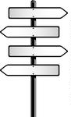
MODELING FRAMEWORK FOR DETERMINING INDIVIDUAL USER RESPONSE TO HIGHWAY NETWORK CHANGES
Where
Did
Everyone
Go?
TRB Planning Applications Conference
Presented by: Dejan Dudich, Transportation Analyst/Modeler
June 4th , 2019

Slide 2
Outline
What is the Framework?
When do we use it?
Example of its use

Slide 3
Framework
It’s a new Spin/Take on a trusted method (Select Link)
Works with discrete trip records (i.e. ABM) but will work with traditional TDMs

Slide 4
When its used
The approach can answer new questions
Like what routes are previous users utilizing after a specific link is closed
With just the traditional select link approach you can at most say how the total volumes have shifted
Notes:
Talk about the other types of projects this can be applied to:
Resiliency projects
Climate change events
Disasters
Users of new (mega) projects
Where were they before? Where did they get pulled from

Slide 5
Quick Example

Slide 6
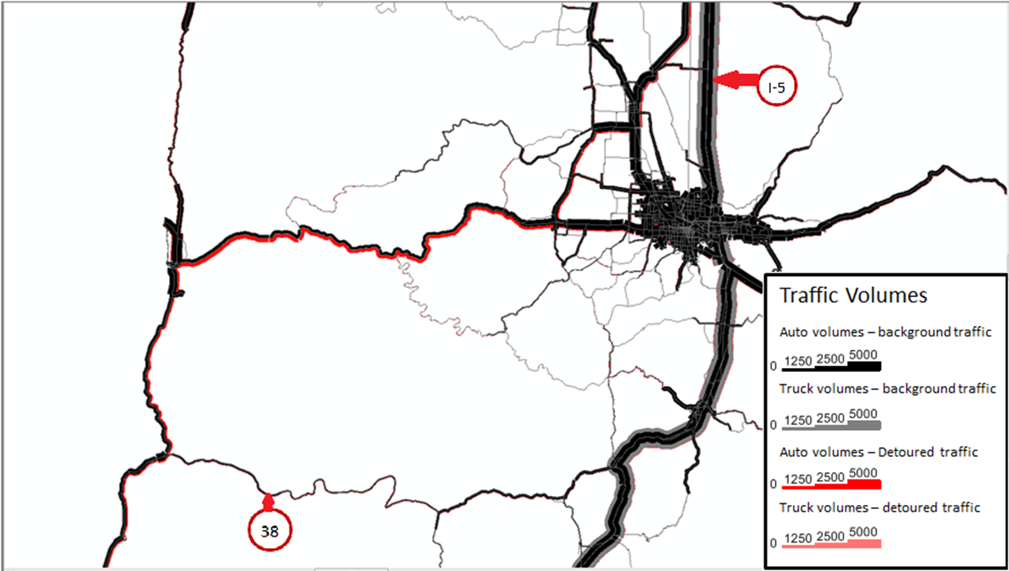
Average Additional Miles of Travel |  | Average Additional Hours of Travel
Auto | Truck | Auto | Truck
45 | 21 | 50 | 18
Notes:
Simulated Landslide closure of OR126 Near Florence.
The truck bars are set to a different scale so they can be seen better.

Slide 7
Dejan Dudich
Oregon Department of Transportation
dejan.dudich@odot.state.or.us

