Slide 1
Integrated Modeling
in this
Brice Nichols | Senior Modeler | Puget Sound Regional Council | bnichols@psrc.org

Slide 2
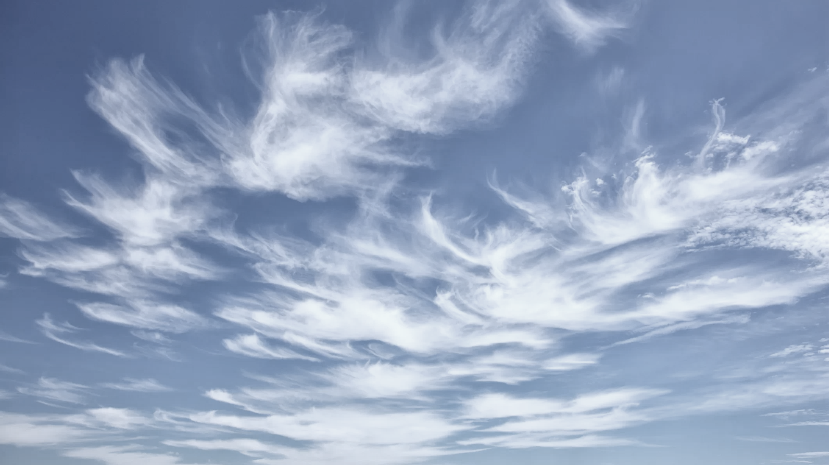
Integrated Models
Travel Model 2014
Land Use Model 2014 – 2025
Accessibility
Travel Model 2025
Land Use Model 2025 – 2040
Accessibility
Travel Model 2040
Land Use Model 2040 – 2050
Accessibility
Travel Model 2050

Slide 3
Data Management
Run environments (software, licenses, libraries)
Code bases
Model configuration
Notes:
Replicable:
- A

Slide 4
(Ideal) Solutions
Virtual environments (conda)
Refresh version-controlled code
Defined directory structure
Manage configuration files and output
Single script for run prep and management
Notes:
Replicable:
- A

Slide 5
Cloud Formation
Extends scripted solutions
Replicable templates
Scalable
Windows
Cost Equivalent
Notes:
Replicable:
- A

Slide 6
Application
Total Run Times (2014 - 2050)
Land Use Model ~ 50 hours
Travel Model ~ 50 hours
50 + 50 ~ 4 (days)
$3.30/hour => $330
2050 Land Use + Travel Model:
~ 50 hours

Slide 7
Cloud Issues
Potentially costly
Run management & storage are not magically cured by cloud therapy
Notes:
Potentially costly if used a lot (or very little because you forgot it’s running!)

Slide 8
Conclusions
Cloud machines provide flexibility
Consistent run environments and replicable processes are key (cloud or not)
Integrated model runs are achievable anchors

Slide 9
Thank You!
Brice Nichols
bnichols@psrc.org

