Slide 1
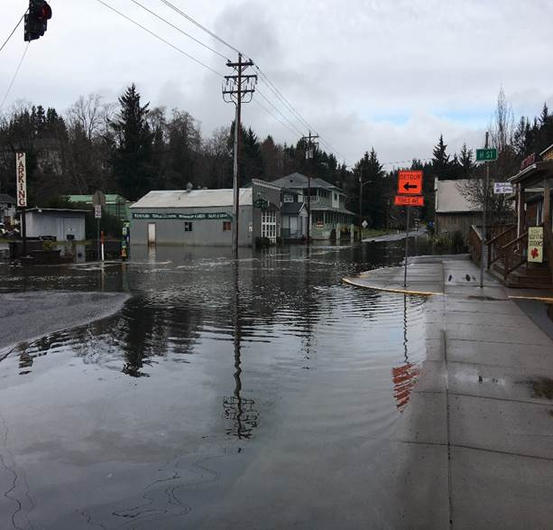
Adaptation of the Transportation Sector
Oregon Transportation
Infrastructure Impacts and Strategies
TRB Planning Applications Conference
June 3, 2019
Geoff Crook
Oregon Department of Transportation

Slide 2
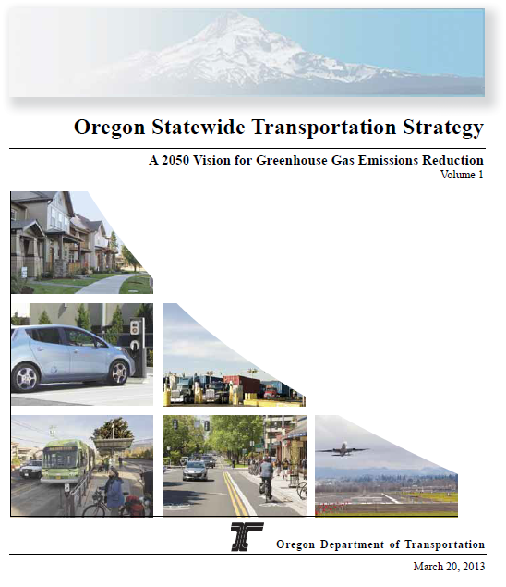
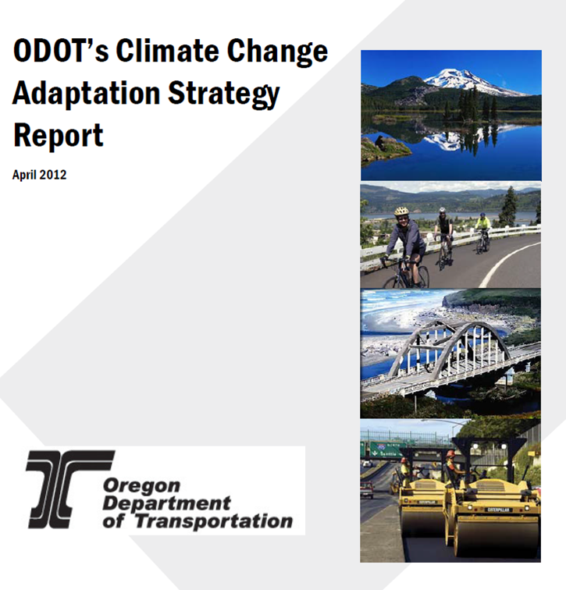
Mitigation vs. Adaptation
Statewide Transportation Strategy… to Climate Change Adaptation Strategy
Mitigation | Comprehensive (Everyone) | Publically vetted | Complete Assessment
Adaptation | Inward Facing (ODOT only) | Internally developed | Preliminary Assessment
Notes:
ODOT’s primary focus due to legislative drivers has been mitigation strategies for reducing GHG from transportation sources. We now have some new drivers for focusing on adaptation.

Slide 3
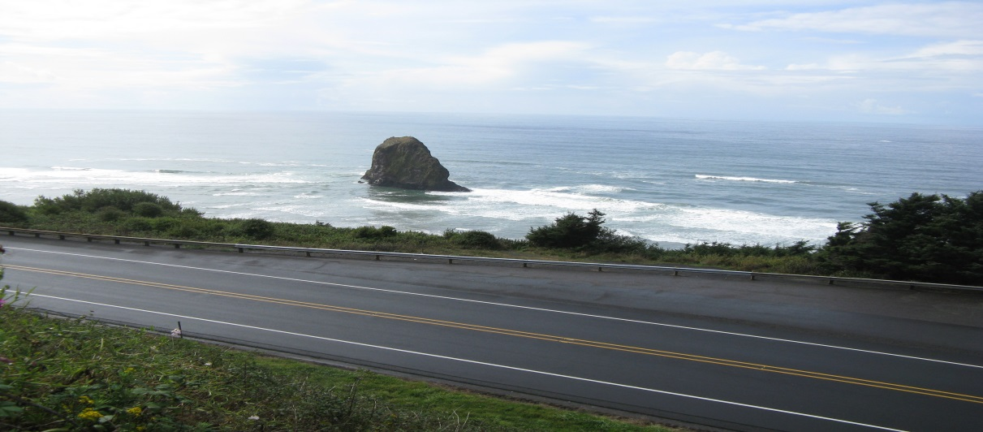
Adaptation
Actions to reduce the vulnerability of natural and human systems or to increase system resiliency in light of expected climate change or extreme weather events.
Notes:
Adaptation is about reducing vulnerability and increasing resilience to climate change and extreme weather events. New and rapidly evolving field. Most all sectors are looking at adaptation- natural resources, health and safety, public works.
For DOTs… no one solution or silo for addressing – cuts across all aspects of work from asset management, planning, design and construction and maintenance.

Slide 4
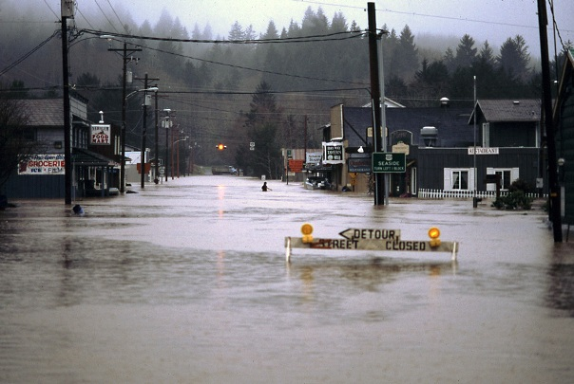
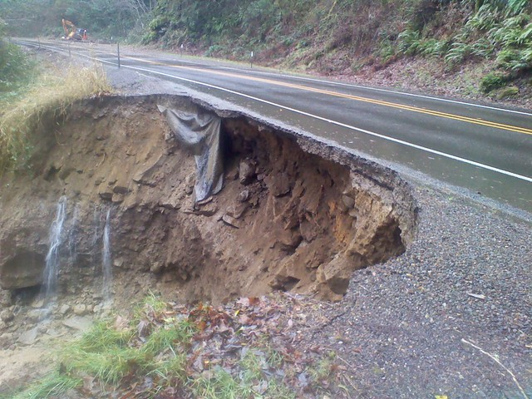
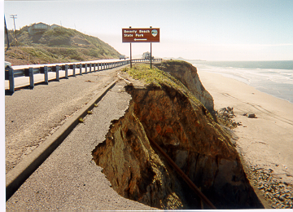
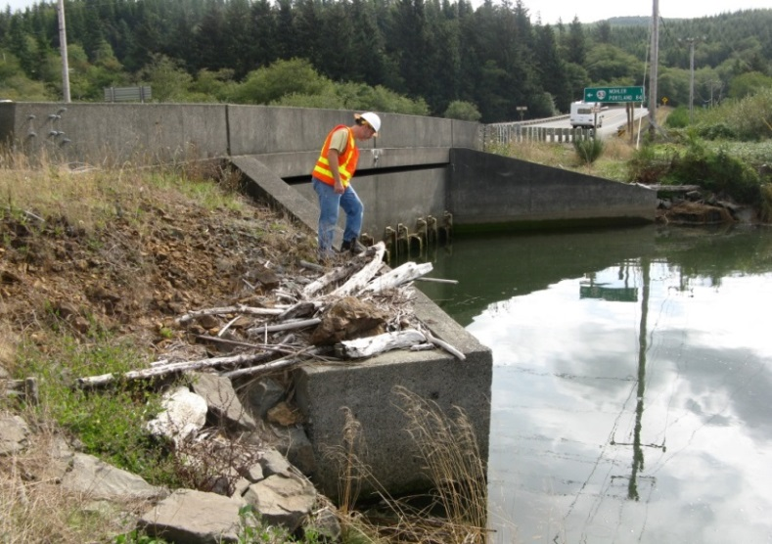
Impacts on Transportation
    Extreme temperatures, drought, wildfires
    Coastal storm surge, sea level rise, bluff erosion
    Increased frequency and magnitude of extreme storms, flooding, landslides
Notes:
Impacts on infrastructure include things we are already used to seeing on a regular basis, but are projected to get worse. –-- from extreme storms, flooding, landslides impacting roads, bridges and culverts – rising sea levels/ storms with coastal bluff erosion, storm surge/ wave scour – and heat/ drought and impacts from wildfire..

Slide 5
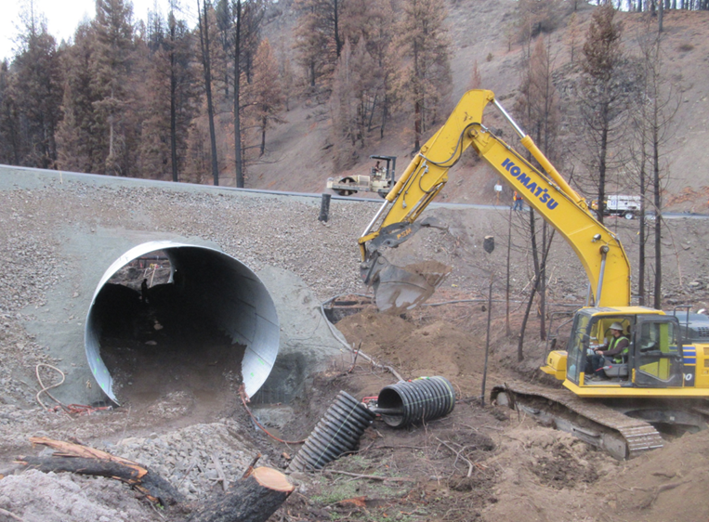
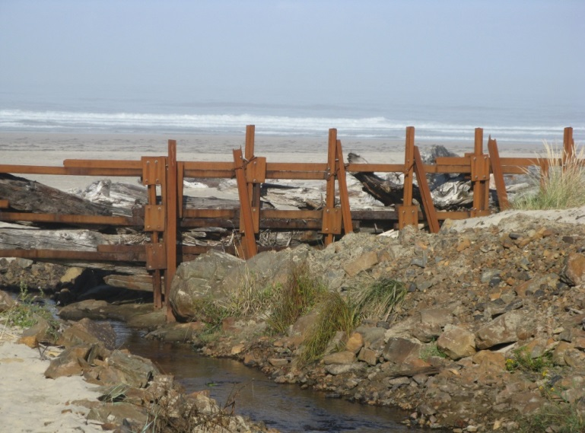
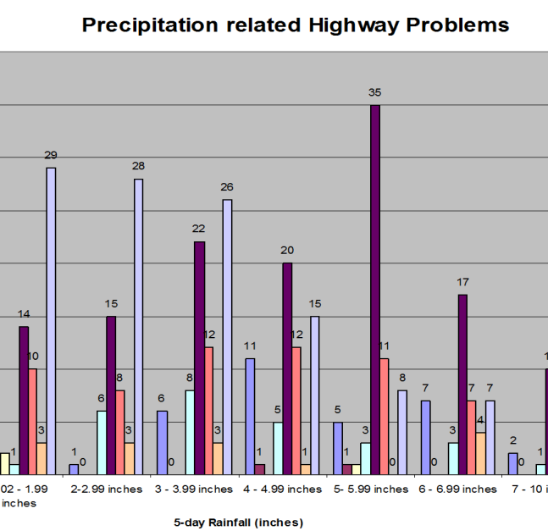
Benefits
Proactive strategies that support ODOT’s mission
Considers future hazards and risks
Lower maintenance and operations costs
Informs investment decisions
Notes:
Adaptation supports ODOT’s mission and policies for protecting and maintaining the existing system. We do some of this already reactively, primarily when a system fails due to a changed condition, however the goal is to be less reactive and more proactive to reap the cost savings and travel benefits for the public.

Slide 6
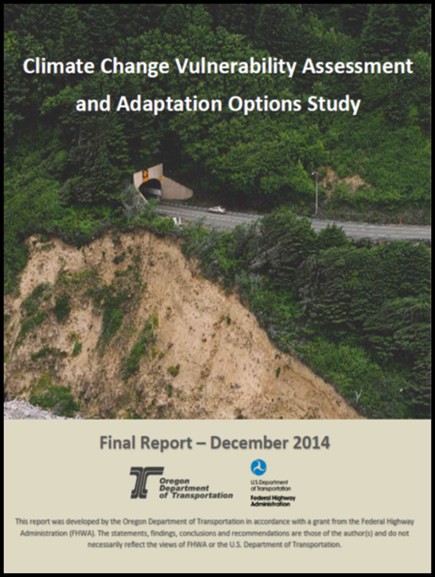
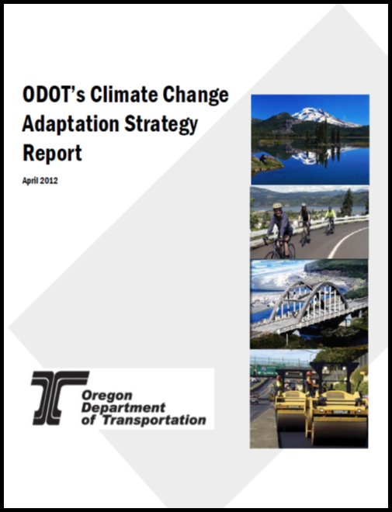
Strategies and Assessments
Vulnerability Assessment and
Options Study
Adaptation Strategy Report
Notes:
We have been working on strategies and assessments:
Adaptation strategy report – identifies risks and strategies for mainstreaming. Vulnerability assessment – FHWA pilot project to test assessment framework

Slide 7
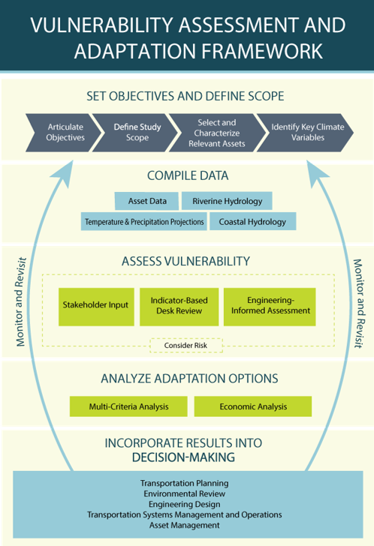
FHWA Vulnerability
Assessment and
Adaptation Framework
VULNERABILITY
Exposure
Sensitivity
Adaptative Capacity
RISK
Probability - likelihood
Consequences – costs - criticality
Notes:
FHWA has a resilience program and has process tools available for DOTs. The idea for assessment is to identify climate variables. Collect data, such a downscaled CMIP data using the FHWA Climate Data Processing Tool, and based on scale of assessment - collect input from stakeholders or engineers. Options to mitigate risks can then be developed. Incorporating the results into decision making is the hard part.

Slide 8
Climate Data
Downscaled climate data - ODOT’s North Coast pilot (CMIP5)
RCP 8.5
Oregon Coast- Gallagher Slough to Rockaway
 |  | Baseline (1950-1999) |  | Mid-Century (2046-2065) |  |  | End-of-Century (2081-2099)
 |  | Observed Value |  | Projected Value |  |  | Projected Value
 | Average Total Annual Rainfall | 95.0 | inches | 119.4 |  | inches | 117.7 |  | inches
 | "Very Heavy" 24-hr Precipitation Amount (defined as 95th percentile precipitation) | 1.2 | inches | 1.6 |  | inches | 1.6 |  | inches
 | "Extremely Heavy" 24-hr Precipitation Amount (defined as 99th percentile precipitation) | 2.1 | inches | 2.9 |  | inches | 3.0 |  | inches
 | Average Number of Baseline "Very Heavy" Rainfall Events per Year (1.2 inches in 24 hrs.) | 13 | times | 27 |  | times | 28 |  | times
 | Average Number of Baseline "Extremely Heavy" Rainfall Events per Year (2.1 inches in 24 hrs.) | 3 | times | 10 |  | times | 11 |  | times
Notes:
Example of downscaled climate data used on the north coast assessment for a portion of US 101 under a “business as usual” GHG emissions scenario. This informs change and risk levels over time.

Slide 9
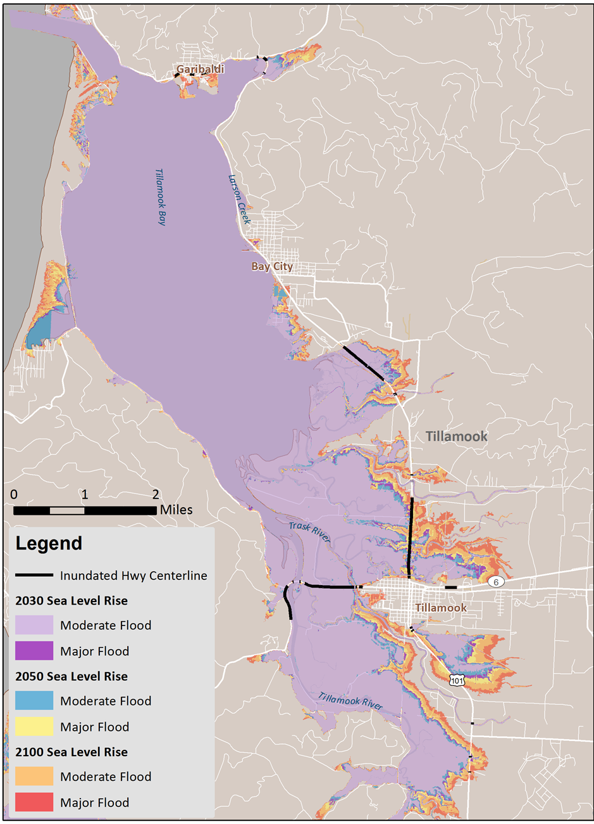
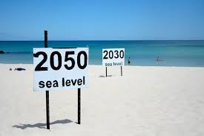
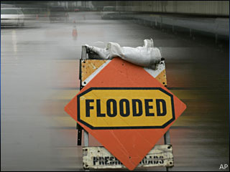
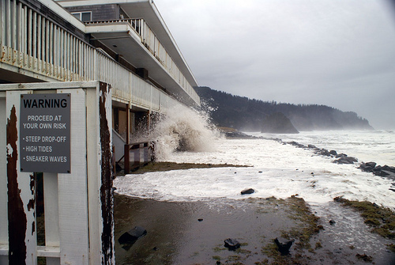
Sea Level Rise
Mapping
and
Risk Assessments
Notes:
Another assessment we did recently was partnering with DLCD for a SLR exposure inventory for state highways, there was a 2012 NRC west coast study that projects 19-inches by 2050; we now have GIS data available.

Slide 10
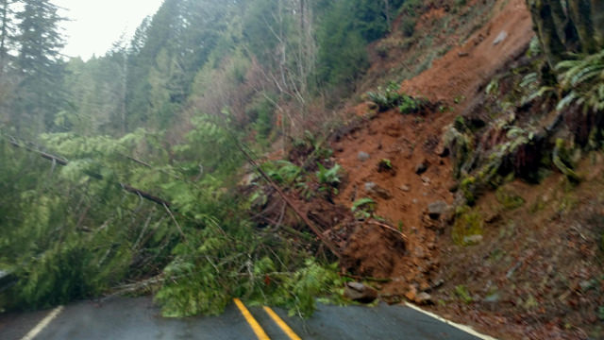
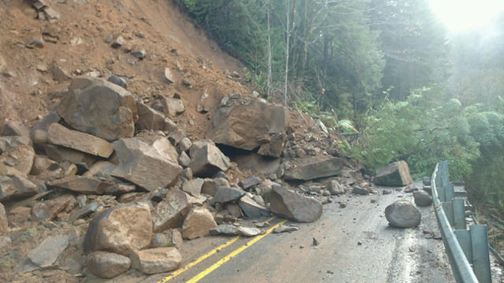
Research
Coastal Landslide and Bluff Retreat Monitoring
Automated Landslide Hot Spot Identification Tool for Climate Change and Seismic Resiliency
Notes:
Applied research is important- sometimes we need to do more to understand the nature of the problems. 1) Coastal landslide and bluff retreat monitoring and risk assessments (5 sites over 7-years); 2) landslide hot spot mapping tool to better identify and prioritize high risk locations.

Slide 11
Preparing for the future…
An Adaptation Menu
of Investment Options
Asset Programs
Priority Corridors
Maintenance/
Operations
Notes:
SHIFTING GEARS – we are now taking the next step necessary to assess vulnerability statewide, as well as integrate our work into how we do business – into our decision making (and include climate as another risk factor!). We are preparing an RFP to cover this work. ODOT is also preparing for potential/ OR ACTUAL (by June 3)? Legislative direction on a cap and invest program that would raise revenue for GHG reduction and adapting the transportation sector. We need this additional work on assessment and prioritization to move this conversation forward.

Slide 12
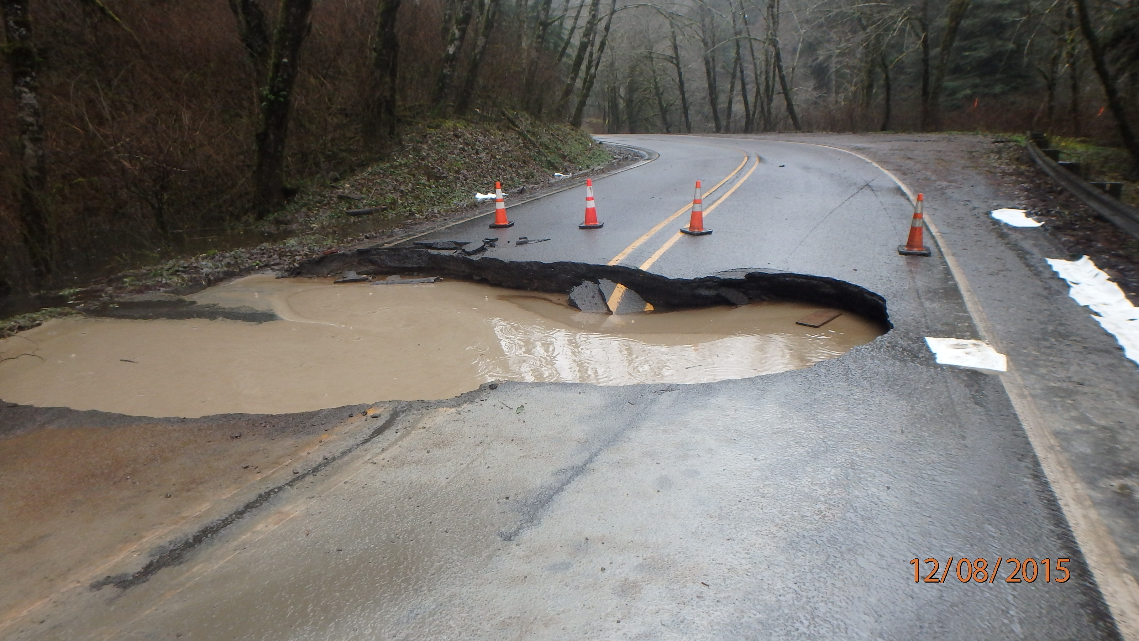
Asset Programs
    Culverts
    Landslides and rockfall
    Bridges
Investment Options
Notes:
Investments by asset program would concentrated funding into specific asset types, such as culverts. Age and condition is a large focus for repair, adaptation funding could fill the gaps to replace and make these less vulnerable to extreme storms, as well as upsize where we know rainfall will be worse

Slide 13
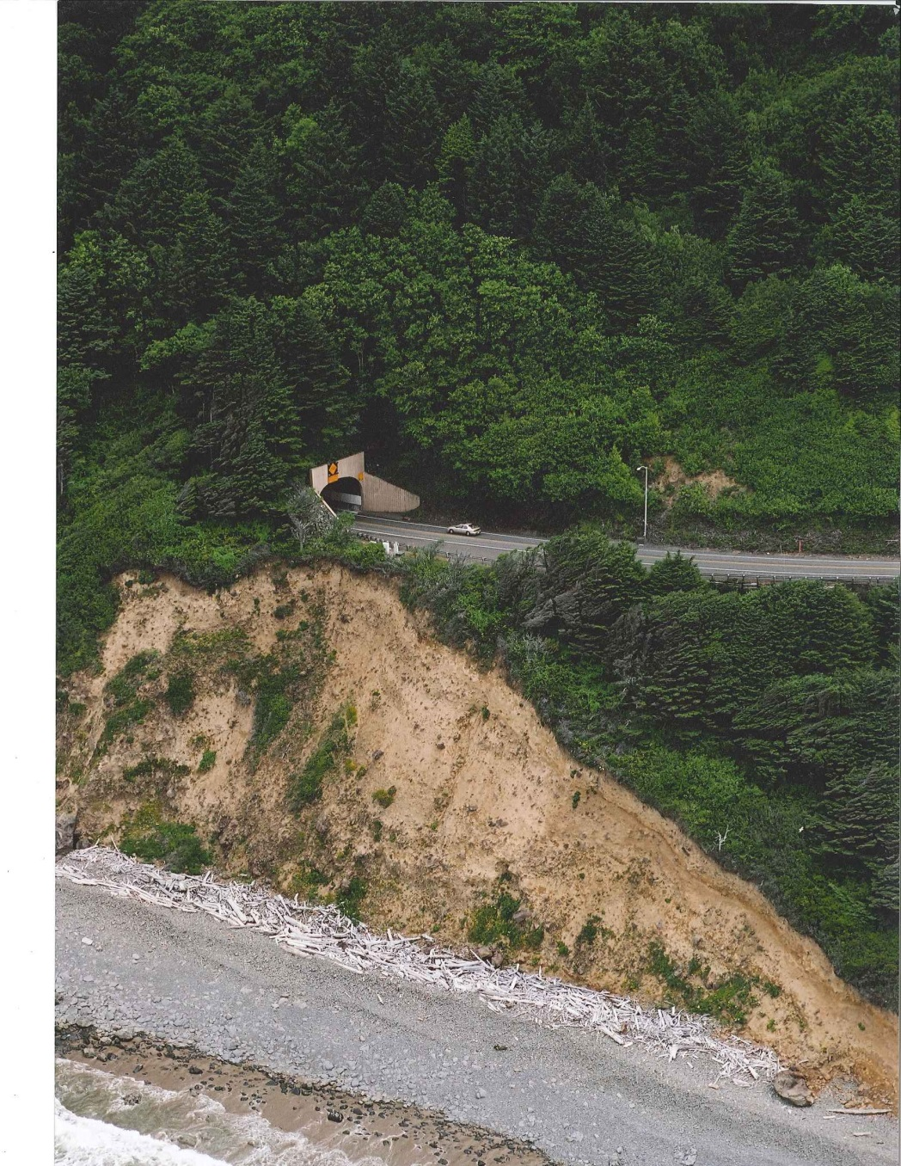
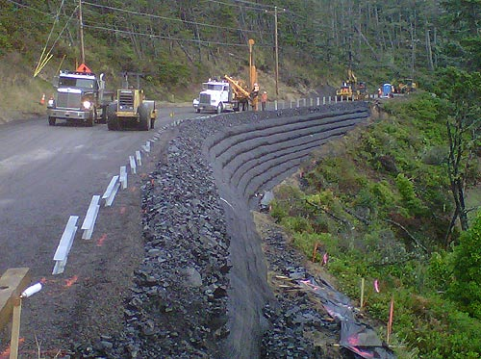
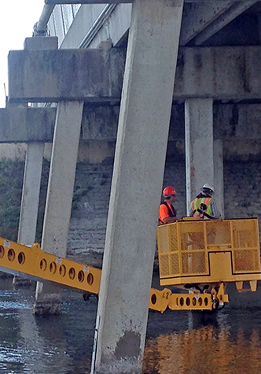
Priority Corridors
    Fix It Priority Corridors
    Seismic Lifeline Routes
    Highest Vulnerability
Investment Options
Notes:
We know through our maintenance budgets where the worst areas are from natural hazards... Impacts will be along rivers prone to flooding, steeps slopes and low- lying coastal areas. A priority corridor strategy would concentrate investments in these vulnerable corridors, such as US 101, the coast ranges or connections over the Cascades. This would be a cross-asset strategy that would build resilience throughout the system. Could leverage work being done on Fix It Priority Routes- also the Lifeline Routes for seismic resilience.

Slide 14
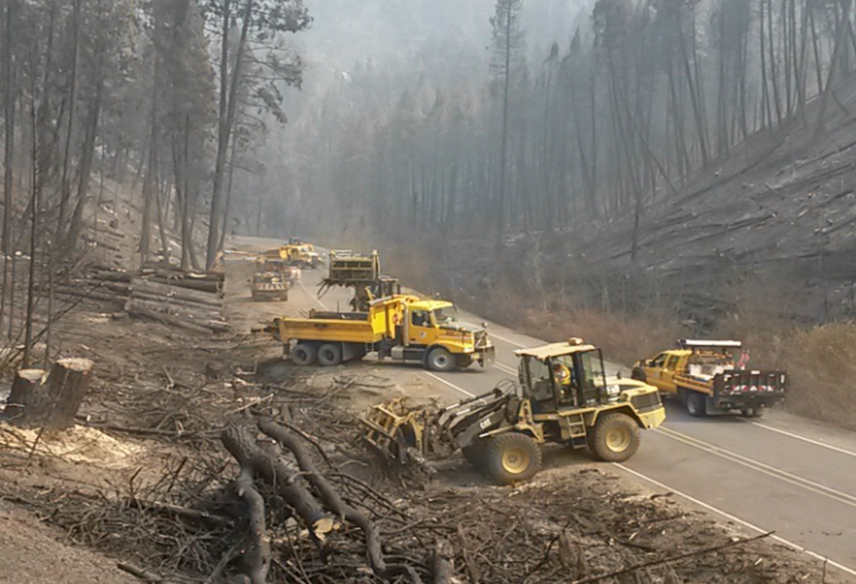
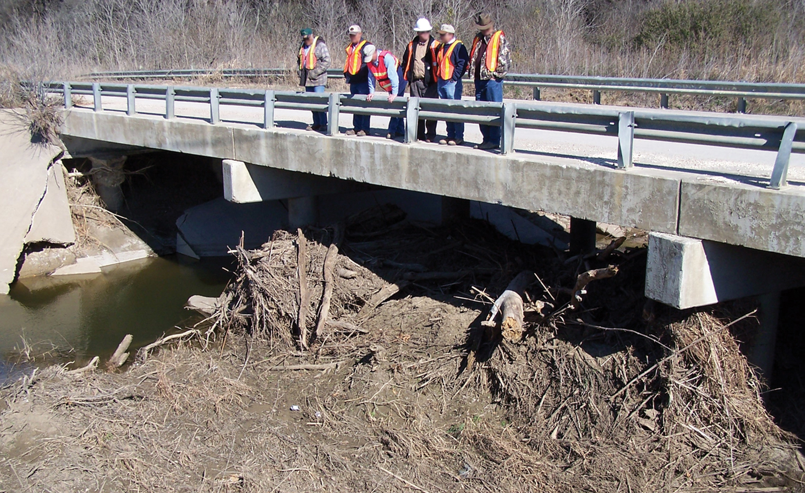
Maintenance and Operations
    Drainage, slope stability, erosion control
    Vegetation management
    Surface and shoulder maintenance
    Structure and scour protection
    Snow and ice removal
    Advanced signage (ITS)
Investment Options
Notes:
Maintenance and ops is often considered where we get greatest “bang for our buck” as proactive strategies to maintain the system can help protect during the worst extreme events. Most of M/O is reactive (cleaning up after storms) but more proactive work, such as culvert repair/ debris and hazard tree removal, etc. being done in advance of storms can save $ and prevent delays.

Slide 15
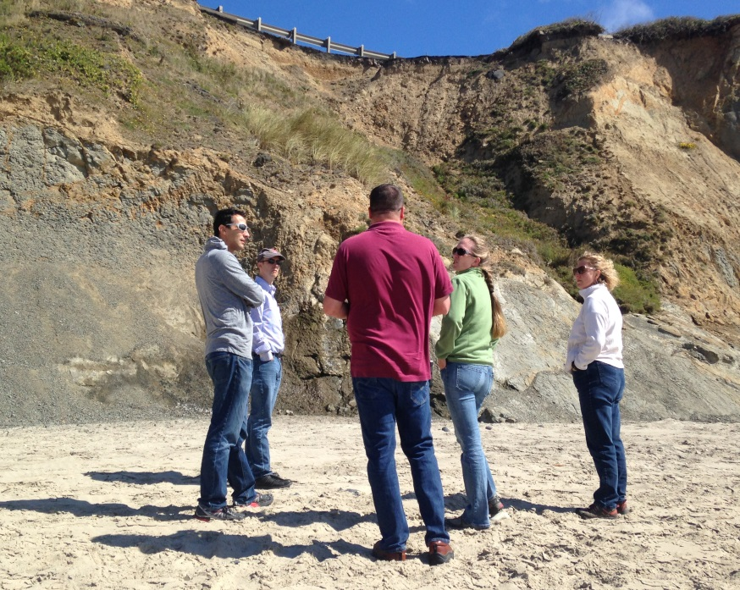
Next steps
Statewide Vulnerability Assessment
and Adaptation Plan
How will extreme weather and climate change impact the transportation system into the future?
What projects and investments are needed?
How do we select and prioritize programs, investments, and projects?
Notes:
These are some of questions we need to narrow down.
How to establish a baseline of changed condition?
What is attributable to climate change? How do we document changed condition? How do we characterize and describe “climate” impacts?
Adaptation Investment funds will not be eligible to supplant existing funding. A baseline level of mitigation activity must be established
What is the baseline / when do we say changes started to occur?
How do we demonstrate impacts to infrastructure (e.g. bridges) and programs (e.g. maintenance)?
How do we describe incremental risks and needs because of climate change?
What areas are most vulnerable? How do we best allocate funding across Regions.
What do we need to do different (sort-, mid-, and long-term)?
How much will it cost?

Slide 16
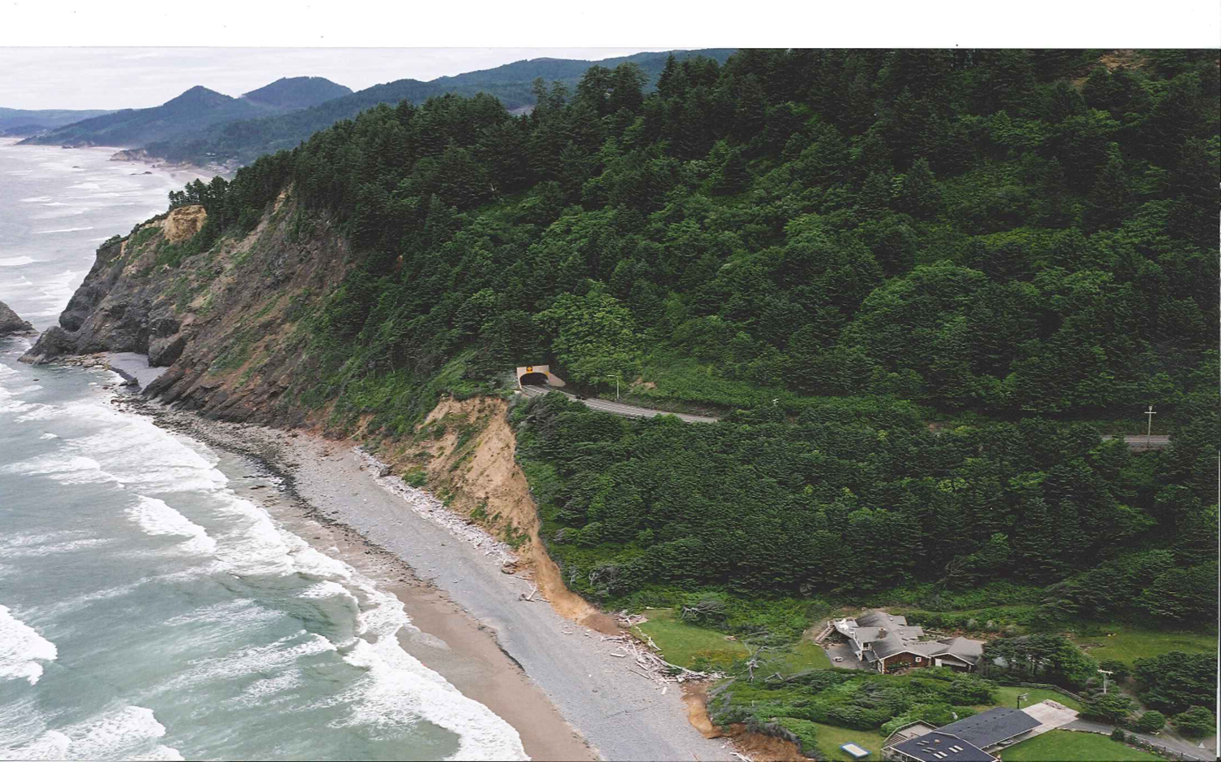
Questions?
Geoff Crook
ODOT Sustainability Program
503-986-3425

