Slide 1
Identifying Intermediate Stops to Improve Commercial Truck Passive Data Processing
Theodore Mansfield, PhD, RSG
Steven Trevino, RSG
Vince Bernardin, PhD, RSG
June 4, 2019

Slide 2
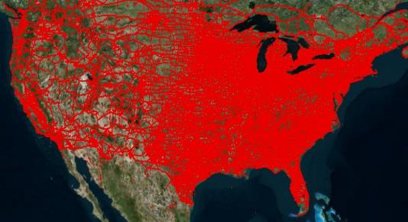
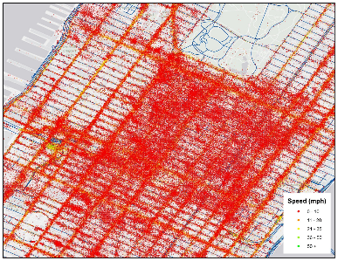
Passive Data is a Powerful Tool in Contemporary Travel Forecasting
ATRI: largest sample of truck GPS data in the US
  Over 2 billion truck positions every day
  Over 800,000 trucks ~ nearly 30% of all semis in US
  One day of ATRI data… …in lower Manhattan

Slide 3
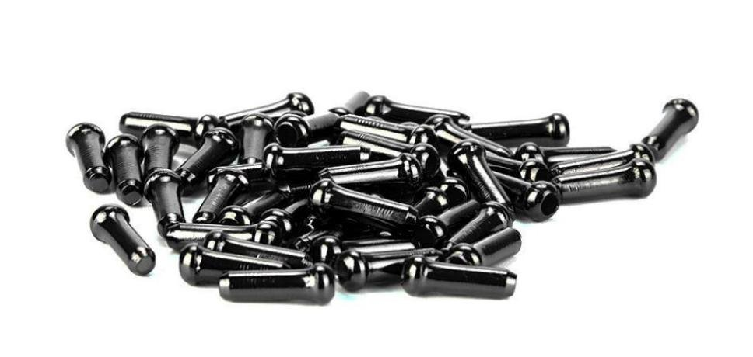
Big Data Processing Can Be Improved By Integrating Additional Data Sources
Notes:
Image will make sense with anecdote

Slide 4
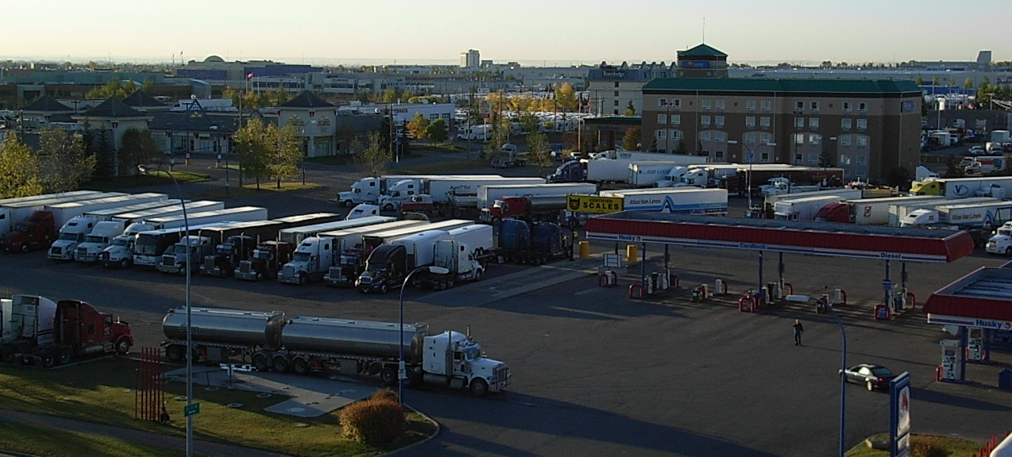
Not All ‘Stops’ Are Freight Origins or Destinations
If intermediate stops are not filtered out, false positive will remain in aggregated OD data
Passive data alone may not be adequate to identify intermediate stops

Slide 5
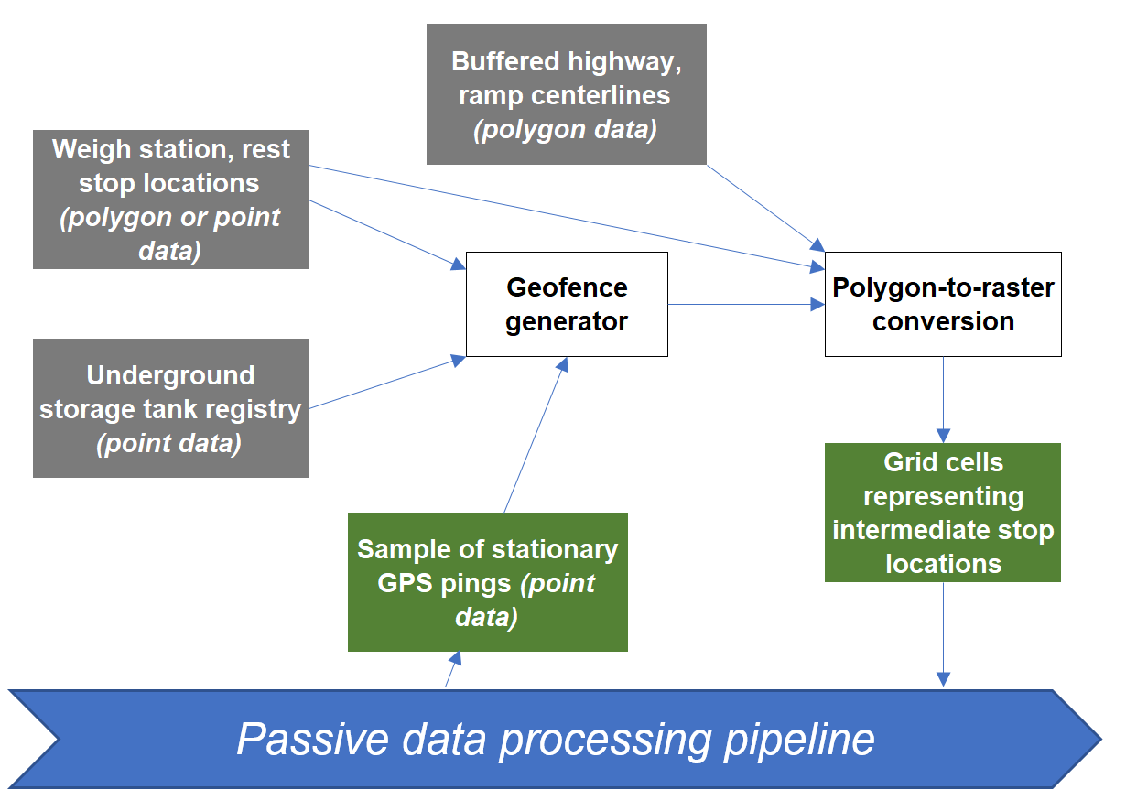
Identifying Intermediate Stops

Slide 6
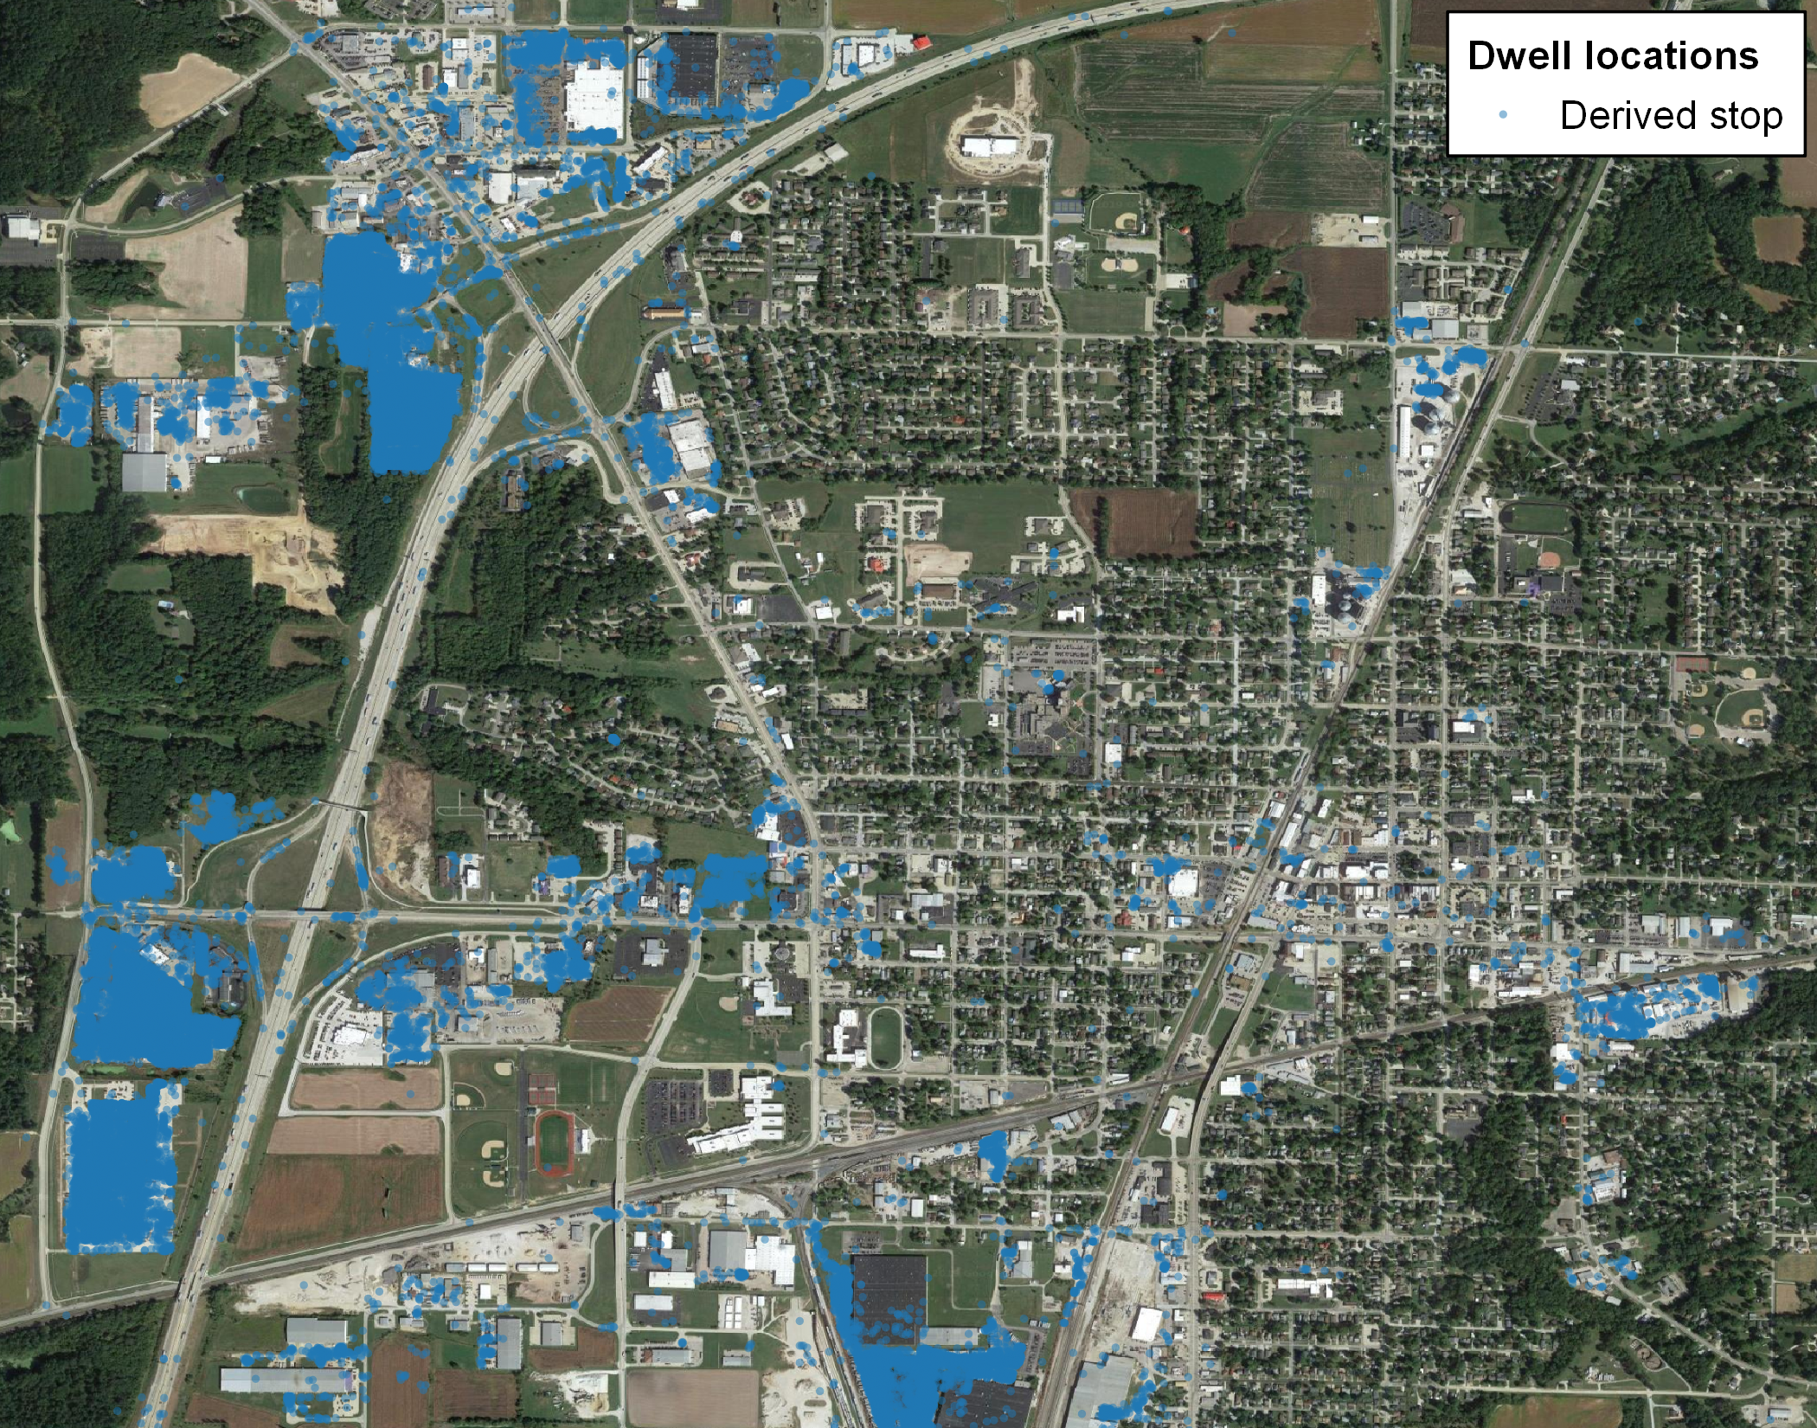
Identifying Intermediate Stops

Slide 7
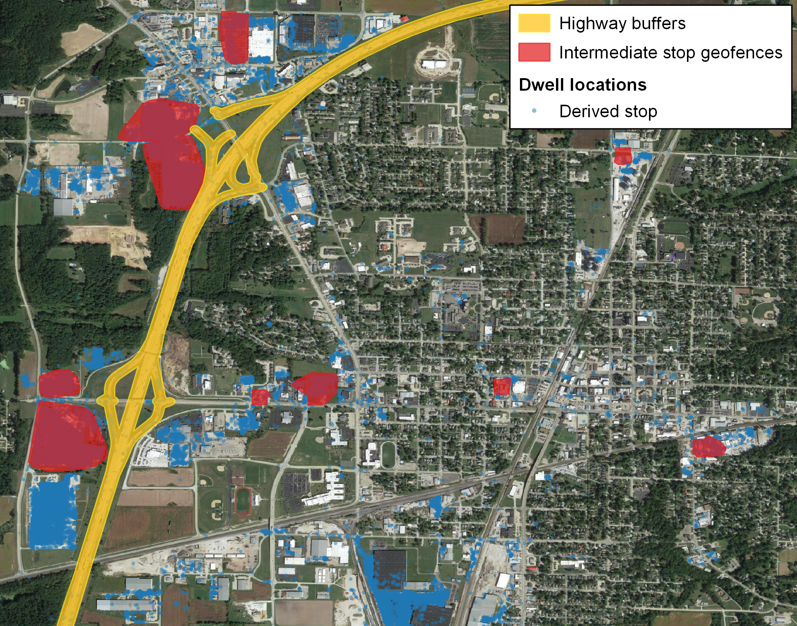
Identifying Intermediate Stops

Slide 8
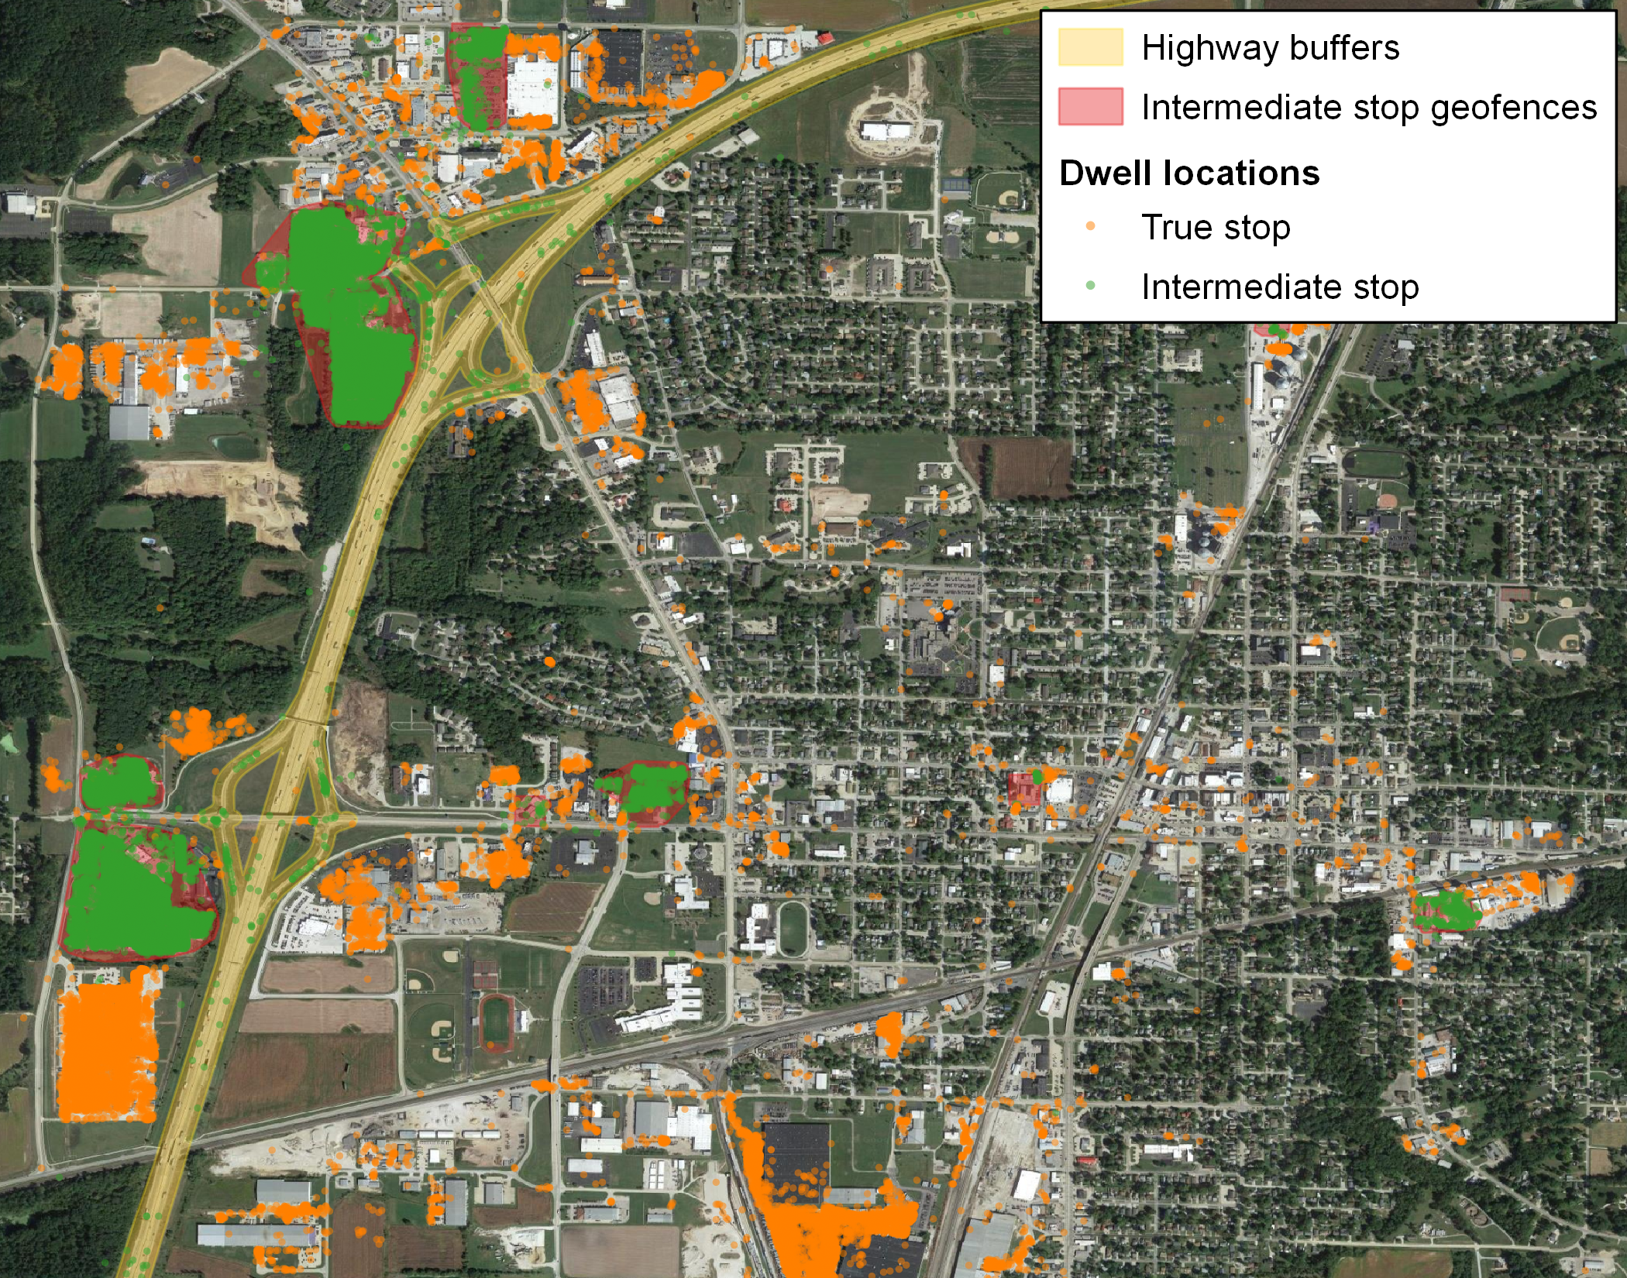
Identifying Intermediate Stops

Slide 9
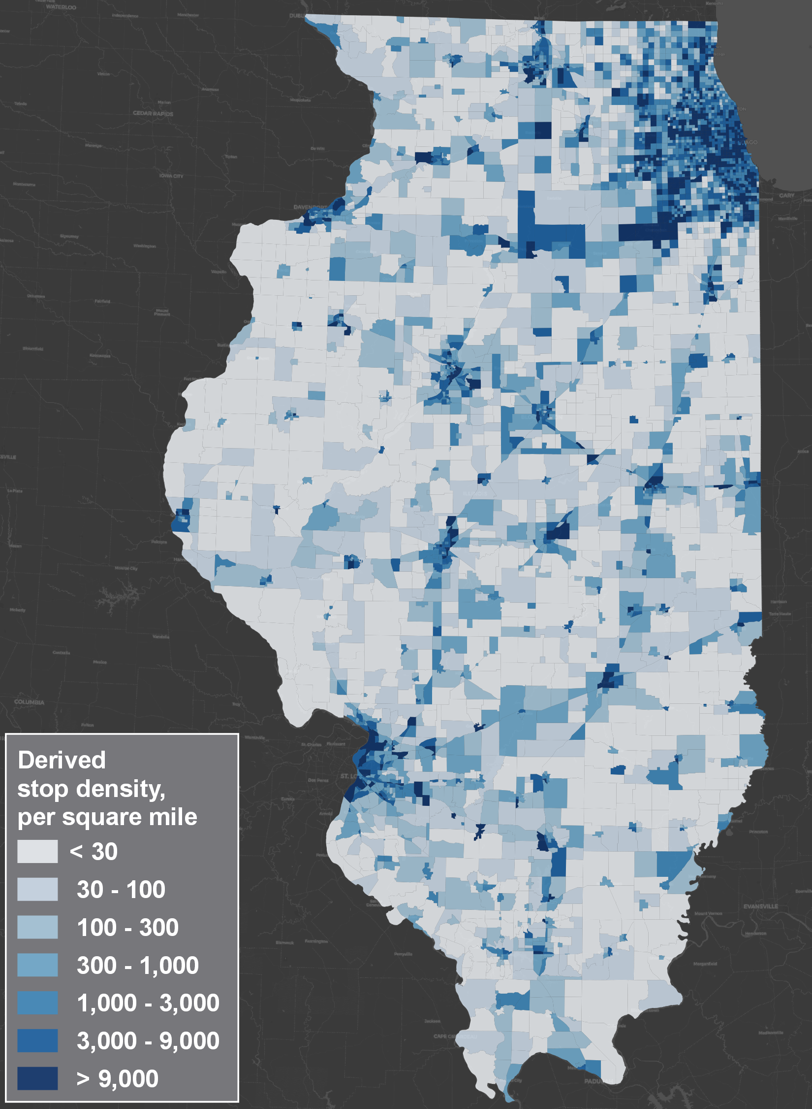
Density of Derived Stops Without Intermediate Stop Filtering

Slide 10
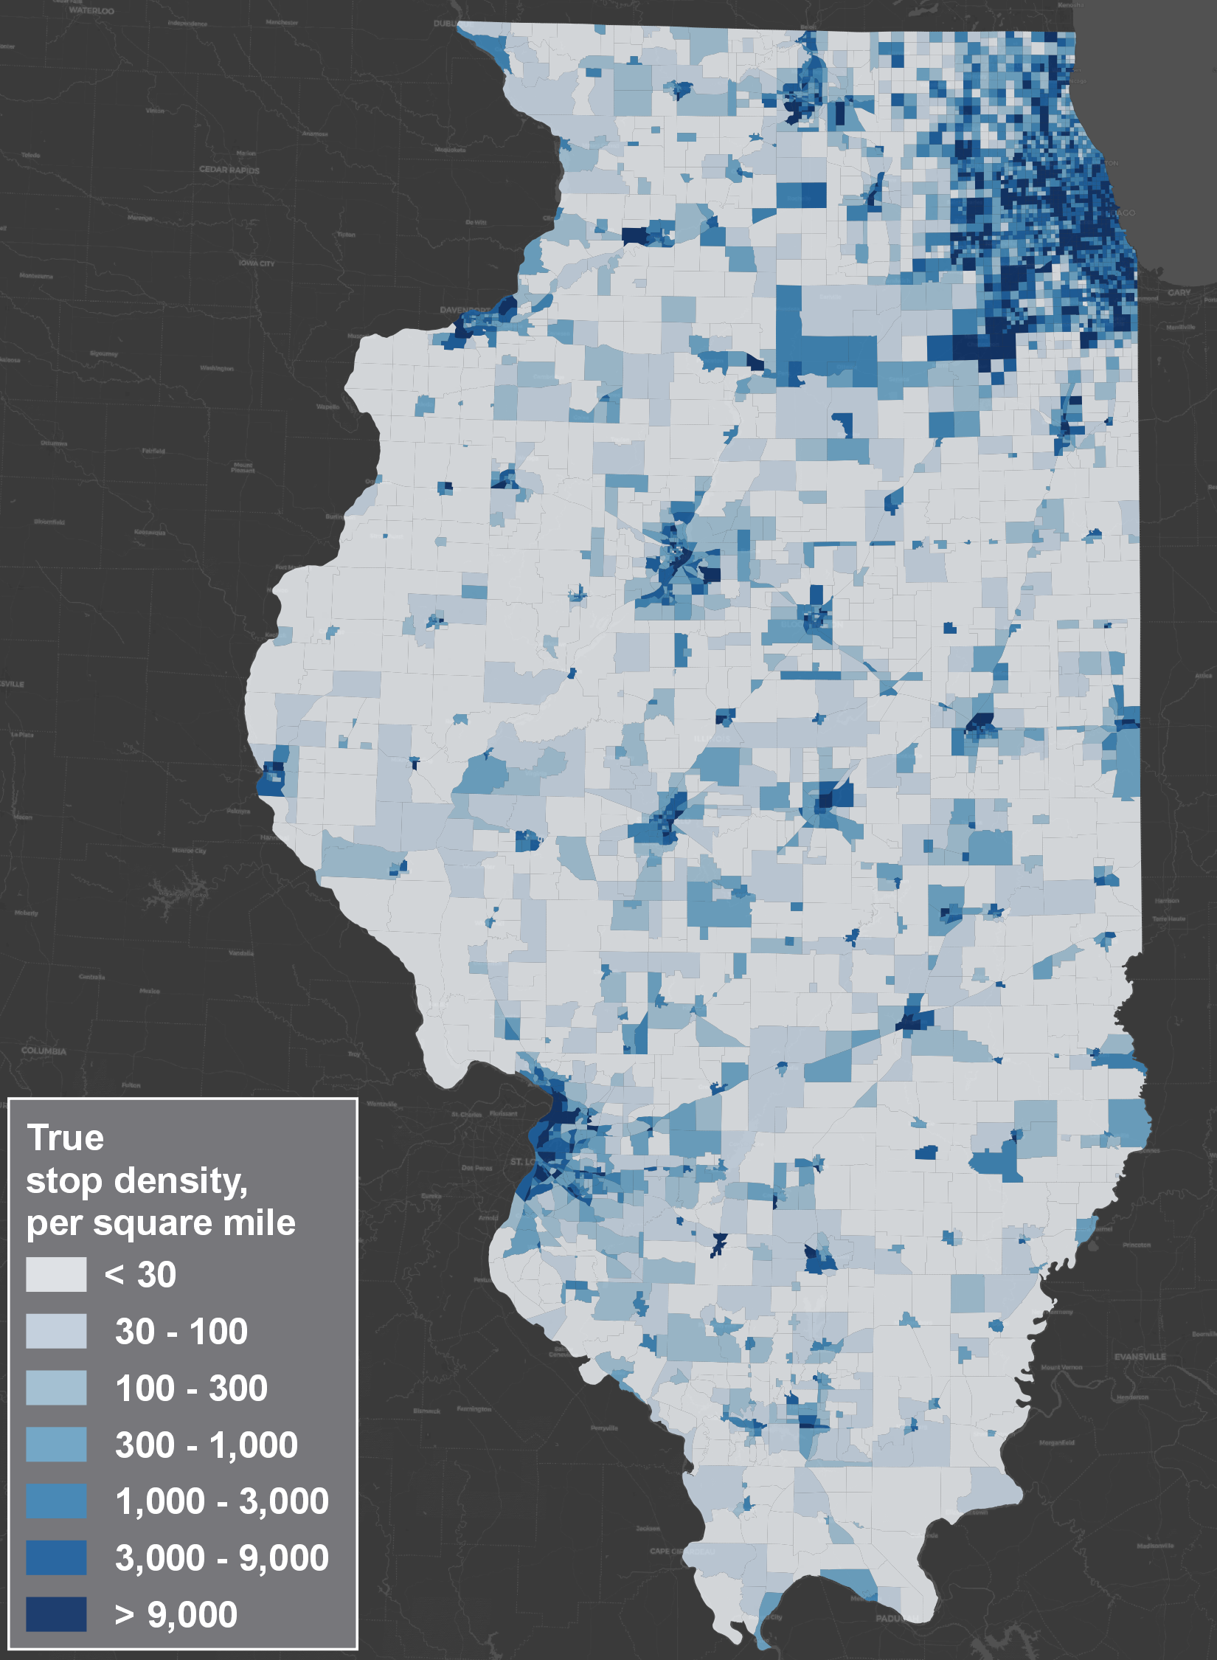
Density of Derived Stops With Intermediate Stop Filtering

Slide 11
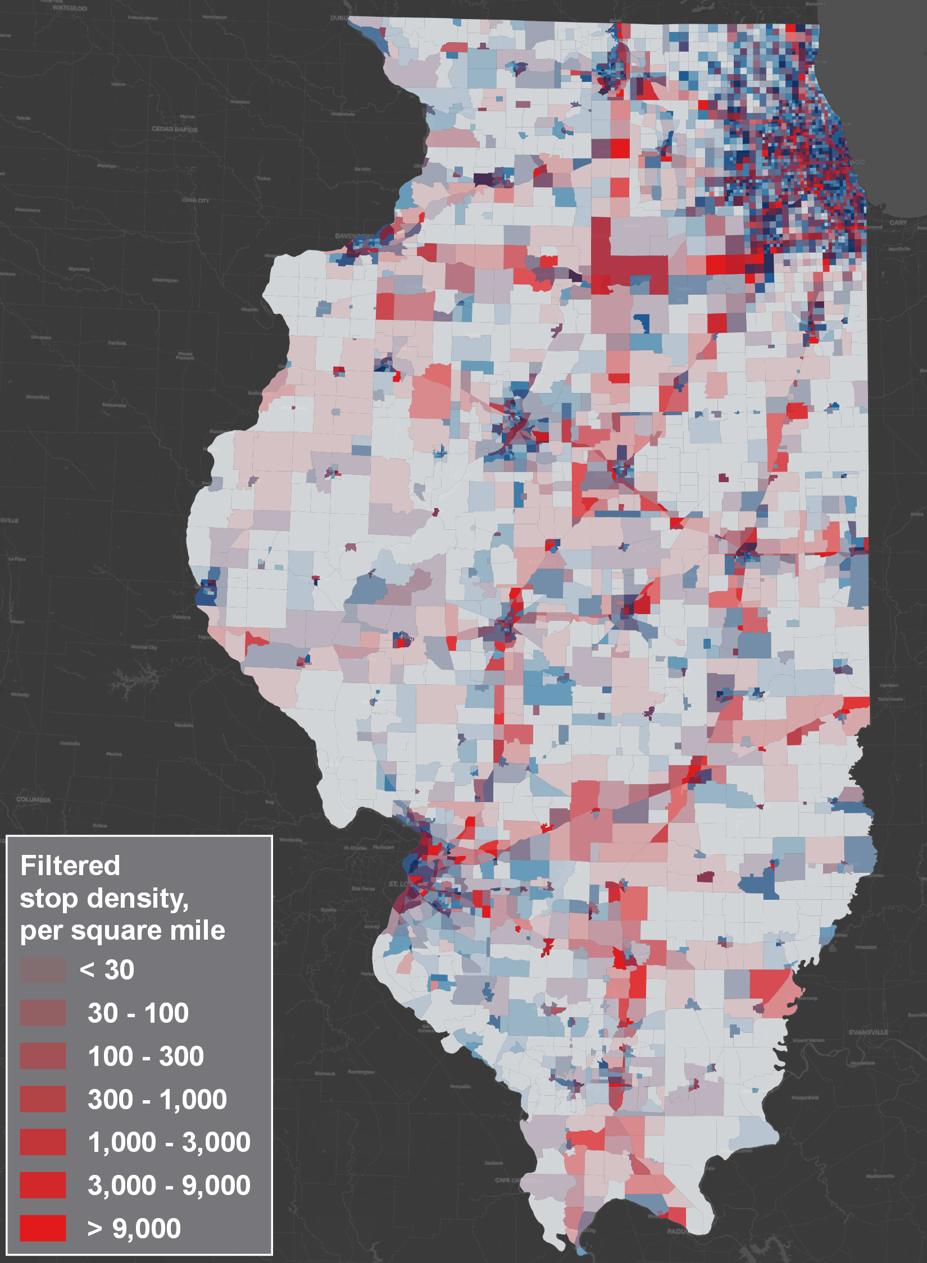
Density of Filtered Intermediate Stops

Slide 12
15-20% Intermediate Stops Removed From
O-D Data in Three Statewide Applications
State | Unexpanded trip count | Trips with 1+ intermediate stop
Illinois | 5,954,313 | 976,694 (16.4%)
Michigan | 2,597,523 | 437,998 (16.9%)
Nebraska | 1,027,573 | 211,629 (20.6%)
Stick around for Big Data 2 to hear how these were used!

Slide 13
Contact
Theodore Mansfield, PhD
www.rsginc.com
SENIOR ANALYST
theodore.mansfield@rsginc.com

