Slide 1
Using Big Data to Estimate Weekend VMT for Crash Analysis
Joseph Flood, Delaware Valley Regional Planning Commission
Andrew Swenson, Indianapolis Metropolitan Planning Organization
Catherine Kostyn, Indianapolis Metropolitan Planning Organization

Slide 2
The Problem
Safety was a long-range plan goal
Wanted to identify projects that addressed dangerous areas
Had data
Point-Level Fatalities and Serious Injuries (KSI)
1-km Grid of the Region
Metric: Identify grid cells with high KSI per VMT

Slide 3
The Problem
Said measure had an inherent bias due to the source data
KSI data was for all days of the week
VMT was for typical weekday
Result: Measure was biased towards areas with higher relative weekend travel
Example: Grand Park in Westfield
Sports complex that opened on fringe of Urbanized Area in 2014
Has many events over the weekend
Such events generate a lot of traffic

Slide 4
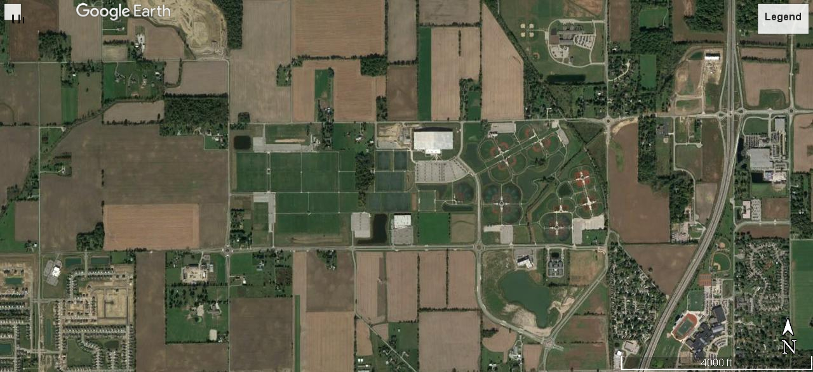

Slide 5
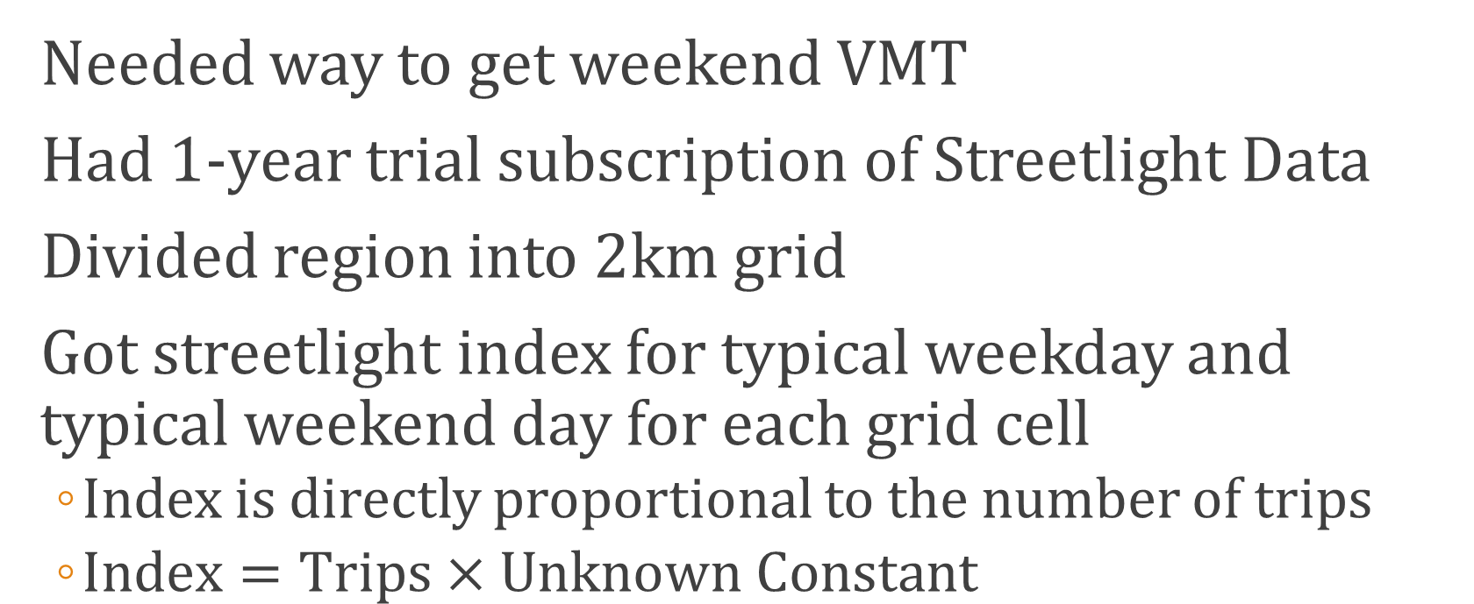
The Solution
Needed way to get weekend VMT
Had 1-year trial subscription of Streetlight Data
Divided region into 2km grid
Got streetlight index for typical weekday and typical weekend day for each grid cell
Index is directly proportional to the number of trips
$Index=Trips×Unknown Constant$

Slide 6
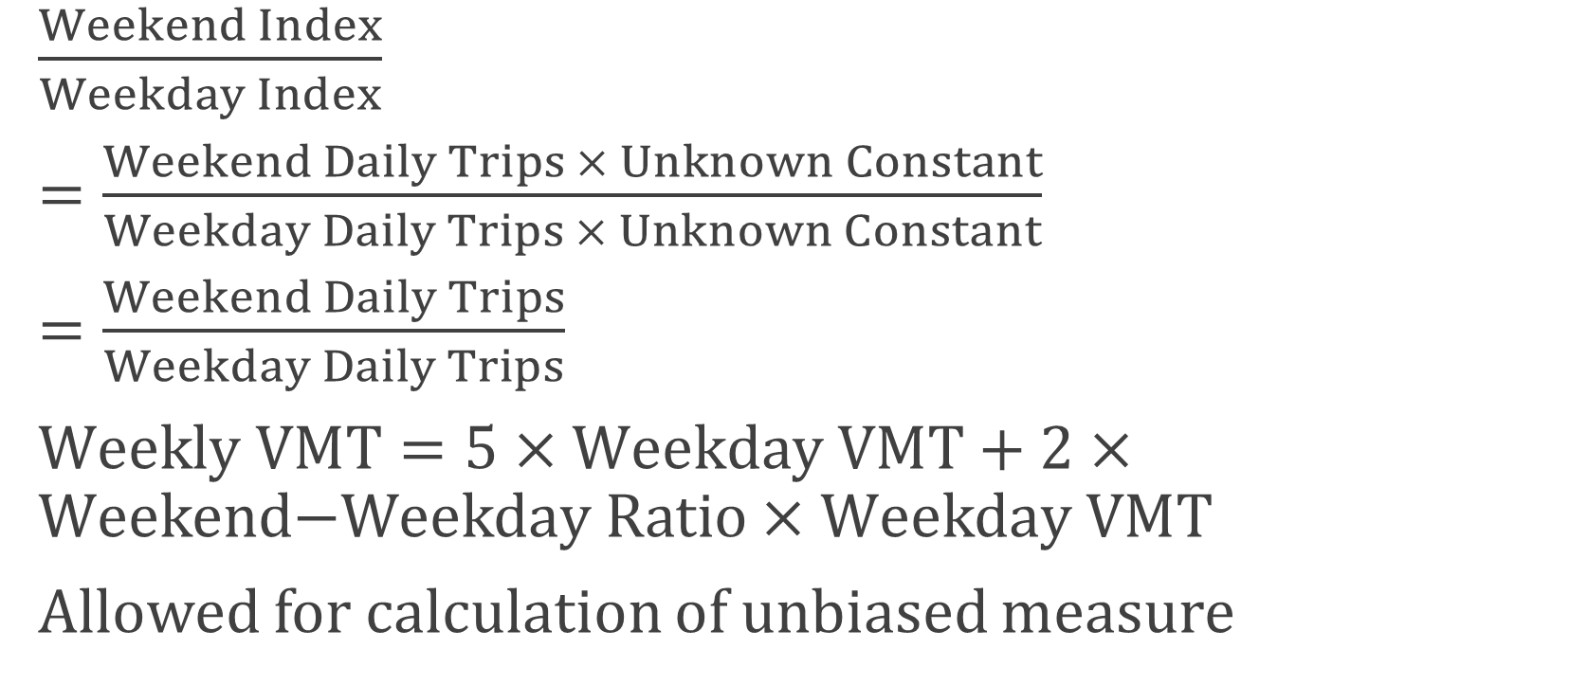
The Solution
$\frac{Weekend Index}{Weekday Index}$
$=\frac{Weekend Daily Trips × Unknown Constant}{Weekday Daily Trips × Unknown Constant}$
$=\frac{Weekend Daily Trips}{Weekday Daily Trips}$
$Weekly VMT=5×Weekday VMT+2×\text{Weekend}\text{−}\text{Weekday} \text{Ratio}×\text{Weekday} \text{VMT}$
Allowed for calculation of unbiased measure

