Slide 1
Open-Source Interactive and Narrative Visualization Tool for Activity-based Travel Demand Model: Application in SCAG ABM Development
Prof. Chih-Hsiao (Vincent) Tsai
Takming Univ. of Science & Technology, Taiwan
Yang Wang
Southern California Association of Governments
June 3, 2019

Slide 2
Outline
Motivation
Open-Source Tools
Web-Based Data Visualization Approach
Dash + Plotly.js
Vue.js
Graphic User Interface for EMFAC
PyQt5

Slide 3
Motivation
Visualize model outputs in interactive and narrative charts/graphics
Explore suitable tools for data analysts (may not be web programmers)
Simplify the process of customize and distribute dashboards/reports
Streamline data processing for better user experience

Slide 4
Open-Source Tools

Slide 5
Data Visualization Approach
Dash
Open-source Python library for creating reactive, analytical web-based applications
Part of Plotly open-source tools
Customizable, concurrency
Pure Python, no JavaScript knowledge
Reactive decorator for binding custom data analysis code to Dash user interface
Flask + React.js
Vue.js
Popular JavaScript front-end framework
Modular design, focus on view layer
Simple, light-weight

Slide 6
Dash and Plotly.js
Notes:
Video clip for Dash and Plotly.JS

Slide 7
Vue.js
Notes:
Video clip for Vue.JS

Slide 8
Graphic User Interface for EMFAC
Problems to solve
System update
Different software version
Cross-platform
Objectives
Integrated user interface
Simplified operating procedures
More flexible

Slide 9
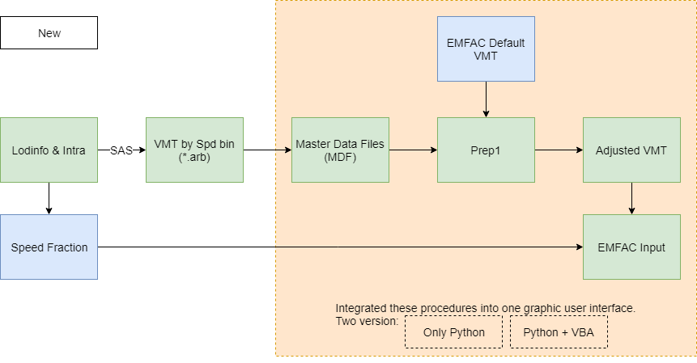
Graphic User Interface for EMFAC

Slide 10
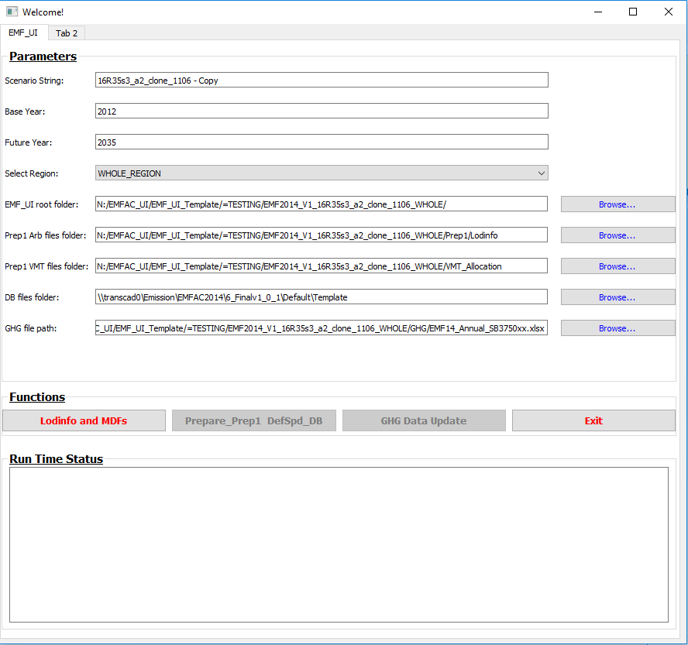
Graphic User Interface for EMFAC: PyQt5

Slide 11
Thank you
Yang Wang
wangy@scag.ca.gov

