Slide 1
Managing and Visualizing Big Data
Examples from the Project Life Cycle

Slide 2
The Cycle
Planning
Design
Construction
Operations & Monitoring
Planning
Design
Construction
Operations & Monitoring
Managing & Visualizing Big Data Throughout the Process
Database Platforms:

Slide 3
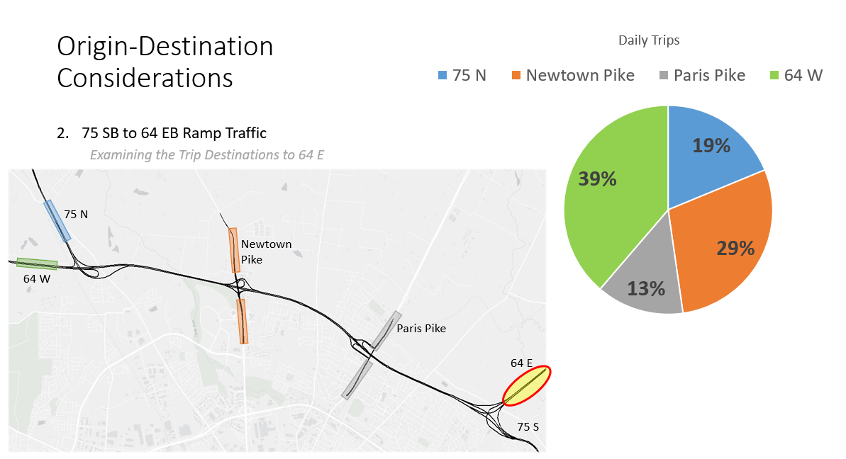
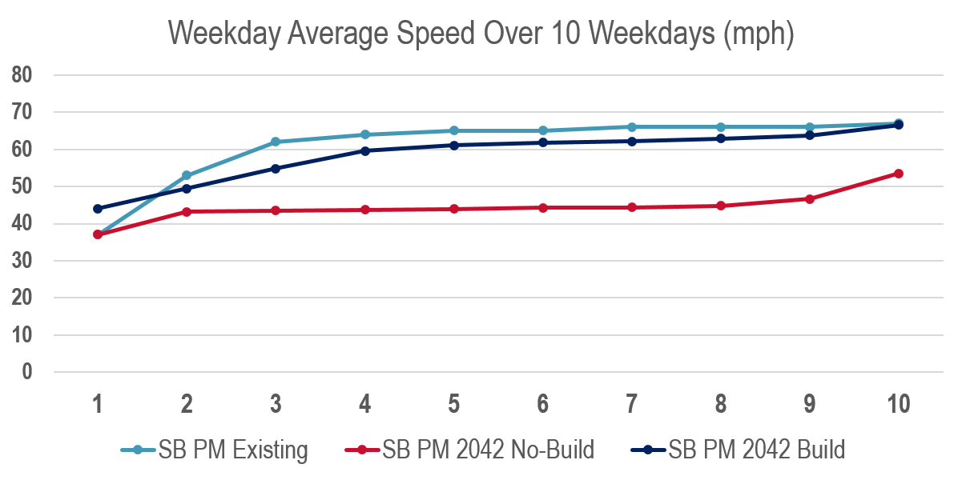
Design
Operations, Simulation Models, and Convincing Decision Makers
StreetLight Data
NPMRDS Speed Data
Data Warehousing Options:

Slide 4
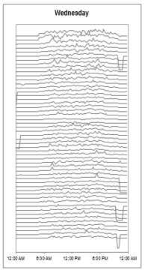
Construction
Data Presentation Options:
Setting and Monitoring Compliance with MOT Thresholds
Example: INRIX Data
Threshold
Target

Slide 5
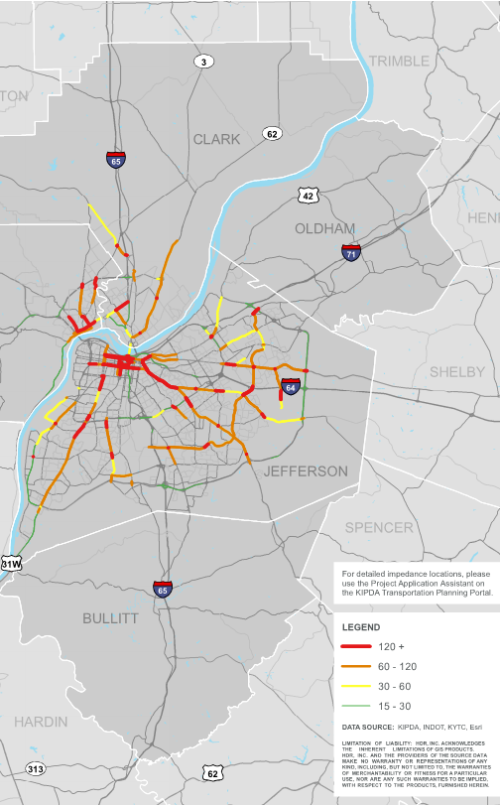
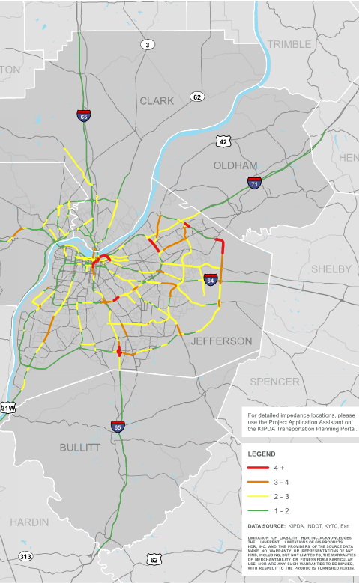
Operations & Monitoring
Delay
TTTR
Truck Travel Time Delay and Reliability
Identifying System Needs
Example: NPMRDS
GIS Presentation Options:

Slide 6
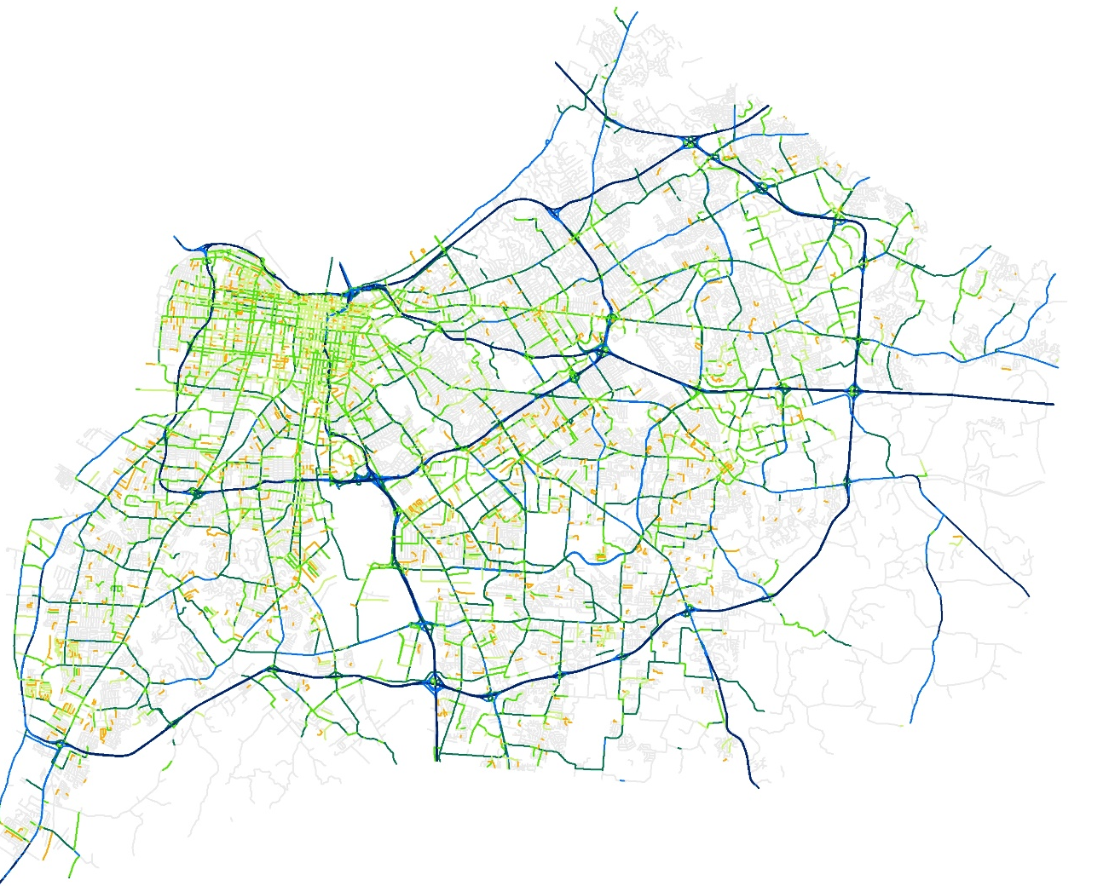
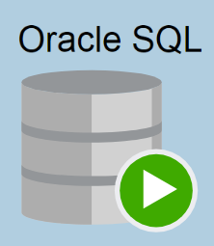
Planning
Percentile Speeds (Created for each Hour)
Hourly Speeds and Congestion
Linking Speed to Crashes by Severity
Using HERE and Crash Data
Data Analytic Options:

Slide 7
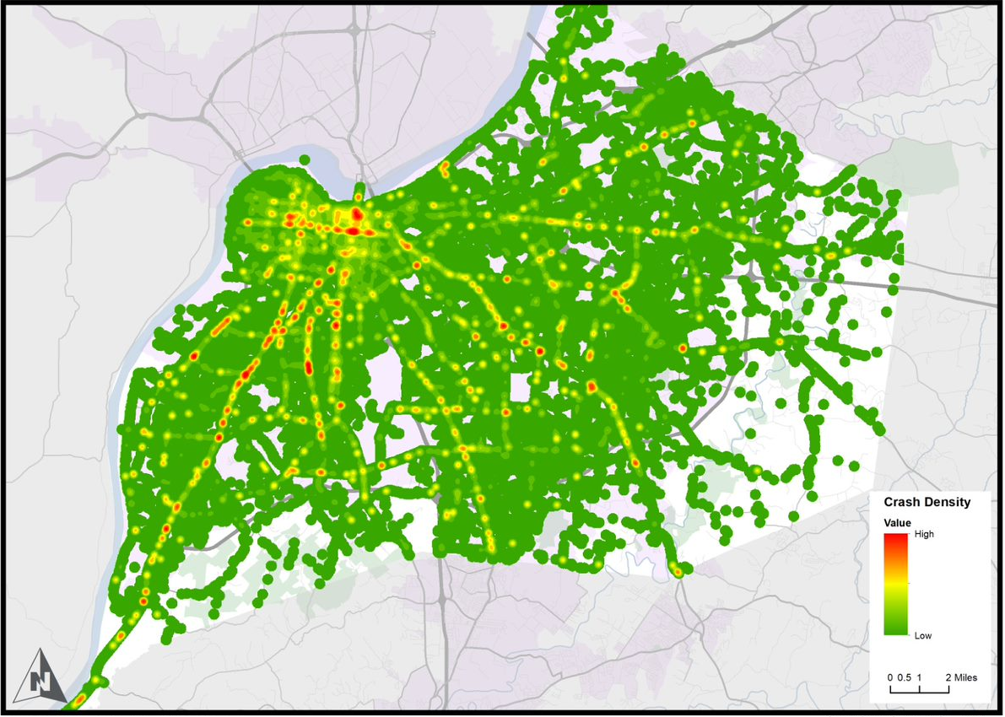
Planning
Equivalent Property Damage Crashes
Hourly Speeds and Congestion
Linking Speed to Crashes by Severity
Using HERE and Crash Data
Example:
HERE Data, Crash Data, and Safety Performance Functions

Slide 8
Thank You!
Scott Thomson, KYTC
Scott.Thomson@ky.gov
Robert Frazier, HDR
Robert.Frazier@hdrinc.com

