Slide 1
The Use of Ensemble Modeling in Socio-Economic Forecasting
Joseph Flood, Delaware Valley Regional Planning Commission
Andrew Swenson, Indianapolis Metropolitan Planning Organization

Slide 2

Indianapolis Metropolitan Area
Largest in State of Indiana
  State Capital
MPO Planning Area covers 8 counties
Population ~1.8 million
Employment ~1.1 million
Notes:
Image source (upper left): https://commons.wikimedia.org/wiki/File:Ims_aerial.jpg
Lower left and right images by presentation author

Slide 3
Background
For previous plans, INDOT county growth rates were uniformly applied to TAZs in modeling area
Meant that already urbanized TAZs, growing TAZs, and rural TAZs all growing at the same rate
  Not realistic
  No way to forecast decline
For 2017 Long-Range Plan Update, MPO undertook efforts to improve precision of land use forecasting

Slide 4
LUCI-2
Land Use Model developed at Indiana University-Purdue University Indianapolis (IUPUI)
Divided the region into half-mile by half-mile grid cells
  Cells would have an amount of urbanization
  Probabilistic model to determine if unurbanized land would become urbanized
  Urban cells would then be used to derive population and employment
Urbanization would diffuse out
  Resulted in sprawling development

Slide 5
Cube Land
TAZ-Level real estate market model
Households and employers place bids on real-estate units or job sites
  Several different household and employer types
  Several different residence and job site types
Residence and employment locations had functions to estimate how desirable they were to modeled bidders
  Largely driven by accessibility to people and jobs

Slide 6
Cube Land
To speed up model development, transferred coefficients from model used by Metropolitan Council in the Twin Cities
  Not all data was available
  Poor quality of data on access to water, a very significant variable
Some areas had decline forecasted, but was unreasonable
Largely driven by accessibility, so compact growth was favored

Slide 7
Problem
We had two things that we did not want
  Multiple forecasts that were not as good as we wanted
  A deadline of a couple of days
Forecasts
  Uniform county growth rates
  LUCI-2 (favored sprawling growth)
  Cube Land (favored compact growth)
  Township-level logistic forecast from Census data
Each forecast was based on different assumptions and had its own biases

Slide 8
Ensemble Forecast
An ensemble forecast is a forecast made up of several other forecasts
By combining multiple forecasts, we could offset each component forecast’s biases

Slide 9
Ensemble Forecast
We had access to the demographic forecasts used in an Interstate construction project in our area
  Included 4 counties in our modeling area
  Had been approved
Ordinary Least-Squares regression was used to find the best combination of component models to match the approved forecasts
  Done at the township level (TAZ-level too noisy)
  Done separately for population and employment
Models estimated with subset of region then applied in whole region
Each TAZ was given its township’s growth rate
  Same problems as using county-level growth rate but on a smaller scale

Slide 10
Ensemble Forecast
Three models were found to be significant in the OLS analysis
  Township Forecast = 0.1613×Cube Land + 0.1583×LUCI-2 + 0.6592×County Growth Rates
  Adjusted R²: 0.994
  Coefficients don’t add up to one in case models are collectively biased
Result
  Most established urbanized areas saw little growth
  Rural areas far from the city center saw no growth
  Largest growth was in suburban areas
    North Suburbs in particular
  Small, localized population decline in some areas

Slide 11
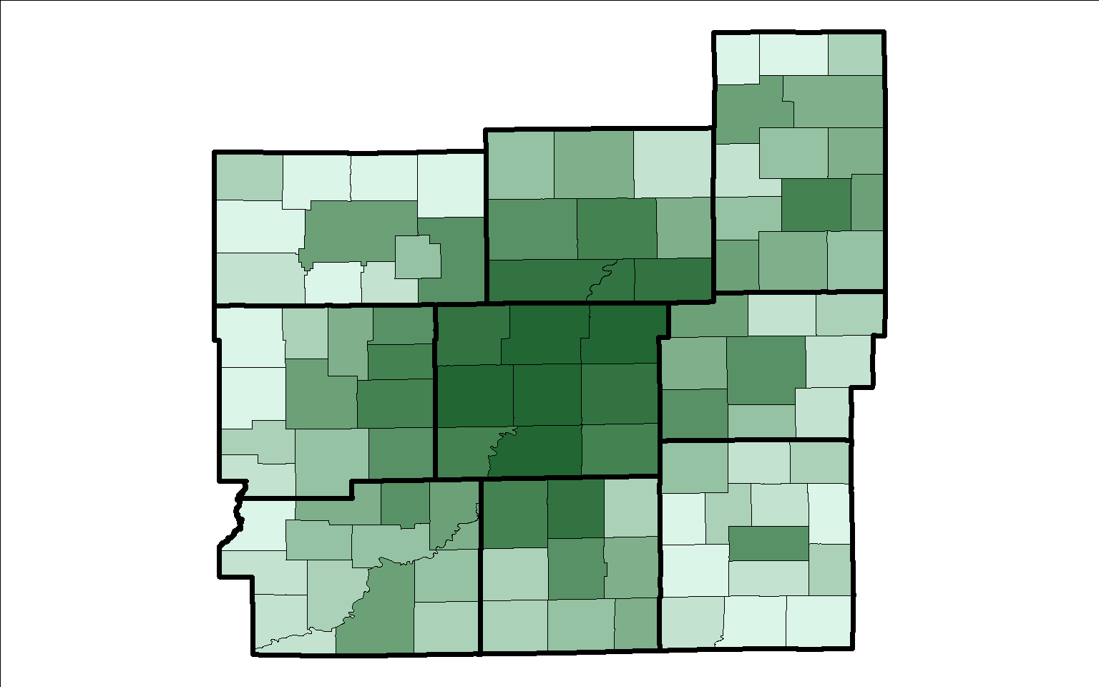
2015 Population

Slide 12
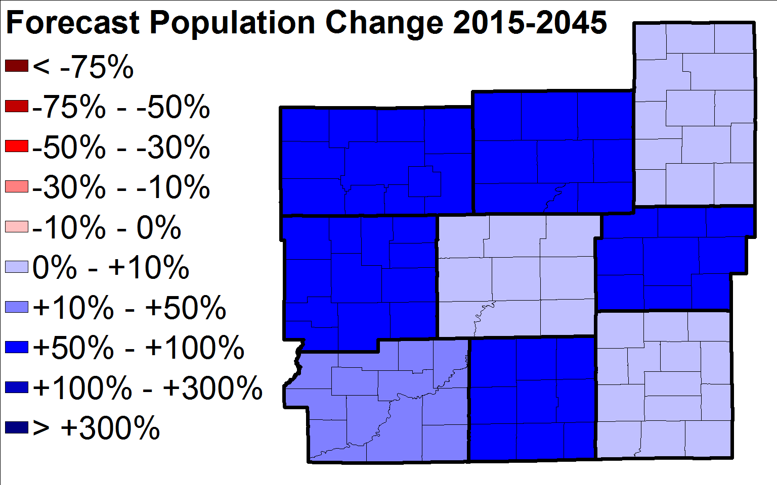
County Growth Rates

Slide 13
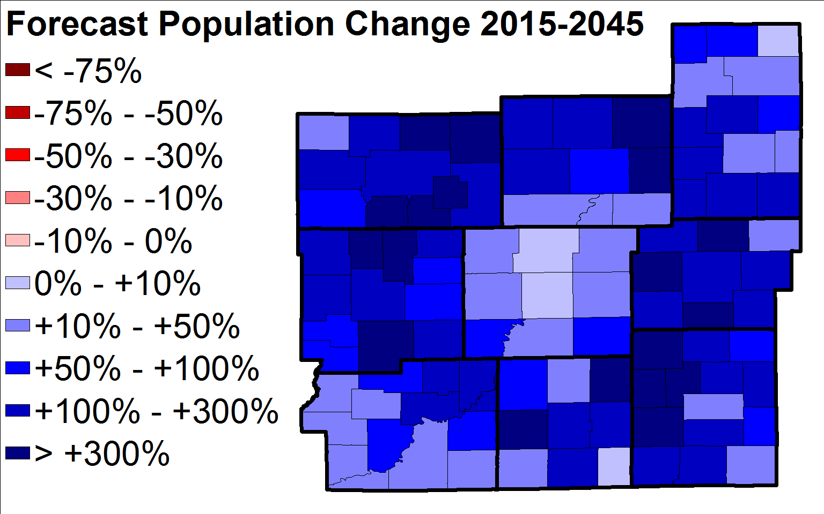
LUCI-2 (Favors Sprawl)

Slide 14
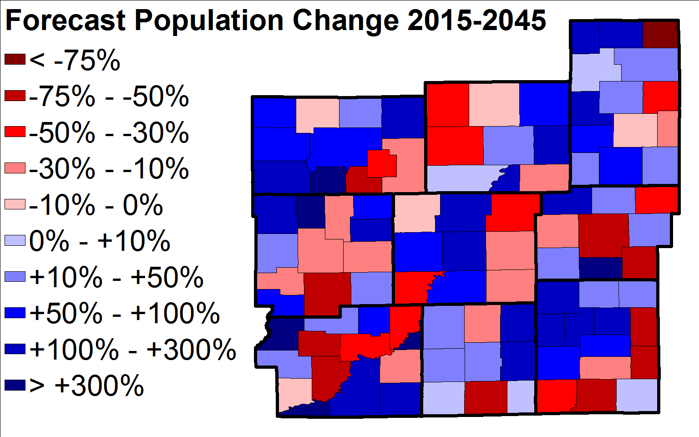
Cube Land (Favors Accessibility)

Slide 15
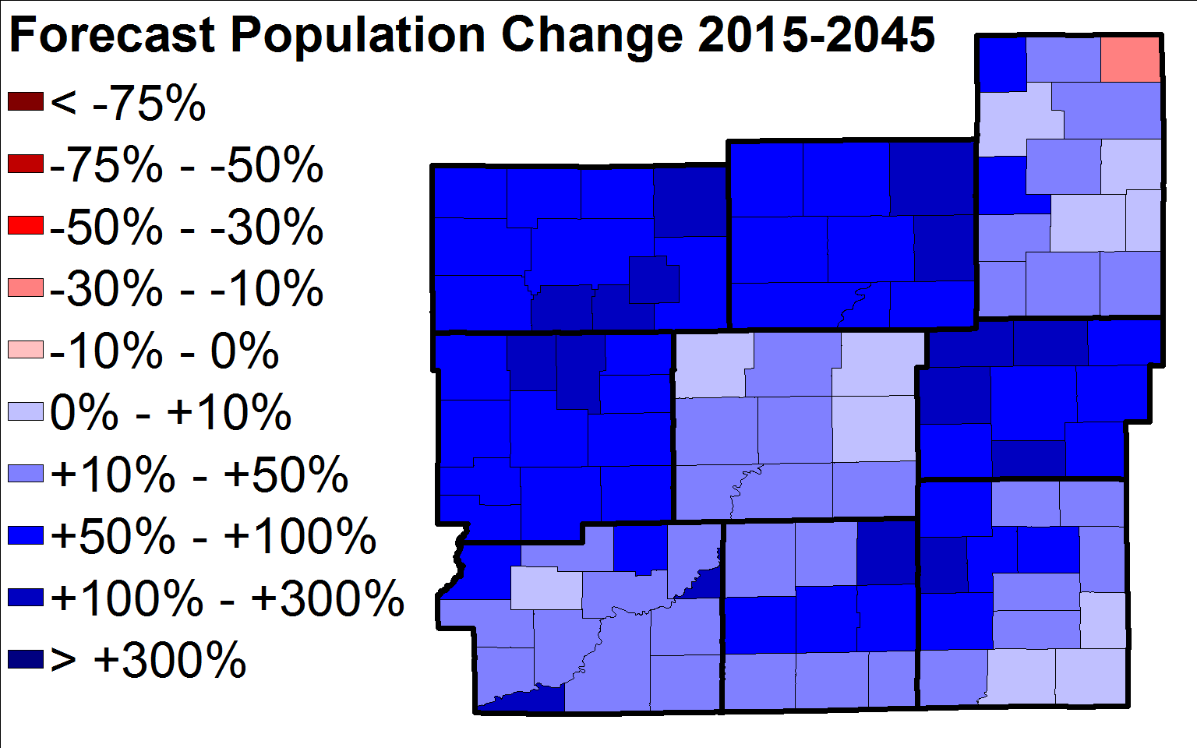
Ensemble

Slide 16
Advantages of Using Ensemble Forecast
Use of different models can offset separate biases
  “All models are wrong”
  Makes the forecast “less wrong”
Time to fine-tune model calibration may not be needed
  Could be spent developing other model
If forecasts not available, methods such as principal component analysis can be used to combine forecasts

Slide 17
?

