Slide 1
MAP MATCHING using Linear Referencing System
Gargi Singh | Byron Chigoy
Texas A&M Transportation Institute

Slide 2
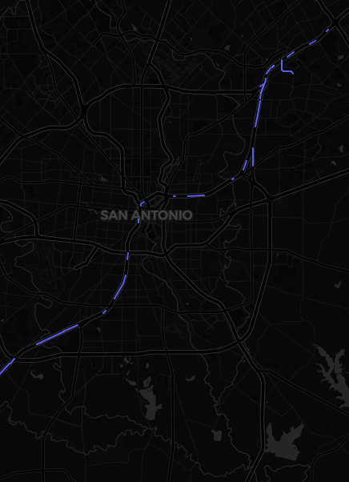
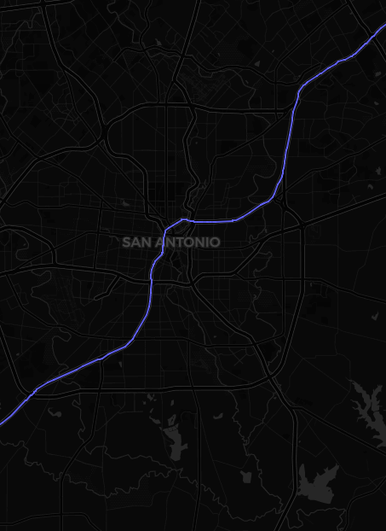
BEFORE
AFTER
What?
Snapping inaccurate waypoints to correct segments
Filling in the gaps between waypoints with road segments
Why?
Correct representation of trips on any given segment of road
How?
Linear Referencing: Distance of features from the origin
0 1 1 2 2 3 3 4

