Slide 1
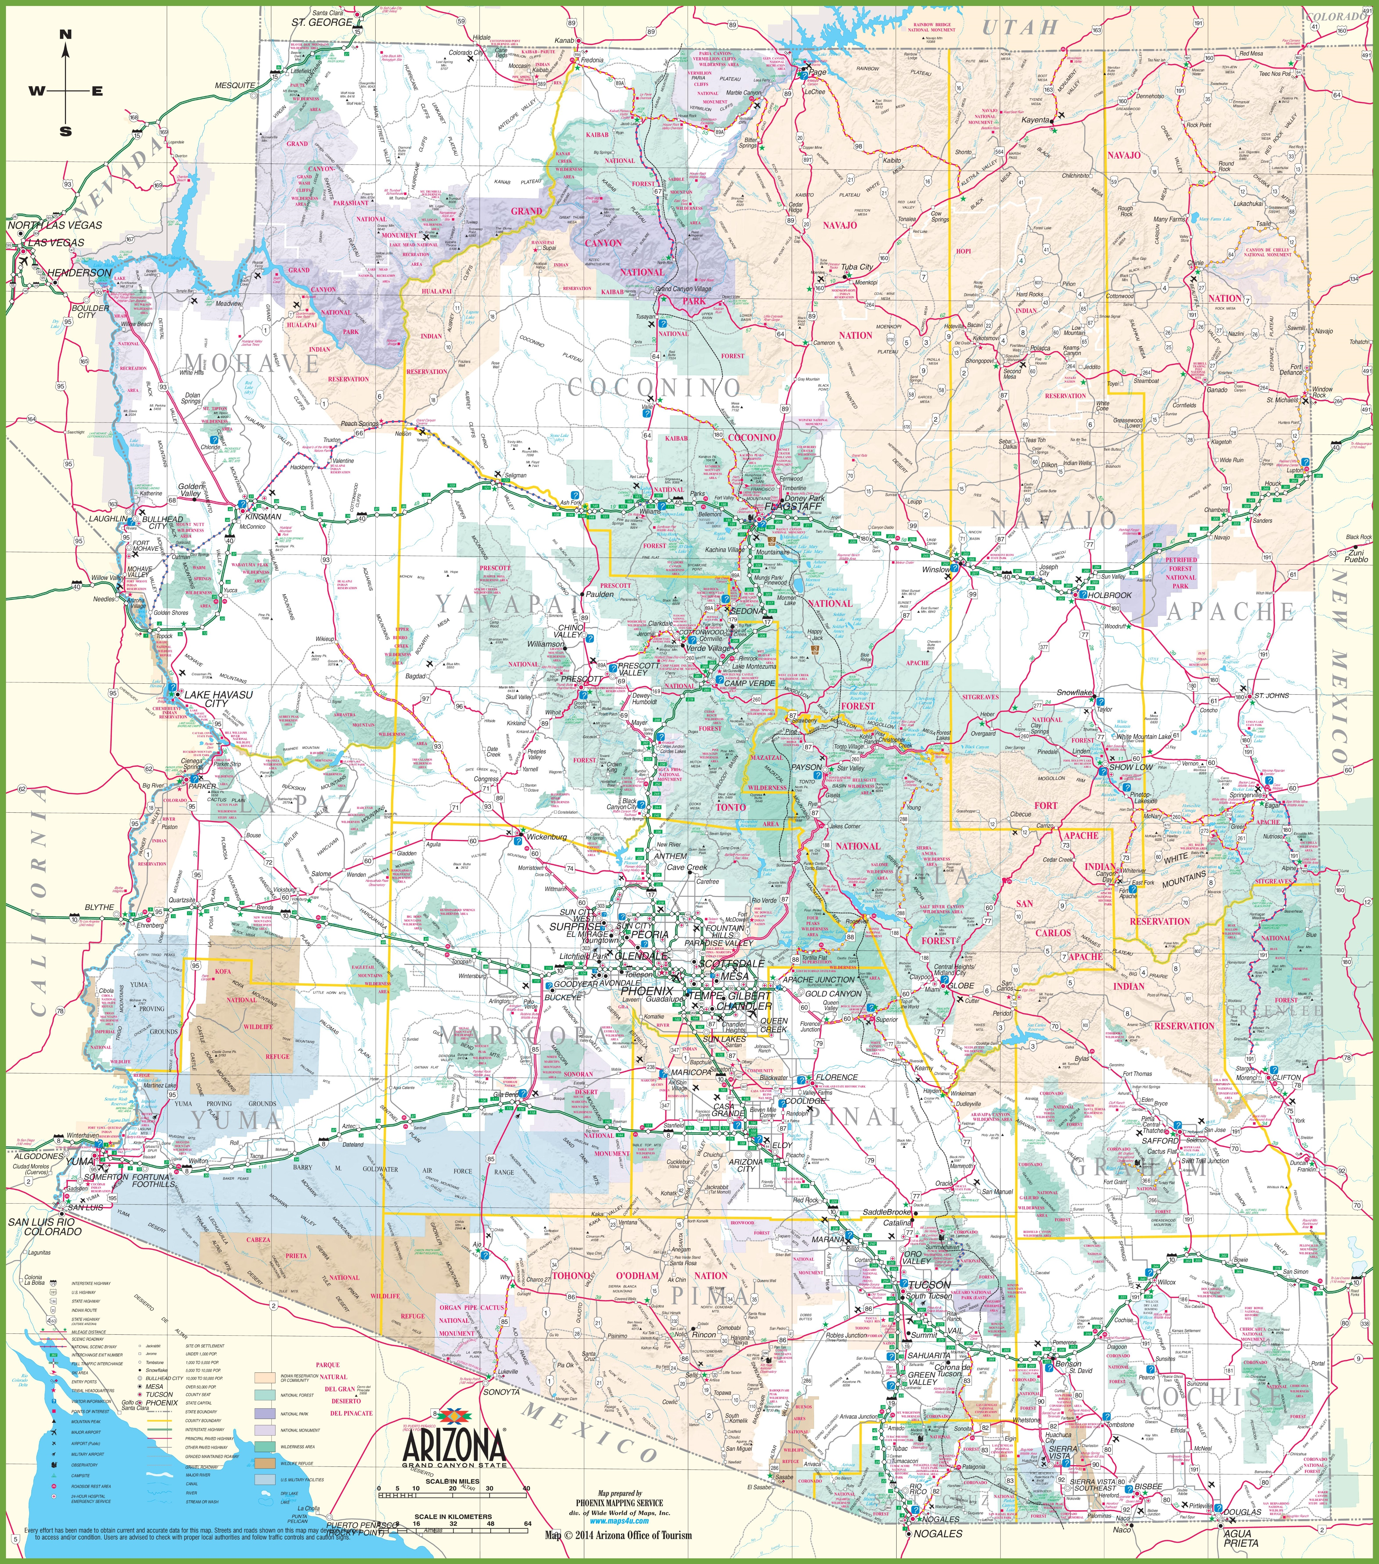

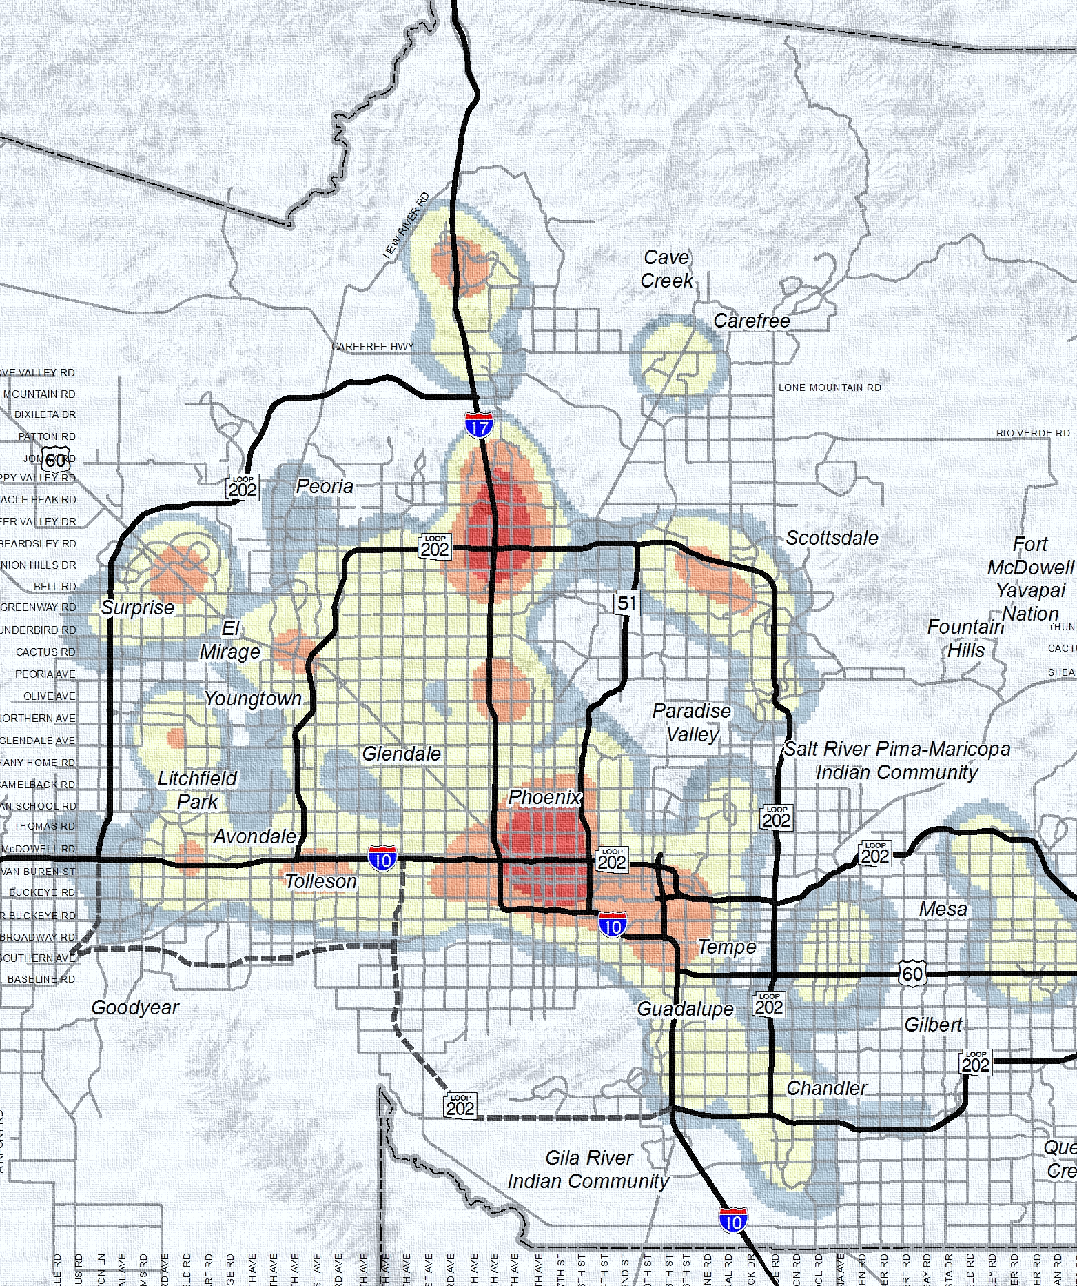

Improving travel models on the Activity-Supply side through Establishment Surveys
Gayathri Shivaraman, Gaurav Vyas, Peter Vovsha, Vladimir Livshits, Shuyao Hong

Slide 2

Significance of Activity-Supply Side
Existing Practices
Activity Demand-Side determinants in Activity Based Models:
  Person and Household Variables
  Aggregate Density and Accessibility Measures
Activity Supply-Side determinants (attraction variables):
  Zonal employment variables
  Similar to 4-step model
Improving travel models on the Activity-Supply side through Establishment Surveys

Slide 3
Significance of Activity-Supply Side
Potential systematic differences in travel demand due to activity supply-side determinants
Large shopping malls vs. smaller shops (Attraction rate by size and type of establishment )
Small Cinemas vs. Carnegie Hall (Uniqueness of activity supply)
Night life in the CBD vs. suburbs (Time-of-day by business hours)
Match Household income and job wages (Workplace location choice)
Improving travel models on the activity-supply side through Establishment Surveys

Slide 4
Assessing Activity Demand-Side and Activity Supply-Side
Household Travel Surveys v. Establishment Surveys
HTS
Trips
Individual Activity Patterns
ES
Individual Activity Participation
Trips organized by individual daily activity patterns
Trips organized by Establishments
Improving travel models on the activity-supply side through Establishment Surveys

Slide 5
Findings from MAG Establishment Survey
Insights into travel behavior and impacts of establishment type and size
Findings from MAG 2017 Establishment Survey
Insights into travel behavior and impacts of establishment type and size
(Establishment sample size: 423)
Improving travel models on the activity-supply side through Establishment Surveys
Improving travel models on the activity-supply side through Establishment Surveys

Slide 6
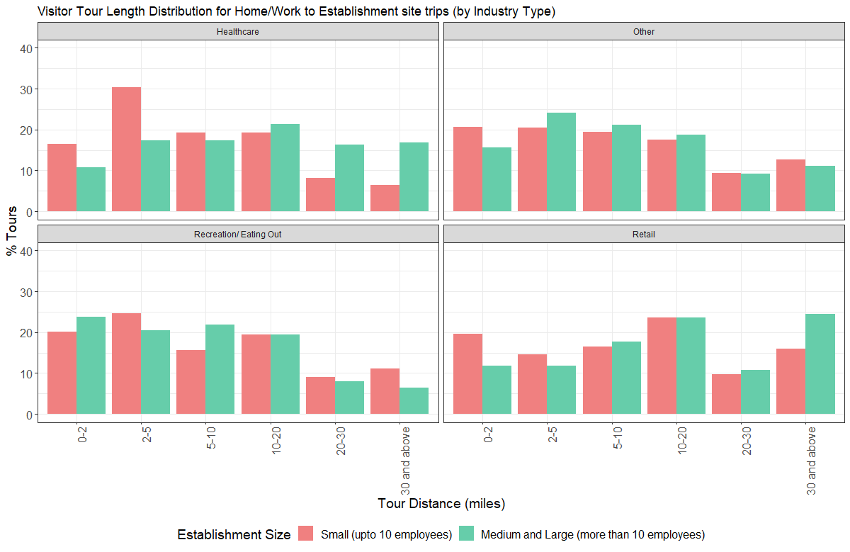
Findings from MAG Establishment Survey:
Tour Length Distribution by Establishment Size: by Industry Type
Improving travel models on the activity-supply side through Establishment Surveys
Notes:
Healthcare facilities – preference is given to facilities at shorter distances for small clinical visits, longer distances to larger institutions with more facilities. Similarly for Retail: larger big box stores often tend to be located further away requiring longer distances to be travelled

Slide 7
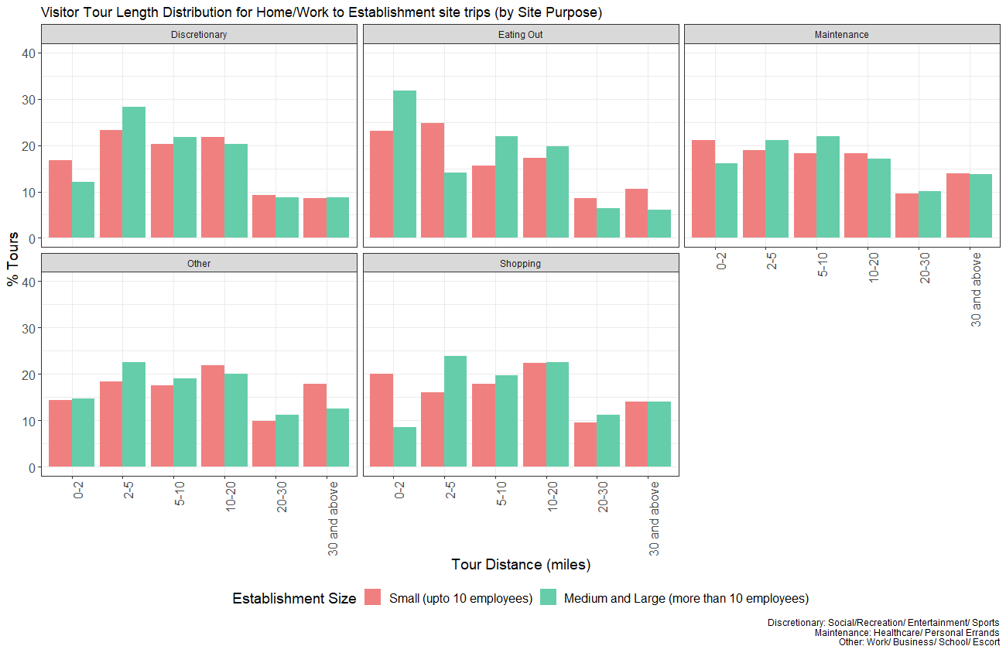
Findings from MAG Establishment Survey:
Tour Length Distribution by Purpose of Travel
Improving travel models on the activity-supply side through Establishment Surveys
Notes:
Preference is given to taking up social activities closer rather than further away from primary locations irrespective of size. – Similar trends observed in eating out.

Slide 8
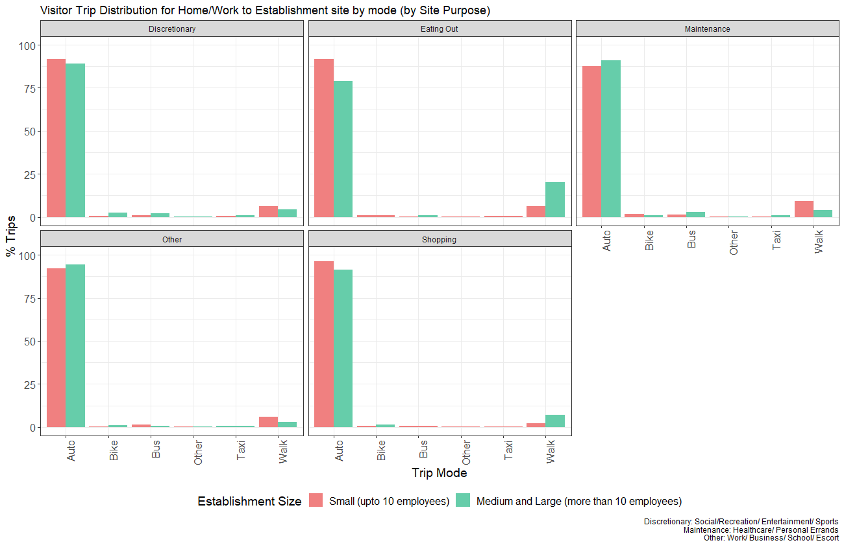
Findings from MAG Establishment Survey:
Trip Distribution by Purpose of Travel: by Mode
Improving travel models on the activity-supply side through Establishment Surveys
Notes:
These findings for eating-out trips were observed to be slightly counter intuitive (here we see a distinct increase in Walk Trips to larger dining establishments. The could be a possible correlation between Establishments and Density and could be explored further.

Slide 9
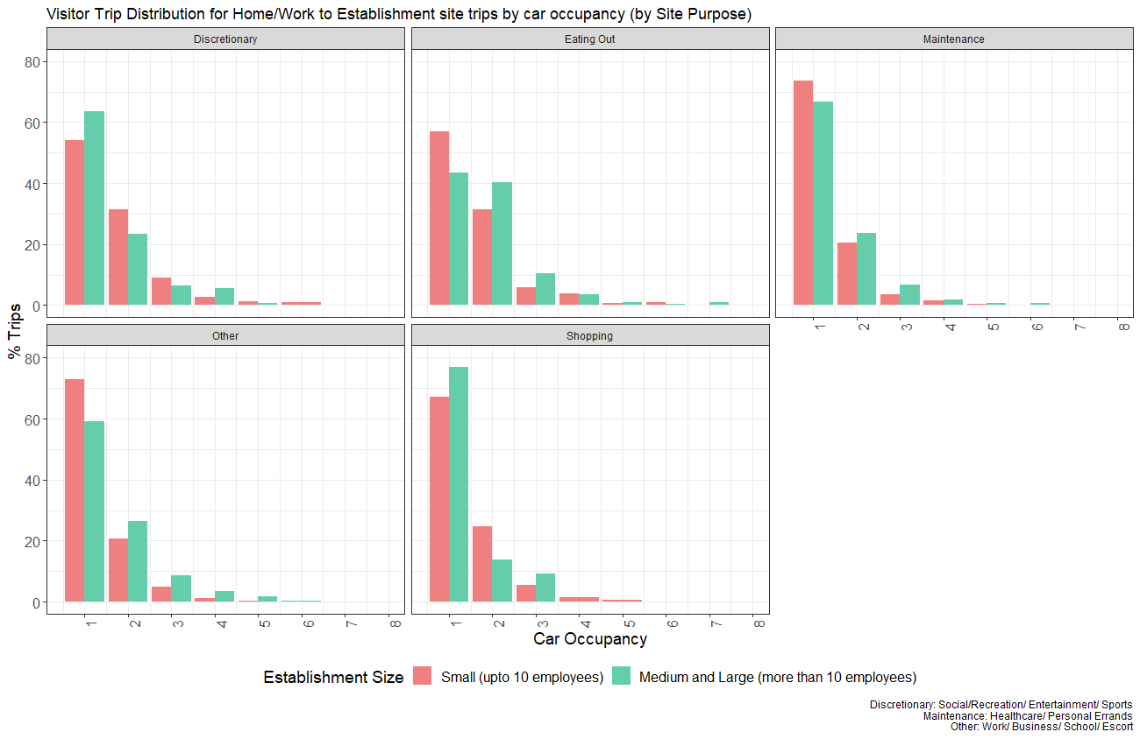
Findings from MAG Establishment Survey:
Trip Distribution by Purpose of Travel: by Car Occupancy
Improving travel models on the activity-supply side through Establishment Surveys
Notes:
We see that in case of all trip purposes majority of the trips are Single Occupant trips – could be a result of coinciding time commitments. Fore shorter distances (Which require less time commitment), multiple occupants can be accomodated

Slide 10
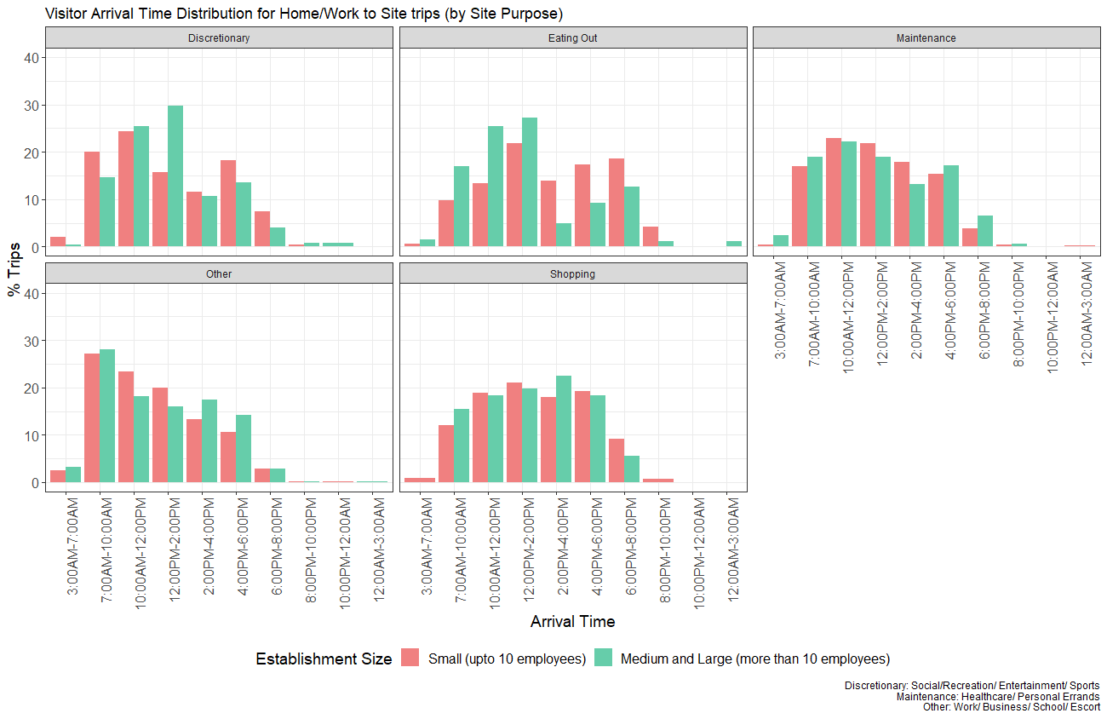
Findings from MAG Establishment Survey:
Trip Distribution by Purpose of Travel: by Arrival Time
Improving travel models on the activity-supply side through Establishment Surveys
Notes:
Highest proportion of eating out trips observed during lunch-time irrespective of size of the establishments.

Slide 11
Findings from MAG Establishment Survey
Insights into travel behavior and impacts of establishment type and size
Comparison between MAG HTS 2008, HTS 2017 and Establishment Survey
Improving travel models on the activity-supply side through Establishment Surveys
Improving travel models on the activity-supply side through Establishment Surveys

Slide 12
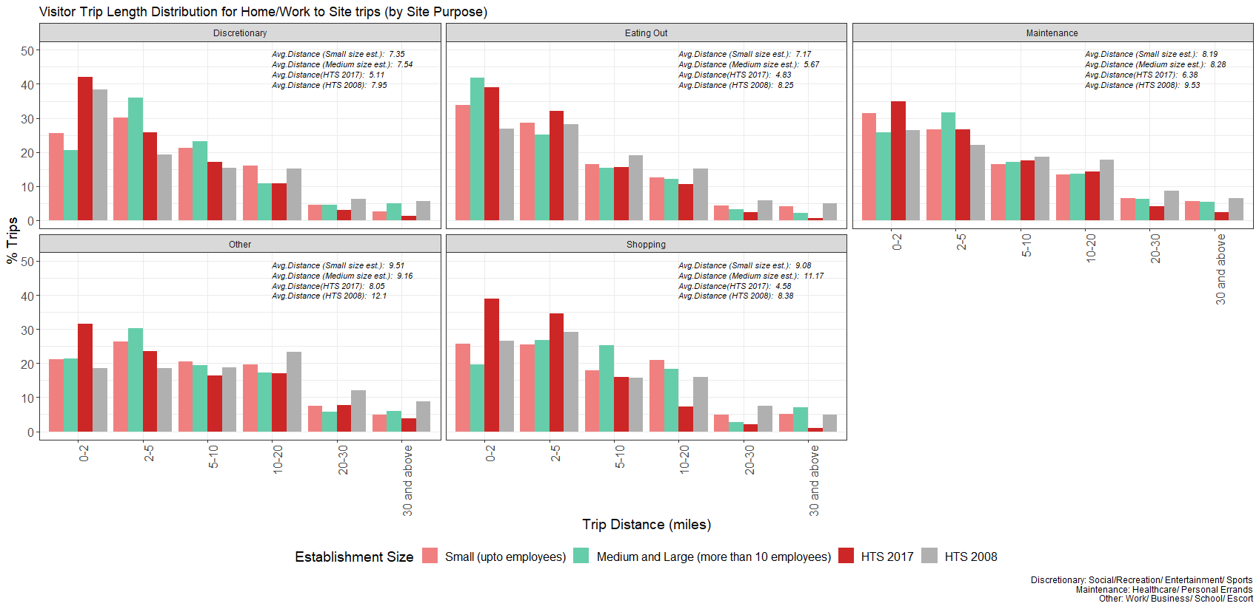
Findings from MAG Establishment Survey:
Trip Length Distribution: Comparing HTS vs. ES
Improving travel models on the activity-supply side through Establishment Surveys

Slide 13
Findings from MAG Establishment Survey
Insights into travel behavior and impacts of establishment type and size
Findings from the NYMTC Establishment Survey
Insights into travel behavior and impacts of establishment type and size
(Establishment sample size: 219)
Improving travel models on the activity-supply side through Establishment Surveys
Improving travel models on the activity-supply side through Establishment Surveys

Slide 14
Findings from the NYMTC Establishment Survey:
Observed Trip Length Distribution by Establishment Size & Urban Area Type
Improving travel models on the activity-supply side through Establishment Surveys
Notes:
For the New York Metro-Region, irrespective of size majority of the trips are taken within 0-5 mile distance. Comparison wise we do see a pattern of longer trips correlating to larger establishments

Slide 15
Findings from the NYMTC Establishment Survey:
Observed TOD Distribution by Industry Type & Area Type (CBD)
Improving travel models on the activity-supply side through Establishment Surveys
Notes:
Looking at the TOD distribution we se a higher portion of recreation trips undertaken during the PM period.

Slide 16
Findings from the NYMTC Establishment Survey:
Observed Trip Mode Distribution by Establishment Size & Area Type
Improving travel models on the activity-supply side through Establishment Surveys
Notes:
Similar to the MAG Survey findings majority fo the Trips irrespective of establishment size is SOV. Considering the geography, Non-motorized trips Small and Medium sized are also observed

Slide 17
Findings from MAG Establishment Survey
Insights into travel behavior and impacts of establishment type and size
Incorporation of activity-supply side in travel demand models
Potential avenues of Implementation
Improving travel models on the activity-supply side through Establishment Surveys
Improving travel models on the activity-supply side through Establishment Surveys

Slide 18
Potential Model Improvements focused on activity-supply side
Variable Segmentation
Categorization of Jobs by NAICS sectors
Categorization of Non-Work Trip Purpose
Synthesis of Individual Establishments
Choice of Individual Location based on:
Establishment/ Event:
Type
Size
Income
Social Determinants
Spatio-Temporal Equilibrium
Two-way implications of activity-demand and supply side in Time and Space
Supply-Driven Approach
Participant Generation
Allocation to Synthetic Population
Improving travel models on the activity-supply side through Establishment Surveys
Notes:
Setting a spatio-temporal equilibrium for both work and non-work related activities where
Store Opening and Closing Hours have an impact on TOD and Destination Choice for Non-work related activities (.generating demand) or TOD choice of workers by occupation industry and location (generating labor supply)

Slide 19
Thank you
wsp.com
inrosoftware.com
azmag.gov

