Slide 1


Shiny Transit Tools
TRBAppCon
3 June 2019
Eric Lind, Joey Reid
Metro Transit
Jessica Shen
WMATA
Jonathan Ehrlich, Joel Huting
Metropolitan Council

Slide 2
Objectives
Demonstrate utility of making data interactive
Describe how one agency/MPO uses Shiny to do so
Share the code so you can:
  try it yourself
  suggest improvements and changes
Continue conversation about code sharing, data visualization, &c

Slide 3
Shiny Transit Tools
Introduction & Motivation 10:30 – 10:40
Shiny architecture 10:40 – 11:00
Examples
  Travel behavior data 11:00 – 11:10
  Ridership trends 11:10 – 11:30
  Bus speeds 11:30 – 11:55
Wrap-up
  Challenges

Slide 4
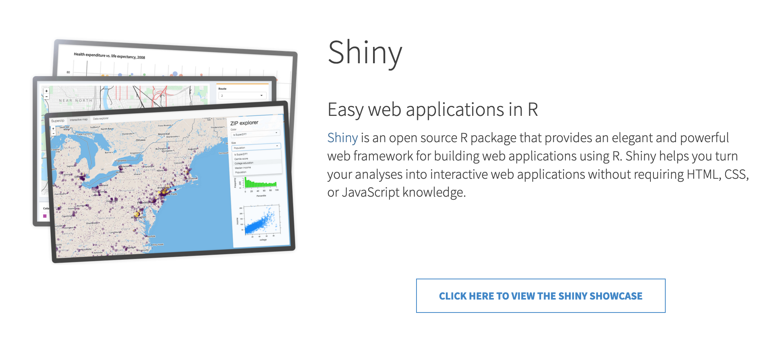
motivation: why Shiny?
what
https://www.rstudio.com/products/shiny/

Slide 5
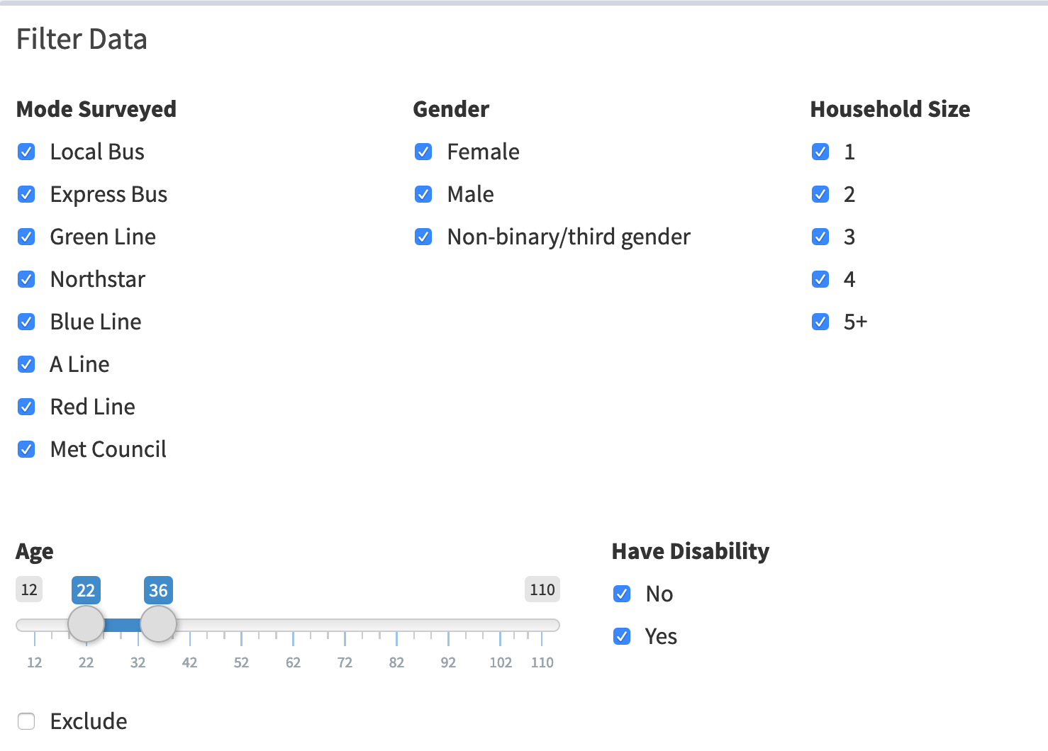
interactivity

Slide 6
dimensionality

Slide 7
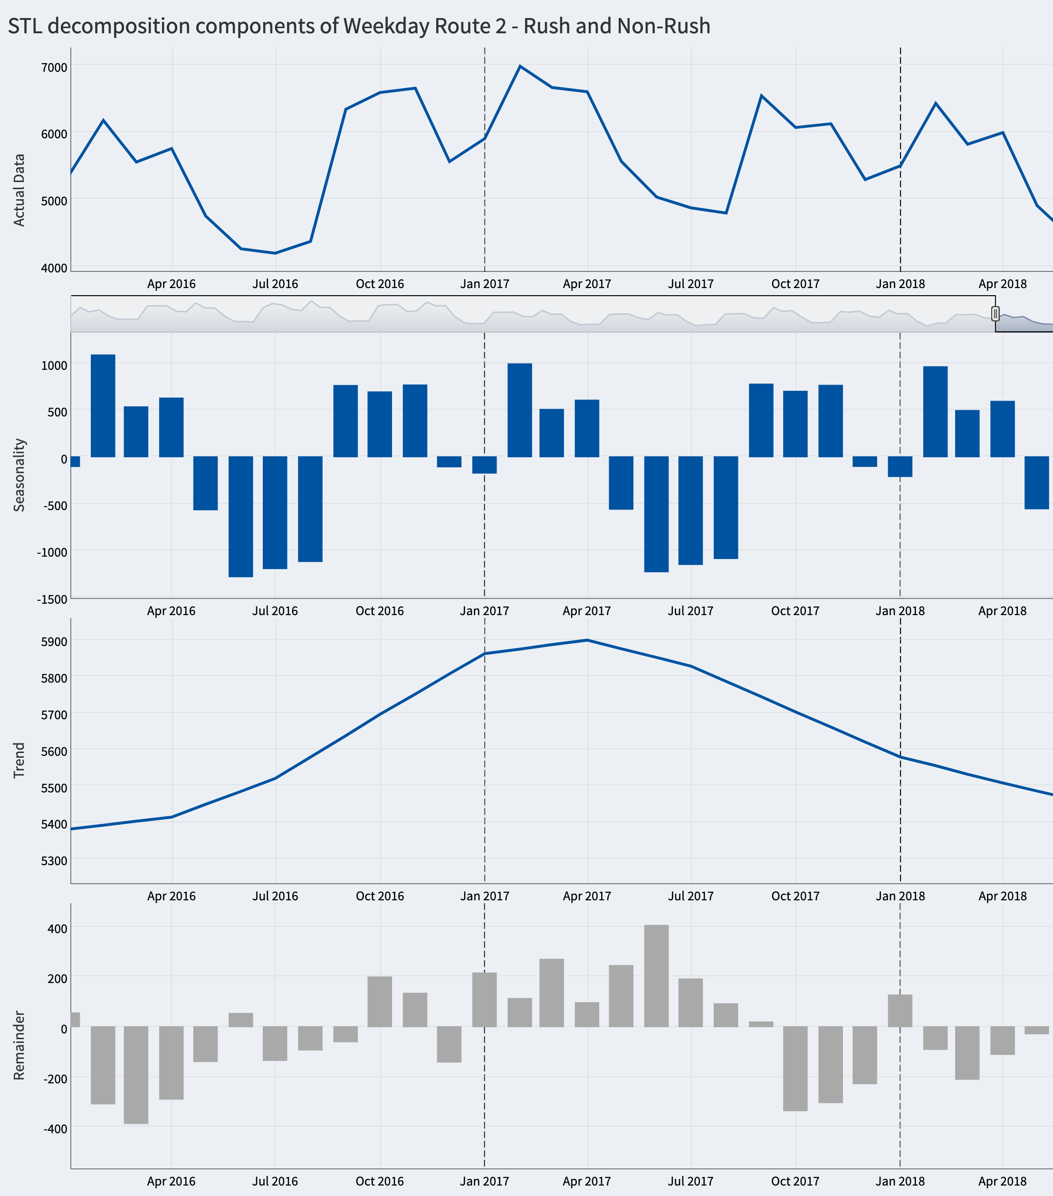
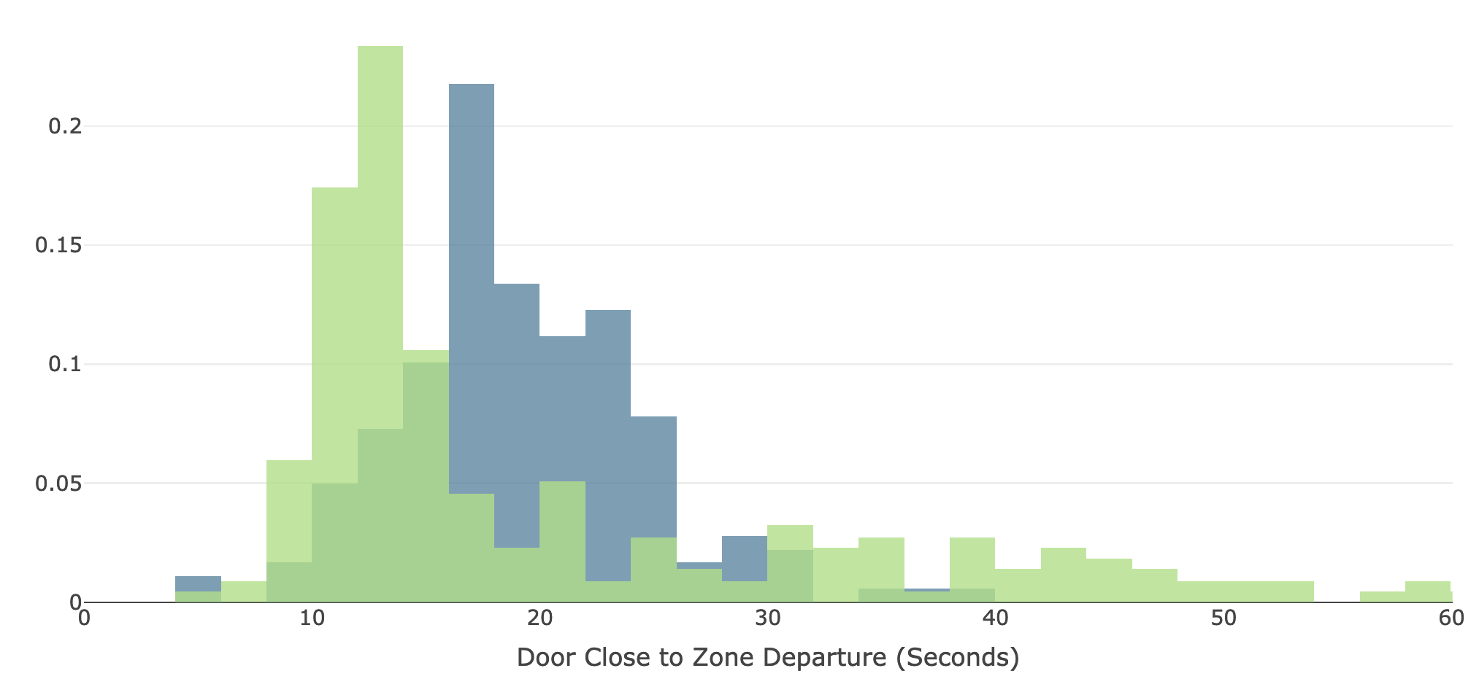
statistical tools

Slide 8
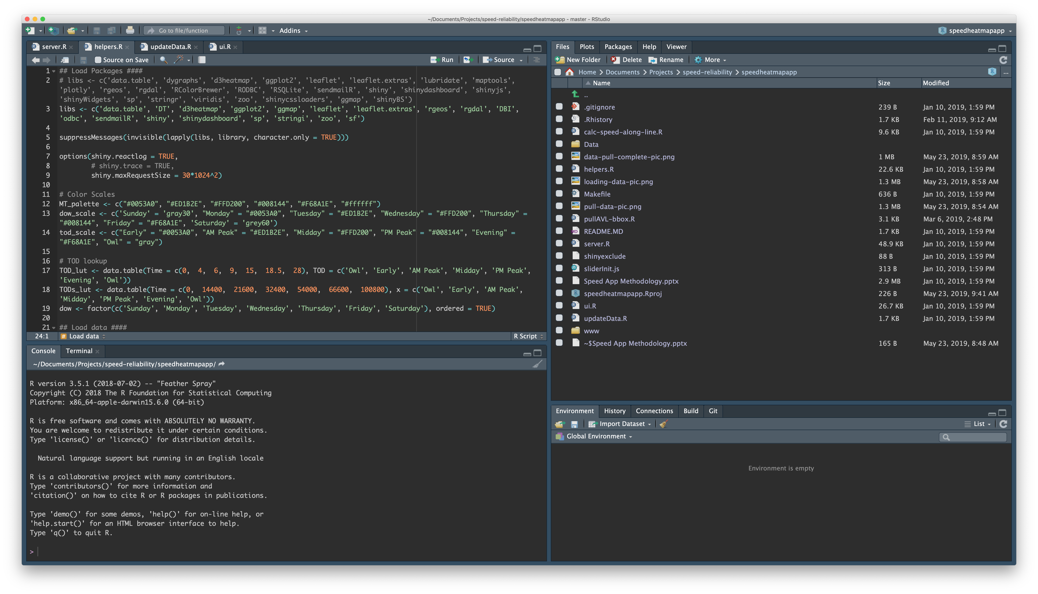

scripting
* reproducibility
* sharing & collaboration

Slide 9
end user perspective

Slide 10
Shiny Transit Tools
Introduction & Motivation 10:30 – 10:40
Shiny architecture 10:40 – 11:00
Examples
  Travel behavior data 11:00 – 11:10
  Ridership trends 11:10 – 11:30
  Bus speeds 11:30 – 11:55
Wrap-up
  Challenges

Slide 11
Shiny Basics
TRBAppCon
3 June 2019
Eric Lind, Joey Reid
Metro Transit

Slide 12
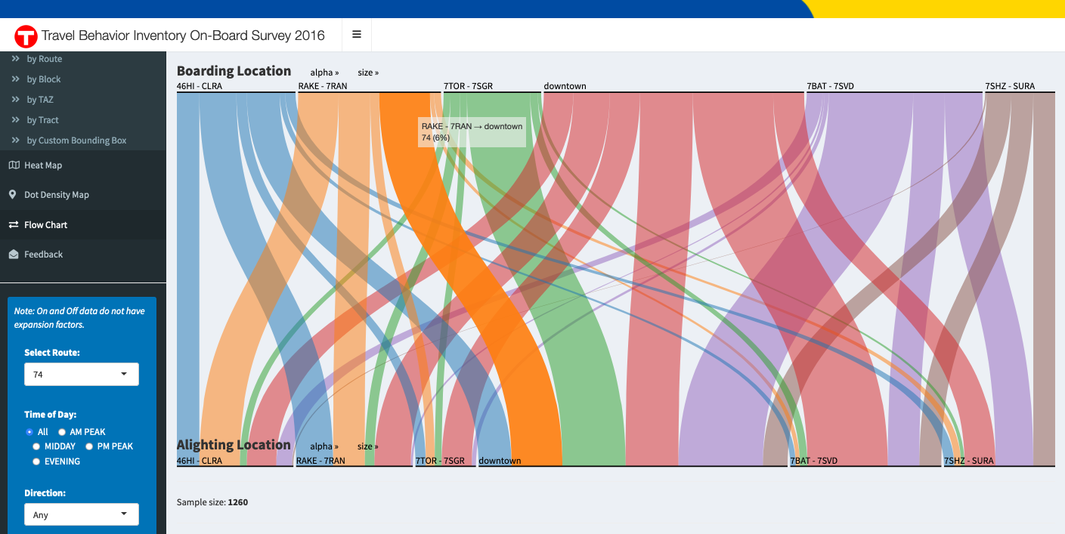
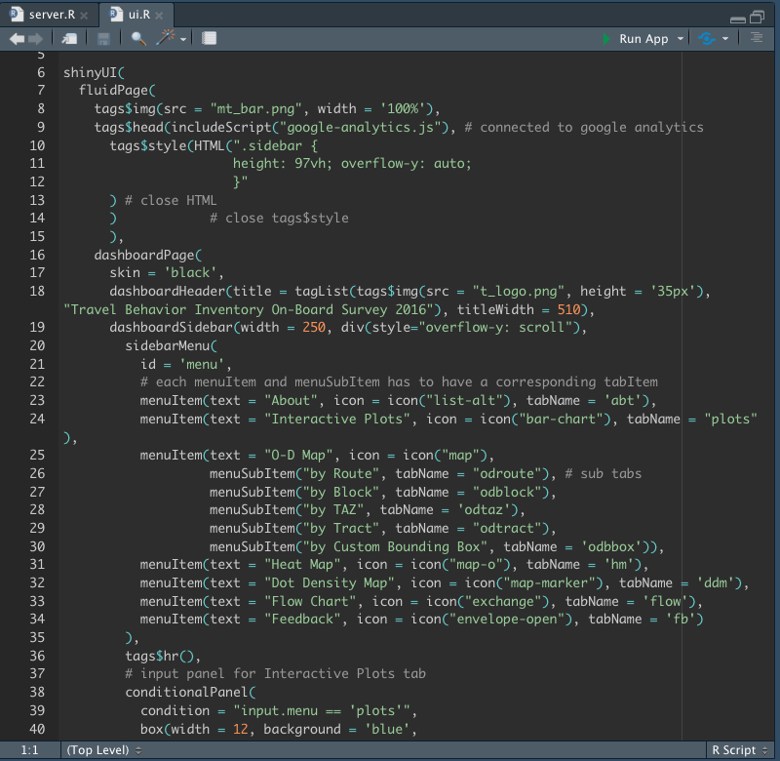
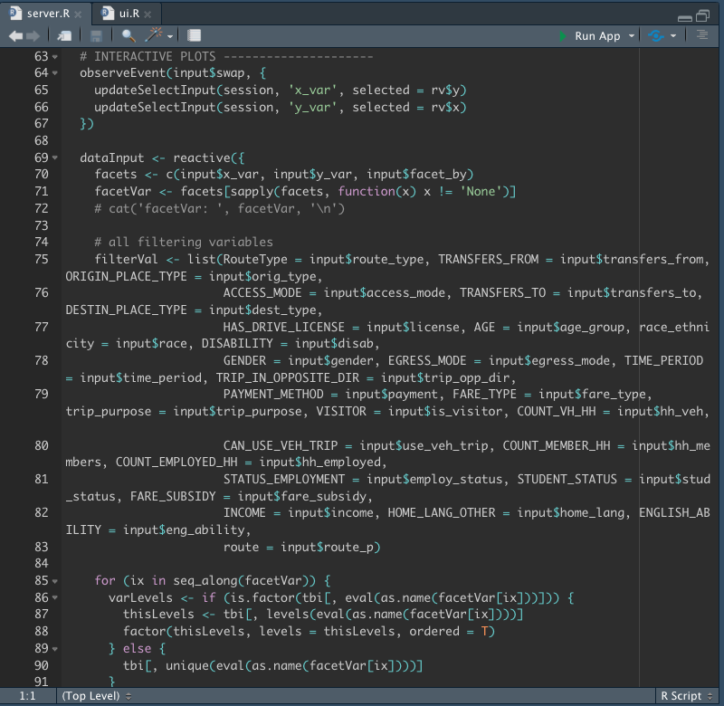
User Interface
Server
input
output = f(input)
output
ui.R
server.R

Slide 13
Shiny Transit Tools
Introduction & Motivation 10:30 – 10:40
Shiny architecture 10:40 – 11:00
Examples
  Travel behavior data 11:00 – 11:10
  Ridership trends 11:10 – 11:30
  Bus speeds 11:30 – 11:55
Wrap-up
  Challenges

