Slide 1

Emerging Modes in Strategic Planning Models
Evidence from a National Stated choice Experiment
Joe Broach – Oregon Metro/Portland State University
Liming Wang – Portland State University
Huajie Yang – Portland State University
Background image: disruptionhub.com - 2017

Slide 2
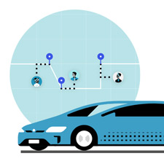
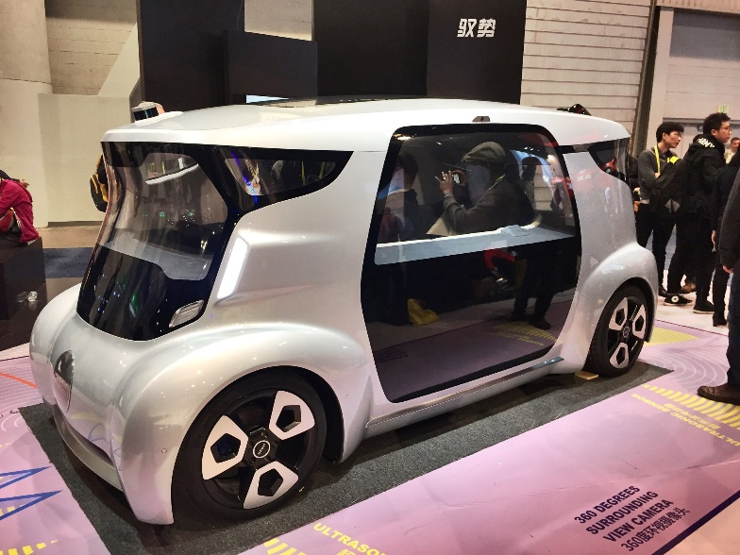
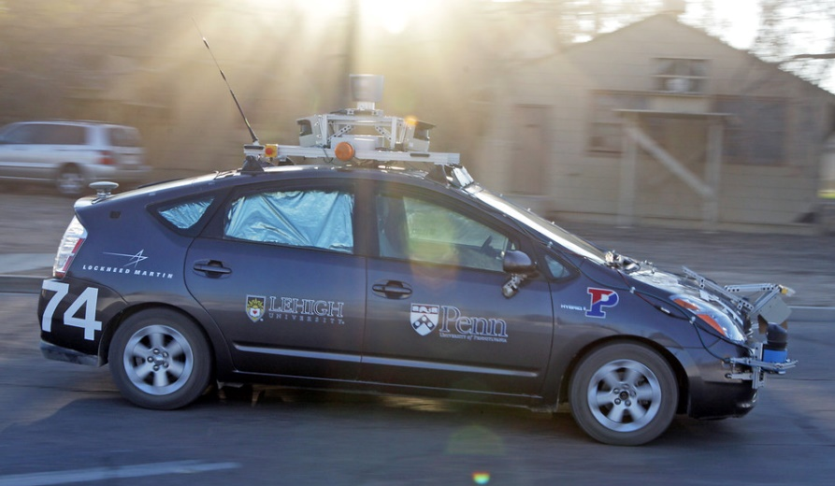
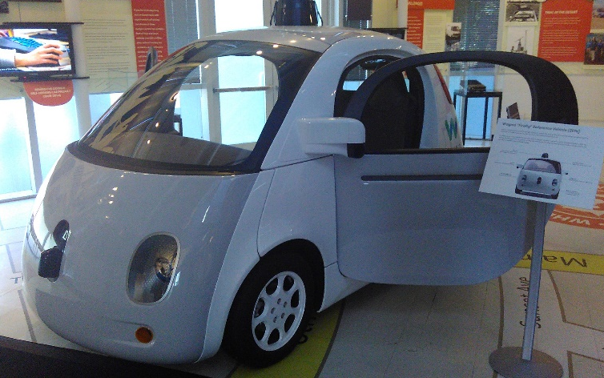
Motivation
Strategic Planning Models becoming more capable, widespread
Only as good as their future inputs
Large uncertainty around supply characteristics and demand responses to emerging mobility options
Flickr user Ken C
CC-BY-NC, 2007
Flickr user Andres Gomez
CC-BY, 2017
Transitwire.com, 2018
Flickr user monsieur paradis
CC-BY-NC, 2017

Slide 3
Key Objectives
Identify reasonable range of supply attributes for emerging modes
Explore individual demand response to new options based on current travel patterns
Incorporate results into RSPM/VisionEval framework

Slide 4
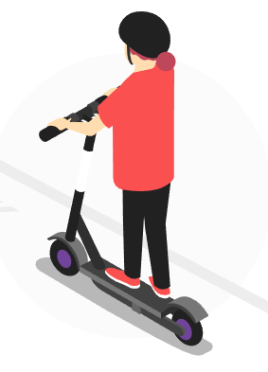
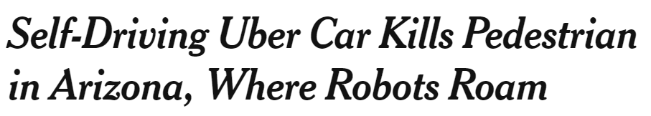
Timeline
Stated choice survey
(Summer 2018)
Emerging modes review/survey design
Initial Analysis
Additional Analysis
Phase 1: Develop multi-modal
Module for RSPM
RSPM Module Update
2016
2017
2018
2019

Slide 5
Emerging modes
Emerging mode alternatives
Self-driving (ride-hail)
Non self-driving
Shared vehicle
Shared
ride
Shared vehicle
Ride-hail
Floating car share (e.g. Car2go)
Public bike share
Shared vehicle
(e.g. UberX, Lyft)
Shared ride
(e.g. UberPOOL, Lyft Line)

Slide 6
Approach
Supply characteristics
  Modes in wide operation (car/bike share, ride-hail): scan of market rates
  Self-driving options: literature review
Demand response: stated choice survey
  National (Top 50 UZAs)
  Adaptive (trip attributes adjusted to RP trip & UAZ context via NHTS)
  Web-based
Discrete choice models fitted

Slide 7
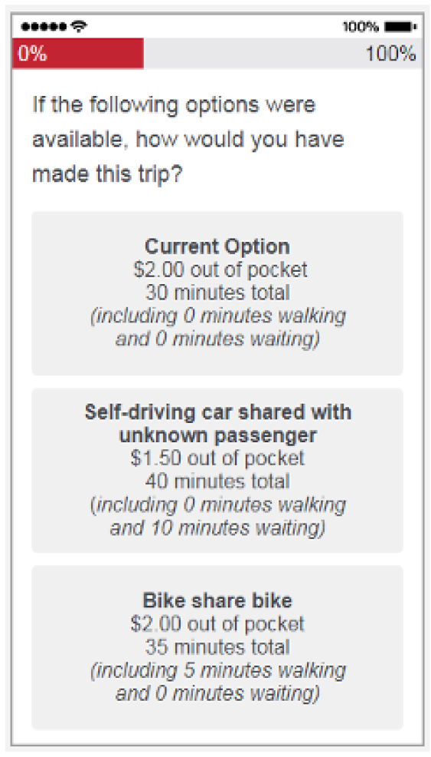
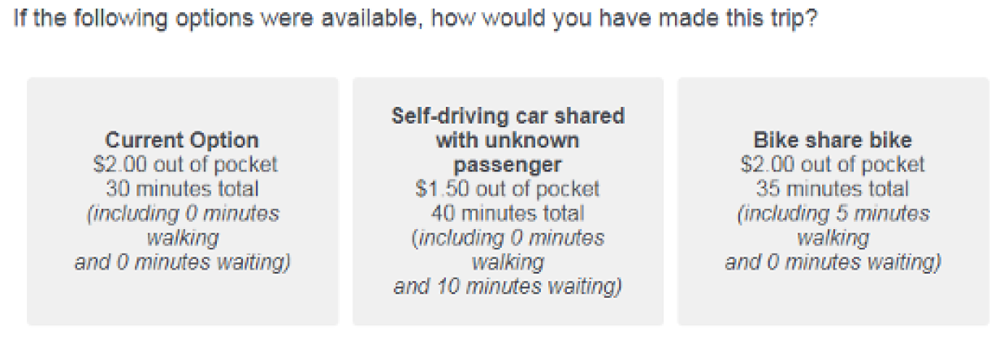
Survey implementation
Qualtrics/Python
smartphone option
Top 50 UZAs (email + mTurk)

Slide 8
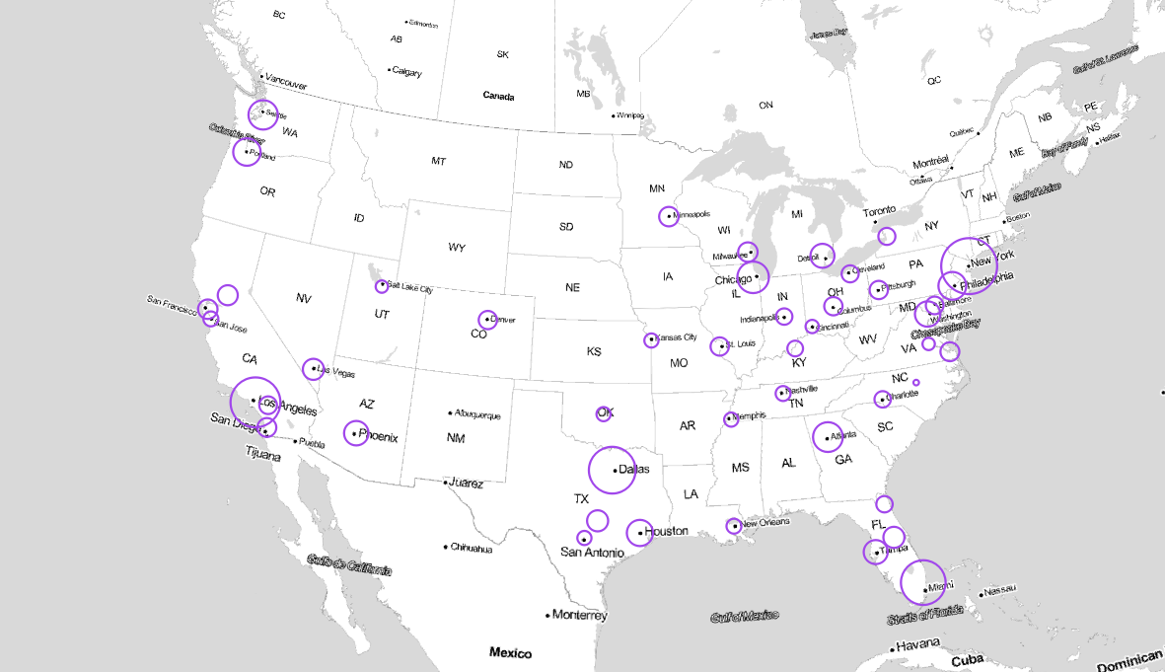

Slide 9
Supply characteristics
 | Self-driving alternatives |  | Non-self-driving alternatives
Attribute | Self-driving | Self-driving (shared ride) | Ride-hail | Ride-hail (shared ride) | Car Share | Bike Share
In-vehicle travel time (mins) | revealed driving time or NHTS-based estimate |  |  |  |  | RP distance at assumed 10 mi/hr
Out of pocket cost ($) | $0.30 - $2.00 /mi | 0.5x – 0.8x Self-driving $ | $0.80 - $1.50 /mi + $0.10 - 0.30/min + $2.00 - 4.00 | 0.5x – 0.8x Ride-hail $ | [0.35, 0.40, 0.45, 0.50] /min + 1.00 | [1.00, 2.00, 3.00] /trip
Walk time (mins) | 0 |  |  |  | NHTS city-specific model estimate | 0 – 10
Wait time (mins) | 2 – 10 | 2 – 15 | 2 – 10 | 2 – 15 | 0

Slide 10
Selected preliminary findings
Results from ~900 initial respondents presented here (~1000 additional available)
  ~1600 RP trips
  ~8000 SC scenarios
What is likely demand potential of emerging modes?
  Directly from experiment…
  Stated mode shift rates – What do people prefer given cost/time diffs and mode prefs?
  From the model…
  Mode bias in a vacuum – What do people prefer all else equal?
  Residual mode bias – What errors would we make by assuming no mode bias?

Slide 11
Stated mode shift rates
Lowest among current private vehicle users (bike, drive, get a ride)
  ~25% of scenarios shift to emerging modes
Higher among current public transit riders and those walking
  ~40-50% of scenarios shift to emerging modes
Highest among those already using emerging or shared modes
  ~60-75% of scenarios shift to a different mode
  Most likely to shift: bike share, car/vanpool, non-shared ride-hail

Slide 12
Emerging mode bias (fixed cost + time)

Slide 13
Prediction bias if mode-specific prefs ignored

Slide 14
Integrating into strategic planning models
Phase 1 produced a multi-modal choice module for RSPM (VETravelDemand)
Results here are being tested in simulations and will be added to module as options
Raises questions about how to forecast trends in technology attitudes/preferences when structural breaks (self-driving) occur

Slide 15
Preliminary Conclusions & Implications
Emerging modes generally NOT preferred at this time, all else equal (technology skepticism?); will need to be considerably cheaper/faster than existing options
Failure to incorporate mode-specific preferences in strategic planning models could lead to significant over-prediction of emerging modes studied
Inertia varies by current travel mode, with personal vehicle (incl. bicycle) users most reluctant to shift in short-run (did not examine longer-term decisions)
If self-driving technology declines in cost as much as theoretical research suggests, changes in urban travel patterns could be substantial and particularly challenging for bike share and public transit markets

Slide 16

Further resources
https://nitc.trec.pdx.edu/research/project/881/
https://visioneval.org/
https://github.com/cities/VETravelDemand
If you’d like to see the web survey instrument:
https://portlandstate.qualtrics.com/jfe/form/SV_2uwDJ3vPn7wc0iV?source=test

