Slide 1
Moving Governance Concepts into Practice
A Discussion of New Collaborative and Open Source Initiatives
Sunday, June 2, 3:30 to 5:00

Slide 2
Our plan today
Purpose of this workshop – 5 min
Introduction of our panelists and their projects – 25 min
Facilitated Q and A with audience participation – 50 min
Additional audience questions – 10 min

Slide 3
Purpose of this workshop

Slide 4
Workshop need
Community developed and maintained (i.e. open source) tools are an emerging best practice for transportation modeling
Unlike privately owned tools, or tools developed by and for a single user, community-based tools require collaborative governance and stewardship
Therefore, today we will share lessons learned and ideas for improved project governance, followed by a facilitated question and answer session

Slide 5
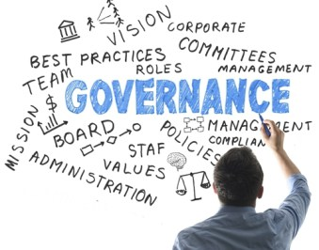
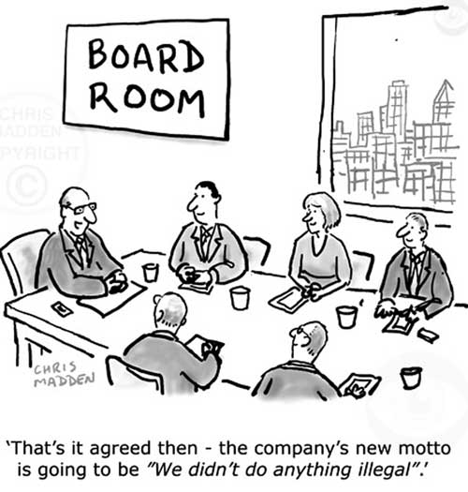
What is governance?
Getting the right people around the right table to make the right decisions to guide overall program processes and standards to decide what initiatives to take on and when
From Oregon DOT
2
1
1
2
https://blog.v-comply.com/governance-styles/
http://www.ft.lk/columns/what-hr-can-do-to-improve
governance-in-enterprises/4-572160

Slide 6
Topics to be discussed today
An overview of the expanding open source toolkit
Ownership and collaboration challenges across contracts, agencies, schedules
Discussion of the contribution and review process
Identification of common needs
Suggestions for future practice and industry collaborations

Slide 7
What will the takeaways be for the audience?
Knowledge of new easily accessible tools
Awareness of partnerships and their value for developing and maintaining agency tools
Ideas and suggestions for improving collaborative projects
Understanding the benefits/challenges of collaborative and open source projects

Slide 8
Project introductions

Slide 9
Project Introductions
Bill Keyrouze, AMPO, ActivitySim
Bibiana McHugh, TriMet, OpenTripPlanner
Billy Charlton, TU-Berlin, matsim
Tara Weidner, Oregon DOT, VisionEval
Elizabeth Sall, UrbanLabs, Zephyr Transport

Slide 10
Questions and Answers with Audience Participation

Slide 11
Getting off the ground
Why did you decide an open source solution was right for your problem?
What were some important steps in getting your project off the ground?
I’ve heard about pooled funds, what is this?
What are some good resources for getting an open source project going?

Slide 12
Governance
How did you develop a governance plan?
How do you make decisions collectively?
What collective decision-making issues have you experienced, and how did they get resolved?

Slide 13
Contracting/Licenses/Legalities
What contracting challenges do you face and how have they been overcome?
I’m concerned about copyright, ownership, and licensing. How does your project deal with this?
How does your project interface with closed source or proprietary solutions?

Slide 14
Funding
What funding challenges do you face and how have they been overcome?
What is done to recognize paying members? Do they have move voice in governance?

Slide 15
Outreach
How do you market your project?
How are you expanding your community beyond your initial base? For example, from agencies to academics and vice versa.
How do people get involved with your project? How do you ensure quality contribution?

Slide 16
Maintenance/Sustainability
New projects need dedicated champions. What happens when the champions move on? How do you, or have you, ensured long term success?
How can foundations, non-profits, etc. help sustain these initiatives?
What are your plans for the future?

Slide 17
Additional Audience Questions

Slide 18
Additional Audience Questions
?

Slide 19
Ben Stabler
Director, RSG
ben.stabler@rsginc.com
Tara Weidner
Integrated Transportation Analysis Engineer, Oregon DOT
Tara.J.WEIDNER@odot.state.or.us

