Slide 1

Prototype Tour/AV Model
William G. Allen, Jr., PE
TRB Planning Applications Conference
Portland
June 2019

Slide 2
Prototype Model Based on Cubetown
Cubetown is the “demo” city for Citilabs software
Sample model + data, used to illustrate capabilities of our software
Small number of zones, runs fast
“Prototype” models are used as training tools
Other software vendors probably have something similar

Slide 3
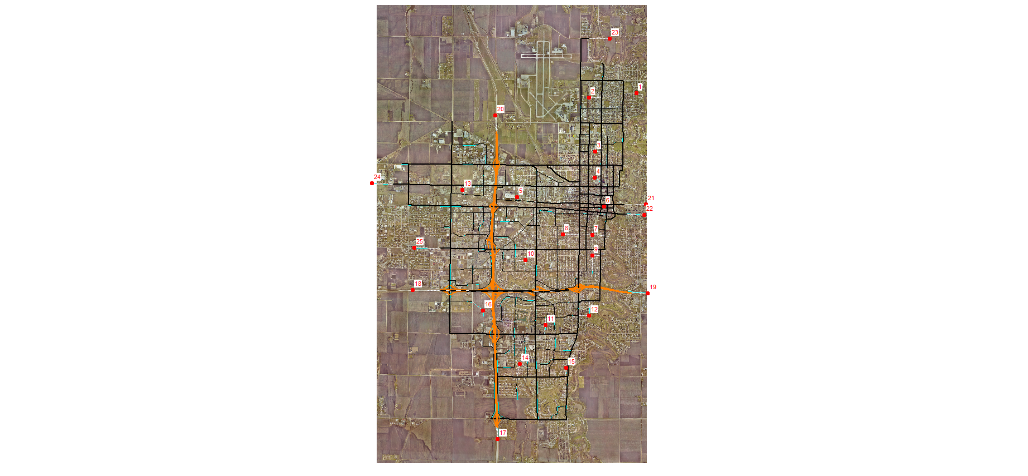
Cubetown
16 zones, 9 external stations
Pop: 94,000
HH: 30,000
Emp: 39,000
School enrollment (K-12): 10,000
Looks a lot like Fargo, ND

Slide 4
Cubetown Model Versions
Four-step
ABM
Tour model with AV
Mobility-as-a-Service (coming soon!)

Slide 5
Simplified Tour Model Structure (STM)
HH synthesis
Tour frequency
Tour destination choice
Mode choice
Intermediate stops
  Number of stops
  Stop location
Time period
Trip accumulator / assignment
Notes:
The trip purposes are mostly conventional. We did split long-distance into Work and Non-Work. The truck model includes 3 types of vehicles. The model inputs are pretty standard for a statewide model. We use over 1900 zones.
Since transit was not a major concern in this study, we did not code a transit network. Transit travel is estimated using look-up tables based on zonal area type. This greatly simplifies the use of the model and was better suited to the needs of this agency.

Slide 6

STM Improvements Over Four-Step
Four-step
  Aggregation error
  Isolated trips (no chaining)
  Non-Home-Based garbage can
  Limited use of HH attributes
STM
  Discrete modelling of households and tours
  HH attributes available at every model step
  Reflects the way people travel
  More accurate trip tables
  No NHB – handles trip chaining explicitly through tours
  Similar effort and data needs
  Slightly longer runtimes
NHB
Notes:
As the project proceeded, we developed a good idea of what we wanted to do and how we wanted to solve the problems. But we weren’t sure if all of these solutions could be implemented at the same time. As it turns out, they can, and we believe this is the first time these concepts have been implemented within the same process.
The assignments matched the counts very well and the run time was judged to be reasonable, so Kansas DOT was happy.

Slide 7

STM Less Complex than ABM
ABM
  Includes many interactions, constraints, trip scheduling
  Synthesize population
  Models activities
  Years to develop
  Run time in days
STM
  Omits some interactions, no scheduling
  Synthesize households
  Models tours
  Similar development as four-step
  Run time < 6 hr

Slide 8
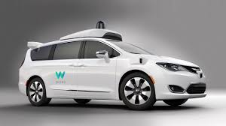
AV Overview
No one knows anything
  Extrapolation, theory, wishful thinking
  Modelling experiments
  No consensus exists
JMHO
  Relatively objective, no agenda
  Automaker experience
Shared vs. owned AVs: very uncertain
Focus here is on long-term effects
Did not include AV trucks
  That’s next

Slide 9
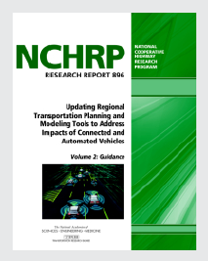
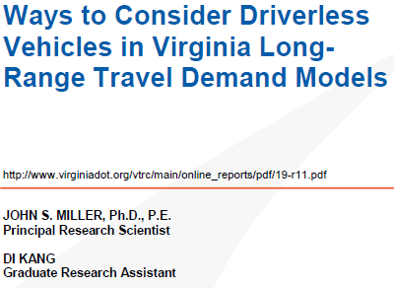
Recent References
2018
  VTPI report (Litman)
  NCHRP Report 896 (Zmud, et al)
  SunCam Continuing Ed course 208 (Washburn)
2019
  VTRC report (Miller & Kang)
  Eno Foundation report (Lewis & Grossman)
  TRB 2019
    Rodier, et al: San Francisco Bay area
    Vyas, et al: Columbus area

Slide 10
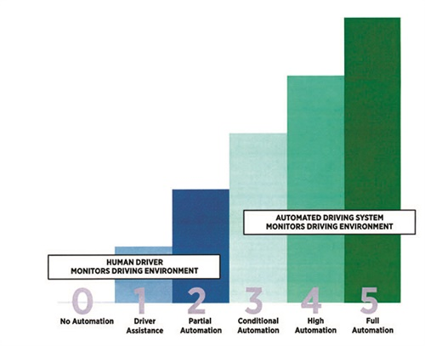
AV Adoption Rate: The Big Unknown
Note difference between new car sales and total fleet usage
  Travel modelling uses the total fleet percentage
Used “pessimistic” VTPI rate (Exhibit 14)
  Set upper limit of 85%
Model script is flexible
  User can choose a year or can input a specific rate
  Facilitates “What if?” analysis
Model includes both privately owned AVs and shared use AVs
Assume all AVs are Level 5 (full autonomy)

Slide 11
Assumed AV Adoption Rate

Slide 12
HH Synthesis and AV
HH synthesis estimates several attributes
  Size (1-5), income group (5), workers (0-3+), life cycle (retired, kids, neither), vehicles (0-3+), AVs (0-3+)
  Look-up tables based on Census data
Incremental logit model for AV
  Pivot off of overall adoption rate based on income, number of vehicles
More likely to own AV if
  Higher income
  HH owns 2+ vehicles
AVs will reduce total auto ownership
  AVs are more expensive and more flexible -- can be “re-used”

Slide 13
Vehicle Ownership Impacts

Slide 14

Tour Frequency and AV
No effect on Work, School travel but discretionary travel (Shop, Other, At-Work) will increase
  Kids and disabled will have cars available
    40%+ of the population!
  AVs are more likely to be available for discretionary trips
  Travel is easier
At-Work tours increase due to empty cars moving to cheaper parking lots
Model change: add a positive coefficient on the number of AVs, on the utility equations for 1+ tours

Slide 15
Tour Frequency Impacts

Slide 16
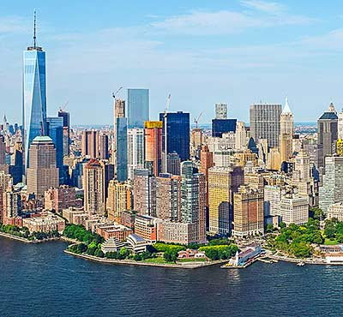
Destination Choice and AV
Value of time decreases – traveller can do other things during travel
  This should increase tour lengths
Some people will keep same house, find another job
Others will keep same job, find another house
  Land use impacts: that’s next
CBD becomes more attractive
  Congestion is less bothersome
  Parking is easier, cheaper
Model change: if HH has AVs:
  Reduce coefficient on time
  Increase CBD attractiveness

Slide 17
Destination Choice Impacts

Slide 18

Mode Choice and AV
Walk-transit decreases: auto travel easier, parking cheaper
  Affects local bus
Drive-transit increases: home-PnR lot travel is easier
  Affects express, guideway services
Parking costs decrease
Taxi/TNC increases: lower fares
  Car sharing, MaaS: that’s next
Auto occupancy decreases: zero is an option
Is HH life cycle important?
Does AV need to be a separate mode?
  But ZOVs need special handling

Slide 19
Mode Choice Impacts
Model change:
  Add mode for “empty AV”, for At-Work tours
  Add positive coefficient on drive-transit
  Add negative coefficient on walk-transit
  Add positive coefficient on taxi/TNC (shared mobility)

Slide 20
Intermediate Stops and AV
We don’t expect a major impact from AV
Probably fewer stops because of the need to predict and program stops
Probably similar impacts as in Destination Choice
  Longer tours (more distant stops)
  More stops in the CBD
Model change:
  Add negative coefficient on making stops
  Reduce coefficient on detour time

Slide 21
Time of Day and AV
This model uses 4 time periods: AM, MD, PM, NT
AV impact expected to be modest
Probably more peak travel
  Less inconvenience/aggravation from congestion
Model change:
  Increase peak period travel slightly

Slide 22
Time of Day Impacts

Slide 23
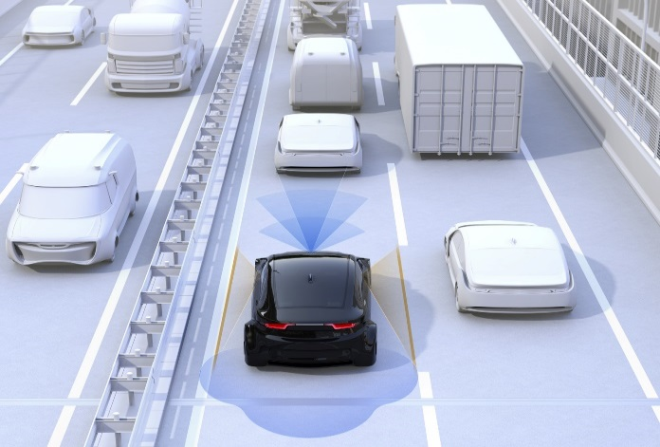
Traffic Assignment and AV
This model uses static assignment
  Dynamic assignment: that’s next
Our objective assumptions:
  AVs are 10% slower because they obey all traffic laws
  We do not believe general roadway capacity will double
    Close vehicle spacing is inherently unsafe
    Must account for emergency stopping
    Higher capacity is feasible for AV-only freeway lanes
    Intersections control arterial capacity -- what will happen there?
  Use PCE = 0.8 for AVs to reflect connectivity, platooning
Keep AV volume separate in order to calculate impacts

Slide 24
Assignment Impacts: VMT

Slide 25
Assignment Impacts: Delay

Slide 26
So What?
AV impacts: same direction as other studies, but less dramatic
  Autos go down 3%, not 35%
  Trips go up 10%, not 50%
  Some trips are longer
  Transit trips go down
  VMT, delay go up -- significantly
Demonstration models are useful for training and sensitivity analysis
Much easier to analyze AV with a discrete tour-based model
This model allows an objective analysis of the travel impacts of AVs
Simple model lets the user easily run “What if?” tests

Slide 27
For More Information
Model details
  Bill Allen
  wallen@citilabs.com
  (888) 770-CUBE
  (803) 642-4489
To get a copy
  US/Canada: Katie Brinson
  kbrinson@citilabs.com
  Europe/Australia/Africa/Middle East: Oliver Charlesworth
  ocharlesworth@citilabs.com
  Asia: Luke Cheng
  lcheng@citilabs.com

