Slide 1
Relating Transit Capacity Measurements to Users’ Experience of Crowding
June 3, 2019
Bruce Kaplan
Bill Kuttner and Brynn Leopold

Slide 2
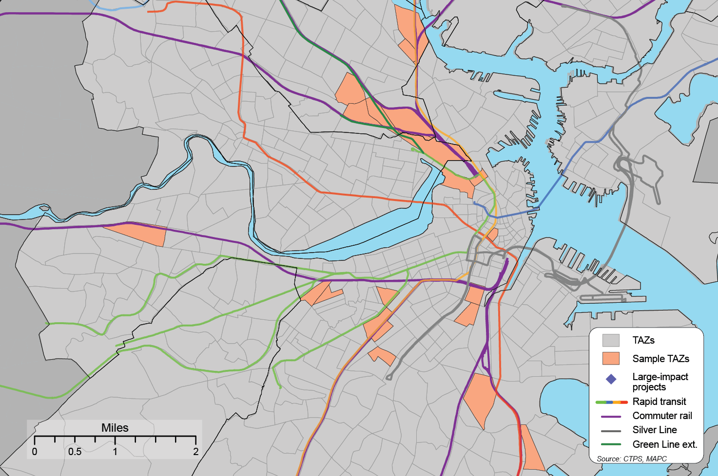
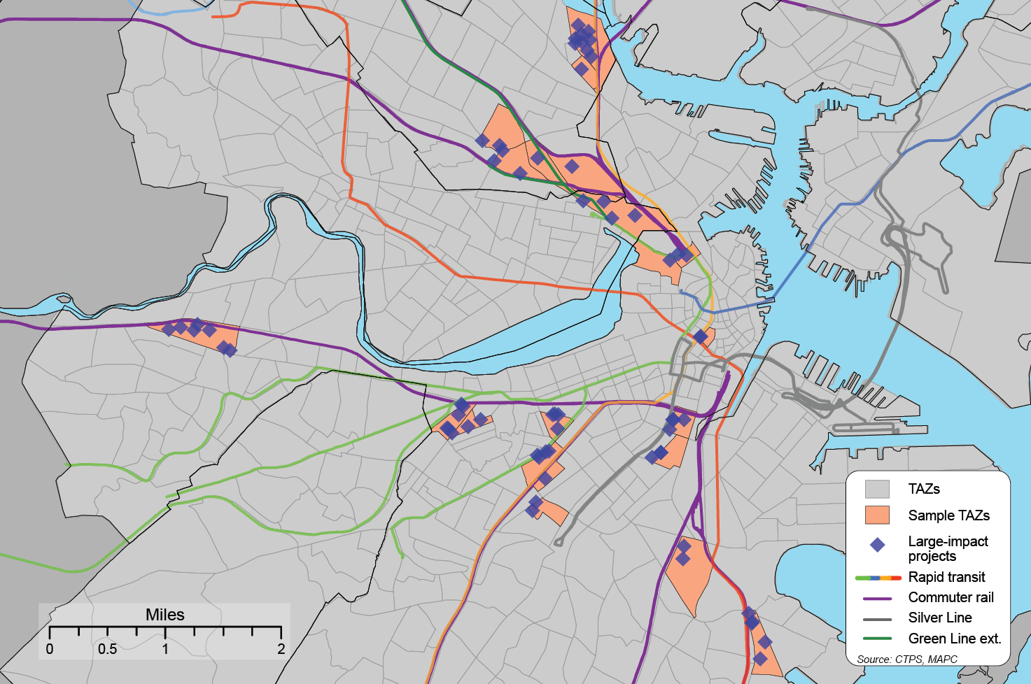
72 Large-Impact Developments

Slide 3
Challenges
We can model demand but can we accurately represent crowding?
Platform crowding not represented in model
Assumptions about capacity
Demand per vehicle turns out to be nuanced

Slide 4
Rapid Transit Vehicle Crowding should be a Simple V/C Calculation
Load Factor = Demand on segment between stations / (frequency of trains * (vehicle policy standard * number of vehicles per train))
Where vehicle policy standard = maximum seated & standing passengers
If Load Factor > 1, then there is crowding

Slide 5
Doesn’t work for Modeling Traditional Time Intervals
Rapid Transit Service | Peak Load Points | AM Peak Period
Red Line NB | Broadway - South Station | 0.56
Red Line NB | Savin Hill - JFK/UMass | 0.45
Red Line SB | Central - Kendall | 0.40
Green Line Subway EB | Hynes-Copley | 0.64
Green Line Subway WB | Park St - Boylston | 0.60
Orange Line NB | Back Bay - Tufts Medical | 0.55
Orange Line SB | Haymarket - State | 0.68
Blue Line NB | State - Aquarium | 0.09
Blue Line SB | Maverick - Aquarium | 0.62
Rapid Transit Service | Peak Load Points | AM Peak Period | AM Peak Hour
Red Line NB | Broadway - South Station | 0.56 | 0.75
Red Line NB | Savin Hill - JFK/UMass | 0.45 | 1.31
Red Line SB | Central - Kendall | 0.40 | 0.66
Green Line Subway EB | Hynes-Copley | 0.64 | 1.13
Green Line Subway WB | Park St - Boylston | 0.60 | 0.81
Orange Line NB | Back Bay - Tufts Medical | 0.55 | 0.84
Orange Line SB | Haymarket - State | 0.68 | 0.98
Blue Line NB | State - Aquarium | 0.09 | 0.10
Blue Line SB | Maverick - Aquarium | 0.62 | 0.72
Rapid Transit Service | Peak Load Points | AM Peak Period | AM Peak Hour | AM Peak 15 min
Red Line NB | Broadway - South Station | 0.56 | 0.75 | 0.68
Red Line NB | Savin Hill - JFK/UMass | 0.45 | 1.31 | 1.17
Red Line SB | Central - Kendall | 0.40 | 0.66 | 0.64
Green Line Subway EB | Hynes-Copley | 0.64 | 1.13 | 1.21
Green Line Subway WB | Park St - Boylston | 0.60 | 0.81 | 0.84
Orange Line NB | Back Bay - Tufts Medical | 0.55 | 0.84 | 0.72
Orange Line SB | Haymarket - State | 0.68 | 0.98 | 0.89
Blue Line NB | State - Aquarium | 0.09 | 0.10 | 0.11
Blue Line SB | Maverick - Aquarium | 0.62 | 0.72 | 0.85
Note: Peak hour ratios possibly greater than Peak 15 min ratios due to frequency assumptions of whole train service

Slide 6
Culprit #1 – Standee Standards
Square Feet per Standee | Passenger Perspective | Operator Perspective
5.4 and above | Comfortable standing load | Easy circulation
4.3 to 5.3 | Same amount of personal space for seated passengers as standees | Reasonably easy circulation
3.2 to 4.2 | Occasional body contact Standees have less space than seated passengers | Balance between passenger comfort and capacity Potential for boarding and alighting delays and increased dwell time
2.2 to 3.1 | Likely uncomfortable conditions Frequent body contact and inconvenience with packages and briefcases | Very difficult circulation Significant boarding and alighting delays and increased dwell times Maximum schedule load
Less than 2.2 | Crush-load conditions | Physical Limit Exceeded Impossible circulation Major increases in dwell and delay times
Industry Standard is 3.76

Slide 7
Local comparison
Transit Vehicle | Operator’sPolicy Max | Seated | Standees | Average Square Ft per Standee | Below industry crowding standard of 3.76 ?
Red | 167 | 57 | 110 | 2.94 | YES
Orange | 131 | 58 | 73 | 3.41 | YES
Green | 104 | 45 | 59 | 3.5 | YES
Blue | 95 | 35 | 60 | 2.57 | YES

Slide 8
Need for New Rapid Transit Crowding Definitions
Passenger Perceptions of crowding do not directly correspond to amount of available capacity
Need to think in terms of levels of crowding, not in terms of exceeding a single standard

Slide 9
Need for New Rapid Transit Crowding Measurement Levels
Overburdened / Apparent Crowding
Standees=seated
Acceptably Full – 3.76 sq. ft. / standee
Overcrowded
Less than 3.76 square feet per standee
Unacceptable
Less than 3.11 square feet per standee

Slide 10
New Definitions and Thresholds
Transit Vehicle | Seating Capacity | Overburdened Apparent Crowding | Overcrowded Acceptably Full | Maximum Acceptable | Physical Limit
Red | 57 | 114 | 142 | 160 | 202
Orange | 58 | 116 | 124 | 138 | 171
Green | 45 | 90 | 100 | 112 | 139
Blue | 35 | 70 | 76 | 85 | 105

Slide 11
Culprit #2 – Service Irregularities
Actual AM Peak Period Rapid Transit Operation
 | Sched Trains | 6:00 AM | 6:15AM | 6:30AM | 6:45AM | 7:00AM | 7:15AM | 7:30AM | 7:45AM | 8:00AM | 8:15AM | 8:30AM | 8:45AM
Red SB | 3.33 | 2.1 | 1.7 | 3.3 | 2.3 | 2.7 | 3.0 | 3.2 | 3.0 | 3.5 | 3.5 | 3.1 | 3.1
Red NB | 3.33 | 3.0 | 2.4 | 3.5 | 3.0 | 3.0 | 3.8 | 3.9 | 3.0 | 3.4 | 3.8 | 3.6 | 3.3
Orange SB | 2.5 | 1.3 | 1.6 | 1.9 | 2.0 | 2.9 | 2.5 | 2.7 | 3.1 | 2.8 | 2.6 | 2.0 | 2.2
Orange NB | 2.5 | 1.1 | 1.8 | 1.9 | 1.9 | 2.9 | 3.0 | 2.8 | 2.9 | 2.5 | 3.0 | 2.7 | 2.8
Green WB | 9.38 | 6.8 | 5.9 | 6.8 | 7.4 | 9.1 | 9.2 | 9.1 | 8.9 | 9.1 | 8.2 | 9.4 | 8.6
Green EB | 9.38 | 6.4 | 6.3 | 9.4 | 9.0 | 10.0 | 10.0 | 8.1 | 10.9 | 9.2 | 8.6 | 9.2 | 10.0
Blue SB | 3.0 | 2.8 | 2.5 | 3.6 | 2.8 | 3.1 | 3.2 | 3.4 | 3.0 | 3.8 | 3.1 | 3.3 | 3.2
Blue NB | 3.0 | 2.1 | 2.2 | 1.8 | 3.1 | 3.6 | 2.9 | 3.7 | 3.3 | 3.1 | 3.2 | 3.6 | 2.9
 | Sched Trains | 6:00 AM | 6:15AM | 6:30AM | 6:45AM | 7:00AM | 7:15AM | 7:30AM | 7:45AM | 8:00AM | 8:15AM | 8:30AM | 8:45AM
Red SB | 3.33 | 2.1 | 1.7 | 3.3 | 2.3 | 2.7 | 3.0 | 3.2 | 3.0 | 3.5 | 3.5 | 3.1 | 3.1
Red NB | 3.33 | 3.0 | 2.4 | 3.5 | 3.0 | 3.0 | 3.8 | 3.9 | 3.0 | 3.4 | 3.8 | 3.6 | 3.3
Orange SB | 2.5 | 1.3 | 1.6 | 1.9 | 2.0 | 2.9 | 2.5 | 2.7 | 3.1 | 2.8 | 2.6 | 2.0 | 2.2
Orange NB | 2.5 | 1.1 | 1.8 | 1.9 | 1.9 | 2.9 | 3.0 | 2.8 | 2.9 | 2.5 | 3.0 | 2.7 | 2.8
Green WB | 9.38 | 6.8 | 5.9 | 6.8 | 7.4 | 9.1 | 9.2 | 9.1 | 8.9 | 9.1 | 8.2 | 9.4 | 8.6
Green EB | 9.38 | 6.4 | 6.3 | 9.4 | 9.0 | 10.0 | 10.0 | 8.1 | 10.9 | 9.2 | 8.6 | 9.2 | 10.0
Blue SB | 3.0 | 2.8 | 2.5 | 3.6 | 2.8 | 3.1 | 3.2 | 3.4 | 3.0 | 3.8 | 3.1 | 3.3 | 3.2
Blue NB | 3.0 | 2.1 | 2.2 | 1.8 | 3.1 | 3.6 | 2.9 | 3.7 | 3.3 | 3.1 | 3.2 | 3.6 | 2.9

Slide 12
It’s About Time
Uneven temporal distribution of actual service leads to crowding on specific trains
Overall line volumes accommodated over peak hours and periods, but crowding happens on a train by train basis
Smaller the temporal period of analysis (and more finer the empirical data), the better the ability to reflect crowding

Slide 13
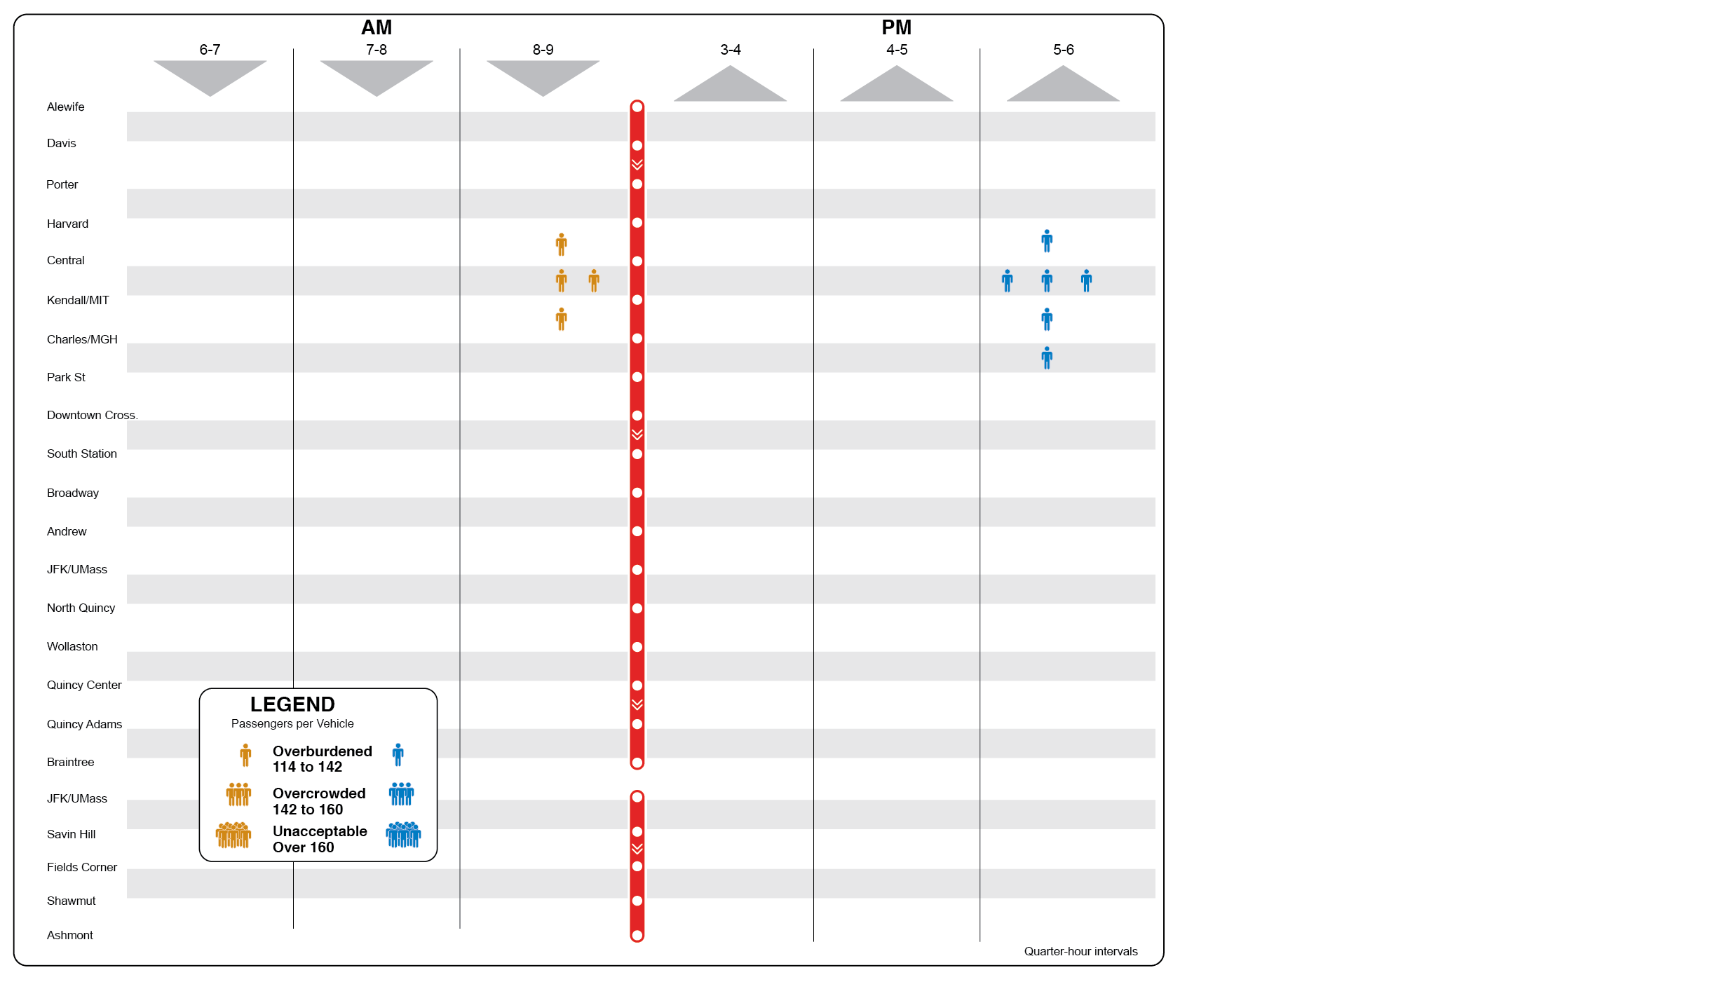
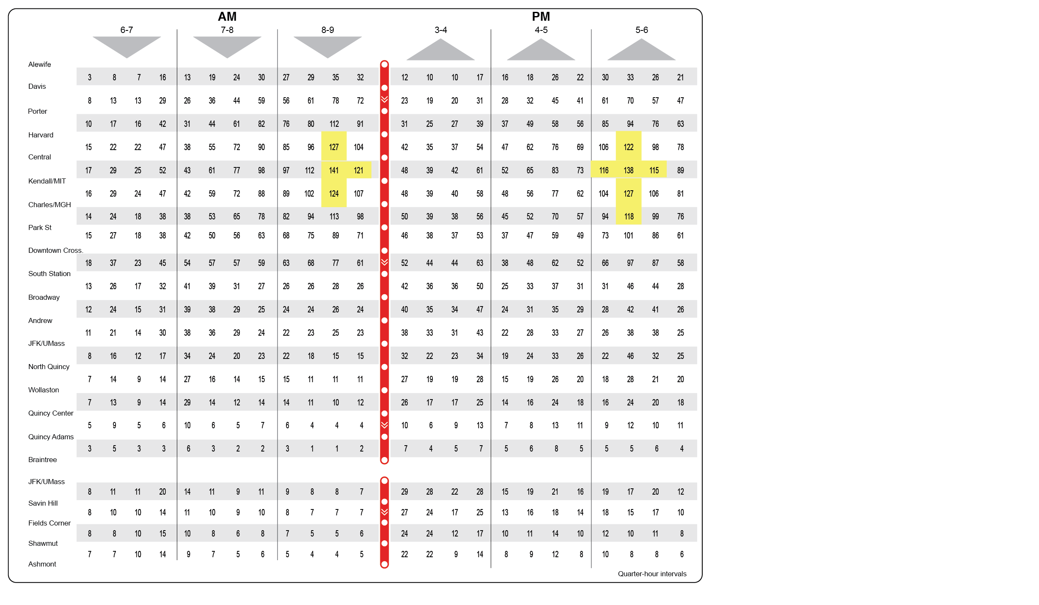
Red Line – Base Year

Slide 14
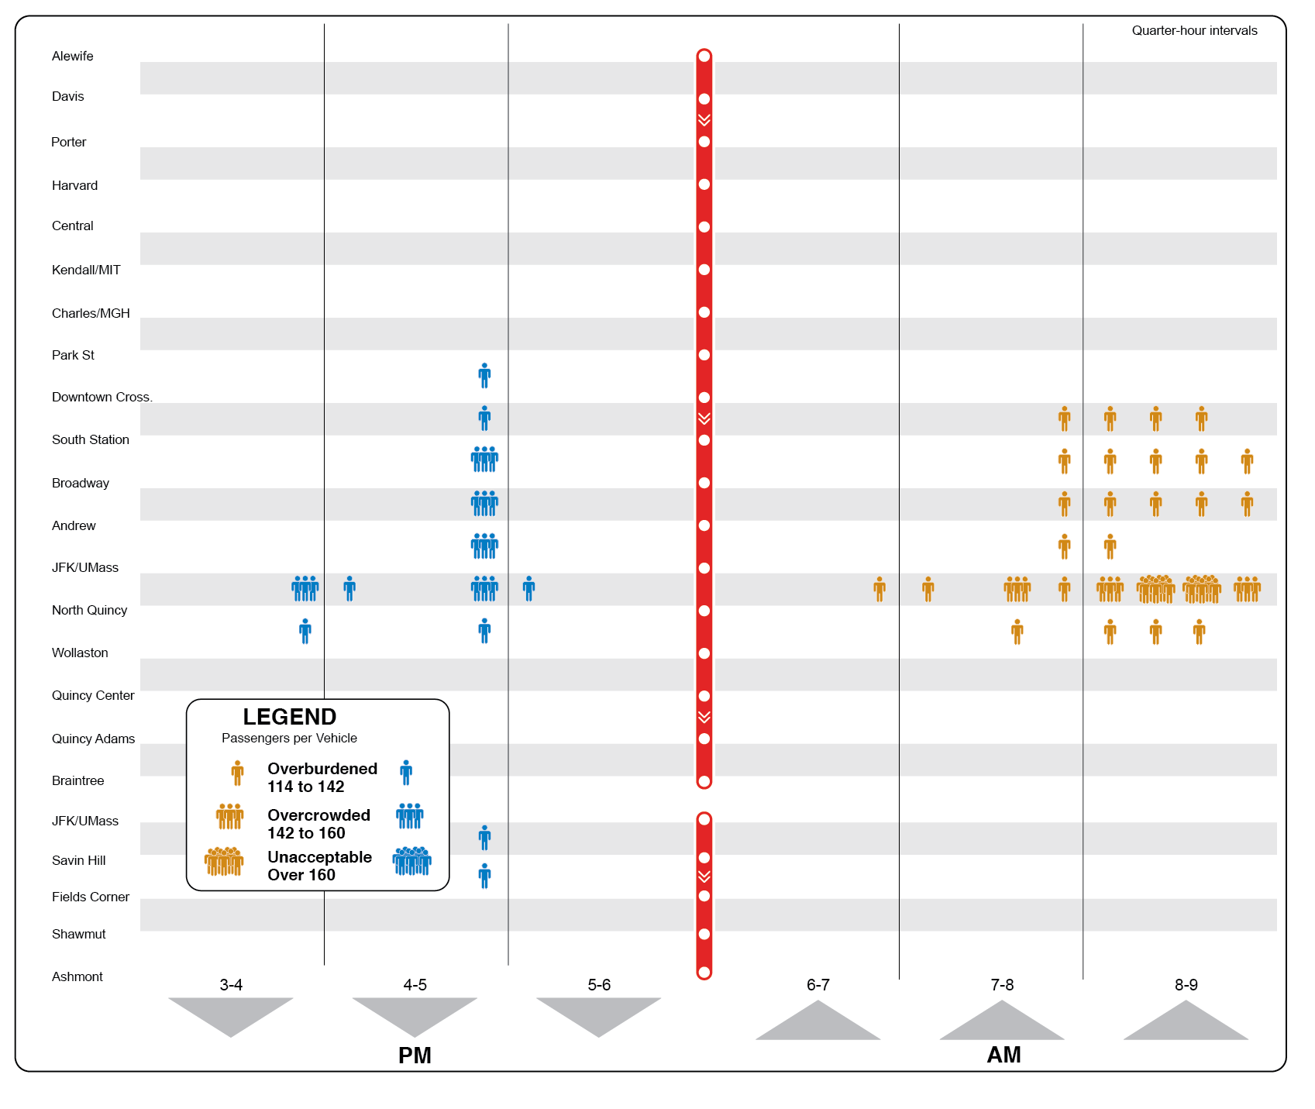
Red Line – Base Year

Slide 15
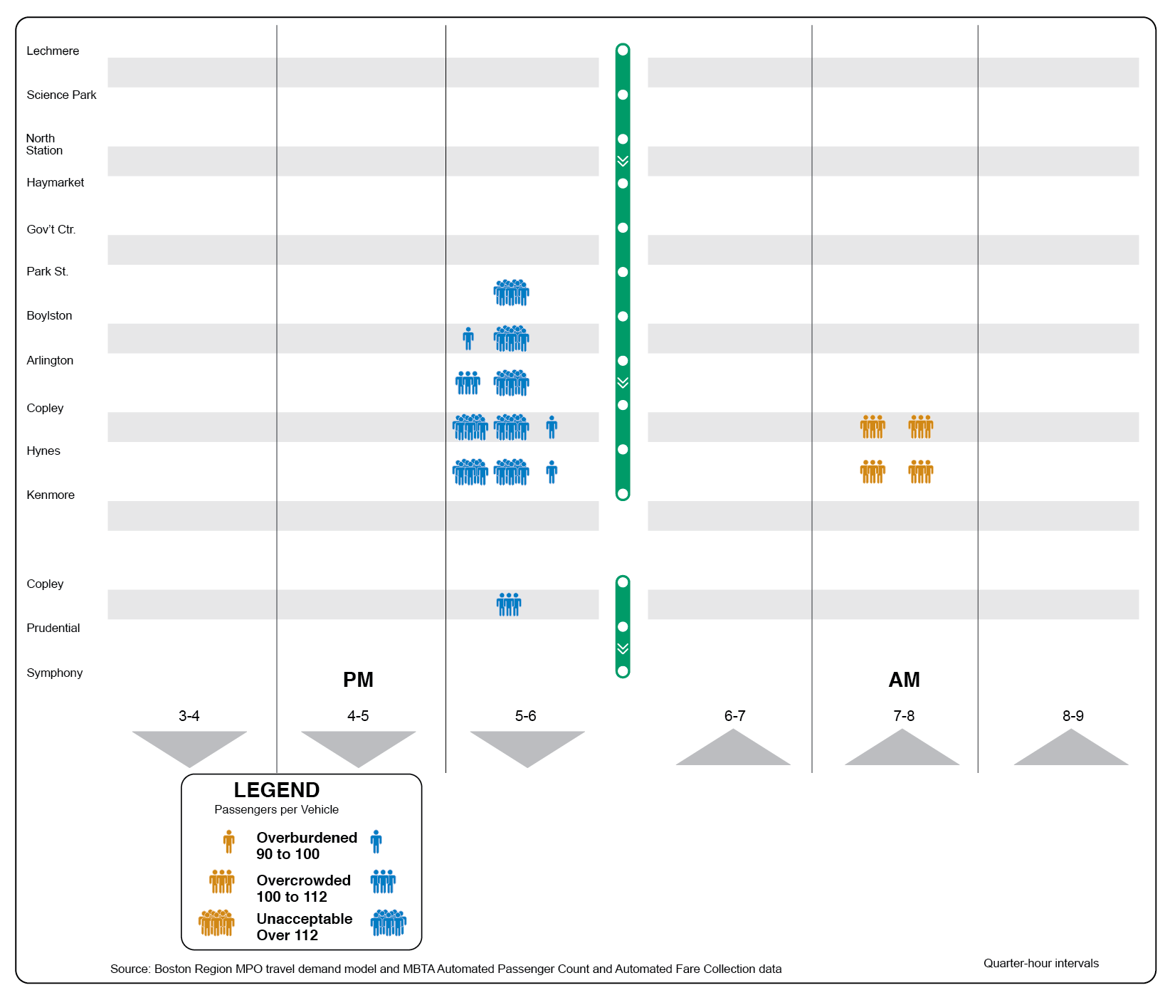
Green Line – Base Year

Slide 16
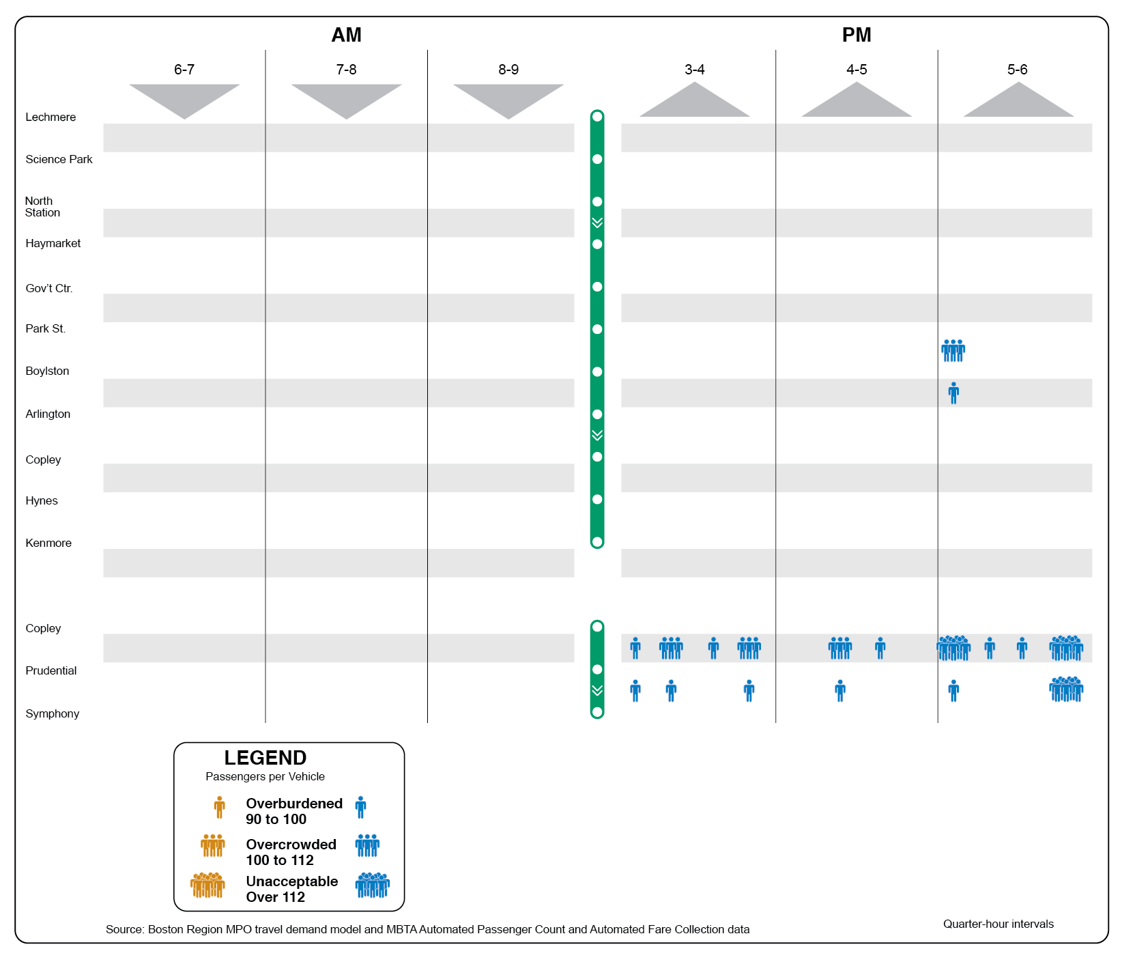
Green Line – Base Year

Slide 17
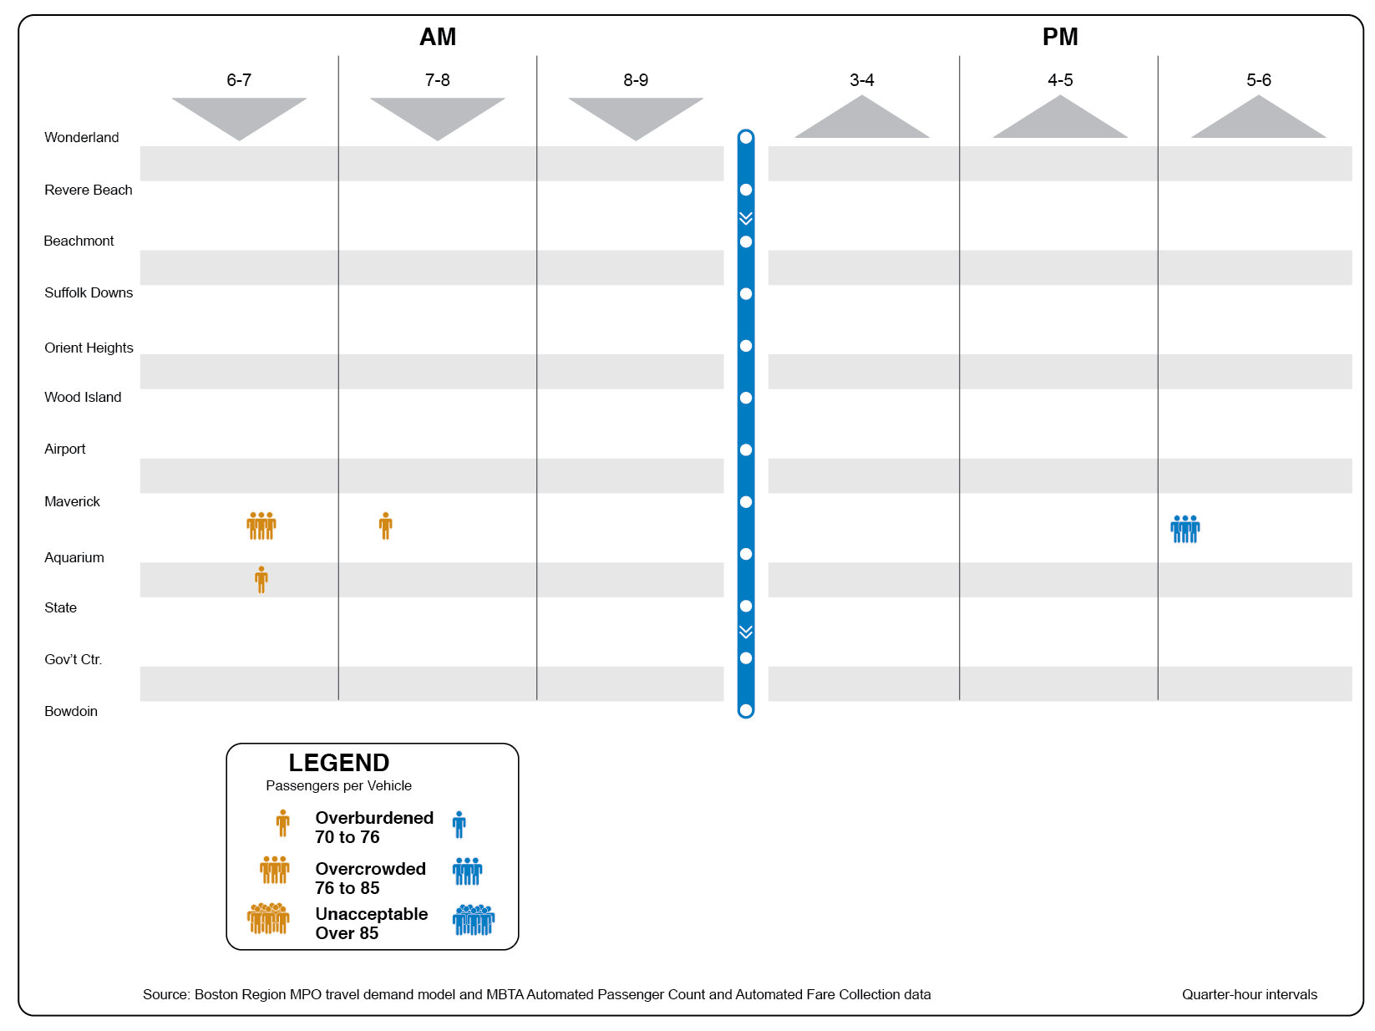
Blue Line – Base Year

Slide 18
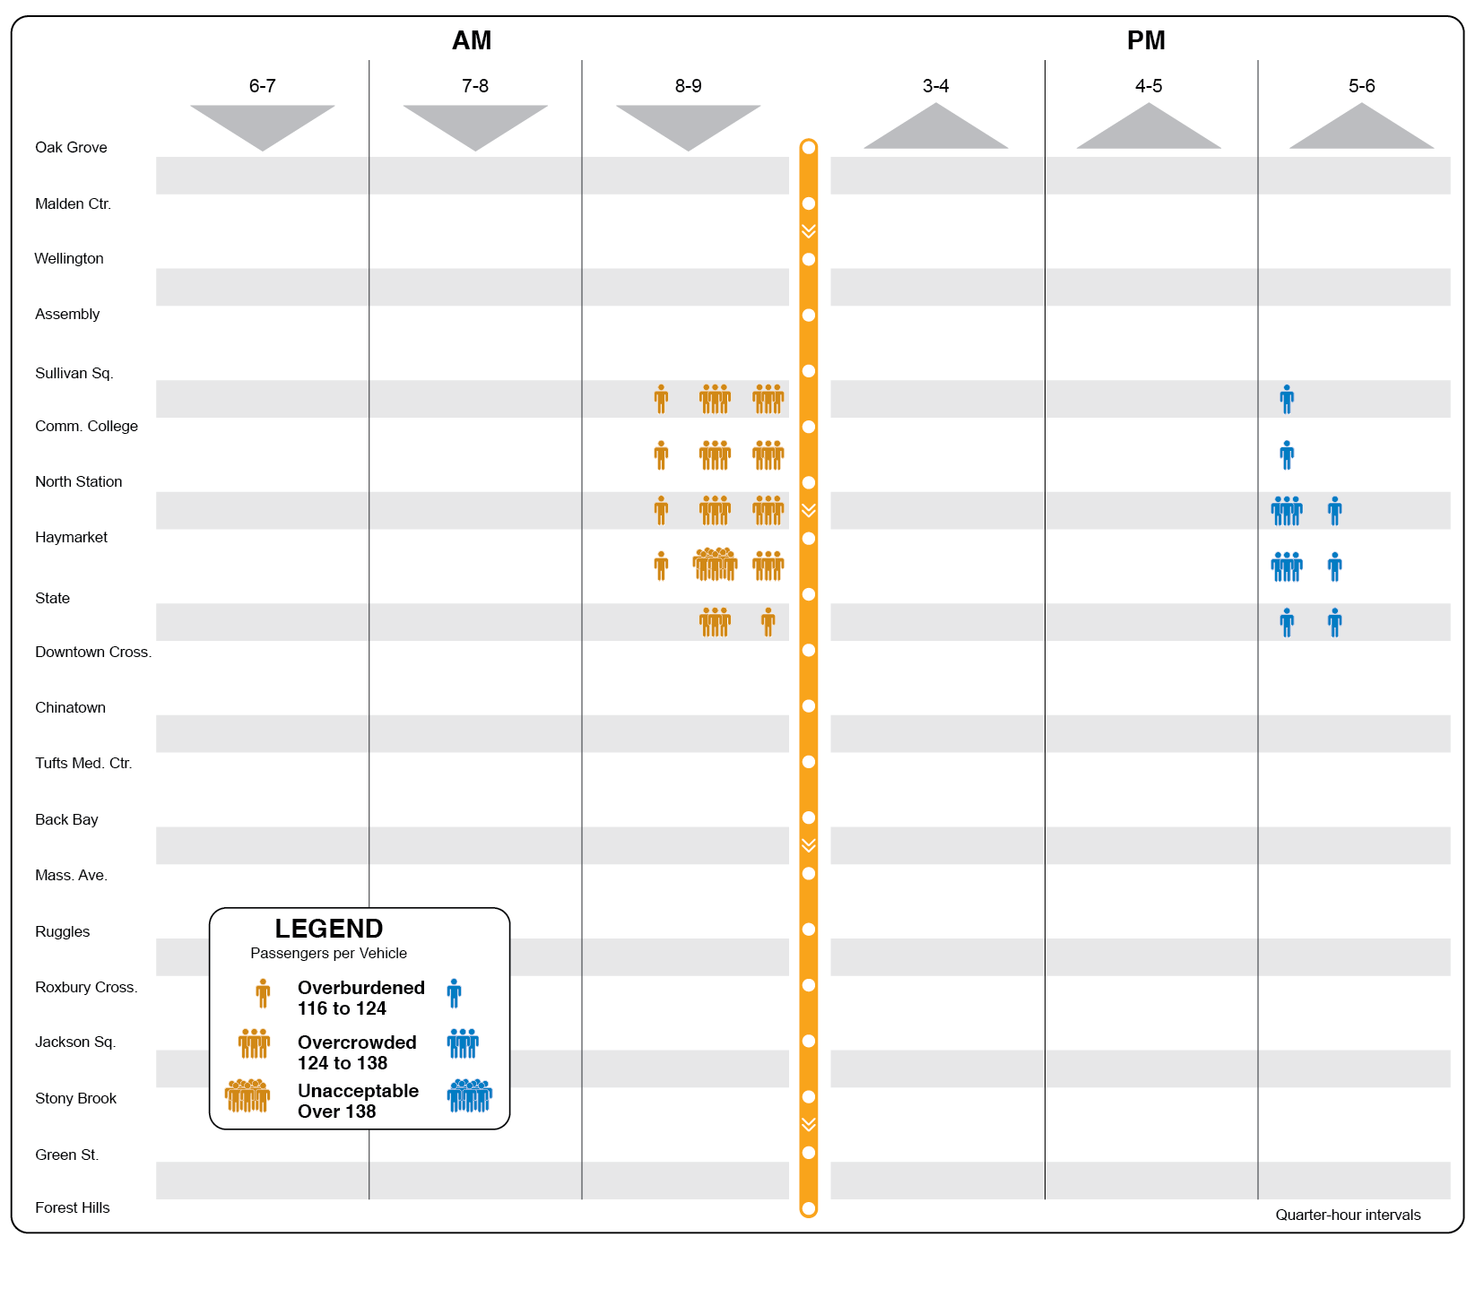
Orange Line – Base Year

Slide 19
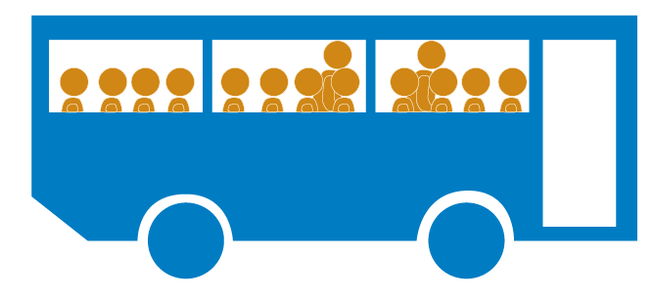
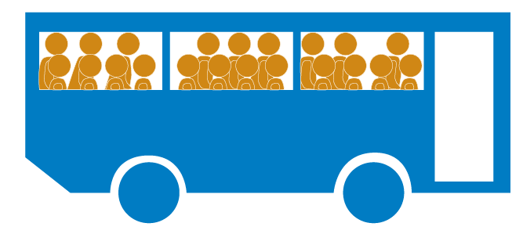
Bus-Vehicle Crowding: Developing Data
Identify the peak load of each bus trip on a route

Slide 20
Bus-Vehicle Crowding: Developing Data
Identify the peak load of each bus trip on a route
Sum the peak loads of all buses over each 15-minute interval
Sum the peak loads of the highest four consecutive 15-minute intervals
5:00 pm
5:15 pm
5:30 pm
5:45 pm

Slide 21
Bus-Vehicle Crowding: Developing Data
Identify the peak load of each bus trip on a route
Sum the peak loads of all buses over each 15-minute interval
Sum the peak loads of the highest four consecutive 15-minute intervals
Divide by the total number of bus seats provided during the interval

Slide 22
Bus-Vehicle Crowding
Peak-hour riders per seat mostly fall between 1.0 and 1.3
Riders per seat vary widely between individual buses
MBTA considers more than 1.4 riders per seat to be crowded; industry standard is 1.5
Peak-hour service ranges between 6 and 20 buses
Crowding measurement difficult and occluded by ability to introduce capacity via additional service

Slide 23
Commuter Rail Crowding
Identify most crowded train on each line for each peak period (26 trains)
Only one train has involuntary standees, but load is acceptable
Riders perceive crowding if load exceeds 80% of seats
Only half of the 26 trains exceed the 80% level at some point

Slide 24
Lessons Learned
Passenger perceptions drive need for other crowding performance metrics besides an operator’s Maximum Policy Standard or Vehicle Crush Capacity
Vehicle Maximum Policy Standards or Crush Capacity usually not feasible from a standee point of view
Need for Levels of Crowding, not a single definition
Crowding Levels vary by mode and vehicle

Slide 25
Lessons Learned
Rapid Transit vehicle crowding cannot be properly measured on a Peak Period or even a peak hour basis
Passenger demand within a peak period or peak hour is not evenly distributed, and neither is Vehicle Capacity
Need to use empirical observed service frequencies, not scheduled service frequencies, to reflect actual service lumpiness and irregularities
Pay attention to branches and standees

Slide 26
Follow Up
For more detailed data and analysis please see
https://www.bostonmpo.org/core-capacity-constraints
or contact
Bruce Kaplan Bill Kuttner
bkaplan@ctps.org bkuttner@ctps.org 857-702-3665 857-702-3671

Slide 27
Thank you!
Questions?

