Slide 1
Modeling University Students Living in Dormitories in an Activity-Based Travel Demand Model
Denver Regional Council of Governments
(DRCOG)
17th TRB Transportation Planning Applications Conference
June 2-5, 2019, Portland, Oregon
Presented by:
Sang Gu Lee
June 4, 2019

Slide 2
Introduction
Why –DRCOG’s Activity-Based Model (ABM) used Census-based households, which do not include university dormitory residents. Model underestimated university travel activities, especially walk and bicycle trips.
Purpose – Develop an approach to account for university students living in dormitories previously not reflected in the model.
Census Population
Households
Modeled
Group Quarters
Institutional Facilities
Nursing
Correctional
Mental
Hospitals
Noninstitutional Facilities
College/University
Now Modeled
Military
Transitional
Shelters

Slide 3
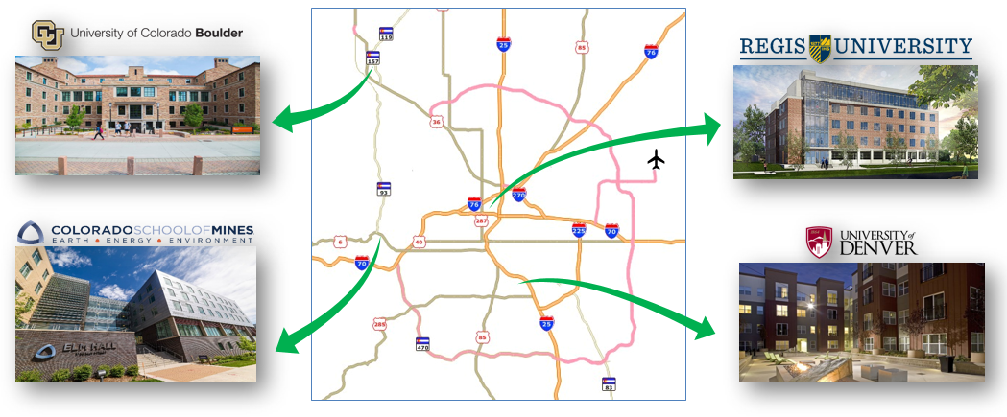
Base Data
Four major campuses – approximately 12,000 dormitory residents

Slide 4
Approach
Simplified approach to improve model results
“Modeling Day” – universities in session
Within ABM component – no specific codes added other than interaction terms
Assumptions - Information from universities and other resources
12,180 Dorm Students
Work Status
30%
Full-time
35%
Part-time
35%
Non-worker
Auto Availability
Income
Grade Level
90%
Low
87%
Undergraduate
13%
Graduate
10%
Medium
23%
1-car
77%
Zero-car

Slide 5
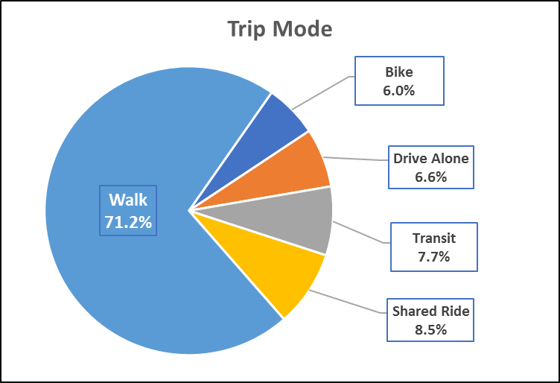
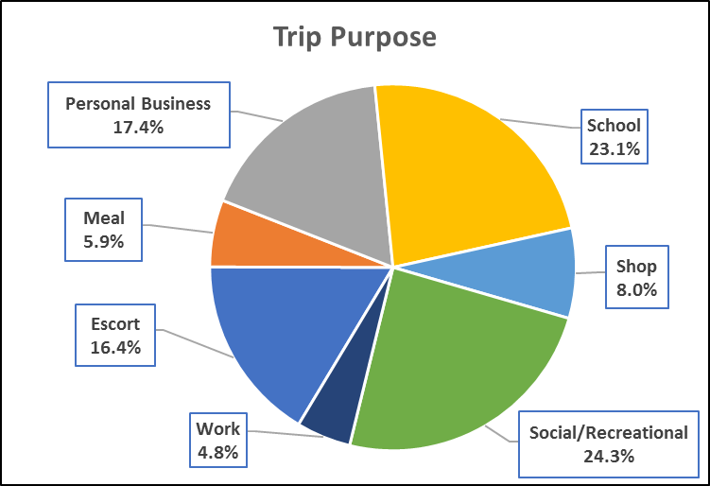
Model Output – Dorm Residents
12,180 Dorm Students
About 33,000 trips on a typical one day

Slide 6
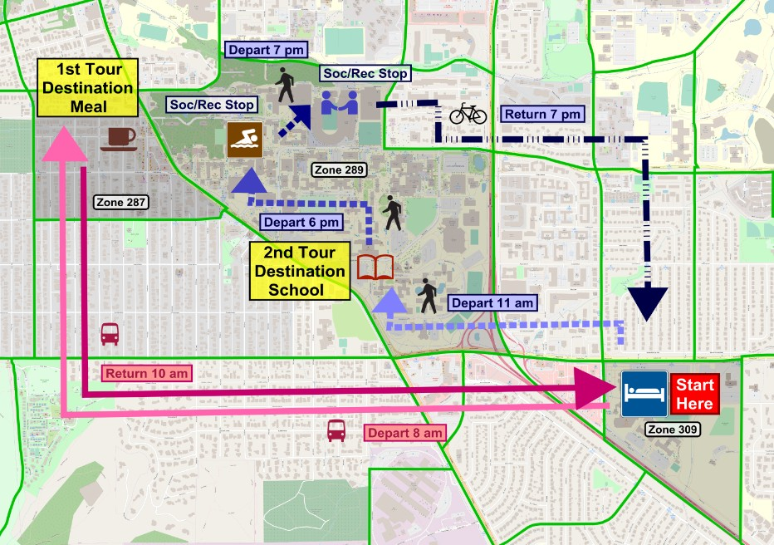
Model Output – Example of Dorm Residents
Daily activities of a dorm resident at the University of Colorado at Boulder

Slide 7
Model Impact – Before and After
Total person trip origins – all four campuses (7 TAZs)

Slide 8
Implications and Future Work
Better representation of Pedestrian and Bicycle trip making, traffic volumes, and transit ridership
Model run results more realistic (future years, transportation alternatives)
Further research and modifications
Use for project application evaluations and performance measurements
Consider applying to military group quarters population

Slide 9
THANK YOU!
Sang Gu Lee
slee@drcog.org
303.480.6765
https://drcog.org/

