Slide 1
TRB Planning Applications Conference
Parallelization of the ActivitySim Activity-Based Modeling Framework
PORTLAND, OREGON – JUNE 4, 2019

Slide 2
OVERVIEW
ACTIVITYSIM
VECTORIZATION
PARALLELIZATION
RESULTS
FUTURE WORK

Slide 3
ACTIVITYSIM
VECTORIZATION
PARALLELIZATION
RESULTS
FUTURE WORK

Slide 4
ACTIVITYSIM
An open-source, online, activity-based travel modeling software platform
Led by a consortium of transportation planning agencies
New member agencies are welcome to join, and all members help make decisions about development priorities
See the Sunday tutorial & activitysim.org

Slide 5
ACTIVITYSIM EXAMPLE MODEL
MTC (San Francisco Bay Area MPO) existing ABM used in production
Downloadable, runnable, full-scale implementation
Used for Continuous Integration test system, results verification, and benchmarking
7.5 million people, 1450 zones, 825 network skims

Slide 6
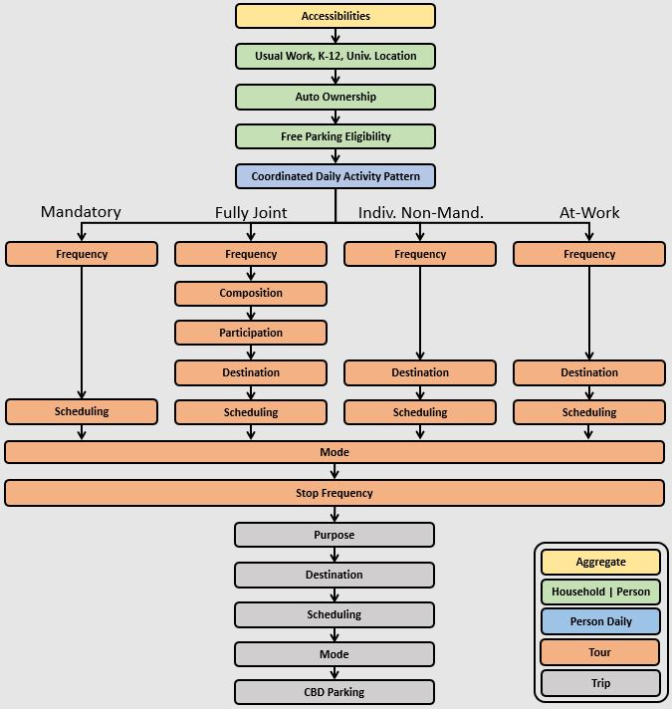
ACTIVITYSIM EXAMPLE MODEL
Replica of CT-RAMP model design at this point
Adding new features every few months

Slide 7
ACTIVITYSIM
VECTORIZATION
PARALLELIZATION
RESULTS
FUTURE WORK

Slide 8
VECTORIZATION
ActivitySim’s core design makes use of vectorization
Vectorization is the processing of an array of data at once instead of each item one at a time
The core Python pandas and numpy data science libraries wrap vectorized interfaces around low level C/C++ numerical computing libraries

Slide 9
VECTORIZATION COMPONENTS
activitysim
Models
Data tables
Matrices
Glue
Intel MKL
Math

Slide 10
VECTORIZATION IN ACTION
activitysim
High-level instructions
Intel MKL
C/C++ arrays

Slide 11
VECTORIZATION
Process chunks of rows of household, person, tour, or trip pandas data tables
Like R, operate on the entire table at once within a single process
The goal
Express all calculations with pandas, numpy vectorized functions and avoid for loops
Write as little raw Python as possible

Slide 12
ACTIVITYSIM
VECTORIZATION
PARALLELIZATION
RESULTS
FUTURE WORK

Slide 13
*Intel Xeon E5 2.6GHz 28 core 224GB RAM
PARALLELIZATION
Single-process, the current full-scale example runs in 24 hours and 30 minutes*
With 24 threads, the reference model runs in 5 hours*
The goal of parallelization is not just speed, but also software that is:
Difficult to break
May use Python package advances
Easy to use and extend

Slide 14
PARALLELIZATION QUESTIONS
Low-level or high-level? High-level most straightforward since the problem is embarrassing simple to parallelize
Process households in parallel since they are largely independent of one another
Create shared data structures and accumulate results across households when necessary

Slide 15
PARALLELIZATION QUESTIONS
By threading within a single process or by using multiple processes?
Threading in Python is not easy due to the Global Interpreter Lock (GIL), which helps make Python fast and easy-to-use
The multiprocessing library is the popular alternative, which means parallel Python sub-processes with independent memory spaces

Slide 16
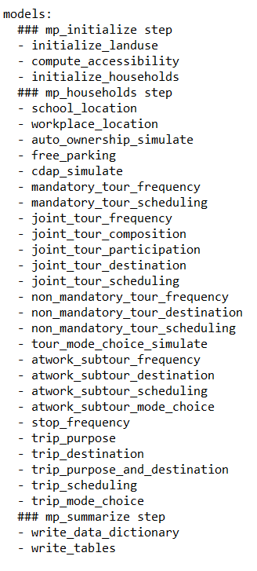
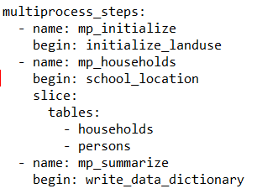
PARALLELIZATION
Restartable
data pipeline sliced by household and then person
Basically the same code for single or multiprocess (except for work and school location choice)
Number of processes and chunk size

Slide 17
ACTIVITYSIM
VECTORIZATION
PARALLELIZATION
RESULTS
FUTURE WORK

Slide 18
RESULTS ON WINDOWS SERVER
With 24 processes, the current full-scale example runs in 200 minutes* (7.3x faster)
With setting MKL environment variable to override low-level threading, 170 minutes (8.6x faster)
SET MKL_NUM_THREADS=1
With MKL=1 and 26 processes,
165 minutes (9x faster)

Slide 19
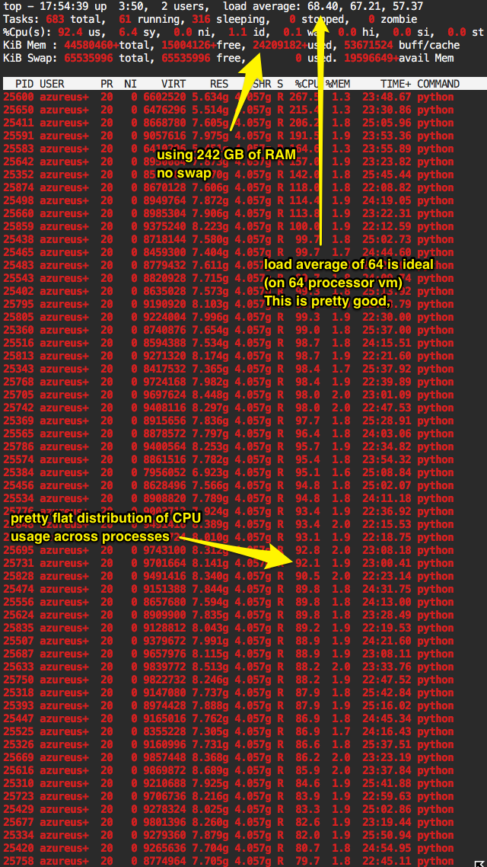
RESULTS IN THE WINDOWS CLOUD
Azure Standard_E64s_v3, with 56 processes, 105 minutes, $12
Azure Standard_M128s, with 120 processes, 84 minutes, $27

Slide 20
RESULTS ON LINUX AND OSX
Azure Standard_E64_v3 Linux, with 56 processes, 71 minutes, $8
Azure Standard_M128 Linux, with 124 processes, 51 minutes , $16
Single process 10% sample runs
OSX, 15 minutes
Linux VM on Mac, 16 minutes
Windows VM on Mac, 28 minutes
Windows hardware, 28 minutes

Slide 21
RESULTS DISCUSSION
Multiprocessing design works well, and surgery was minimally invasive
Good speed-up, but diminishing returns
Linux and OSX faster than Windows
Multiprocessing currently running slower with Python 3, which we’ll soon fix
More research required to make optimal use of the Python MKL toolkit

Slide 22
ACTIVITYSIM
VECTORIZATION
PARALLELIZATION
RESULTS
FUTURE WORK

Slide 23
FUTURE WORK FOR CONSIDERATION
Existing code improvements
e.g. replace costly string operations with faster categorical data operations
Algorithmic improvements
e.g. pre-calculate and cache a fixed set of segmented logsums
Machine tuning
e.g. optimize Windows MKL settings

Slide 24
Ben Stabler
Director
ben.stabler@rsginc.com
Jeff Doyle
Director
jeff.doyle@rsginc.com
www.activitysim.org

