Slide 1
Scenario Analysis and Visualization of Hundreds of Scenarios with VisionEval
2019 TRB Planning Applications Conference, Portland Oregon

Slide 2
VisionEval Strategic Modeling
What is VisionEval?
VisionEval is a common framework for strategic transportation planning modeling
Strategic models evaluate many (i.e. hundreds of) alternative futures and policies under uncertainty
VisionEval is supported by an FHWA pooled funds of 11 member agencies

Slide 3











VisionEval Strategic Modeling

Slide 4

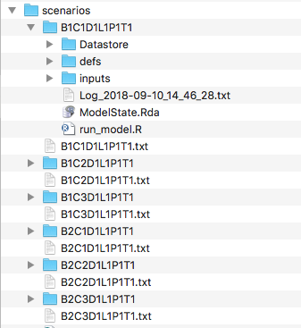
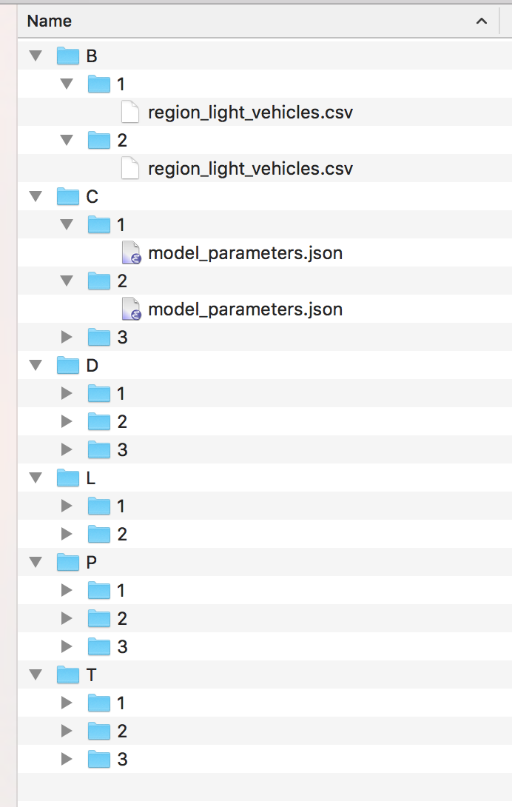
VisionEval Strategic Modeling
Sensitivity test the relationship between inputs and outputs
Model every combination of input dimensions and analyze the distribution of outputs
Bicycle scenarios (x2)
324 Scenarios
Vehicle cost (x3)
Demand management (x3)
Land Use (x2)
Parking (x3)
Transit LOS (x3)

Slide 5
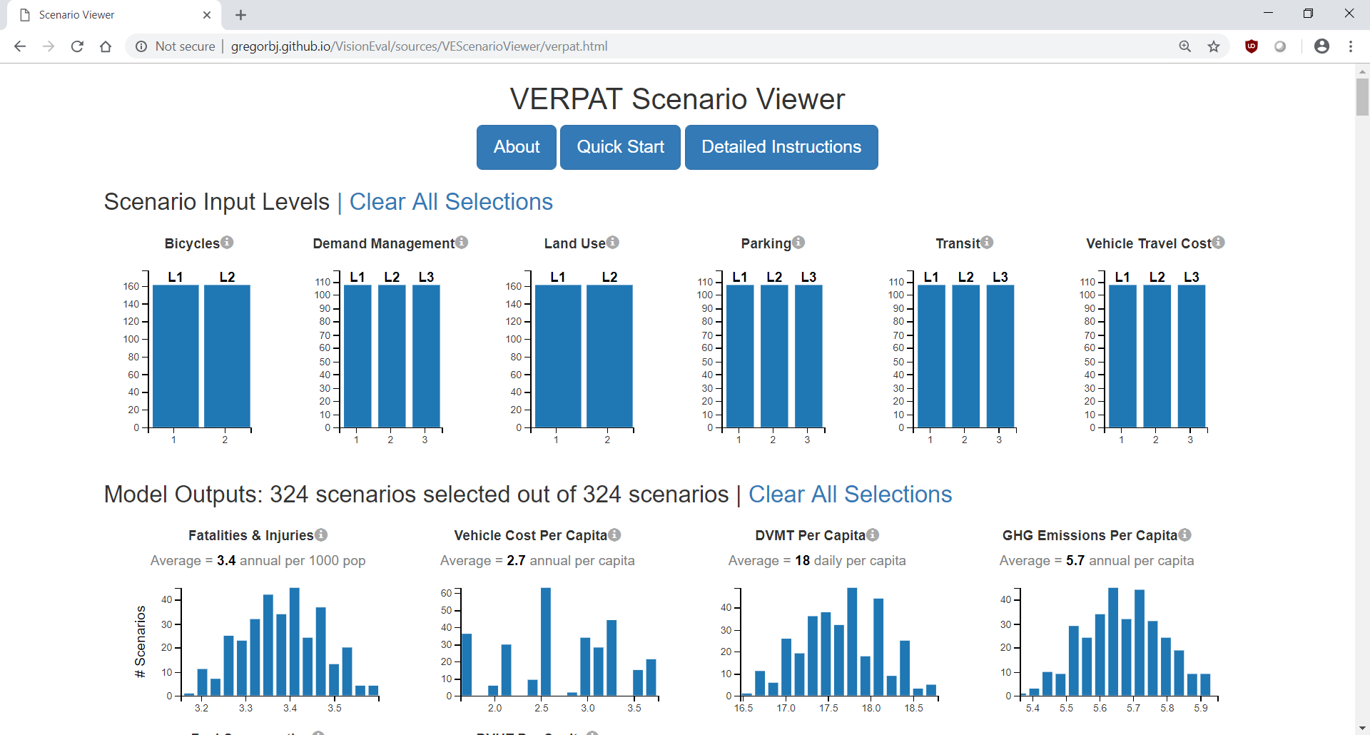
VisionEval Strategic Modeling
Portland example results in 324 total model runs
https://htmlpreview.github.io/?https://github.com/VisionEval/VisionEval/blob/master/sources/VEScenarioViewer/verpat.html

Slide 6
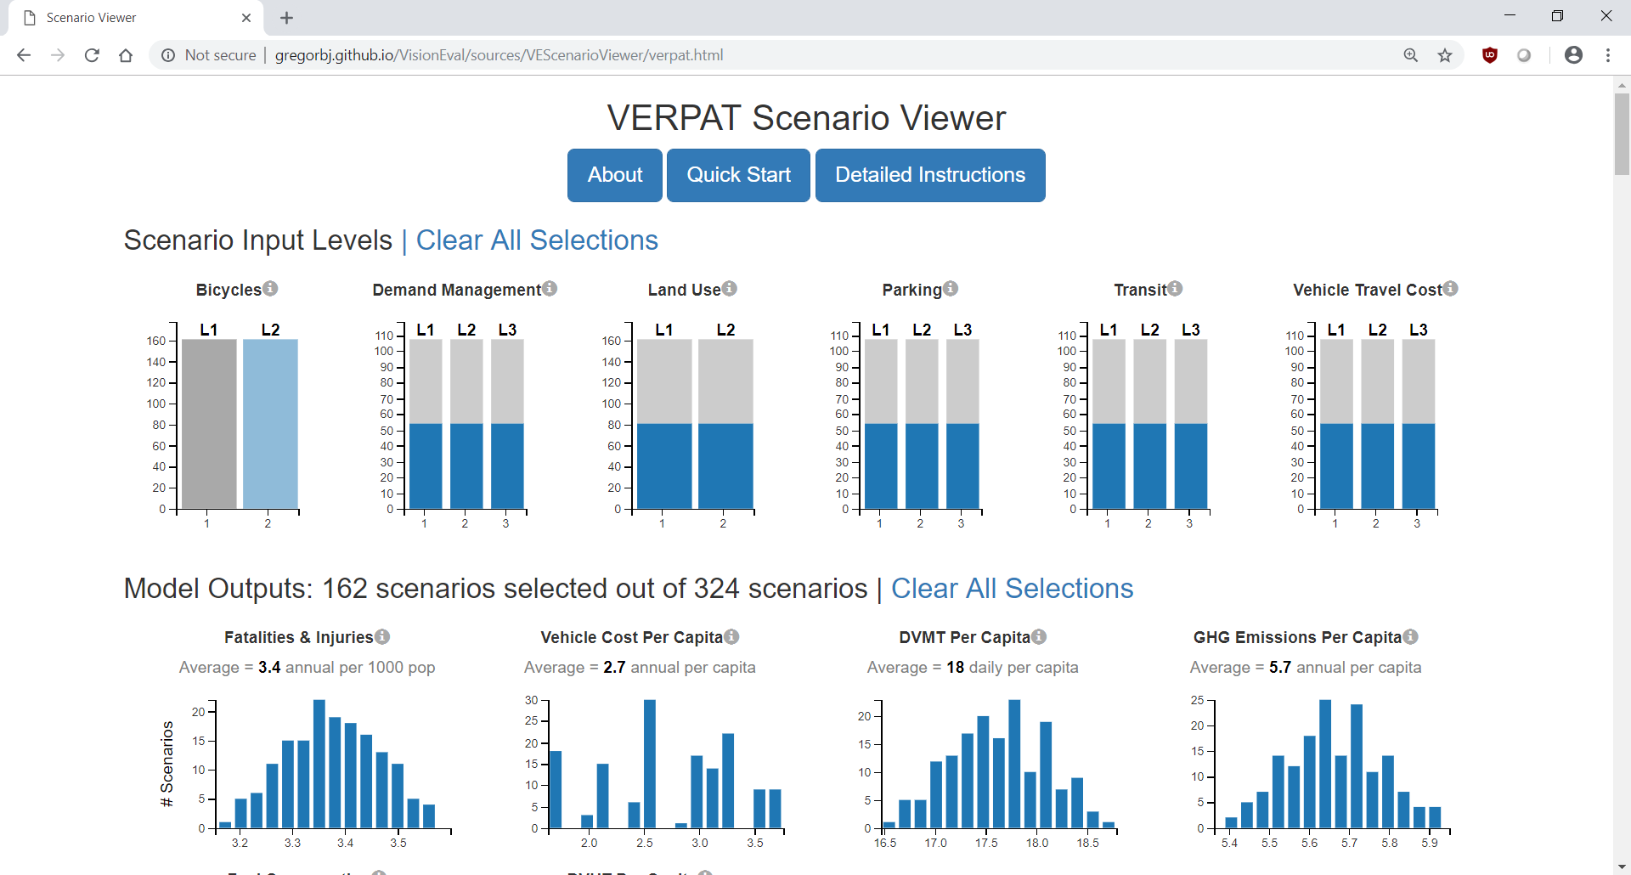
VisionEval Strategic Modeling
Filter outputs by selected scenarios to see outcomes
https://htmlpreview.github.io/?https://github.com/VisionEval/VisionEval/blob/master/sources/VEScenarioViewer/verpat.html
L2=Increase diversion of SOV auto tours to bike by 20% over base scenario

Slide 7
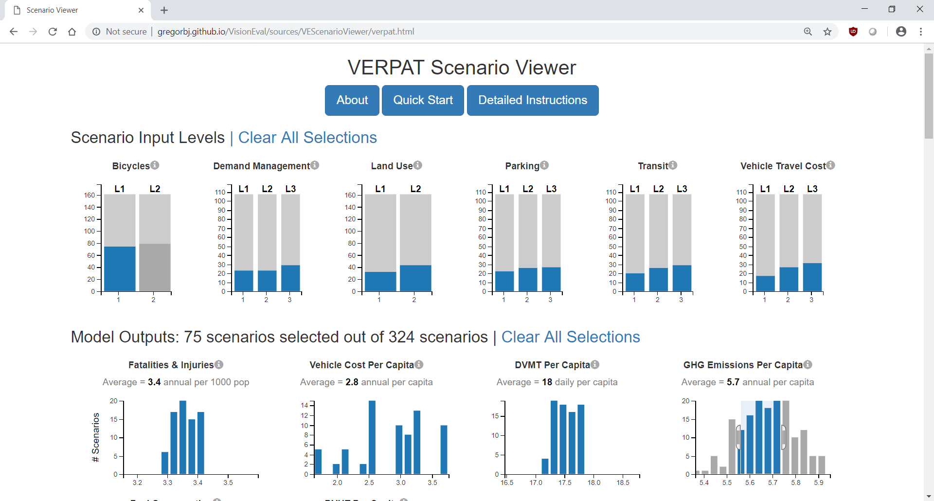
VisionEval Strategic Modeling
Filter desired outcomes to see input scenarios
https://htmlpreview.github.io/?https://github.com/VisionEval/VisionEval/blob/master/sources/VEScenarioViewer/verpat.html

Slide 8
VisionEval Strategic Modeling
Open Source Contribution
VisionEval is a community owned project for all to use and improve
  Sunday workshop
  Other presentations this week
We contributed two software components
  VEScenarios R package for parallel scenario management, running, and processing
  VEScenarioViewer for interactive visualization

Slide 9
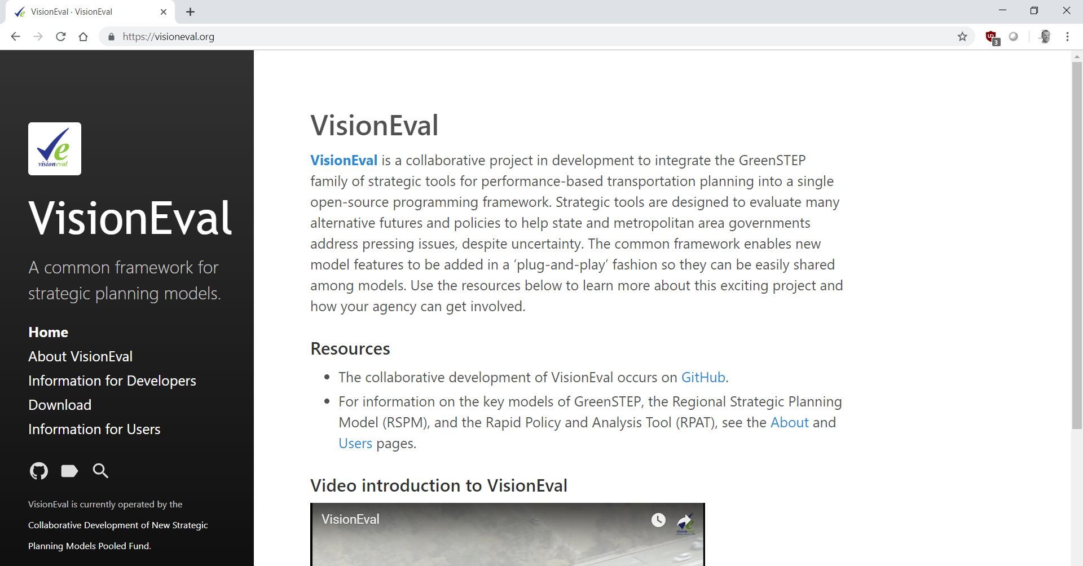
VisionEval Strategic Modeling
http://www.visioneval.org
Ben Stabler, Director, RSG ben.stabler@rsginc.com

